Slide 1
Instruction | Opcode | Register | Data/Addr_h | Data/Addr_l
Load R1 257 | 0x00 | 1 | 0x01 | 0x01
Load R2 R1 | 0x01 | 2 | 0x00 | 1
Load R3 $257 | 0x02 | 3 | 0x01 | 0x01
Store R1 $257 | 0x10 | 1 | 0x01 | 0x01
Cmp R1 257 | 0x20 | 1 | 0x01 | 0x01
Cmp R1 R2 | 0x21 | 1 | 0x00 | 2
BEQ label | 0x30 | 0x00 | the addr of label
BNQ label | 0x31 | 0x00 | the addr of label
Add R1 257 | 0x40 | 1 | 0x01 | 0x01
Sub R1 257 | 0x41 | 1 | 0x01 | 0x01
Add R1 R2 | 0x42 | 1 | 0x00 | 2
Sub R1 R2 | 0x44 | 1 | 0x00 | 2
Halt | 0xFE | 0xFE | 0xFE | 0xFE

Slide 2
Assumption
- 16 bit architecture
- Instructions are 32 wide

Slide 3
Instruction format
First byte is opcode
00(0x00) is LOAD
16(0x10) is STORE
32(0x20) is CMP
48(0x30) is BRANCH
Second byte is register
Third and fourth are data

Slide 4
Load——example
direct Load
65535 is 0xFFF
Load R2 65535
0x00 0x02 0xFF 0xFF
Load from another register
Load R3 R6
0x01 0x03 0x00 0x06
Load from memory
Load R3 0xABCD
0x02 0x03 0xAB 0xCD

Slide 5
Missing?
Multipy, Divide, AND, OR, XOR, etc
Subroutines
Stack
More ...

Slide 6
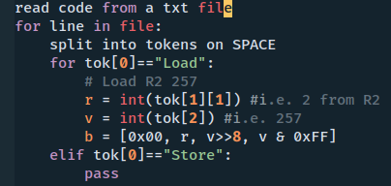
pseudo code(convert the instruction to Machine code）

Slide 7

Label
All the Labels start with dot
.loop
Use directory to save the table of labels
dic = {loop1:0xABCD, loop2:0xDEFF}
example

