Slide 1

Real-time Gesture Classification System Based on
Dynamic Vision Sensor
WangJian
School of Computer
Notes:
Hello eveyone. I am WangJian. Today, I want to introduce my paper: Real-time Gesture Classification System Based on
Dynamic Vision Sensor.

Slide 2
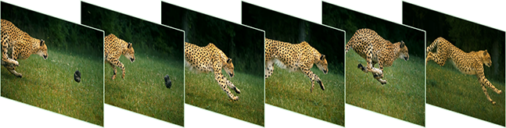
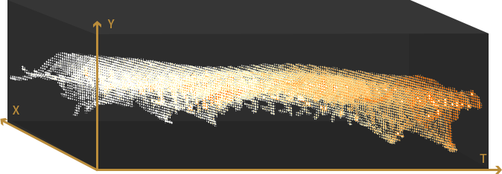
1 Dynamic Vision Sensor
Standard Camera Output:
DVS Output:
Notes:
So, what is Dynamic Vision Sensor? Let’s take a look at the two pictures.
Conventional Image Sensor is driven for higher resolution/frame rate/contrast, instead of what computer vision really needs. Discontinuous sampling, huge amount of redundant data and high light-dependency, will lead to complex algorithm, waste of computation resources, high power consumption and low system robustness.
Dynamic Vision Sensor perceives actively like human eyes: all-time sensing and high-speed tracking of motion without shutter time. Effectively filtering redundant background and outputing structured motion data make it reduce algorithm complexity and enable real-time processing system with low computation power.

Slide 3
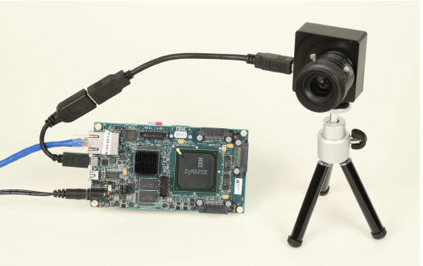
1 Dynamic Vision Sensor
We are using the Celex IV made by CelexPixel Technology
Each pixel works independently
No frame rate limitation
Low power consumption
Low system costs
Notes:
I our work, we used the Celex IV which is made by CelexPixel Technology.
It has four characteristics.
First, each pixel works independently
Second, corresponding time in microseconds, so there is no frame rate limit
Third, it is in low power consumption because each pixel outputs the change information in the form of event signal only when the light intensity changes. No signal is output when there is no change.
Four, high percentage of effective information greatly reduced the amount of system data processing and reducing system costs

Slide 4
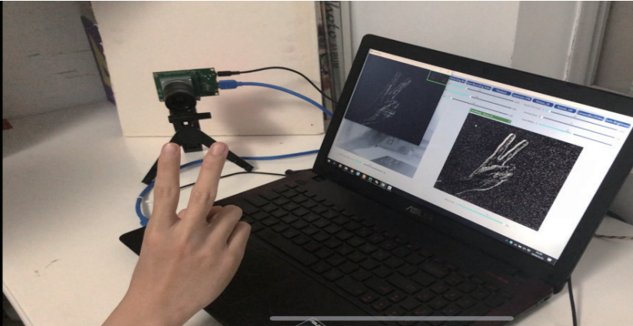
2 Real-time image reconstruction and classification
The main workflow：
Image reconstruction algorithm
Denoising algorithm
Keyframe detection
Image Classification
Notes:
In this paper, we mainly explored the design of an efficient event data reconstruction and recognition system for hand
gesture using only Celex camera. By adapting some off the-shelf feature detection and description algorithms, we
successfully achieved competent accuracy while remaining low latency.

Slide 5
𝟛 Image reconstruction
—— Convert the events to Image
Event-accumulated Algorithm
More events, better quality（Pro）
More events, much cost（Con）
Use 8k as threshold
Notes:
We use Event-accumulated Algorithm to convert the events to images.
Given that the amount of raw event data is limited, we basically reconstructed the data with 8k, 16k and 24k per frame
based on the event-accumulated method.

Slide 6
4 Keyframe detection
Much redundant information in a sequence
We need to detection key frame.
Descriptor describe the pixel information around the key point
Notes:
The 4th part is the keyframe detection.
Video is more informative than images, but there is too much redundant information in a sequence. How to extract key frame information unsupervised is crucial for many tasks.
In order to be able to perform image matching better, it is necessary to select representative areas in the image, such as corners, edges and some blocks
The circle in the figure represents the descriptor, which is used to describe the pixel information (vector) around the key point
If the number of similar descriptors in two pictures is lower than a certain threshold, we will identify the picture as a key frame

Slide 7

5 Image Classification
LeNet-5 is one of the classic CNN network structures
We propose the following network based on lenet and identify the key frame pictures

Slide 8

THANK YOU
Real-time Gesture Classification System Based on Dynamic Vision Sensor
Wang Jian
School of Computer

