Slide 1
Advanced Computer Architecture (ACA2020)
Dr. ZHANG Chun-yuan
College of Computer, NUDT
Fall, 2020

Slide 2
Lecture 04 ILP & Loop Unrolling

Slide 3

How Changes Brustad: Reformation to Revolution
IBM PC
Personal Computing
Ad, 11/81
Giant

Slide 4
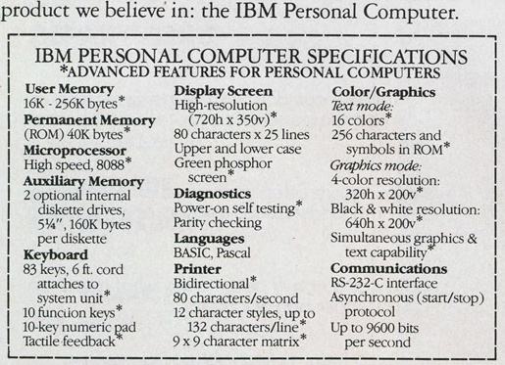
Notes:
8088是4044的改进版，8080是8位，8086是16位，兼容8位，但是硬件不兼容，8088硬件兼容。。。。

Slide 5
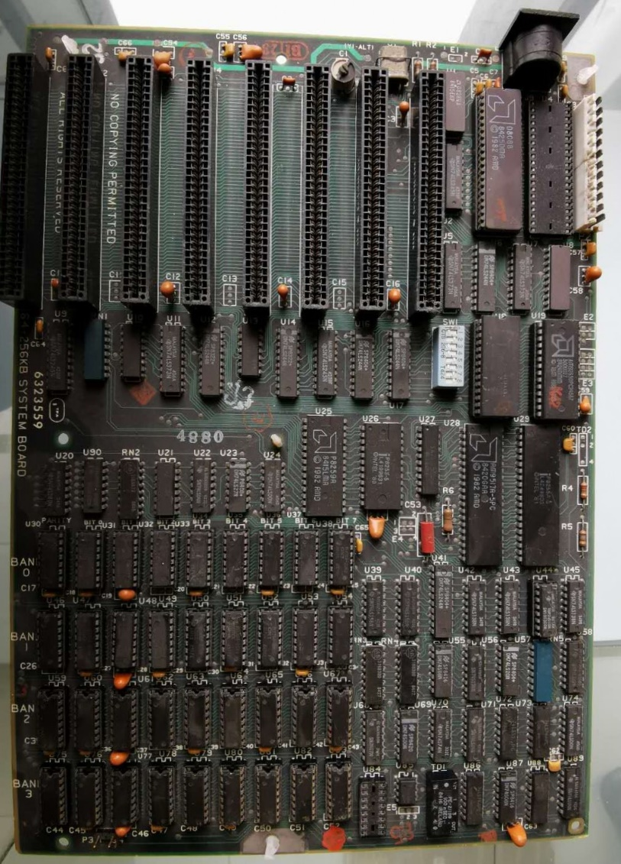
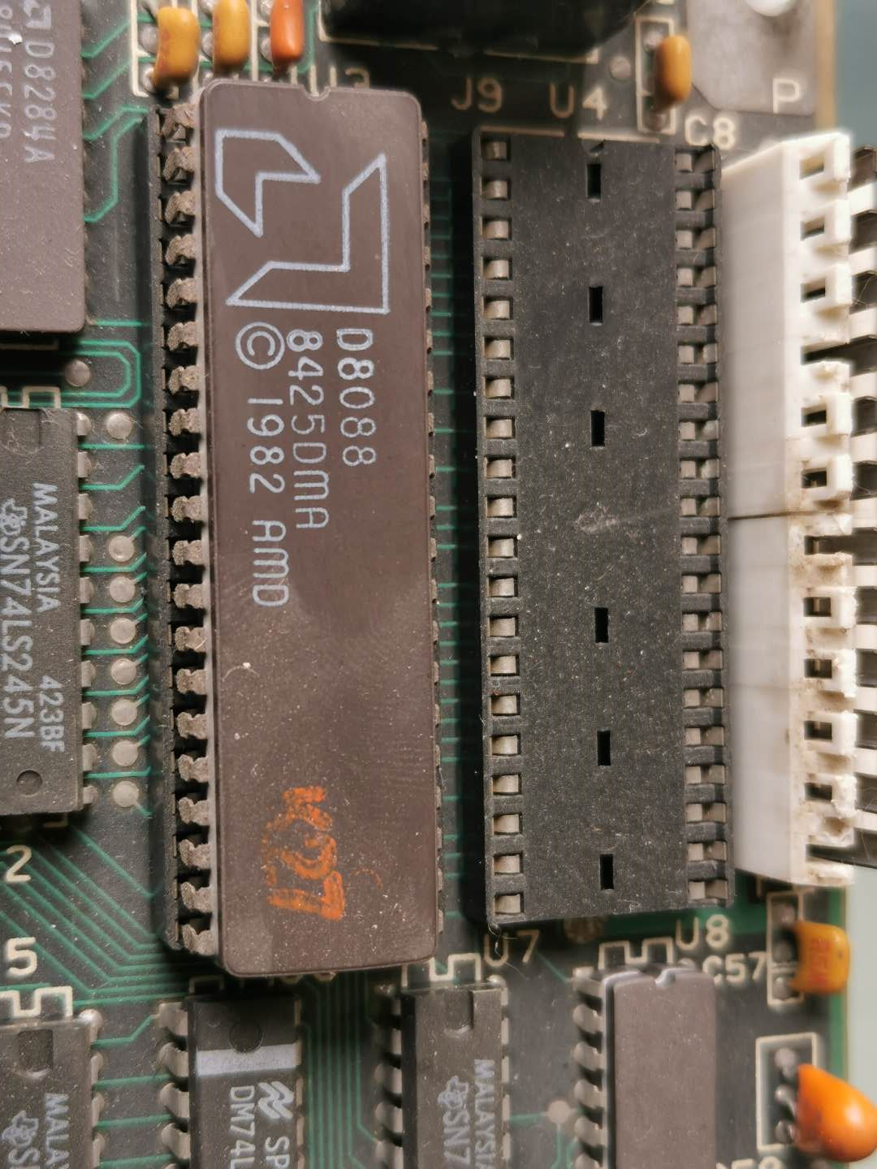
PC inside

Slide 6
IBM PC, 1981
Hardware
Team from IBM building PC prototypes in 1979
Motorola 68000 chosen initially, but 68000 was late
IBM builds “stopgap” prototypes using 8088 boards from Display Writer word processor
8088 is 8-bit bus version of 8086 => allows cheaper system
Estimated sales of 250,000 => 100,000,000s were sold
Software
Microsoft negotiates to provide OS for IBM
Later buys and modifies QDOS from Seattle Computer Products
Open System
Standard processor, Intel 8088
Standard (hardware) system interfaces => 8088 extension => ISA standard buses
Standard OS, MS-DOS, PC-DOS, DR-DOS ...
IBM permits cloning and third-party software

Slide 7
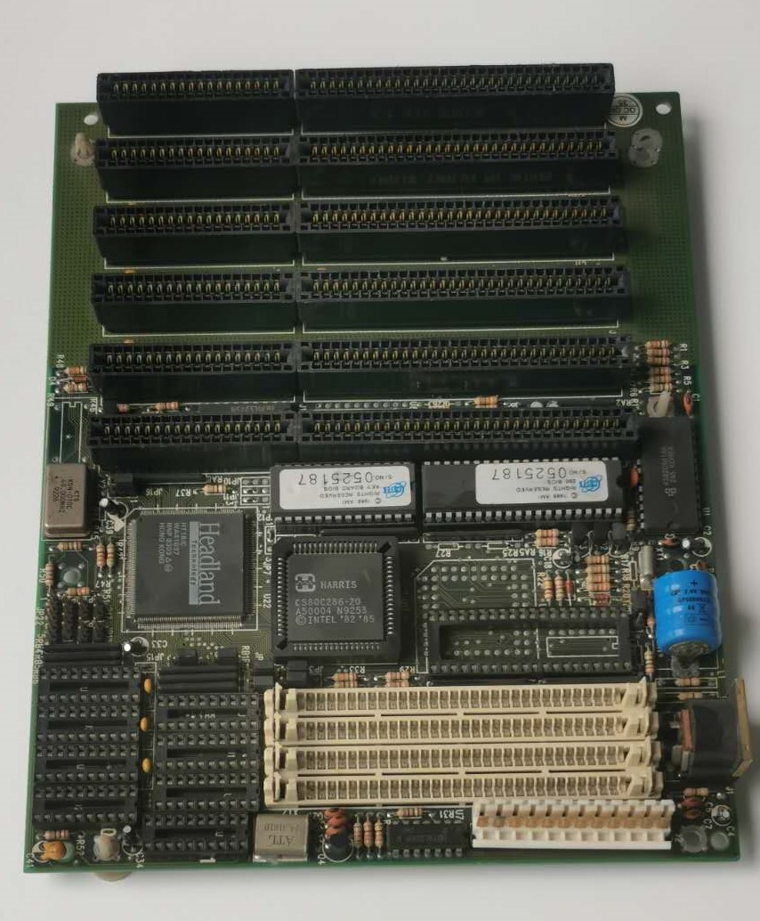
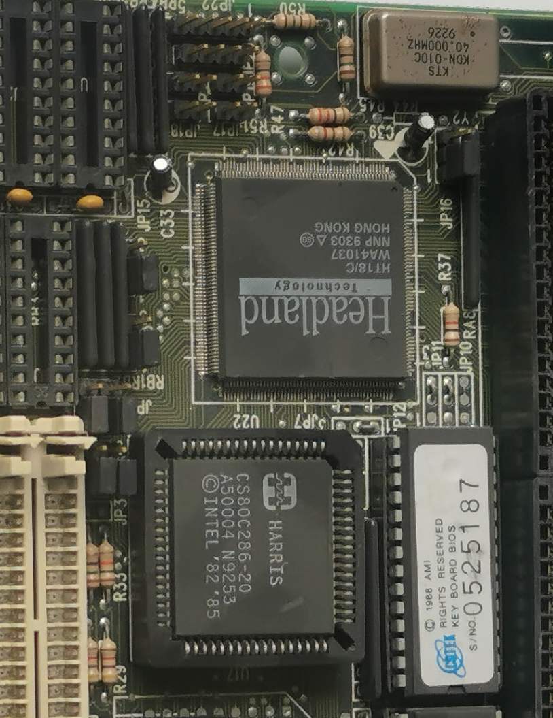
PC/AT 286

Slide 8
ILP
ILP -- Instruction Level Parallel
Exploiting ILP Goal
Minimize CPI
How to?
Pipeline CPI = Ideal pipeline CPI
+ Structural stalls
+ Data hazard stalls
+ Control stalls
Notes:
指令集并行

Slide 9
The Major ILP Techniques 1/2
Technique | Reduces | Section
Forwarding and bypassing | Potential data hazard stalls | C.2
Delayed branches and simple branch scheduling | Control hazard stalls | C.2
Basic compiler pipeline scheduling | Data hazard stalls | C.2, 3.2
Basic dynamic scheduling (scoreboarding) | Data hazard stalls from true dependences | C.7
Loop unrolling | Control hazard stalls | 3.2
Branch prediction | Control stalls | 3.3
Notes:
这两张表测试学的怎么样

Slide 10
The Major ILP Techniques 2/2
Technique | Reduces | Section
Dynamic scheduling with renaming | stalls from Data hazard, output dependences and antidependences | 3.4
Hardware speculation | Data hazard and control hazard stalls | 3.6
Dynamic memory disambiguation | Data hazard stalls with memory | 3.6
Issuing multiple instructions per cycle | Ideal CPI | 3.7, 3.8
Compiler dependence analysis, software pipelining, trace scheduling | Ideal CPI, data hazard stalls | H.2, H.3
Hardware support for compiler speculation | Ideal CPI, data hazard stalls, branch hazard stalls | H.4, H.5

Slide 11
Dependences, Hazard and Stall
Dependence
Hazard
Stall
Notes:
依赖，阻塞，空转

Slide 12
3 Type Data Hazards: Regs
Data-dependence
r3 ← r1 op r2 Read-after-Write
r5 ← r3 op r4 (RAW) hazard
Anti-dependence
r3 ← r1 op r2 Write-after-Read
r1 ← r4 op r5 (WAR) hazard
Output-dependence
r3 ← r1 op r2 Write-after-Write
r3 ← r6 op r7 (WAW) hazard

Slide 13
Data Hazards: An Example
I1 FDIV.D f6, f6, f4
I2 FLD f2, 45(x3)
I3 FMUL.D f0, f2, f4
I4 FDIV.D f8, f6, f2
I5 FSUB.D f10, f0, f6
I6 FADD.D f6, f8, f2
Notes:
典型代码

Slide 14
Data Hazards: RAW Hazards – 1
I1 FDIV.D f6, f6, f4
I2 FLD f2, 45(x3)
I3 FMUL.D f0, f2, f4
I4 FDIV.D f8, f6, f2
I5 FSUB.D f10, f0, f6
I6 FADD.D f6, f8, f2
Notes:
写后读

Slide 15
Data Hazards: RAW Hazards – 2
I1 FDIV.D f6, f6, f4
I2 FLD f2, 45(x3)
I3 FMUL.D f0, f2, f4
I4 FDIV.D f8, f6, f2
I5 FSUB.D f10, f0, f6
I6 FADD.D f6, f8, f2

Slide 16
Data Hazards: RAW Hazards – 3
I1 FDIV.D f6, f6, f4
I2 FLD f2, 45(x3)
I3 FMUL.D f0, f2, f4
I4 FDIV.D f8, f6, f2
I5 FSUB.D f10, f0, f6
I6 FADD.D f6, f8, f2

Slide 17
Data Hazards: RAW Hazards – 4
I1 FDIV.D f6, f6, f4
I2 FLD f2, 45(x3)
I3 FMUL.D f0, f2, f4
I4 FDIV.D f8, f6, f2
I5 FSUB.D f10, f0, f6
I6 FADD.D f6, f8, f2

Slide 18
Data Hazards: WAR Hazards – 1
I1 FDIV.D f6, f6, f4
I2 FLD f2, 45(x3)
I3 FMUL.D f0, f2, f4
I4 FDIV.D f8, f6, f2
I5 FSUB.D f10, f0, f6
I6 FADD.D f6, f8, f2

Slide 19
Data Hazards: WAR Hazards – 2
I1 FDIV.D f6, f6, f4
I2 FLD f2, 45(x3)
I3 FMUL.D f0, f2, f4
I4 FDIV.D f8, f6, f2
I5 FSUB.D f10, f0, f6
I6 FADD.D f6, f8, f2

Slide 20
Data Hazards: WAW Hazards – 1
I1 FDIV.D f6, f6, f4
I2 FLD f2, 45(x3)
I3 FMUL.D f0, f2, f4
I4 FDIV.D f8, f6, f2
I5 FSUB.D f10, f0, f6
I6 FADD.D f6, f8, f2

Slide 21
Data Hazards - All
I₁
I1 FDIV.D f6, f6, f4
I2 FLD f2, 45(x3)
I3 FMUL.D f0, f2, f4
I4 FDIV.D f8, f6, f2
I5 FSUB.D f10, f0, f6
I6 FADD.D f6, f8, f2
Execuation order
In-order
Out-of-order (o-o-o)
I₂
I₃
I₄
I₅
I₆
Notes:
除法更耗时

Slide 22
Instruction Scheduling: Valid Orderings
I₁
I1 FDIV.D f6, f6, f4
I2 FLD f2, 45(x3)
I3 FMUL.D f0, f2, f4
I4 FDIV.D f8, f6, f2
I5 FSUB.D f10, f0, f6
I6 FADD.D f6, f8, f2
I₂
I₃
I₄
in-order | I1 | I2 | I3 | I4 | I5 | I6
o-o-o
I₅
I₆

Slide 23
Instruction Scheduling: Out-of-order
I₁
I1 FDIV.D f6, f6, f4
I2 FLD f2, 45(x3)
I3 FMUL.D f0, f2, f4
I4 FDIV.D f8, f6, f2
I5 FSUB.D f10, f0, f6
I6 FADD.D f6, f8, f2
I₂
I₃
I₄
in-order | I1 | I2 | I3 | I4 | I5 | I6
o-o-o | I2 | I1 | I3 | I5 | I4 | I6
I₅
I₆
Notes:
l3和l4可能存在结构相关

Slide 24
Latency of Instructions: Assumption
Latency*
I1 FDIV.D f6, f6, f4 4
I2 FLD f2, 45(x3) 1
I3 FMUL.D f0, f2, f4 3
I4 FDIV.D f8, f6, f2 4
I5 FSUB.D f10, f0, f6 1
I6 FADD.D f6, f8, f2 1
*The latencies are extra cycles to the 5-stage

Slide 25
In-order Issue and In-order Completion
I1 FDIV.D f6, f6, f4 4
I2 FLD f2, 45(x3) 1
I3 FMUL.D f0, f2, f4 3
I4 FDIV.D f8, f6, f2 4
I5 FSUB.D f10, f0, f6 1
I6 FADD.D f6, f8, f2 1
clk | 1 | 2 | 3 | 4 | 5 | 6 | 7 | 8 | 9 | 10 | 11 | 12 | 13 | 14 | 15
in/in | 1 | 2 |  |  | 1 | 2 | 3 | 4 |  | 3 | 5 | 4 | 6 | 5 | 6
FDIV.D: 123456789 simplified as-> 1234

Slide 26
In-order Issue and Out-of-order Completion
I1 FDIV.D f6, f6, f4 4
I2 FLD f2, 45(x3) 1
I3 FMUL.D f0, f2, f4 3
I4 FDIV.D f8, f6, f2 4
I5 FSUB.D f10, f0, f6 1
I6 FADD.D f6, f8, f2 1
clk | 1 | 2 | 3 | 4 | 5 | 6 | 7 | 8 | 9 | 10 | 11 | 12 | 13 | 14 | 15
in/out | 1 | 2 | 2 | 3 | 1 | 4 | 3 | 5 | 5 | 4 | 6 | 6
Notes:
输出允许乱序时

Slide 27
Usage:
Loop Unrolling
& Instruction Scheduling

Slide 28
Assumptions
5-stage integer pipeline
FUs are fully pipelined or replicated
Branches delay: 1 clock cycle
Conditions delay: 1 clock cycle
An integer ALU operation latency of 0

Slide 29
The Revised Pipelined (Lecture 02)
Instruction
Fetch
Instr. Decode
Reg. Fetch
Execute
Addr. Calc
Memory
Access
Write
Back
Next SEQ PC
Next PC
ID/EX
EX/MEM
MEM/WB
MUX
IF/ID
Adder
Adder
Zero?
4
RS1
Address
RS2
Reg File
Memory
ALU
Data
Memory
MUX
MUX
Sign
Extend
Imm
WB Data
RD
RD
RD

Slide 30
Control Hazard on Branches
10: beq r1,r3,36
14: and r2,r3,r5
18: or r6,r1,r7
22: add r8,r1,r9
36: xor r10,r1,r11
Ifetch
Reg
ALU
DMem
Reg
Ifetch
Reg
ALU
DMem
Reg
Ifetch
Reg
ALU
DMem
Reg
Ifetch
Reg
ALU
DMem
Reg
Ifetch
Reg
ALU
DMem
Reg
Notes:
分支指令造成的延迟

Slide 31
Latencies of FP Operations
Instruction producing result | Instruction using result | Latency in cycles
FP ALU op | Another FP ALU op | 3
FP ALU op | Store double | 2
Load double | FP ALU op | 1
Load double | Store double | 0

Slide 32
Code Translate
for (i=999; i>=0; i=i–1)
x[i] = x[i] + s;

Slide 33
Code Translate
Loop: fld f0,0(x1) //f0=array element
fadd.d f4,f0,f2 //add scalar in f2
fsd f4,0(x1) //store result
addi x1,x1,8 //decrement pointer
//8 bytes (per DW)
bne x1,x2,Loop //branch x1 != x2
R1: initially highest address of the array
R2: pre-computed to last element address - 8

Slide 34
The Loop Execution Without Scheduling
Clock | Unscheduled
1 | fld f0,0(x1)

Slide 35
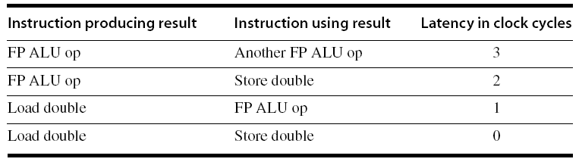
The Loop Execution Without Scheduling
Clock | Unscheduled
1 | fld f0,0(x1)
2 | ? fadd.d f4,f0,f2
Load double used by a FP ALU op, the Latency in 1 cycle

Slide 36
The Loop Execution Without Scheduling
Clock | Unscheduled
1 | fld f0,0(x1)
2 | Stall
3 | fadd.d f4,f0,f2

Slide 37
The Loop Execution Without Scheduling
Clock | Unscheduled
1 | fld f0,0(x1)
2 | Stall
3 | fadd.d f4,f0,f2
4 | ? fsd f4,0(x1)
a FP ALU op used by a Store double , the Latency in 2 cycle

Slide 38
The Loop Execution Without Scheduling
Clock | Unscheduled
1 | fld f0,0(x1)
2 | Stall
3 | fadd.d f4,f0,f2
4 | Stall
5 | ? fsd f4,0(x1)
a FP ALU op used by a Store double , the Latency in 2 cycle
This is the second

Slide 39
The Loop Execution Without Scheduling
Clock | Unscheduled
1 | fld f0,0(x1)
2 | Stall
3 | fadd.d f4,f0,f2
4 | Stall
5 | Stall
6 | fsd f4,0(x1)
a FP ALU op used by a Store double , the Latency in 2 cycle
there are two stall cycles

Slide 40
The Loop Execution Without Scheduling
Clock | Unscheduled
1 | fld f0,0(x1)
2 | Stall
3 | fadd.d f4,f0,f2
4 | Stall
5 | Stall
6 | fsd f4,0(x1)
7 | ? addi x1,x1,8

Slide 41
The Loop Execution Without Scheduling
Clock | Unscheduled
1 | fld f0,0(x1)
2 | Stall
3 | fadd.d f4,f0,f2
4 | Stall
5 | Stall
6 | fsd f4,0(x1)
7 | addi x1,x1,8

Slide 42
The Loop Execution Without Scheduling
Clock | Unscheduled
1 | fld f0,0(x1)
2 | Stall
3 | fadd.d f4,f0,f2
4 | Stall
5 | Stall
6 | fsd f4,0(x1)
7 | addi x1,x1,8
8 | ? bne x1,x2,Loop

Slide 43
The Loop Execution Without Scheduling
Clock | Unscheduled
1 | fld f0,0(x1)
2 | Stall
3 | fadd.d f4,f0,f2
4 | Stall
5 | Stall
6 | fsd f4,0(x1)
7 | addi x1,x1,8
8 | Stall
9 | bne x1,x2,Loop
what is the next?

Slide 44
The Loop Execution Without Scheduling
Clock | Unscheduled
1 | fld f0,0(x1)
2 | Stall
3 | fadd.d f4,f0,f2
4 | Stall
5 | Stall
6 | fsd f4,0(x1)
7 | addi x1,x1,8
8 | Stall
9 | bne x1,x2,Loop
10 | ?

Slide 45
The Loop Execution Without Scheduling
Clock | Unscheduled
1 | fld f0,0(x1)
2 | Stall
3 | fadd.d f4,f0,f2
4 | Stall
5 | Stall
6 | fsd f4,0(x1)
7 | addi x1,x1,8
8 | Stall
9 | bne x1,x2,Loop
10 | Stall

Slide 46
The Loop Execution Without Scheduling
10 clock cycles an iteration
Just 3 for execution (fld, fadd.d, fsd)
30%
5 clock cycles of stall (50%)
2 for loop overhead (20%)
Rewrite code to minimize stalls?

Slide 47
Focus, 👀, Focus: Rewrite the Code!
Clk | Unscheduled | scheduled
1 | fld f0,0(x1) | fld f0,0(x1)
2 | Stall
3 | fadd.d f4,f0,f2
4 | Stall
5 | Stall
6 | fsd f4,0(x1)
7 | addi x1,x1,8
8 | Stall
9 | bne x1,x2,Loop
10 | Stall

Slide 48
Scheduling the Loop 1/4
Clk | Unscheduled | scheduled
1 | fld f0,0(x1) | fld f0,0(x1)
2 | Stall | addi x1,x1,8
3 | fadd.d f4,f0,f2
4 | Stall
5 | Stall
6 | fsd f4,0(x1)
7 | addi x1,x1,8
8 | Stall
9 | bne x1,x2,Loop
10 | Stall

Slide 49
Scheduling the Loop 2/4
Clk | Unscheduled | scheduled
1 | fld f0,0(x1) | fld f0,0(x1)
2 | Stall | addi x1,x1,8
3 | fadd.d f4,f0,f2 | fadd.d f4,f0,f2
4 | Stall
5 | Stall
6 | fsd f4,0(x1)
7 | addi x1,x1,8
8 | Stall
9 | bne x1,x2,Loop
10 | Stall

Slide 50
Scheduling the Loop 3/4
Clk | Unscheduled | scheduled
1 | fld f0,0(x1) | fld f0,0(x1)
2 | Stall | addi x1,x1,8
3 | fadd.d f4,f0,f2 | fadd.d f4,f0,f2
4 | Stall | ? Stall
5 | Stall | ? Stall
6 | fsd f4,0(x1) | fsd f4,0(x1)
7 | addi x1,x1,8
8 | Stall
9 | bne x1,x2,Loop
10 | Stall

Slide 51
Scheduling the Loop 4/4
Clk | Unscheduled | scheduled
1 | fld f0,0(x1) | fld f0,0(x1)
2 | Stall | addi x1,x1,8
3 | fadd.d f4,f0,f2 | fadd.d f4,f0,f2
4 | Stall | Stall
5 | Stall | bne x1,x2,Loop
6 | fsd f4,0(x1) | fsd f4,0(x1)
7 | addi x1,x1,8
8 | Stall
9 | bne x1,x2,Loop
10 | Stall
Notes:
分支槽中的指令是必须执行的

Slide 52
The Loop With and Without Scheduling
6 clock cycles an iteration
The speedup is 10/6=1.7
Still just 3 for execution (fld, fadd.d, fsd)
50%
1 clock cycle of stall (17%)
2 clock cycles for loop overhead (33%)
How to minimize stalls and get rid of the overhead cycles?
Notes:
编译器的指令优化

Slide 53
Loop Unrolling
Omit Control Overhead and Stall

Slide 54
Loop Unrolled Code
Loop: fld f0,0(x1)
fadd.d f4,f0,f2
fsd f4,0(x1) //drop addi & bne
fld f6,8(x1)
fadd.d f8,f6,f2
fsd f8,8(x1) //drop addi & bne
fld f0,16(x1)
fadd.d f12,f0,f2
fsd f12,16(x1) //drop addi & bne
fld f14,24(x1)
fadd.d f16,f14,f2
fsd f16,24(x1)
addi x1,x1,32
bne x1,x2,Loop
Notes:
寄存器增加

Slide 55
Loop Unrolled Code: Exec Time
 |  |  | start waiting, …,execute
 | Loop: | fld f0,0(x1) | 1
 |  | fadd.d f4,f0,f2 | 2,3
 |  | fsd f4,0(x1) | 4,5,6
 |  | fld f6,8(x1) | 7
 |  | fadd.d f8,f6,f2 | 8,9
 |  | fsd f8,8(x1) | 10,11,12
 |  | fld f0,16(x1) | 13
 |  | fadd.d f12,f0,f2 | 14,15
 |  | fsd f12,16(x1) | 16,17,18
 |  | fld f14,24(x1) | 19
 |  | fadd.d f16,f14,f2 | 20,21
 |  | fsd f16,24(x1) | 22,23,24
 |  | addi x1,x1,32 | 25
 |  | bne x1,x2,Loop | 26,27
 |  | Stall | 28
Notes:
指令调度

Slide 56
Cost of The Code
This loop will run in 28 clock cycles
14 instruction issue cycles
14 stalls
7 clock cycles per iteration
8 Registers
Use different registers for each iteration

Slide 57
Scheduling to Eliminate All Stalls
1 | Loop: | fld | f0,0(x1)
2 |  | fld | f6,8(x1)
3 |  | fld | f0,16(x1)
4 |  | fld | f14,24(x1)
5 |  | fadd.d | f4,f0,f2
6 |  | fadd.d | f8,f6,f2
7 |  | fadd.d | f12,f0,f2
8 |  | fadd.d | f16,f14,f2
9 |  | fsd | f4,0(x1)
10 |  | fsd | f8,8(x1)
11 |  | addi | x1,x1,32
12 |  | fsd | f12,-16(x1)
13 |  | bne | x1,x2,Loop
14 |  | fsd | f16,-8(x1)

Slide 58
After Scheduling
The execution time of the unrolled loop has dropped to 14 clock cycles
3.5 cycles per element of the four
Compared with
Unrolled but not scheduling: 7 cycles per element
Scheduled but not unrolled: 6 cycles per element

Slide 59
Summary of Loop Unrolling
The key is to know
WHEN and HOW the ordering among instructions may be changed
In practice, this process must be performed in a methodical fashion by
A compiler or (and)
Hardware

Slide 60
Homework
Textbook: 3.1-3.2
Exercise
Coding: write a piece code that unrolling our examples

Slide 61
Next…
Dynamic Algorithms

