Slide 1




Fast and Generic Collectives for Distributed ML
Guanhua Wang, Shivaram Venkataraman, Amar Phanishayee Jorgen Thelin, Nikhil R. Devanur, Ion Stoica
Notes:
王冠华，加州伯克利分校的RISELab的博士生，https://people.eecs.berkeley.edu/~guanhua/
作者研究领域：分布式机器学习，网络，区块链
第二作者来自威斯康星大学麦迪逊分校
后面三位来自微软实验室
最后一位是作者的导师斯托卡，同时是riselab的leader
其他资料：
https://rise.cs.berkeley.edu/projects/blink/

Slide 2


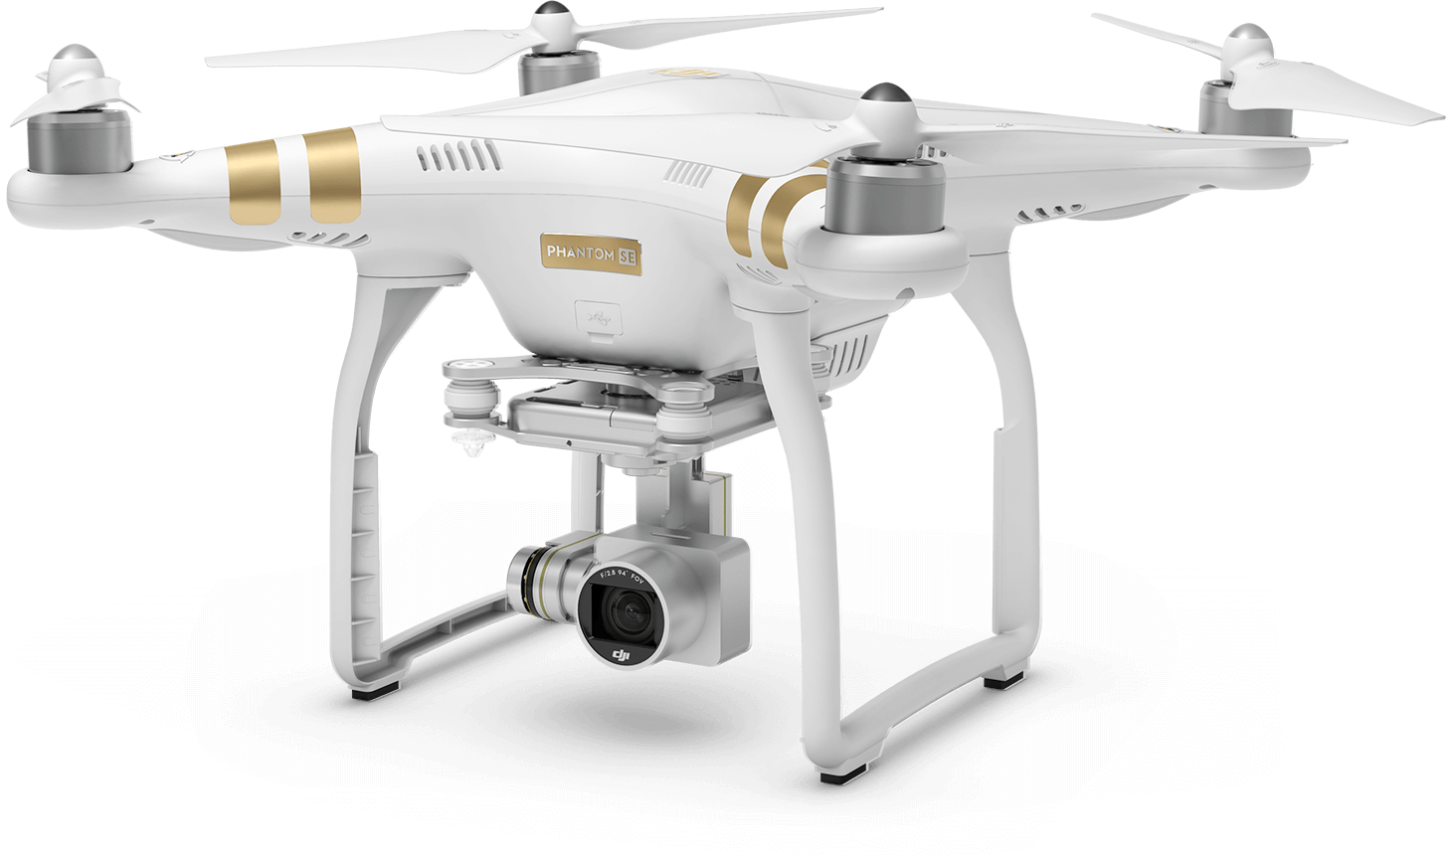



DNNs empower state-of-the-art results across many different applications
Image Classification
Robot Control
Speech Recognition
Game Playing
Notes:
DNNs为许多不同应用提供了最先进的结果

Slide 3
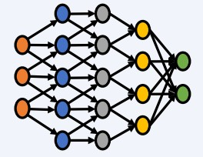
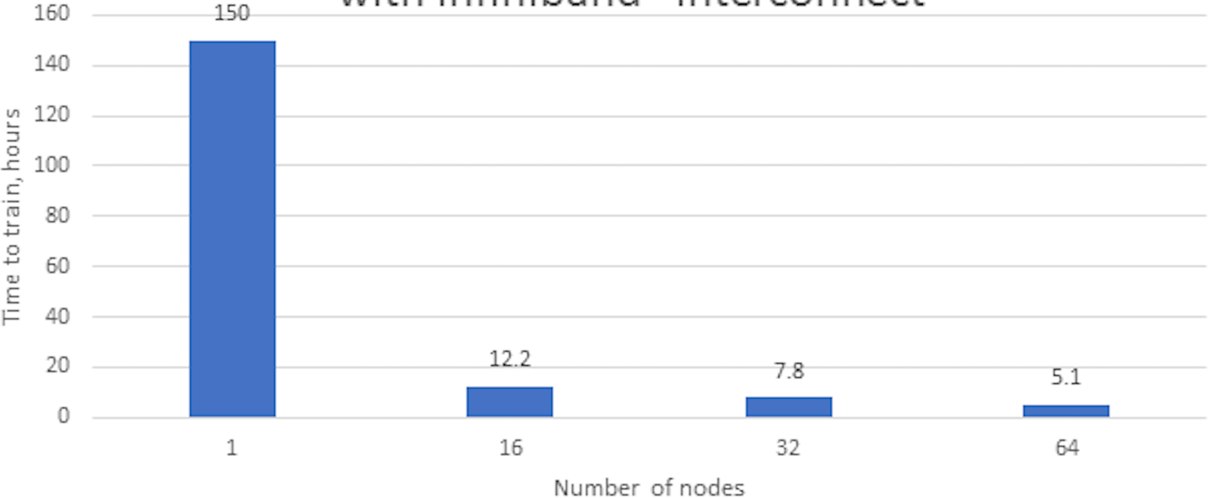

Speed-up DNN training: Data Parallelism
∇W¹
∇W²
Data parallel training speed-up on ImageNet-1K dataset*
Significantly reduce training time
∇W³
∇W⁴
Model Synchronization
∇W = ∇W¹ + ∇W² + ⋯ + ∇W^{N}
* https://software.intel.com/en-us/articles/caffe-training-on-multi-node-distributed-memory-systems
Notes:
分布式深度学习最常用的方法是数据并行化，增加训练所用的节点数量，能够有效地减少训练时间。上图显示了在ImageNet数据集上，随着训练所用的节点数量增加，训练时间极大地减少了。
每个节点仅读取和处理唯一的数据子集，并在训练期间更新本地模型。然后，将这些本地模型参数与其他节点同步以计算全局参数。

Slide 4
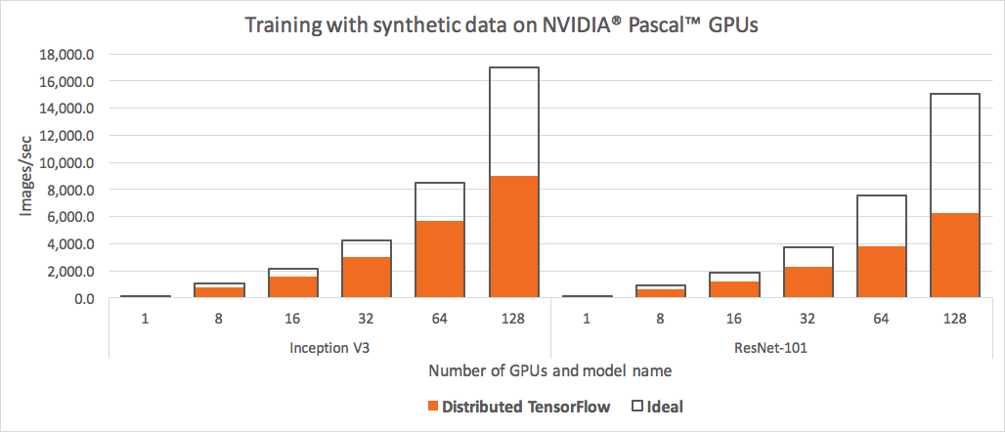
Despite many performance optimizations, model synchronization is a big overhead in data parallel training on cloud servers
>50% communication overhead
Multi-GPU scaling performance using TensorFlow*
*Horovod: fast and easy distributed deep learning in TensorFlow, arXiv:1802.05799, 2018
6
Notes:
尽管进行了许多性能优化，但是模型同步是云服务器上数据并行训练中的一大开销。通信开销往往占到50%

Slide 5
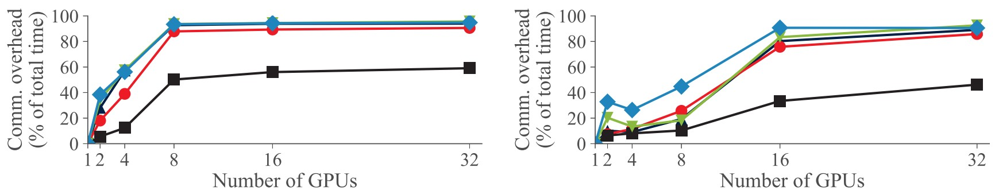
Despite many performance optimizations, model synchronization is a big overhead in data parallel training on cloud servers
>50% communication overhead
Multi-GPU scaling performance using TensorFlow*
Up to 90% communication overhead
Communication overhead of data-parallel training with Multi-GPU servers using PyTorch^
^PipeDream: Generalized Pipeline Parallelism for DNN Training, SOSP 2019
7
*Horovod: fast and easy distributed deep learning in TensorFlow, arXiv:1802.05799, 2018
Notes:
GNMT-谷歌的神经网络翻译系统，8个RNN层和16个RNN层，在通信密集型网络如AlexNet,VGG,GNMT，通信开销达到90%
为了缓解通信瓶颈，最近硬件和软件都有了很大的改进。

Slide 6
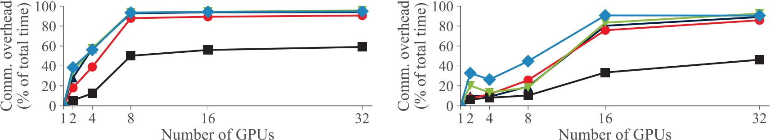
Model synchronization is a big overhead in data parallel training despite many performance optimizations
>50% communication overhead
Multi-GPU scaling performance using TensorFlow*
Up to 90% communication overhead
Communication overhead of data-parallel training with Multi-GPU servers using PyTorch^
^PipeDream: Generalized Pipeline Parallelism for DNN Training, SOSP 2019 8
*Horovod: fast and easy distributed deep learning in TensorFlow, arXiv:1802.05799, 2018
To alleviate communication bottlenecks, recently there have been
big improvements in hardware and software.
Notes:
尽管进行了许多性能优化，但是模型同步是云服务器上数据并行训练中的一大开销。通信开销往往占到50%
GNMT-谷歌的神经网络翻译系统，8个RNN层和16个RNN层，在通信密集型网络如AlexNet,VGG,GNMT，通信开销达到90%
为了缓解通信瓶颈，最近硬件和软件都有了很大的改进。
TODO

Slide 7
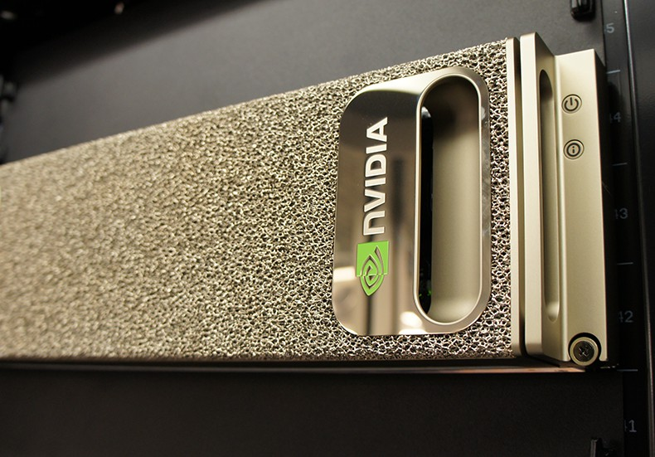
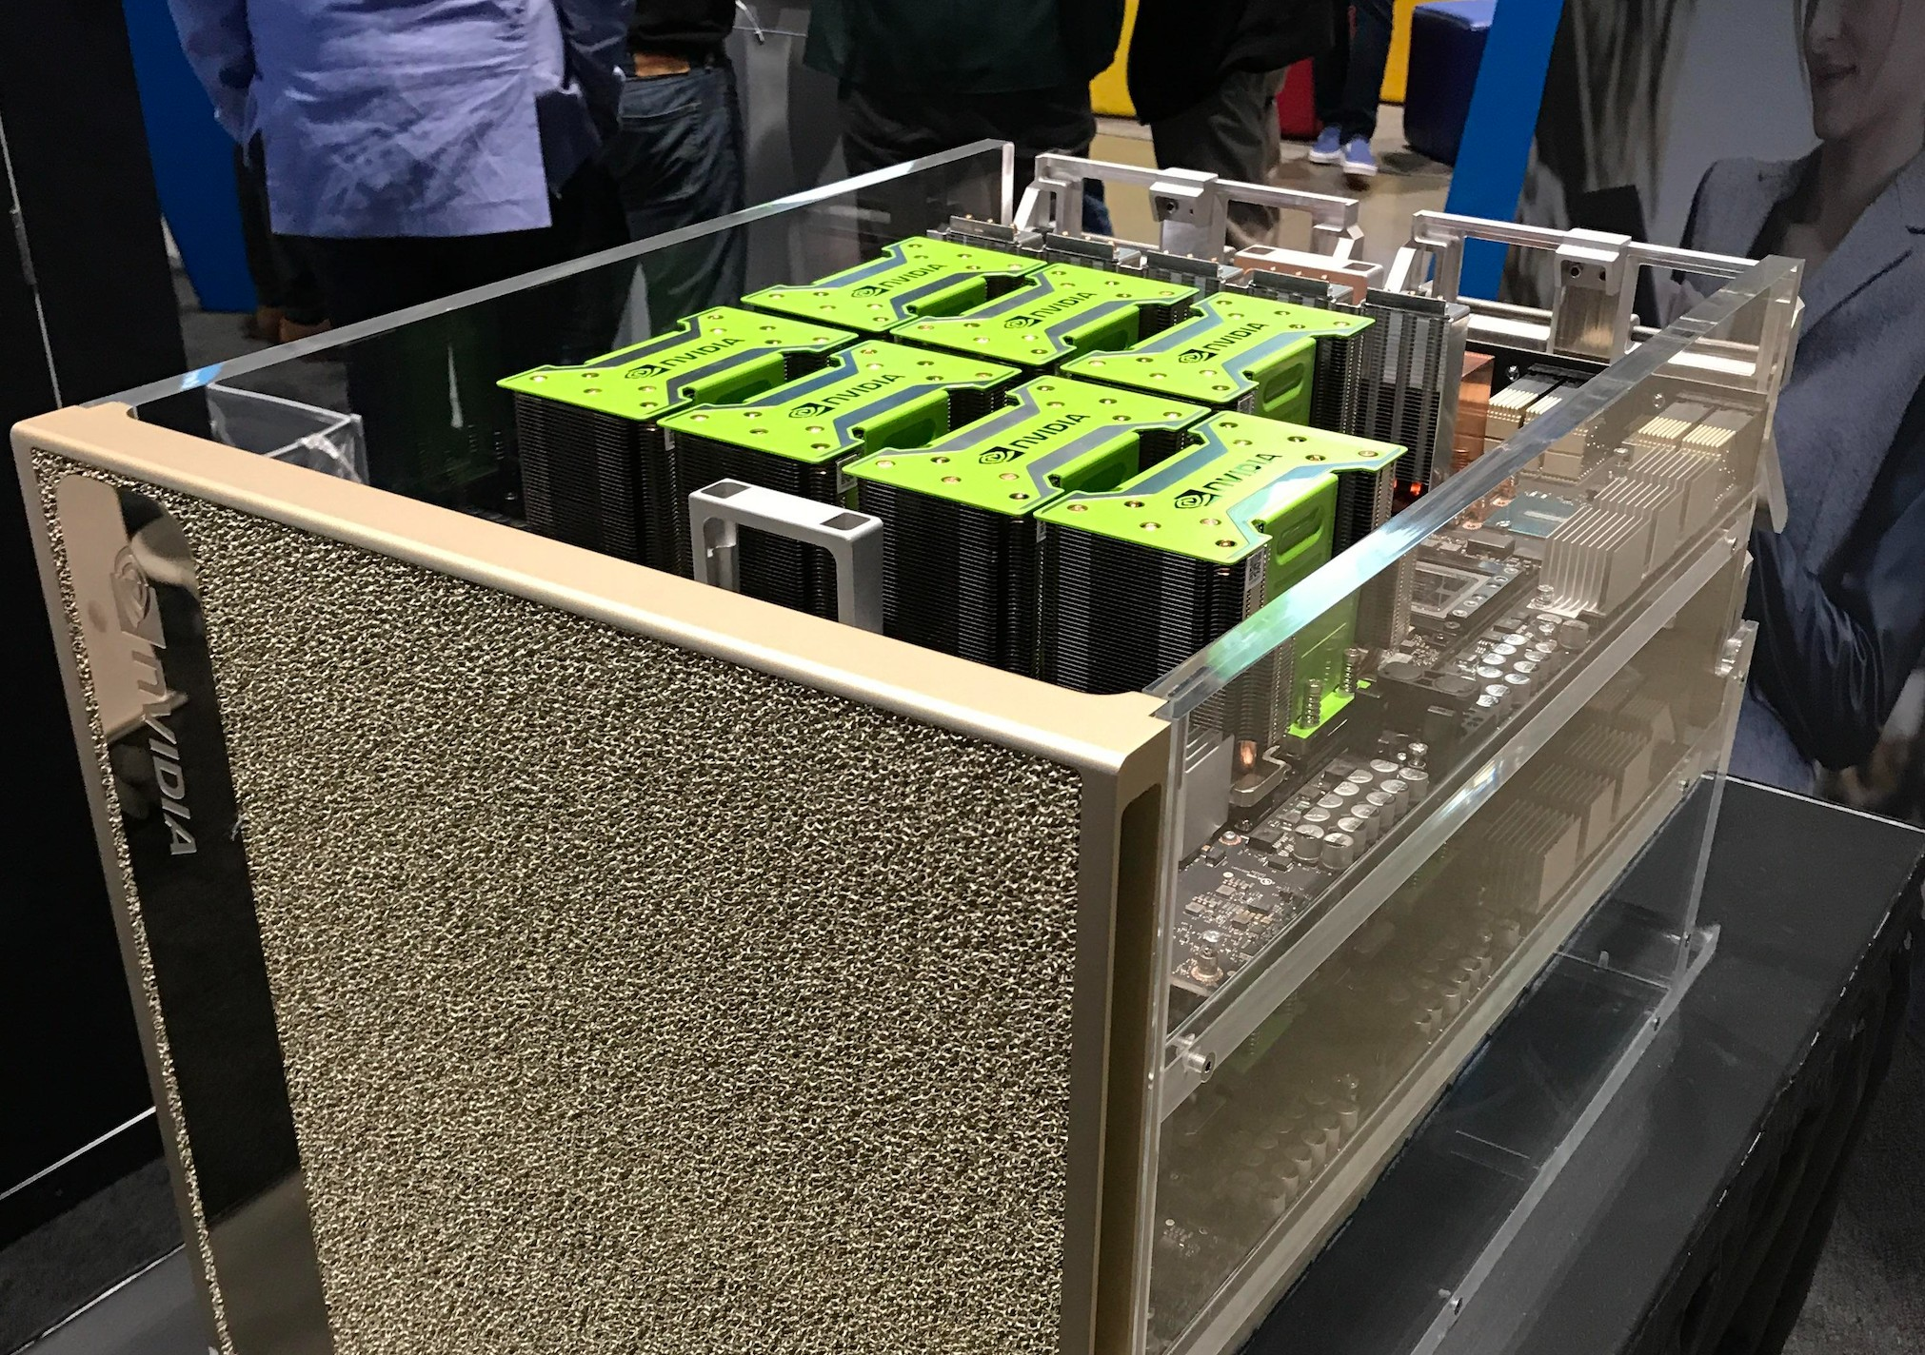
NVIDIA DGX-1
NVIDIA DGX-2
State of the art (hardware)
9
Notes:
在硬件方面，NVIDIA DGX-1 和 DGX-2 是最先进的多GPU服务器

Slide 8
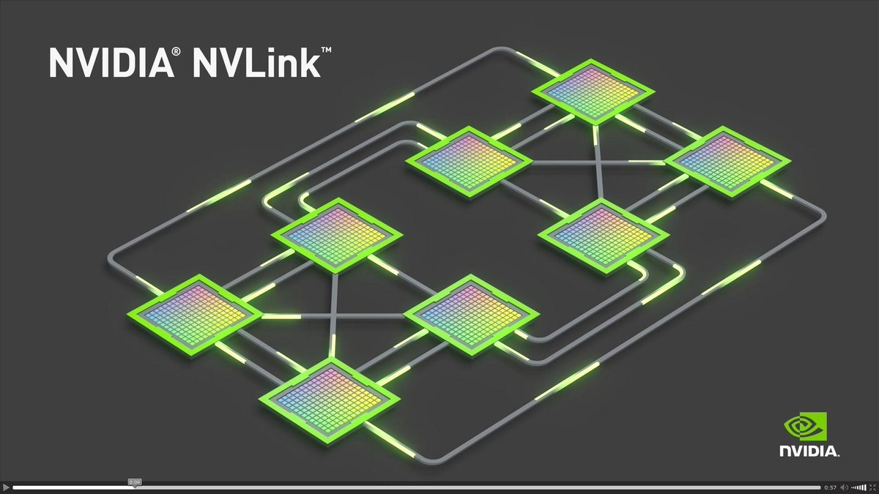
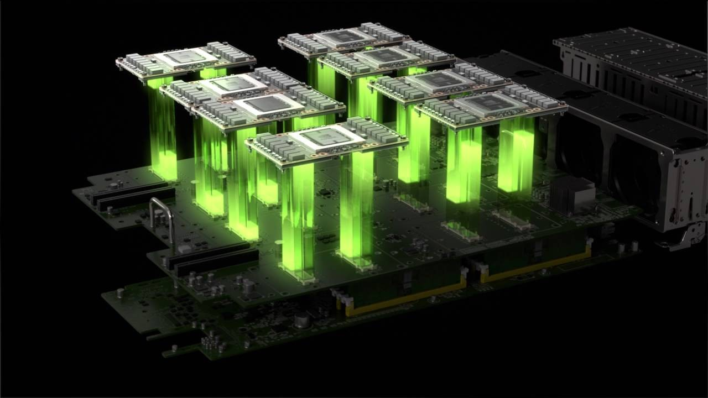
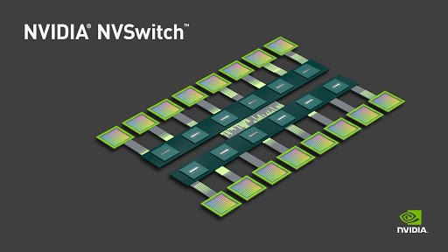
What is inside?
Computation
Faster Interconnects
NVIDIA P100: 5.3 Tera-FLOPs
Double Precision
PCIe 3.0 (x16) ~10GB/s
Shared
NVIDIA V100: 7.8 Tera-FLOPs
Double Precision
NVLink
Point-to-point
1st Gen (P100) ~18GB/s
2nd Gen (V100) ~ 23GB/s
NVSwitch
Fully connected crossbar
6x NVLink 2nd Gen Bandwidth
~130GB/s
Notes:
隐藏
算力：

Slide 9





State of the art (software)
NCCL
(Nvidia Collective Communication Library)
Ring-based collective communication protocols
Notes:
软件：NVIDIA的NCCL，Uber的horovod，facebook的gloo，还有百度的Ring AllReduce。这些都是Ring-based collective 通信协议

Slide 10
Ring-based collectives (e.g. Broadcast)
GPU0 GPU1 GPU2
GPU3
GPU0
GPU1
GPU3
GPU2
Topology
Ring Broadcast (from GPU0)

Slide 11
Ring-based collectives (e.g. Broadcast)
GPU0 GPU1 GPU2
GPU3
GPU0
GPU1
GPU3
GPU2
Topology
Ring Broadcast (from GPU0)

Slide 12
Ring-based collectives (e.g. Broadcast)
GPU0 GPU1 GPU2
GPU3
GPU0
GPU1
GPU3
GPU2
Topology
Ring Broadcast (from GPU0)

Slide 13
Ring-based collectives (e.g. Broadcast)
GPU0 GPU1 GPU2
GPU3
GPU0
GPU1
GPU3
GPU2
Topology
Ring Broadcast (from GPU0)

Slide 14
Ring-based collectives (e.g. Broadcast)
GPU0 GPU1 GPU2
GPU3
GPU0
GPU1
GPU3
GPU2
Topology
Ring Broadcast (from GPU0)

Slide 15
Ring-based collectives (e.g. Broadcast)
GPU0 GPU1 GPU2
GPU3
GPU0
GPU1
GPU3
GPU2
Topology
Ring Broadcast (from GPU0)

Slide 16
Ring-based collectives (e.g. Broadcast)
GPU0 GPU1 GPU2
GPU3
GPU0
GPU1
GPU3
GPU2
Topology
Ring Broadcast (from GPU0)

Slide 17
State of the art (software)
NCCL
(Nvidia Collective Communication Library)
Ring-based collective communication protocols

Slide 18
Can these hardware & software improvements alleviate communication bottleneck
in data-parallel training?

Slide 19
Can these hardware & software improvements alleviate communication bottleneck
in data-parallel training?
Not Really

Slide 20
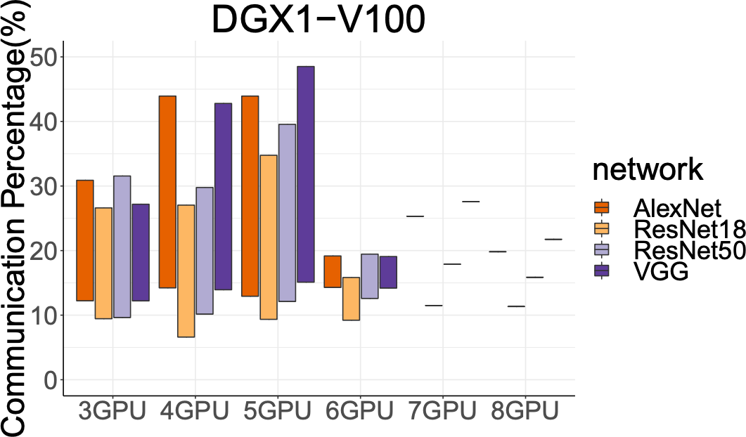
High communication overheads even with
state-of-the-art hardware (NVLink) and software (NCCL)
There are many different 4 GPU allocations with a server
Cross-GPU communication measured as the percentage of total epoch time when running within a single 8-GPU DGX-1 box

Slide 21
High communication overheads even with
state-of-the-art hardware (NVLink) and software (NCCL)
4 GPU allocation with highest overhead
High communication overheads even with state-of-the-art hardware (NVLink) and software (NCCL)
4 GPU allocation with lowest overhead
Cross-GPU communication
measured as the percentage of total epoch time when running within a single 8-GPU DGX-1 box

Slide 22
High communication overheads even with
state-of-the-art hardware (NVLink) and software (NCCL)
High communication overheads is consistent across different number of workers and
for a range of DNNs
Cross-GPU communication
measured as the percentage of total epoch time when running within a single 8-GPU DGX-1 box

Slide 23
High communication overheads even with
state-of-the-art hardware (NVLink) and software (NCCL)
High communication overheads is consistent across different number of workers and
for a range of DNNs
Communication overheads become more pronounced with increasing GPU
computation power.
Cross-GPU communication
measured as the percentage of total epoch time when running within a single 8-GPU DGX-1 box

Slide 24
High communication overheads even with
state-of-the-art hardware (NVLink) and software (NCCL)
High communication overheads consistent
across different number of workers and for a range of DNNs
Communication overheads become more pronounced with increasing GPU
Cross-GPU communication ^{computation power.} measured as the percentage of
total epoch time when running within a single 8-GPU DGX-1 box
28
We need Faster Collective Communication Protocols.

Slide 25
Talk Outline
Motivation
Challenges to achieving faster collective communication
Design
Evaluation

Slide 26

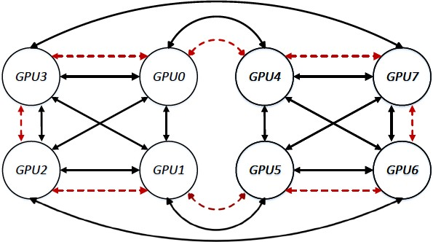












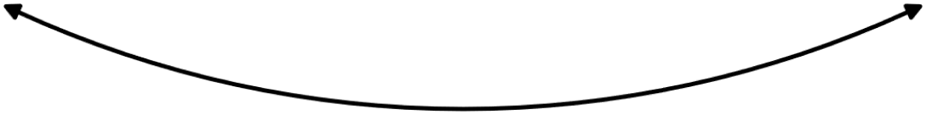
Challenge 1: Different server configurations
GPU3
GPU0
GPU4
GPU7
GPU2
GPU1
GPU5
GPU6
DGX1-P100 (NVLink 1st Gen, ~18GB/s)
DGX1-V100 (NVLink 2nd Gen, ~23GB/s)

