Slide 1

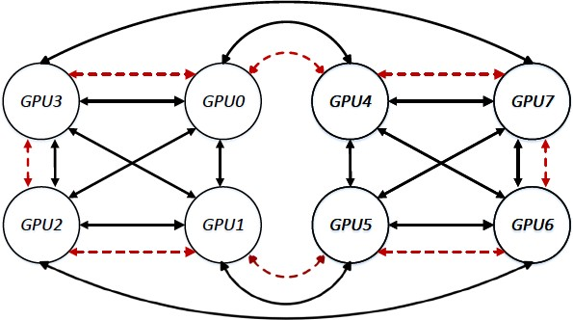













Challenge 1: Different server configurations
GPU3
GPU0
GPU4
GPU7
GPU2
GPU1
GPU5
GPU6
DGX1-P100 (NVLink 1st Gen, ~18GB/s)
DGX1-V100 (NVLink 2nd Gen, ~23GB/s)
Protocols needs to be topology aware to effectively use hardware links.

Slide 2
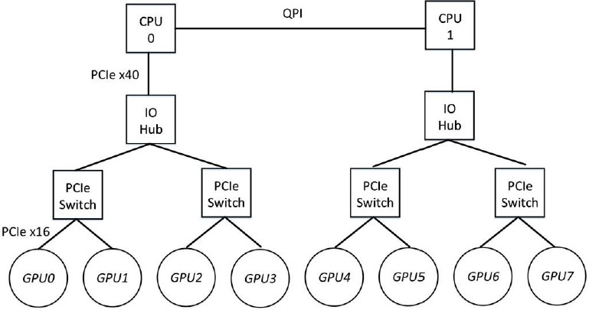


Challenge 2: Link heterogeneity
PCIe topology
NVLink topology
GPU3
GPU0
GPU4
GPU7
GPU2
GPU1
GPU5
GPU6
GPU0
GPU1
GPU3
Ring-based collectives can only utilize homogeneous links.

Slide 3
Challenge 2: Link heterogeneity
PCIe topology
NVLink topology
GPU3
GPU0
GPU4
GPU7
GPU2
GPU1
GPU5
GPU6
GPU0
GPU1
GPU3
Ring-based collectives can only utilize homogeneous links.
Why not heterogeneous links?
e.g. PCIe will be bottleneck if included in a NVLink ring
33

Slide 4
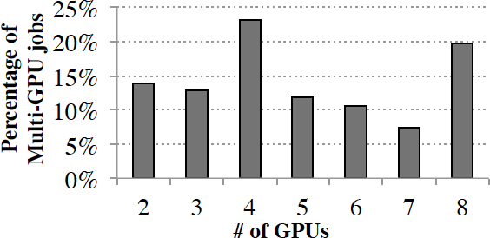
Challenge 3: Fragmentation in multi-tenant clusters
Within each 8-GPU server, # of GPUs allocated to 40,000 multi-GPU jobs at Microsoft.
Examples of fragmented allocation (8GPU job across 2 servers)
3 + 5
2 + 6
34

Slide 5
Challenge 3: Fragmentation in multi-tenant clusters
Within each 8-GPU server, # of GPUs allocated to 40,000 multi-GPU jobs at Microsoft.
Why fragmentation?
Many cluster schedulers are not topology-aware.
Without support for efficient migration, DNN jobs must embrace fragmentation to avoid queuing delays.

Slide 6
Challenge 3: Fragmentation in multi-tenant clusters
GPU3
GPU0
GPU4
GPU7
GPU2
GPU1
GPU5
GPU6
Within each 8-GPU server, # of GPUs allocated to 40,000 multi-GPU jobs at Microsoft.
Why fragmentation?
Many cluster schedulers are not topology-aware.
Irregular topo. → no ring
Existing solutions (NCCL) fall back to PCIe if they cannot form a NVLink ring.
Without support for efficient migration, DNN jobs must embrace fragmentation to avoid queuing delays.

Slide 7

Can we do better than state-of-the-art?
Topology Heterogeneity
Different server configurations
Link heterogeneity
Fragmentation in multi-tenant clusters
Ring-based collective communication protocols

Slide 8

Can we do better than state-of-the-art?
Topology Heterogeneity
Different server configurations
Link heterogeneity
Fragmentation in multi-tenant clusters
BLINK

Slide 9
Talk Outline
Motivation
Challenges to achieving high-performance collective communication
Different server configurations
Link heterogeneity
Fragmentation in multi-tenant clusters
Design
Evaluation

Slide 10
How Blink handles topology heterogeneity
Topology Heterogeneity Blink
Different server configurations Probe available links at job run time

Slide 11
How Blink handles topology heterogeneity
Topology Heterogeneity Blink
Different server configurations Probe available links at job run time
Link heterogeneity
Concurrent data transfer over heterogenous links

Slide 12
How Blink handles topology heterogeneity
Topology Heterogeneity Blink
Different server configurations Probe available links at job run time
Link heterogeneity
Concurrent data transfer over heterogenous links
Fragmentation in multi-tenant clusters (irregular topology)
Spanning trees (v.s. Rings) are more flexible and optimal.

Slide 13
How Blink handles topology heterogeneity
Topology Heterogeneity Blink
Different server configurations Probe available links at job run time
Link heterogeneity
Concurrent data transfer over heterogenous links
Fragmentation in multi-tenant clusters (irregular topology)
Spanning trees (v.s. Rings) are more flexible and optimal.
NCCL-compatible API, seamless integration with TF, PyTorch, etc.
More

Slide 14
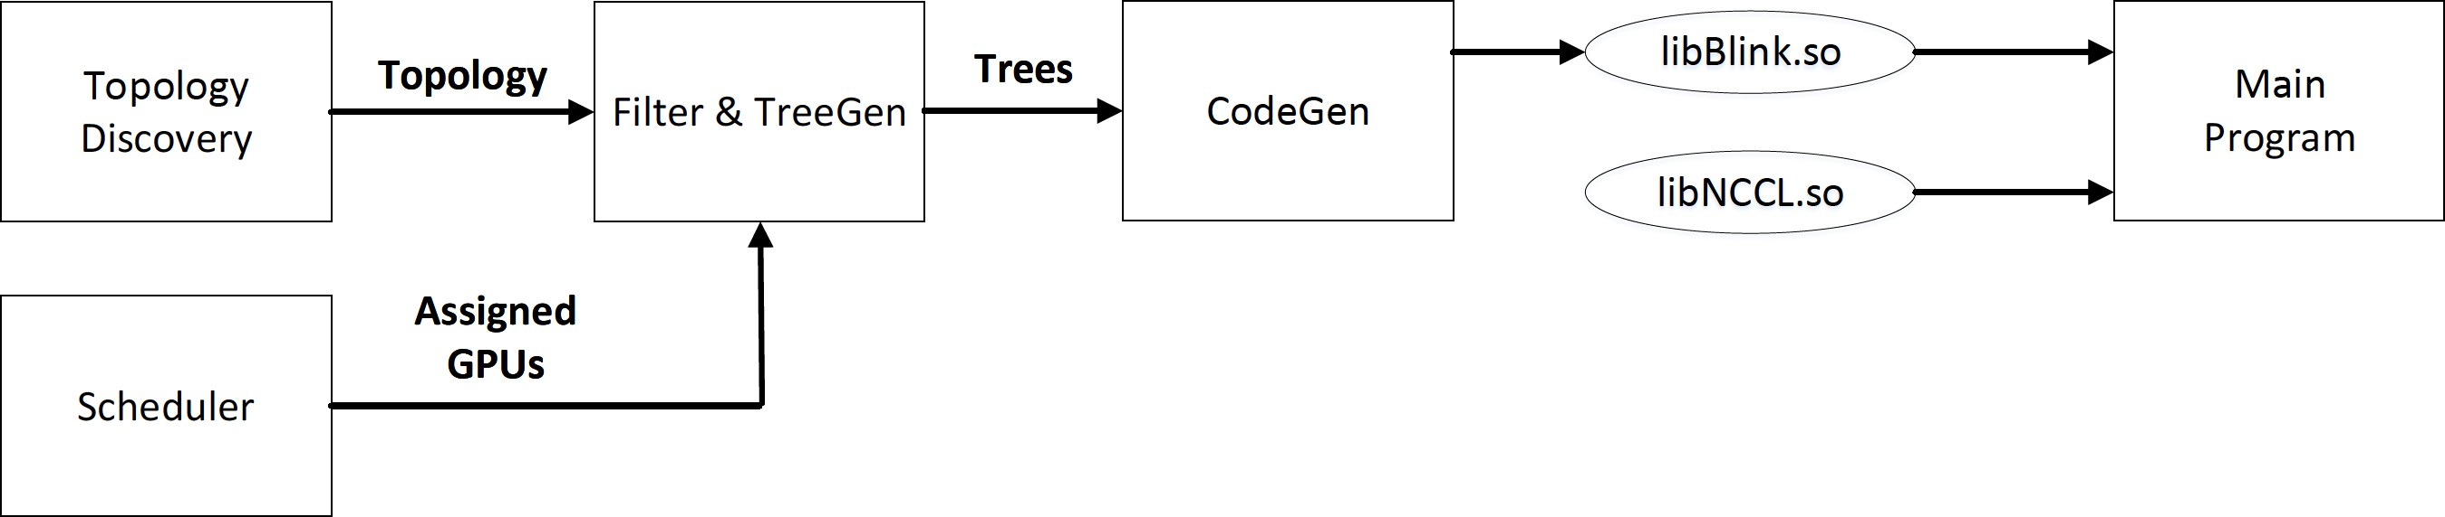
Blink workflow

Slide 15
Blink workflow

Slide 16
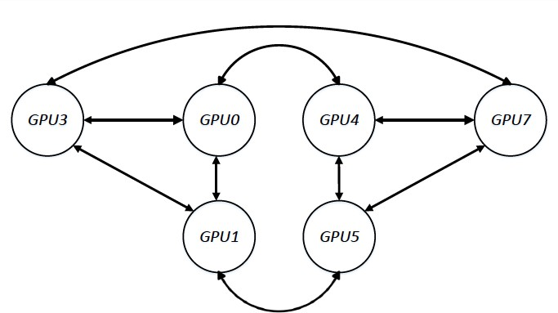
Broadcast comparison (Trees v.s. Rings)
6-GPU topology

Slide 17
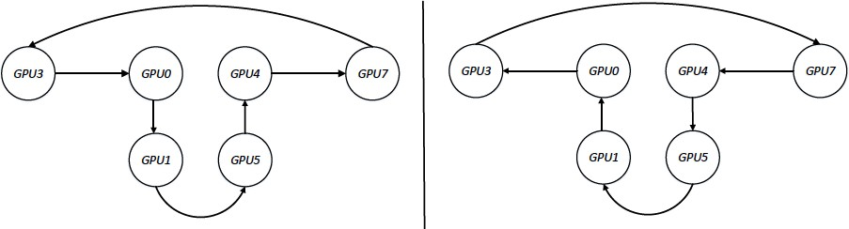
Broadcast comparison (Trees v.s. Rings)
Unused link
Broadcast from GPU3
NCCL 2 rings

Slide 18
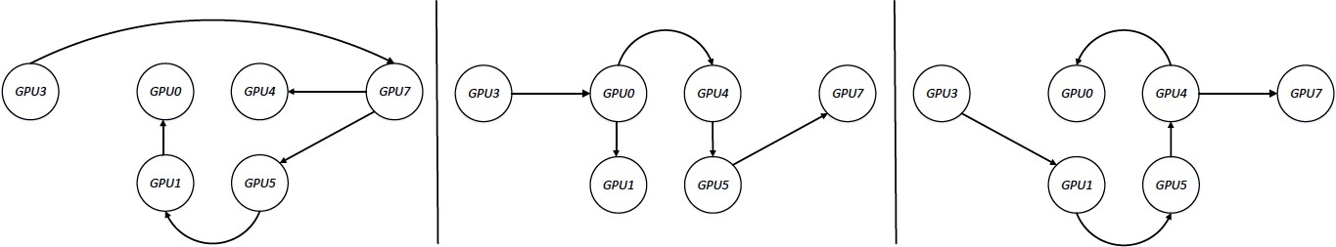
Broadcast comparison (Trees v.s. Rings)
Broadcast from GPU3
Blink 3 Spanning trees
3 Spanning trees > 2 Rings
Use All the links available → Optimal

Slide 19
TreeGen: packing max. spanning trees
Given available topology, pack max. unidirectional spanning trees.
GPU1
GPU1
GPU1
GPU1
GPU2
GPU3
GPU2
GPU3
GPU2 GPU3 GPU2
Packing unidirectional spanning trees
GPU3
Topology

Slide 20
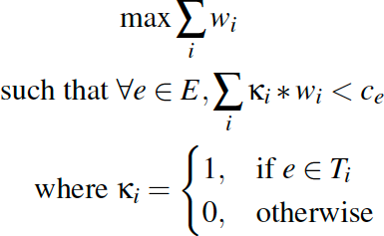
TreeGen: packing max. spanning trees
Given available topology, pack max. unidirectional spanning trees.
GPU1
GPU1
GPU1
GPU1
GPU2
GPU3
GPU2
GPU3
GPU2 GPU3 GPU2
Packing unidirectional spanning trees
GPU3
Topology
Optimization problem
Maximize the sum of bandwidth usage among all links
Constrain: amount of BW usage should not exceed ANY link capacity when packing multiple trees

Slide 21
TreeGen: packing max. spanning trees
Given available topology, pack max. unidirectional spanning trees.
GPU1
GPU1
GPU1
GPU1
GPU2
GPU3
GPU2
GPU3
GPU2 GPU3 GPU2
Packing unidirectional spanning trees
GPU3
Topology
Optimization problem
Maximize the sum of bandwidth usage among all links
Constrain: amount of BW usage should not exceed ANY link capacity when packing multiple trees
Too many trees!
181 spanning trees for
8-GPU DGX-1V
Data size per-tree is too small to fully saturate link BW.

Slide 22
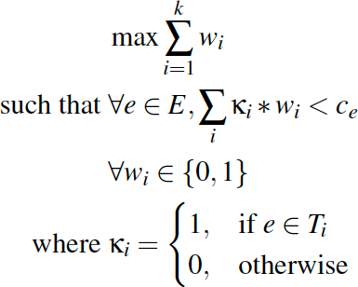
TreeGen: packing max. spanning trees
Given available topology, pack max. unidirectional spanning trees.
Optimization problem
Approximate packing
181 trees for 8GPU DGX-1V
approximation
approxi mation
Either a tree use ALL BW of a link, or not use it.
6 trees for 8GPU DGX-1V

Slide 23
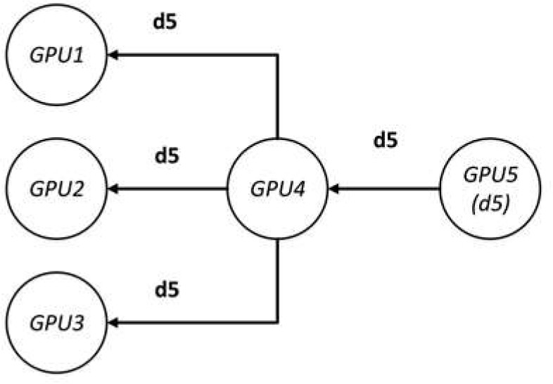
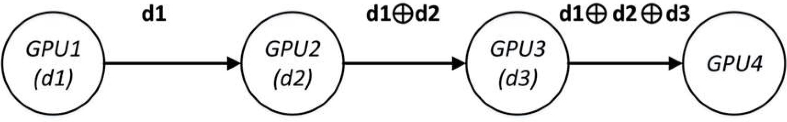
TreeGen
Given available topology, pack max. unidirectional spanning trees
Direct support for one-to-many/many-to-one primitives
e.g. Reduce, Broadcast, etc.
Broadcast
Reduce

Slide 24
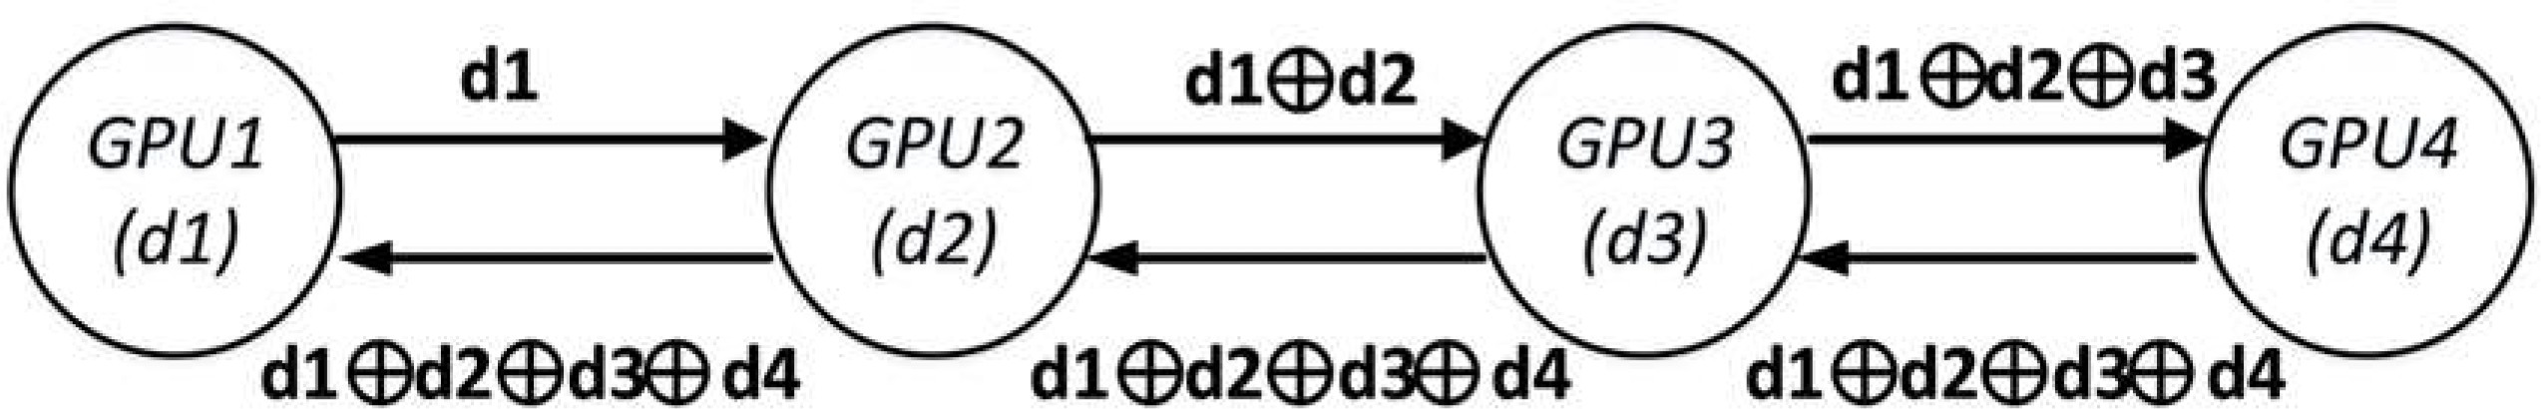
TreeGen
Given available topology, pack max. unidirectional spanning trees
Direct support for one-to-many/many-to-one primitives
e.g. Reduce, Broadcast, etc.
Broadcast
Reduce
Extend to many-to-many primitives (e.g. AllReduce)
Pick a root node, reduce towards root, then broadcast in reverse direction.
Reduce →
Broadcast ←
AllReduce

Slide 25
TreeGen for NVSwitch (DGX-2)

Slide 26
TreeGen for NVSwitch (DGX-2)
With NVSwitch, the connectivity among any subset of GPUs is uniform
NCCL constructs a multi-hop ring.
GPU1
NVSwitch
GPU2
GPU3
GPU 4
4GPU Reduce (G1->G4)

Slide 27
TreeGen for NVSwitch (DGX-2)
With NVSwitch, the connectivity among any subset of GPUs is uniform
NCCL constructs a multi-hop ring.
GPU1
Hop Count
NVSwitch
1
GPU2
GPU3
GPU 4
4GPU Reduce (G1->G4)

Slide 28
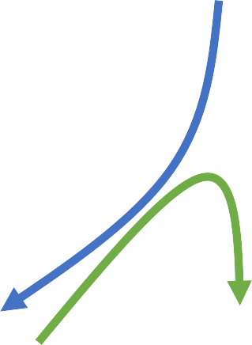
TreeGen for NVSwitch (DGX-2)
With NVSwitch, the connectivity among any subset of GPUs is uniform
NCCL constructs a multi-hop ring.
GPU1
Hop Count
NVSwitch
2
GPU2
GPU3
GPU 4
4GPU Reduce (G1->G4)

Slide 29
TreeGen for NVSwitch (DGX-2)
With NVSwitch, the connectivity among any subset of GPUs is uniform
NCCL constructs a multi-hop ring.
GPU1
Hop Count
NVSwitch
3
GPU2
GPU3
GPU 4
4GPU Reduce (G1->G4)

Slide 30
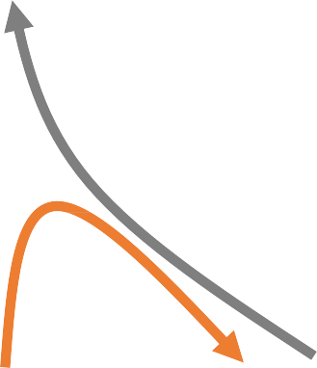
TreeGen for NVSwitch (DGX-2)
With NVSwitch, the connectivity among any subset of GPUs is uniform
NCCL constructs a multi-hop ring.
GPU1
Hop Count
NVSwitch
4
GPU2
GPU3
GPU 4
4GPU Reduce (G1->G4)

Slide 31
TreeGen for NVSwitch (DGX-2)
DGX-2 single-hop tree
GPU1
Reduce
1-hop tree introduces Min. latency
NVSwitch
GPU2
GPU3
GPU 4
4GPU Reduce
61

Slide 32
TreeGen for NVSwitch (DGX-2)
DGX-2 single-hop tree
GPU1
Reduce
1-hop tree introduces Min. latency
NVSwitch
Broadcast
GPU2
GPU3
GPU 4
For N GPUs,
N 1-hop trees, with each tree responsible for 1/N data.
AllReduce → Reduce, Broadcast
62

Slide 33
Blink workflow

Slide 34
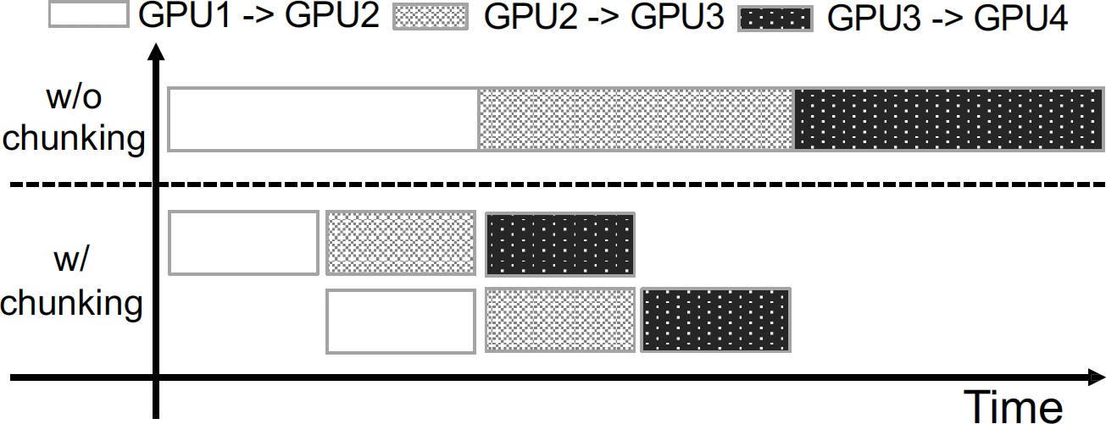
CodeGen
Translate TreeGen output (spanning trees) into real data transfer commands
CodeGen optimizations:
Pipelining data chunks to reduce latency

Slide 35
CodeGen
Translate TreeGen output (spanning trees) into real data transfer commands
CodeGen optimizations:
Pipelining data chunks to reduce latency
What chunk size to use?
• Too small, cannot fully utilize BW
• Too big, high latency

Slide 36
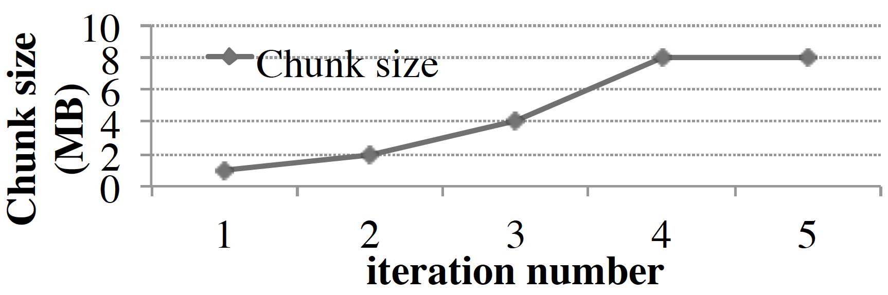
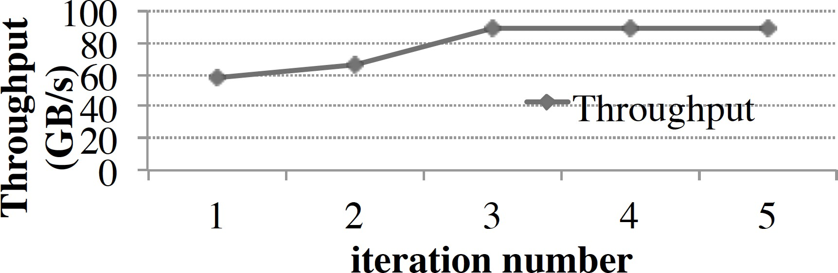
CodeGen
Translate TreeGen output (spanning trees) into real data transfer commands
CodeGen optimizations:
Automatic chunk size selection MIAD
(multiple-increase, additive-decrease)
Pipelining data chunks to reduce latency
What chunk size to use?
• Too small, cannot fully utilize BW
• Too big, high latency

Slide 37
CodeGen
Translate TreeGen output (spanning trees) into real data transfer commands
CodeGen optimizations:
Automatic chunk size selection MIAD
(multiple-increase, additive-decrease)
Pipelining data chunks to reduce latency
What chunk size to use?
• Too small, cannot fully utilize BW
• Too big, high latency

Slide 38
CodeGen
Translate TreeGen output (spanning trees) into real data transfer commands
CodeGen optimizations:
Automatic chunk size selection MIAD
(multiple-increase, additive-decrease)
Pipelining data chunks to reduce latency
What chunk size to use?
• Too small, cannot fully utilize BW
• Too big, high latency

Slide 39
CodeGen
Translate TreeGen output (spanning trees) into real data transfer commands
CodeGen optimizations:
Automatic chunk size selection MIAD
(multiple-increase, additive-decrease)
Pipelining data chunks to reduce latency
What chunk size to use?
• Too small, cannot fully utilize BW
• Too big, high latency

Slide 40
Blink design recap
Packing spanning trees while minimizing trees
Single hop trees for DGX-2 (NVSwitch)
Chunking, pipelining transfers for max link utilization
Auto chunk size selection with MIAD
GPU stream reuse for fair sharing of links
PCIe + NVLink Hybrid transfers
Support for multi-machine collectives
Drop-in NCCL replacement (load-time, no code recompile)

Slide 41
Talk Outline
Motivation
Challenges to achieving high-performance collective communication
Different server configurations
Link heterogeneity
Fragmentation in multi-tenant clusters
Design
Evaluation
AllReduce and Broadcast Microbenchmarks
End-to-end improvements
Benefits of One-Hop Trees over Rings or Double Binary trees
Rest of the extensive evaluation → refer to the paper

Slide 42
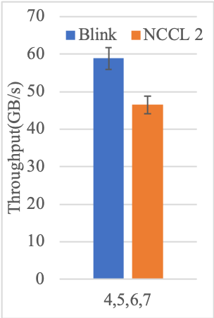


Microbenchmarks (DGX-1V)
GPU3
GPU0
GPU4
GPU7
GPU2
GPU1
GPU5
GPU6
Topology
AllReduce

Slide 43
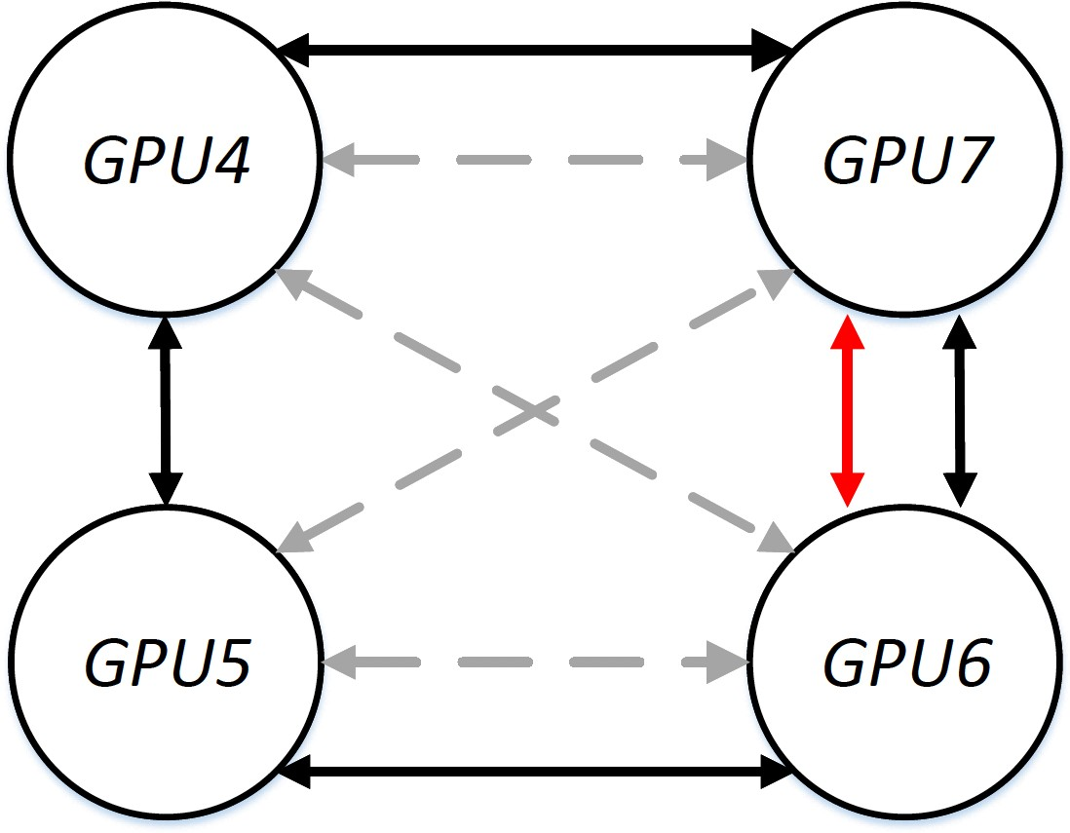
Microbenchmarks (DGX-1V)
GPU3
GPU0
GPU4
GPU7
NCCL2 (2 rings)
GPU2
GPU1
GPU5
GPU6
Topology
AllReduce

Slide 44
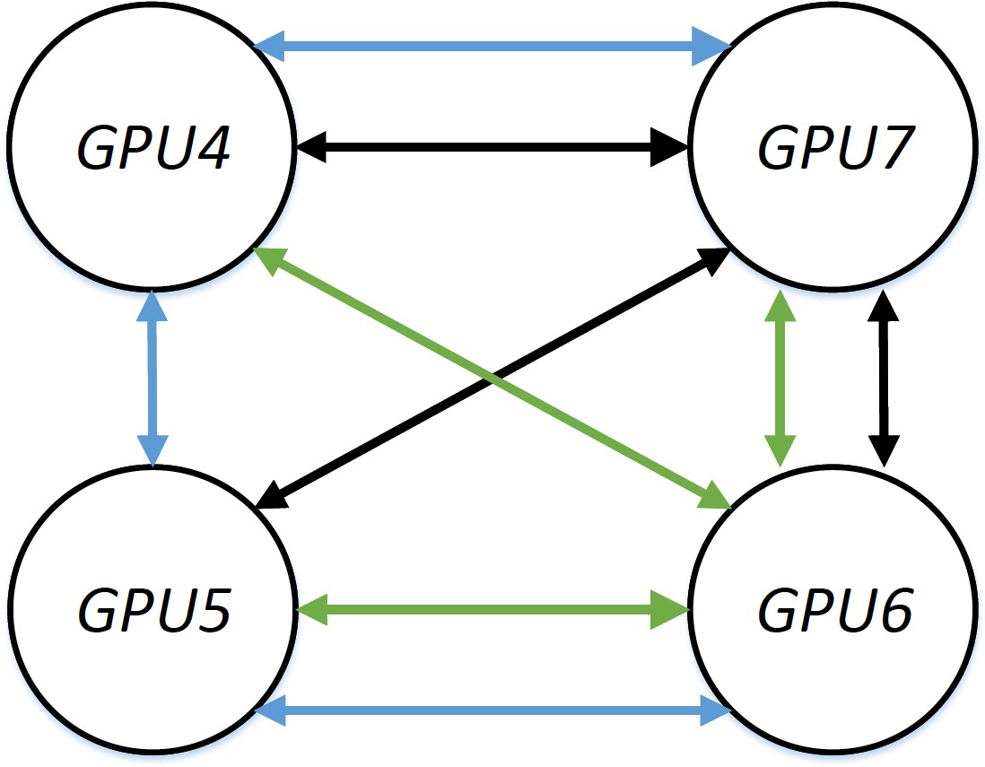
Microbenchmarks (DGX-1V)
GPU3
GPU0
GPU4
GPU7
NCCL2 (2 rings)
GPU2
GPU1
GPU5
GPU6
Topology
AllReduce
Blink (3 spanning trees)

Slide 45
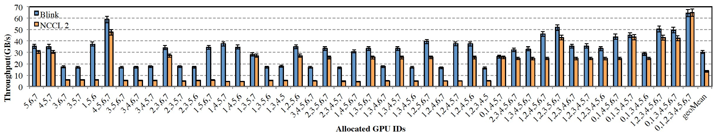
Microbenchmarks (DGX-1V)
AllReduce
(up to 8x speed-up, 2x geo-mean)

Slide 46
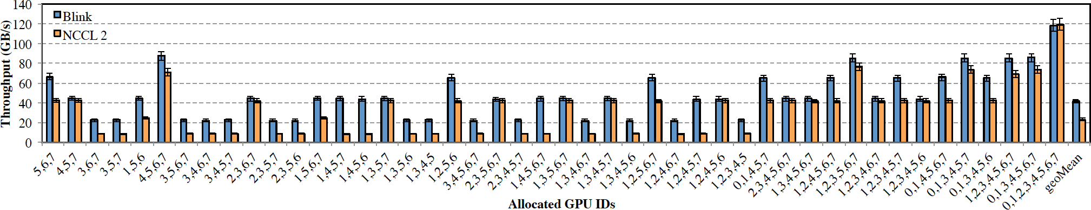
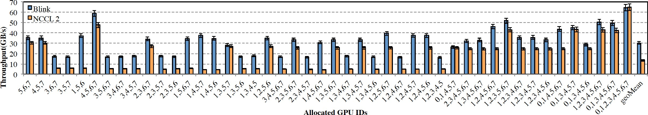
Microbenchmarks (DGX-1V)
Broadcast (up to 6x speed-up, 2x geo-mean)
AllReduce (up to 8x speed-up, 2x geo-mean)
76

Slide 47
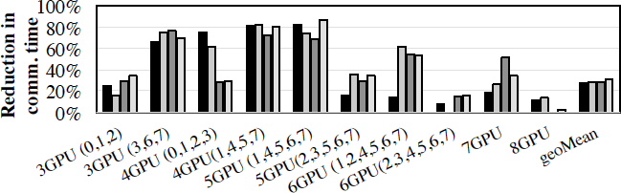

End-to-end Benchmarks (DGX-1V)
up to 87% Communication time reduction (51% avg.)
Blink end-to-end Communication time reduction (ImageNet1K)

Slide 48
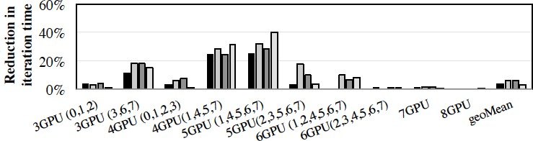
End-to-end Benchmarks (DGX-1V)
up to 87% Communication time reduction (51% avg.)
Blink end-to-end Communication time reduction (ImageNet1K)
up to 40% end-to-end training time reduction
Blink end-to-end training time reduction (ImageNet1K)

Slide 49
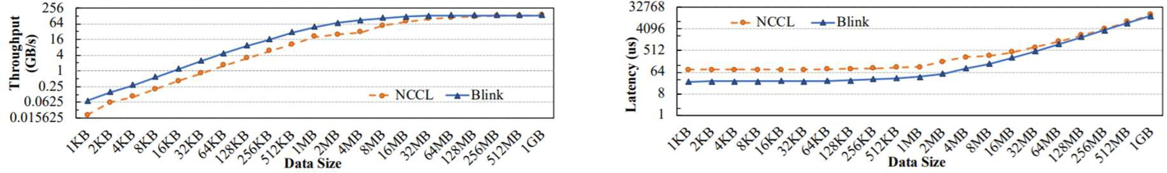
Microbenchmarks (DGX-2)
16 GPU AllReduce
Throughput
(up to 3.5x speed-up)
Latency
(Up to 3.32x reduction)
Biggest win in small chunk sizes because our 1-hop tree achieve min. latency.

Slide 50

Guanhua Wang guanhua@cs.berkeley.edu
Topology heterogeneity results in link underutilization for collectives.
Blink packs spanning trees for optimal link utilization
Auto-generates one-to-all, all-to-one, all-to-all collectives
Broadcast, AllReduce, etc.
Faster collective communication than NCCL
Up to 6x faster Broadcast (2x geo-mean)
Up to 8x faster AllReduce (2x geo-mean)
Up to 7.7x (2x geo-mean) communication time reduction in E2E data-parallel training on DGX-1 machines.

Slide 51
Back-ups

Slide 52
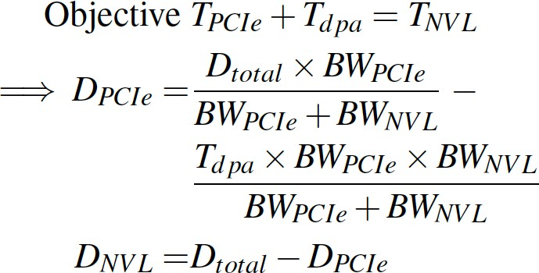
TreeGen
Handle hybrid communication (e.g. PCIe & NVLink)
Balance amount of data transfer over different link types based on link bandwidth.
Take link type switching (i.e. disable_peer_access) latency into account.

Slide 53
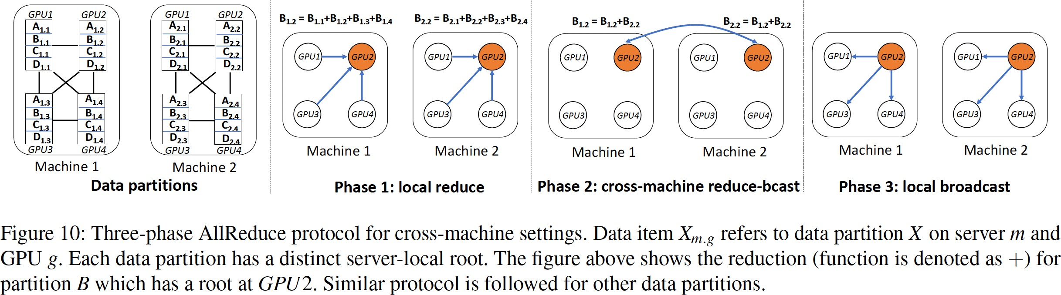
TreeGen
Multi-server transfers

Slide 54
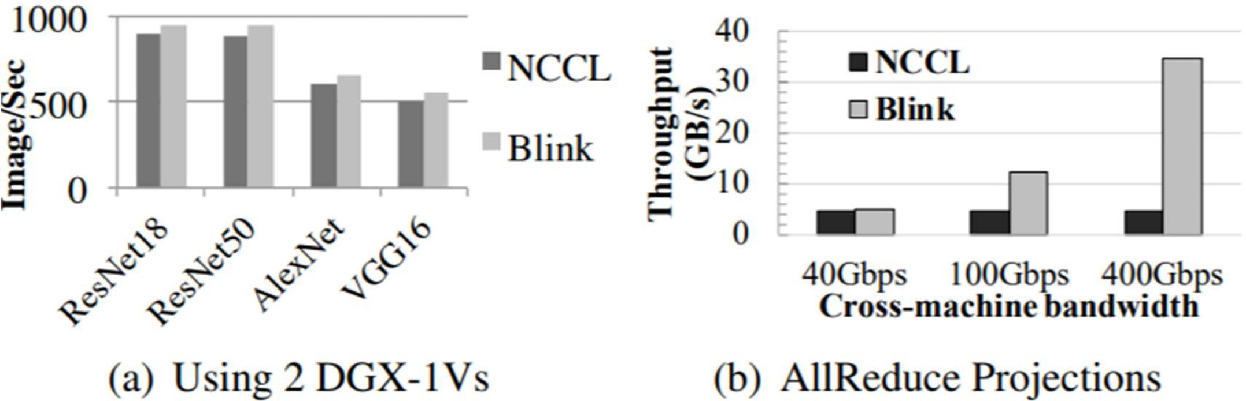
Multiple DGX-1s DNN Training
8-GPU job on 2 DGX-1V machines (5-3 GPU placement)
Inter-server tput (40Gb/s) < Intra-server tput (40GB/s)
Projection with 100/400 Gbps inter-server bandwidth, highlight Blink’s advantage.

