Slide 1
SmartDisplay_CANbus_Arduino_Examples
Arduino Demo Project

Slide 2
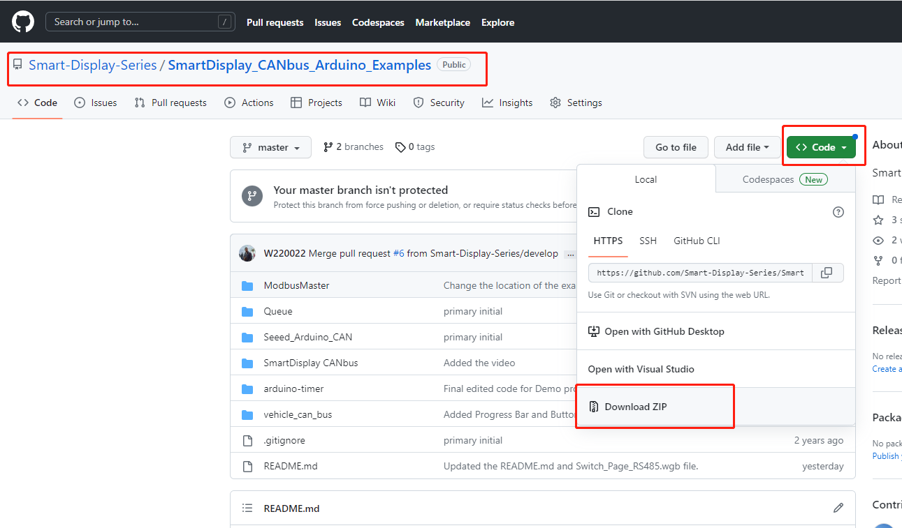
Procedure
Download the ZIP file from GitHub
This is the GitHub link for your reference.
https://github.com/Smart-Display-Series/SmartDisplay_CANbus_Arduino_Examples.git

Slide 3
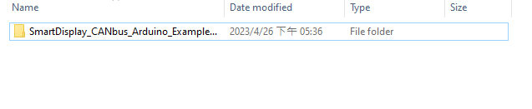
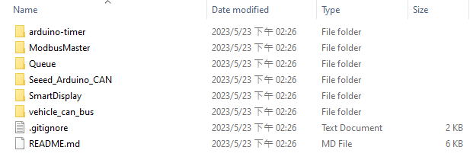
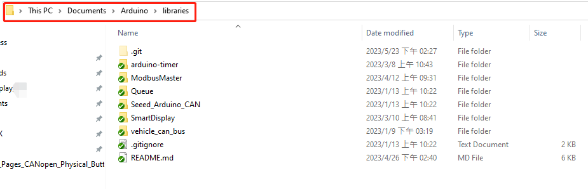
Unzip the file SmartDisplay_CANbus_Arduino_Examples-master and open this folder
Copy all file
Follow this path to paste these files into the Arduino libraries.

Slide 4
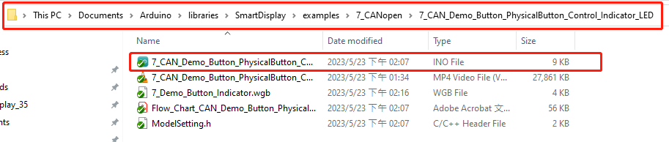
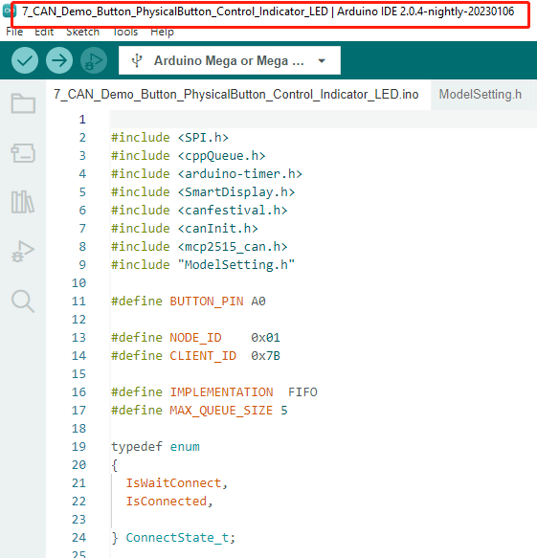
Open this .ino file with you Arduino IDE.
We used IDE Version2.0.4

Slide 5
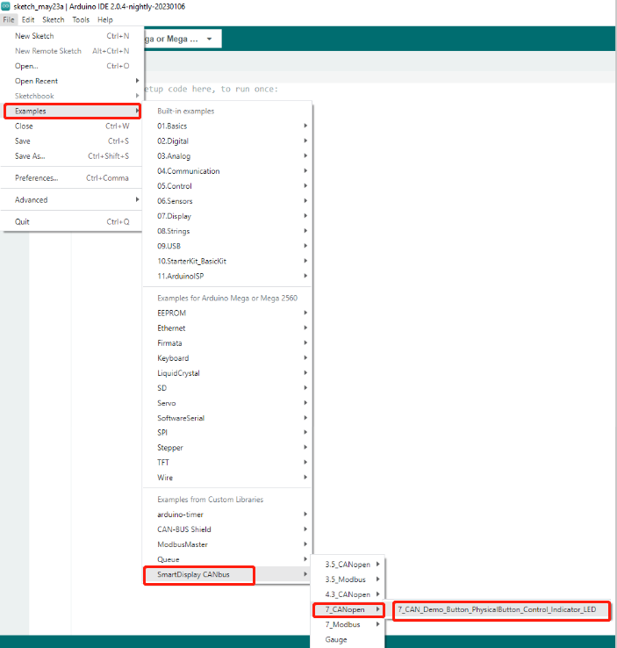
If you have already saved this program into your Documents>Arduino>libraries then open your Arduino IDE software and follow this to open the any Demo project in the new sketch.

Slide 6
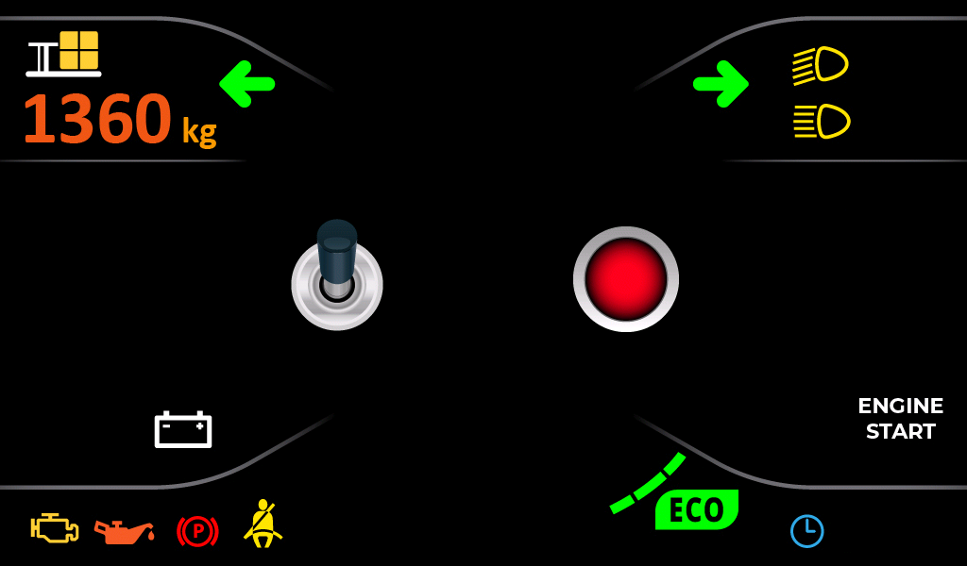
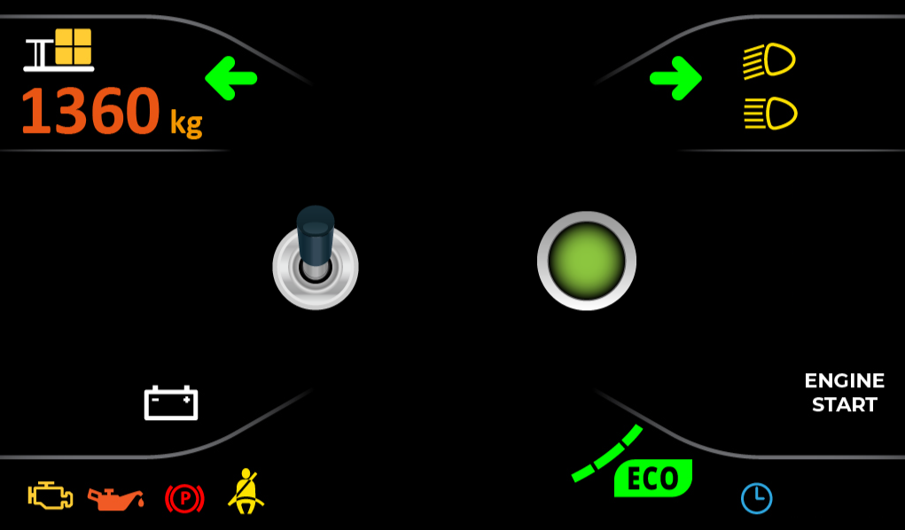
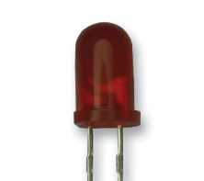
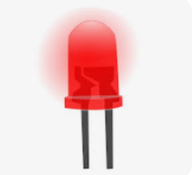
Demo Scenario
When the touch button or physical button sensor is pressed, the color of the indicator on the screen changes from red to green, and the connected LED turns ON. And when the touch button or physical button sensor is not pressed, the indicator on the screen turns red and the connected LED remains off.
Fig.1 (when the touch button or physical button sensor is not pressed) Fig.2 (when the touch button or physical button sensor is pressed)

