Slide 1

[ AI Study ] 2주차
Lec3 – Gradient descent
Lec4 – multi-variable linear regression
고명진

Slide 2
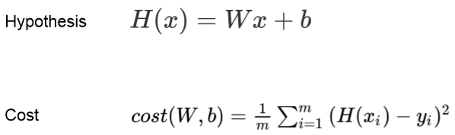
Lec3 – Gradient descent

Slide 3
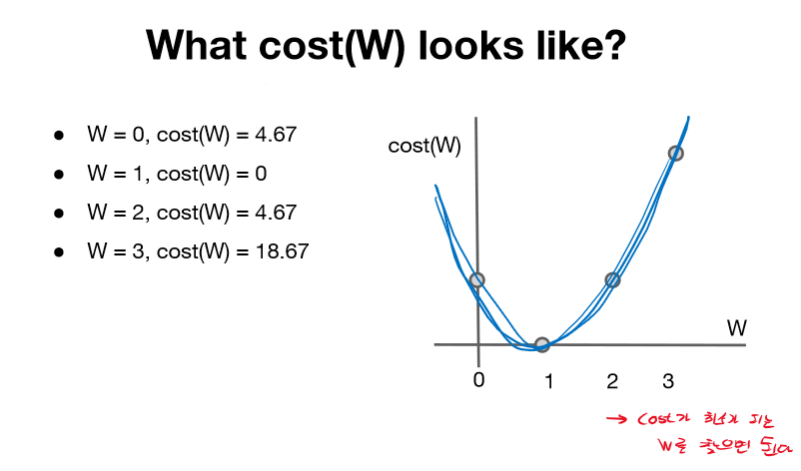
Lec3 – Gradient descent

Slide 4
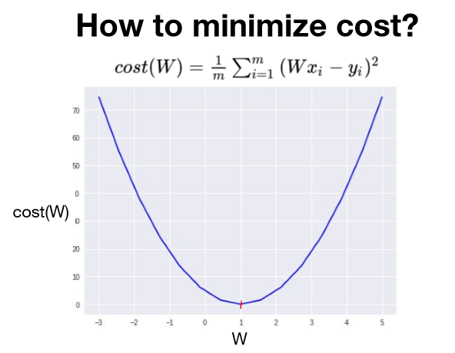
Lec3 – Gradient descent
Gradient descent algorithm

Slide 5
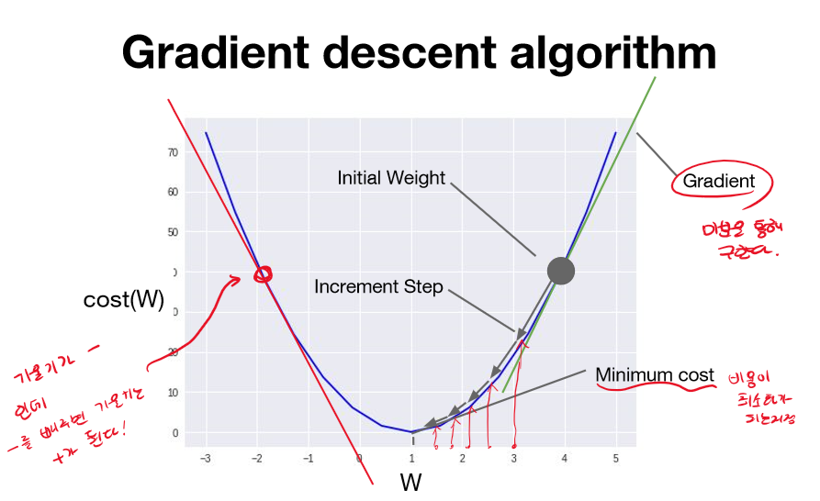

Slide 6
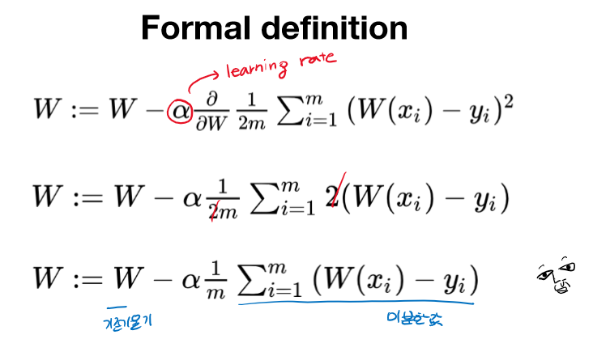

Slide 7
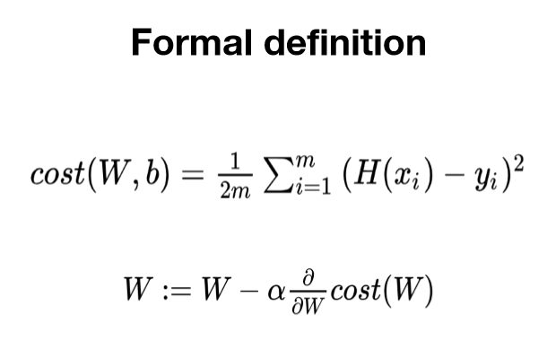

Slide 8
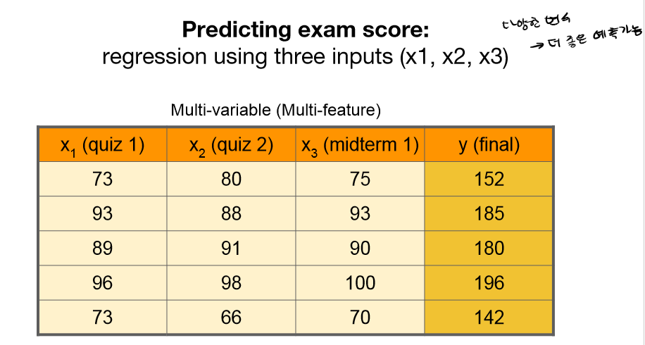
Lec4 – multi-variable linear regression

Slide 9
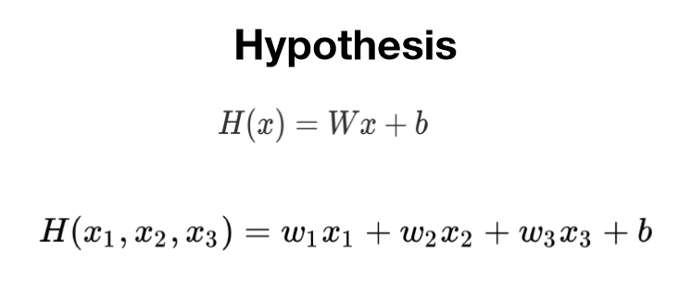
Lec4 – multi-variable linear regression

Slide 10
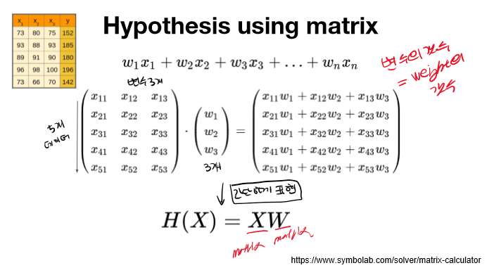
Lec4 – multi-variable linear regression

Slide 11
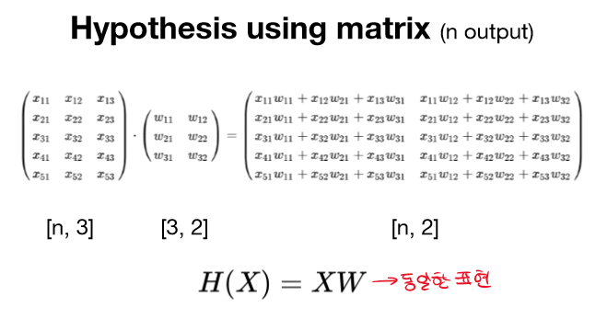
Lec4 – multi-variable linear regression

