Slide 1
Lec9. Neural Nets for XOR
2020.01.14
이미미

Slide 2
목차
Logistic regression
Neural nets
backpropagation

Slide 3
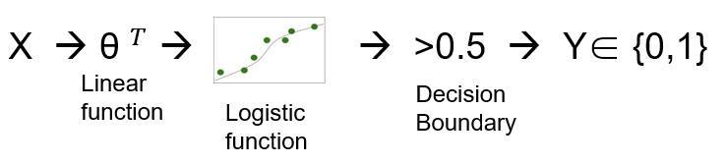
Logistic regression
x1
x2

Slide 4
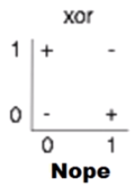
xor using NN(neural nets)
x1 | x2 | Y
0 | 0 | 0(-)
0 | 1 | 1(+)
1 | 0 | 1(+)
1 | 1 | 0(-)
MLP(multilayer neural nets)
xor문제를 하나의 layer로 풀 수 없음
여러 개의 layer는 w, b 학습 불가

Slide 5


Neural nets(2 layer)
$w_{1}$=$\left[\begin{aligned}5 \\ 5\end{aligned}\right]$, $b_{1}$=-8
$w_{2}$=$\left[\begin{aligned}−7 \\ −7\end{aligned}\right]$, $b_{2}$=3
$w_{3}$=$\left[\begin{aligned}−11 \\ −11\end{aligned}\right]$, $b_{3}$=6
x1
Wx+b
sigmoid
y1
x2
sigmoid
$$\overline{y}$$
x1
sigmoid
Wx+b
y2
x2
3개의 logistic regression으로 xor 풀 수 있음

Slide 6
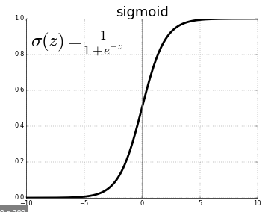
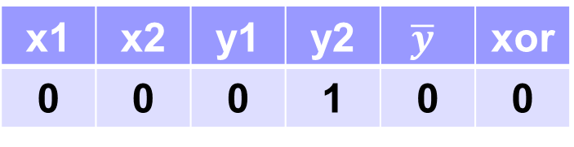

Neural nets(1)
$\left[0, 0\right]\left[\begin{aligned}5 \\ 5\end{aligned}\right]$ -8 = -8, ${ y}_{1}=s\left(−8\right)=0$
$\left[0, 0\right]\left[\begin{aligned}−7 \\ −7\end{aligned}\right]+3$ = 3, $y_{2}=s\left(3\right)=1$
$\left[0, 1\right]$ $\left[\begin{aligned}−11 \\ −11\end{aligned}\right]+6=−11+6=−5, \overline{y}=s\left(−5\right)=0$
x1 | x2 | y1 | y2 | $$\overline{y}$$ | xor
0 | 0 | 0 | 1 | 0 | 0

Slide 7
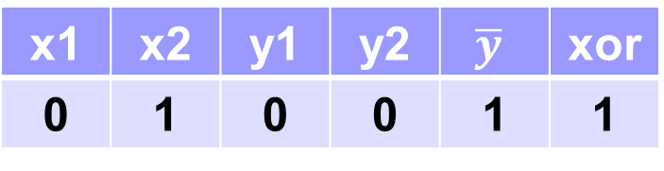

Neural nets(2)
$\left[0, 1\right]\left[\begin{aligned}5 \\ 5\end{aligned}\right]$ -8 = 5-8=-3, ${ y}_{1}=s\left(−3\right)=0$
$\left[0, 1\right]\left[\begin{aligned}−7 \\ −7\end{aligned}\right]+3$ = -7+3=-4, $y_{2}=s\left(−4\right)=0$
$\left[0, 0\right]$ $\left[\begin{aligned}−11 \\ −11\end{aligned}\right]+6=6, \overline{y}=s\left(6\right)=1$
x1 | x2 | y1 | y2 | $$\overline{y}$$ | xor
0 | 1 | 0 | 0 | 1 | 1

Slide 8
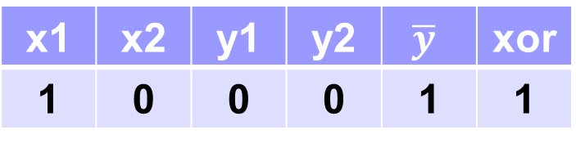

Neural nets(3)
$\left[1, 0\right]\left[\begin{aligned}5 \\ 5\end{aligned}\right]$ -8 = 5-8=-3, ${ y}_{1}=s\left(−3\right)=0$
$\left[1, 0\right]\left[\begin{aligned}−7 \\ −7\end{aligned}\right]+3$ = -7+3=-4, $y_{2}=s\left(−4\right)=0$
$\left[0, 0\right]$ $\left[\begin{aligned}−11 \\ −11\end{aligned}\right]+6=6, \overline{y}=s\left(6\right)=1$
x1 | x2 | y1 | y2 | $$\overline{y}$$ | xor
1 | 0 | 0 | 0 | 1 | 1

Slide 9
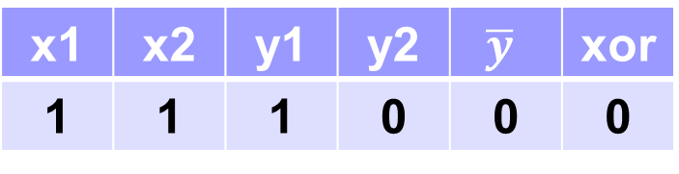

Neural nets(4)
$\left[1, 1\right]\left[\begin{aligned}5 \\ 5\end{aligned}\right]$ -8 = 5+5-8=2, ${ y}_{1}=s\left(2\right)=1$
$\left[1, 1\right]\left[\begin{aligned}−7 \\ −7\end{aligned}\right]+3$ = -7-7+3=-11, $y_{2}=s\left(−11\right)=0$
$\left[1, 0\right]$ $\left[\begin{aligned}−11 \\ −11\end{aligned}\right]+6=−11+6=−5, \overline{y}=s\left(−5\right)=0$
x1 | x2 | y1 | y2 | $$\overline{y}$$ | xor
1 | 1 | 1 | 0 | 0 | 0

Slide 10




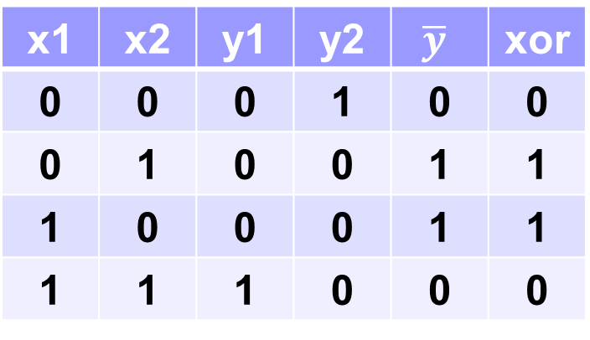
Neural nets(5)
x1 | x2 | y1 | y2 | $$\overline{y}$$ | xor
0 | 0 | 0 | 1 | 0 | 0
0 | 1 | 0 | 0 | 1 | 1
1 | 0 | 0 | 0 | 1 | 1
1 | 1 | 1 | 0 | 0 | 0
x1
Wx+b
sigmoid
y1
x2
sigmoid
$$\overline{y}$$
x1
sigmoid
Wx+b
y2
x2

Slide 11



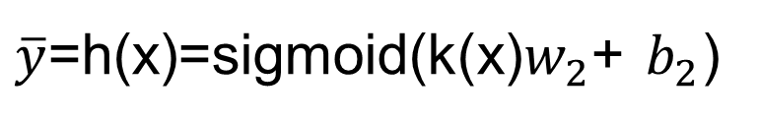
Neural nets
$w$=$\left[\begin{aligned}5 , −7 \\ 5,−7\end{aligned}\right]$, b=$\left[−8, 3\right]$
k
K(x)=sigmoid(xw+b)
x
sigmoid
sigmoid
$$\overline{y}$$
$\overline{y}$=h(x)=sigmoid(k(x)$w_{2}$+ $b_{2}$)
$$\left[0, 0\right]$$
$$\left[0, 1\right]$$
$$\left[1, 0\right]$$
$$\left[1, 1\right]$$

Slide 12
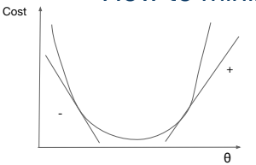
어떻게 w, b를 학습시키는가
기울기( =미분값) 필요
Global minimun

Slide 13
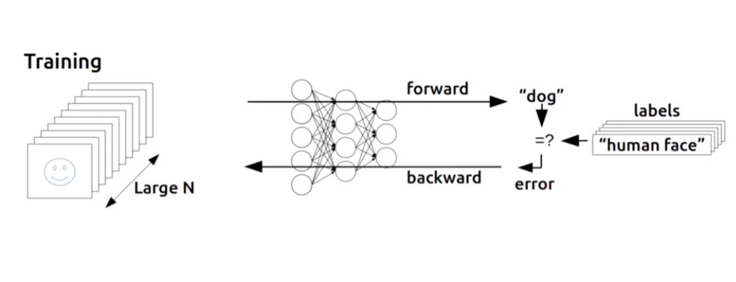
backpropagation
➔ Paul, Hinton에 의해 해결

Slide 14
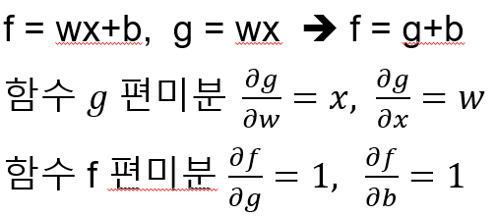
Back propagation(chain rule)
1. forward(w=-2, x=5, b=3) →실제 값을 그래프에 입력
2. backward
Notes:
B의 미분값이 1 비유링 1로 비례
W로 미분한 값이 5이므로 w가 1만큼바뀌면 f값이 5배 바뀜

Slide 15




Back propagation(chain rule)
W=-2
$\frac{∂f}{∂w}$= $\frac{∂f}{∂g}$* $\frac{∂g}{∂w}=1∗5=5$
g=-10
*
$$\frac{∂f}{∂g}=1$$
X=5
f=-7
$\frac{∂f}{∂x}$= $\frac{∂f}{∂g}$* $\frac{∂g}{∂x}=1∗−2=−2$
+
b
$$\frac{∂f}{∂b}=1$$
Notes:
B의 미분값이 1 비유링 1로 비례
W로 미분한 값이 5이므로 w가 1만큼바뀌면 f값이 5배 바뀜

Slide 16






Back propagation(chain rule)
G=xy,
x
$$\frac{∂f}{∂a}$$
$\frac{∂f}{∂x}$= $\frac{∂f}{∂g}$* $\frac{∂g}{∂x}$
*
f=a+b
$$\frac{∂g}{∂x}$$
g
a
…
+
f
$$\frac{∂f}{∂g}$$
b
y
$$\frac{∂f}{∂b}$$
$$\frac{∂f}{∂y}$$
Notes:
F가 최종적결과, x가 입력
A가 f에 미치는 영향
곱하기인지 아니까 x가 g에 미치는 영향을 앎

Slide 17
Lab9. Neural Nets XOR
2020.01.14
이미미

Slide 18

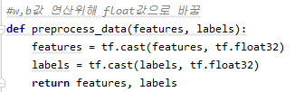

Slide 19
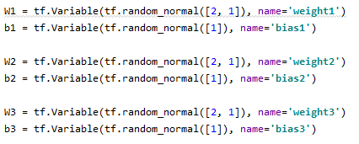
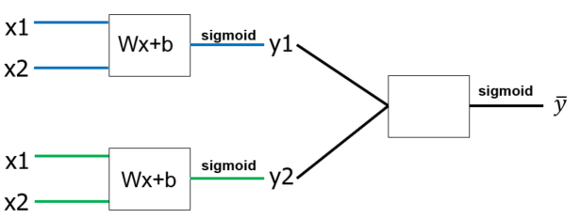
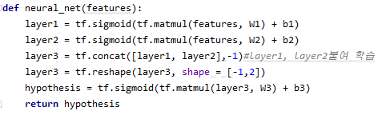

Slide 20
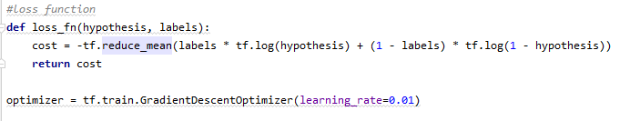
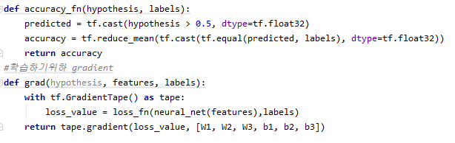

Slide 21
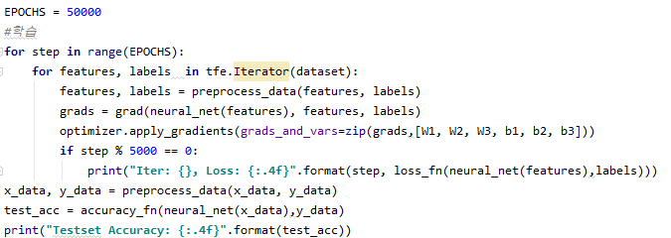
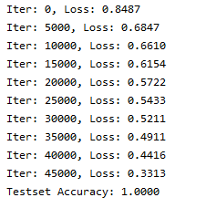

Slide 22
