Slide 1
Lec06 Softmax Classification
박지우

Slide 2
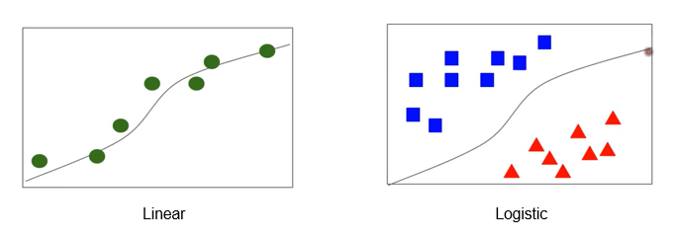

지난 시간에 다뤘던 것
Binary Classification ( Pass or Fail, Real or Fail )
“분류”
[0,1] encoding

Slide 3
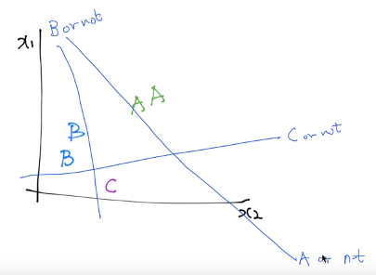
Multinomial classification

Slide 4


Multinomial classification
Binary classification 에서 연산

Slide 5
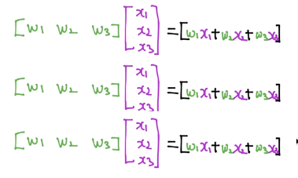
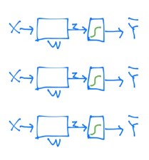
Multinomial classification

Slide 6
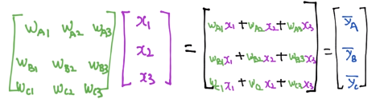
Multinomial classification

Slide 7
Softmax
2.0
1.0
0.1
0.7
0.2
0.1

Slide 8
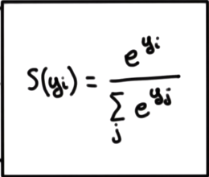
Softmax
2.0
1.0
0.1
0.7
0.2
0.1

Slide 9
Softmax
One hot encoding
2.0
1.0
0.1
0.7
0.2
0.1
1.0
0.0
0.0

Slide 10
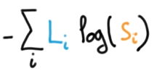

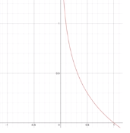
Cost function
예측값
실제값
0.7
0.2
0.1
1.0
0.0
0.0

Slide 11
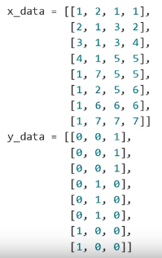


코드

Slide 13
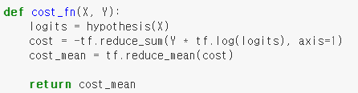

Slide 14
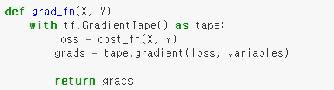

Slide 15
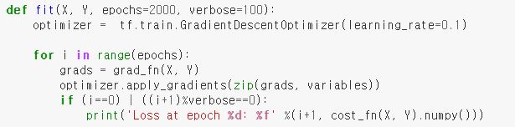

Slide 16
