Slide 1
mouse_monitor_beagle
mouse_monitor_pc
Beagle Bone Black
WLAN (ROS)
PC
SPI
pln_minotaur
PLN2033

Slide 2
Services:
- Get Data
- Get Settings
- Set Resolution
mouse_monitor_beagle
mouse_monitor_pc
Call Service
(with 15Hz)
Beagle Bone Black
PC
WLAN (ROS)
SPI
Read with 1kHz
PLN2033

Slide 3
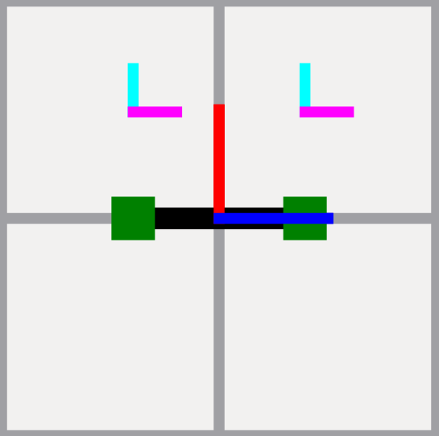
Y-Axis
X-Axis
Sensor
sensorAngle
distanceToSensor_radius
Robot axis

Slide 4
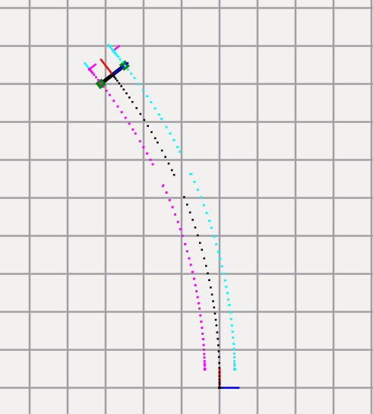
Real driven
distance:
Y = 93cm
X = 0cm
Drift results from
angular sensor

Slide 5
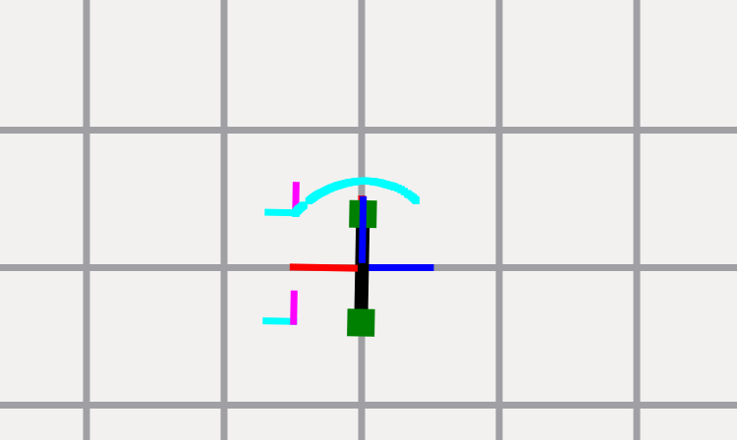
90° left rotation
Get rotation angle from driven distance
Not processed data:
A straight line in -Y and +X (with a known grade)

Slide 6
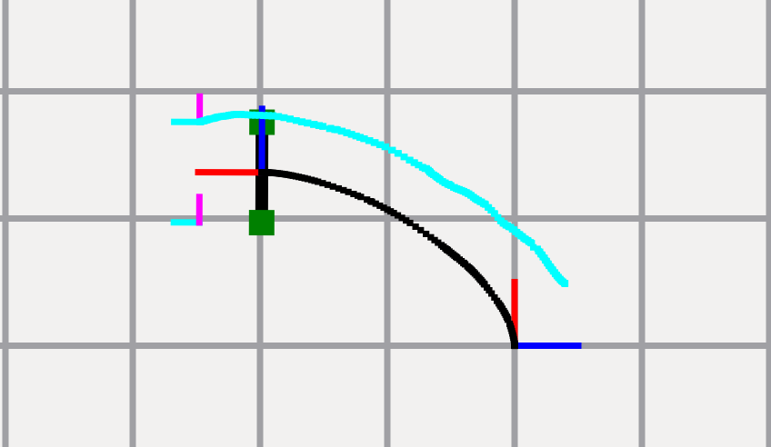
90° left rotation + forward
Get rotation angle AND forward distance
Separate rotation and forward movement

