Slide 1
Hackathon, 2017
Team No. 9
School/ College: Manav Rachna International University, Faridabad
Team Members: Rohan Khurana, Dhanajay Gambhir, Gaurav Saini, Yash Singhal
Topic: Smart-Traffic

Slide 2
Problem Statement
Smarter traffic management using Artificial Intelligence, to relieve traffic from congestion in a traffic-dynamic scenarios.

Slide 3
Solution Proposed
In urban cities, traffic is a huge concern, we want to solve problems caused by poorly managed traffic congestions and related issues using Artificial Intelligence. Here’s how :-
1. We capture frames from a live stream of a camera installed on a traffic light and run it through our AI system.
2. AI processes the image and looks for “traffic-density” and dynamically adjusts the traffic light system for better traffic management.
3. The AI also does side jobs cause it can, like it can detect a berzerked Police/Ambulance vehicle and dynamically manipulate lights to clear them out faster.

Slide 4
Here’s a video to define a very common problem on a road and how our AI solves it -

Slide 5
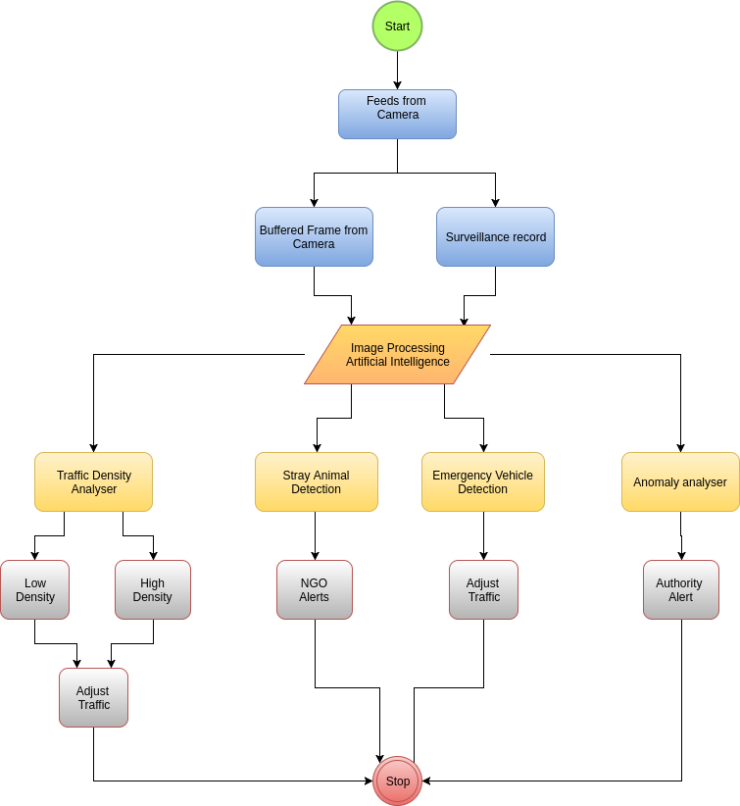
Technical Design -

Slide 6
Technology used
Artificial Intelligence based on a combination of BASH and Python.
Fast Internet, of course.

Slide 7
Hardware Requirements
Pre-existing systems like Cameras and Traffic lights.
Supposedly we can deploy a raspi to run AI and to keep them all connected together

Slide 8
Assumptions
In our case, We are assuming that we are getting data in form of buffers as in frames from a live stream on a traffic light system. Since we have a trained model of our AI based on 100’s of images on web to understand the concept of traffic density. We can make it give outputs based on dataset we provide it in form of images.
We are assuming that the Internet connection

Slide 9
Thank You

