Slide 1
Providing bus signal priority without damaging car discharge capacities
Weihua Gu (Hong Kong Polytechnic University)
Haoyu Chen (UC Berkeley)
Yiguang Xuan (UC Berkeley)
Yu Mei (Hong Kong Polytechnic University)

Slide 2
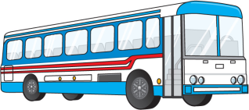

Why prioritize ?
(i.e., de-prioritize )

Slide 3
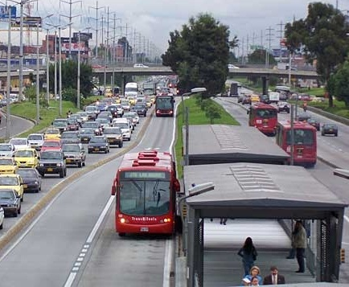
Because we want buses to beat cars.

Slide 4
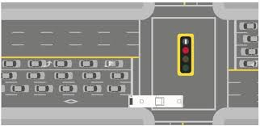
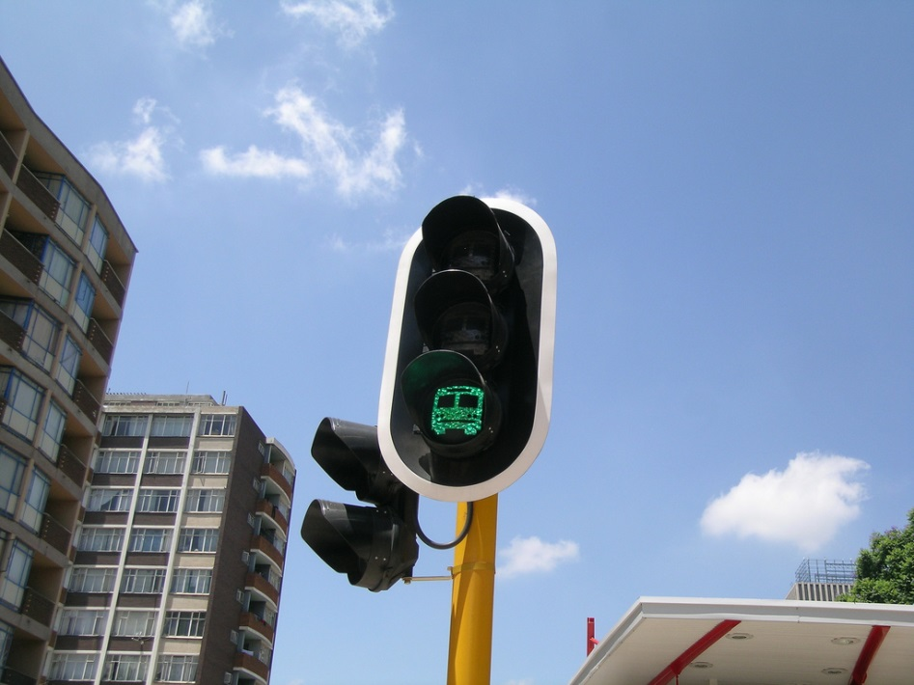
Bus lane + transit signal priority (TSP)

Slide 5
Downside of bus priority strategies - Damage to cars
Cars lose a travel lane
Cars lose green times (oftentimes in the cross-street directions)

Slide 6


Prioritize
De-prioritize

Slide 7
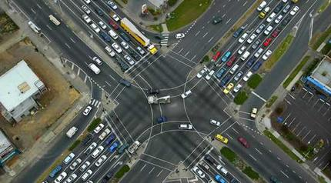
Car drivers complain about:
Empty bus lanes
Long cross-street queues

Slide 8
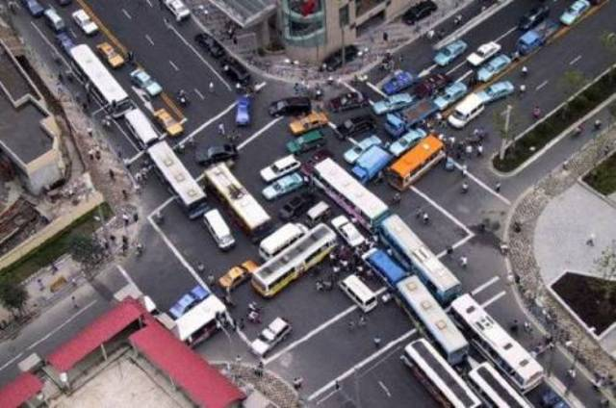
For congested intersections with high flows of both cars and buses,
No solution!

Slide 9
Propose a strategy that:
Prioritize
Without deprioritizing

Slide 10


Based upon a mid-block pre-signal to sort left-turning and through-moving traffic (Xuan et al., 2011)
Conventional intersection approach
With pre-signal

Slide 11
The proposed strategy
main signal with TSP
pre-signal
sorting area
left-turning lane
through-moving lane
bus lane

Slide 12




The proposed strategy
Main signal
$$R_{L}$$
$$G_{L}$$
$$R_{T}$$
$$G_{T}$$

Slide 13

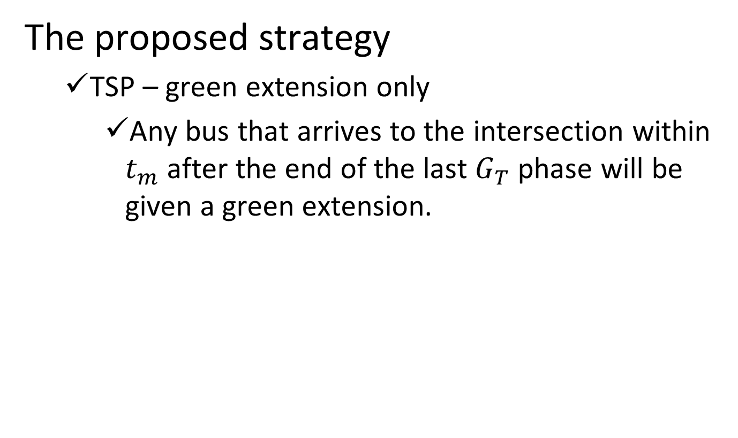





The proposed strategy
TSP – green extension only
Any bus that arrives to the intersection within $t_{m}$ after the end of the last $G_{T}$ phase will be given a green extension.
Before the change
$$G_{T}$$
$$R_{L}$$
$$G_{L}$$
$$R_{T}$$
$$G_{T}$$
time
$$t_{m}$$
Bus arrival time

Slide 14


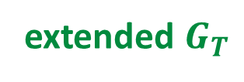


The proposed strategy
TSP – green extension only
Any bus that arrives to the intersection within $t_{m}$ after the end of the last $G_{T}$ phase will be given a green extension.
After the change
extended $G_{T}$
$$R_{L}$$
$$G_{L}$$
$$R_{T}$$
time
$$t_{m}$$
truncated $G_{T}$
The cycle length remains unchanged.
The capacity for cross-street traffic
Is not compromised.
Bus arrival time

Slide 15







The proposed strategy
Pre-signal plan
Based upon kinematic wave theory of traffic flows
space (direction of flow)
$$R_{L}$$
$$G_{L}$$
$$R_{T}$$
$$G_{T}$$
$$t$$
intersection
No
flow
Jam
Satura-tion
flow
No flow
Discharge flow
from pre-signal
pre-signal
$$g_{L}$$
$$g_{T}$$

Slide 16



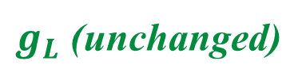
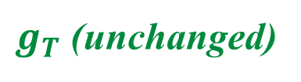




The proposed strategy
Coordinating pre-signal with bus priority at main signal
space (direction of flow)
bus trajectory
extended $G_{T}$
truncated $G_{T}$
$R_{L}$ (shifted)
$$G_{L}$$
$$R_{T}$$
inter-section
$$t$$
pre-signal
$g_{T}$ (unchanged)
$g_{L}$ (unchanged)
truncated $g_{T}$

Slide 17
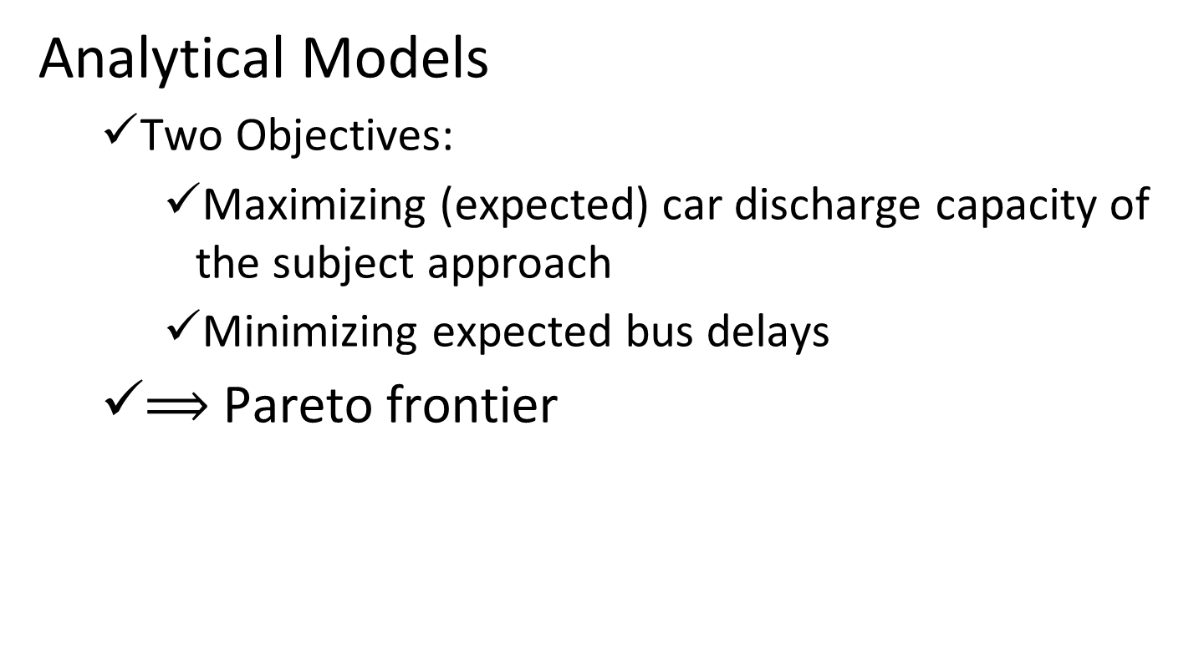
Analytical Models
Two Objectives:
Maximizing (expected) car discharge capacity of the subject approach
Minimizing expected bus delays
$⟹$ Pareto frontier

Slide 18
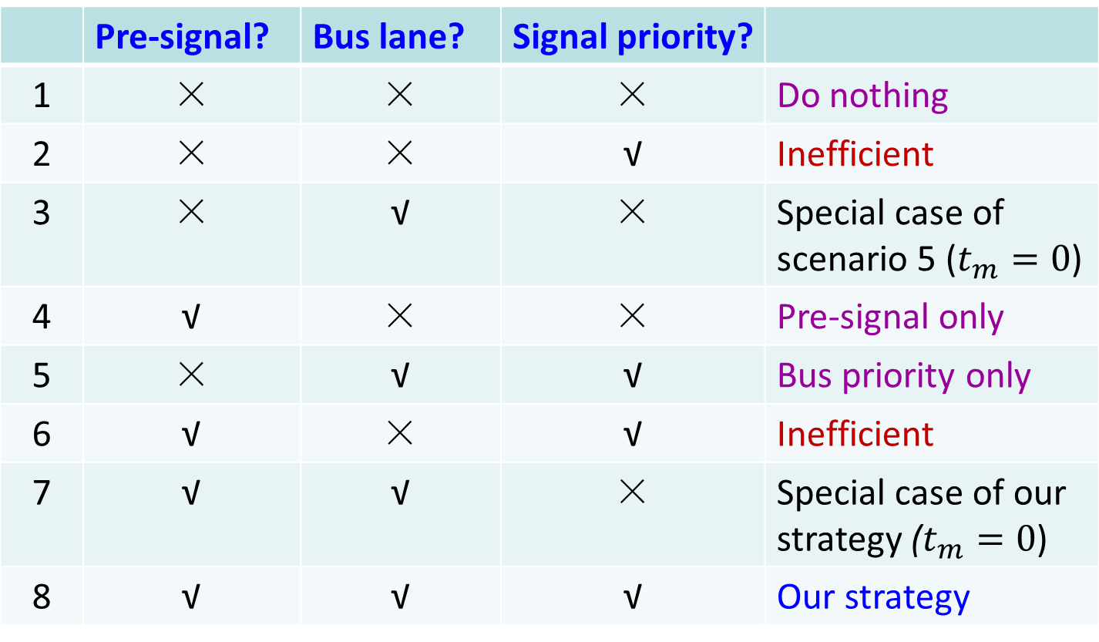
Scenarios for comparison
 | Pre-signal? | Bus lane? | Signal priority?
1 | × | × | × | Do nothing
2 | × | × | √ | Inefficient
3 | × | √ | × | Special case of scenario 5 ($t_{m}=0$)
4 | √ | × | × | Pre-signal only
5 | × | √ | √ | Bus priority only
6 | √ | × | √ | Inefficient
7 | √ | √ | × | Special case of our strategy ($t_{m}=0$)
8 | √ | √ | √ | Our strategy

Slide 19
Numerical case studies
Parameters:
Three lanes
Left-turning ratio: 0.2
Signal cycle length: 120 sec
Green time for the subject approach: 60 sec
Saturation flow per lane: 0.5 veh/sec
Bus flow: 30 bus/hr (low-bus-flow case)

Slide 20
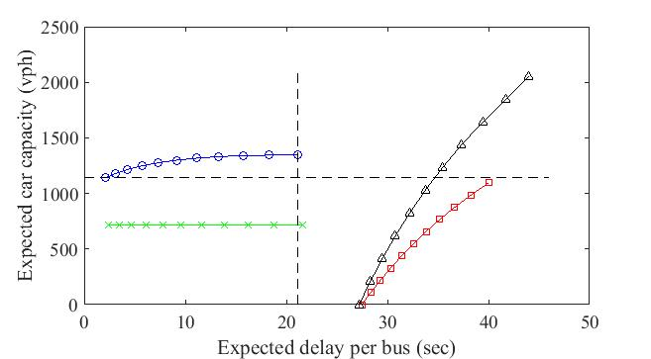
Results
 Do nothing
Δ Pre-signal but no bus priority
 Bus priority but no pre-signal
 Our strategy

Slide 21
Numerical case studies
Parameters:
Three or four lanes
Left-turning ratio: 0.2, 0.3, 0.4
Signal cycle length: 120 sec
Green time for the subject approach: 60 sec
Saturation flow per lane: 0.5 veh/sec
Bus flow: 30 bus/hr (low-bus-flow case)

Slide 22
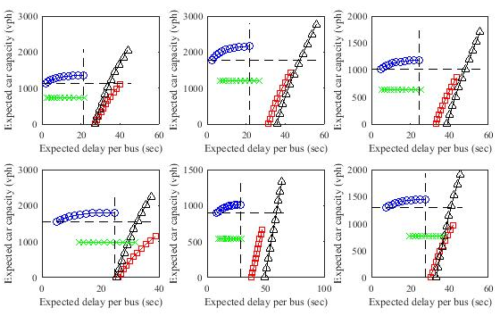
Left-turning ratio: 0.2 0.3 0.4
3 lanes
4 lanes

Slide 23
Numerical case studies
Parameters:
Three or four lanes
Left-turning ratio: 0.2, 0.3, 0.4
Signal cycle length: 120 sec
Green time for the subject approach: 60 sec
Saturation flow per lane: 0.5 veh/sec
Bus flow: 90 bus/hr (high-bus-flow case)

Slide 24
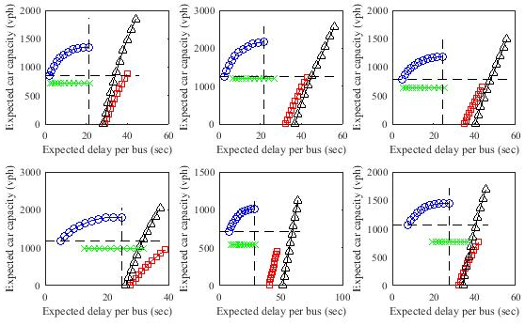
Left-turning ratio: 0.2 0.3 0.4
3 lanes
4 lanes

Slide 25
Concluding remarks
We show by a simple (and conservative) strategy that bus and car operations at a busy intersection can be both improved by large margins.
The proposed strategy can be applied to busy intersections where car and bus flows are both high.
The strategy can be extended to incorporate more efficient signal priority schemes, intermittent use of the bus lane, and left-turning buses.

Slide 26
Limitations
Kinematic wave theory – cannot account for bounded acceleration, lane changes, heterogeneous vehicles and drivers, and random car arrivals
Accuracy of bus arrival time prediction using GPS technology
Impacts of neighboring bus stops

Slide 27
Questions?
Weihua Gu
weihua.gu@polyu.edu.hk

