Slide 1



RDF Editing on the Web with REX
Claus Stadler, Natanael Arndt, Michael Martin, Jens Lehmann
presented by
Claus Stadler
27. October 2016

Slide 2
REX: RDF Edit Extensions (for HTML)
Problem Statement
Use case: Portal for rare disease

Slide 3

The Problem

Slide 4


Slide 7



Slide 8

https://angularjs.org/

Slide 9
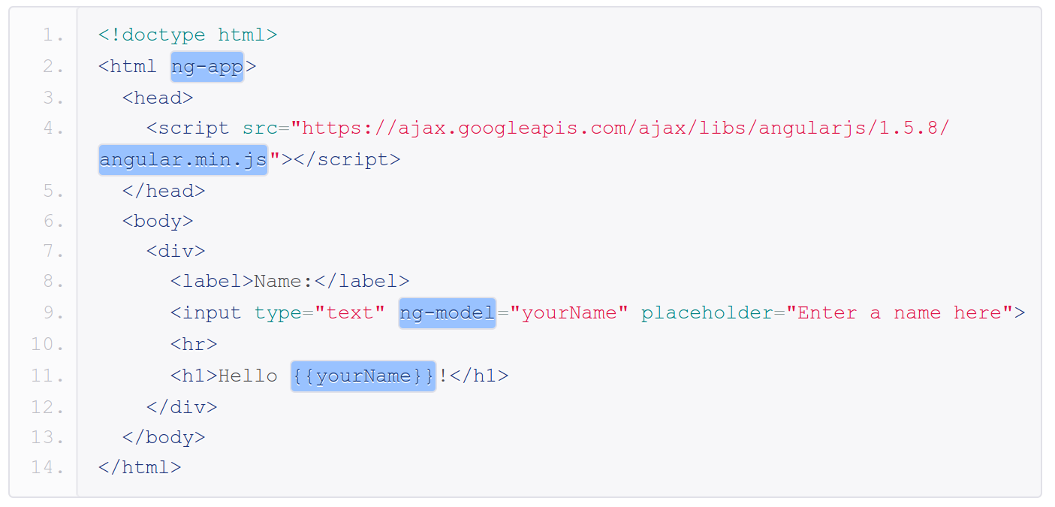
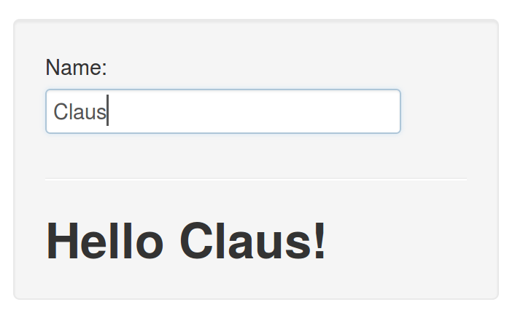
Getting started with AngularJS

Slide 10
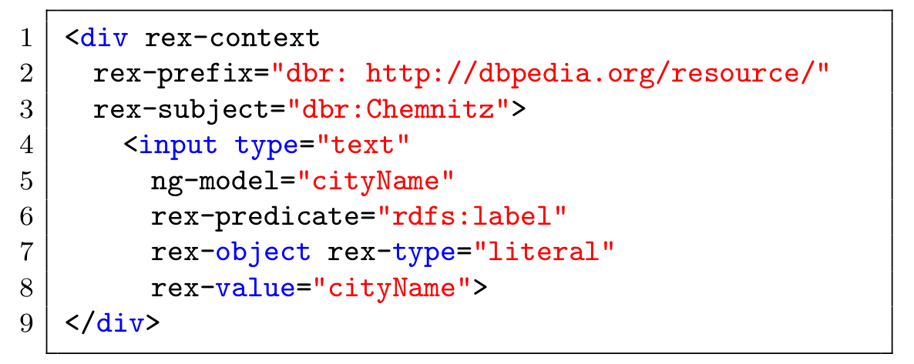
Getting started with REX

Slide 11
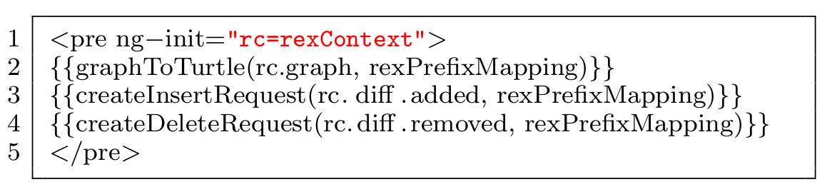

Slide 12
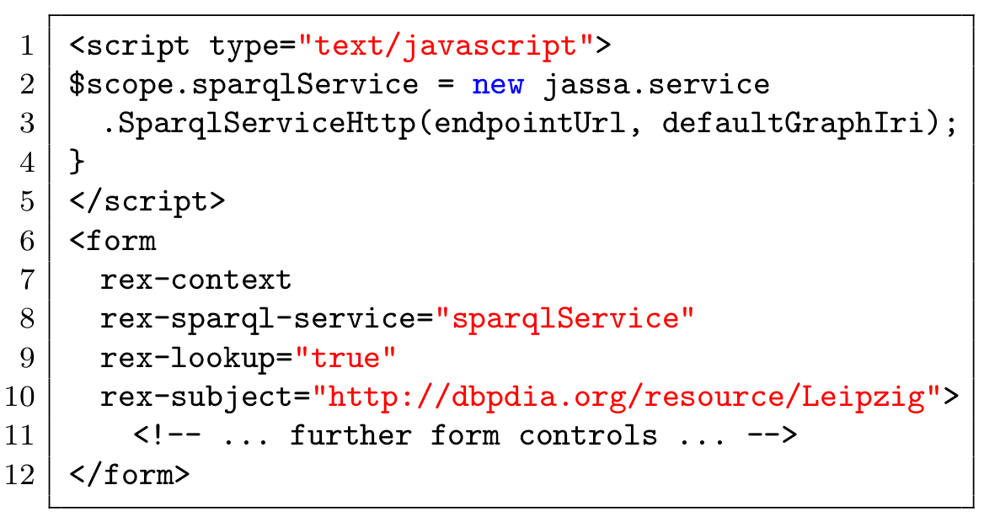

Slide 13
Live Demo

Slide 14


Resources
https://github.com/GeoKnow/Jassa-UI-Angular
bower install jassa-ui-angular-edit:0.9.0-SNAPSHOT
      Claus Stadler
      University of Leipzig
      cstadler@informatik.uni-leipzig.de

