Slide 1
Question Answering
Relation Identification and Linking
Saptarshi Bhattacharya

Slide 2
Objective
Identify relations between entities
Find corresponding information from a database
For example:
Who are the family members of Peter Griffin?
Who are the family members of Peter Griffin?
family members ⟵ Peter Griffin
Look up for family members of Peter Griffin in DBpedia

Slide 3
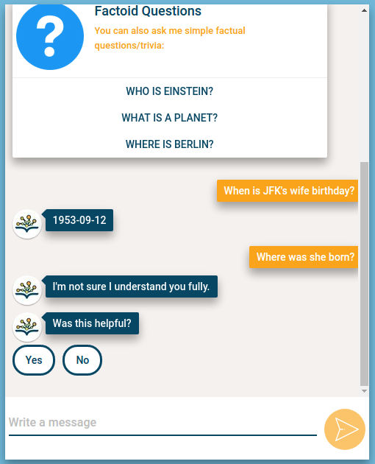
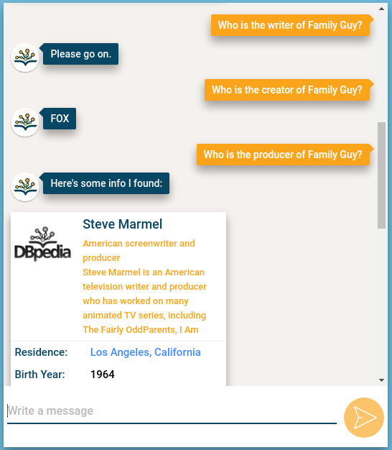
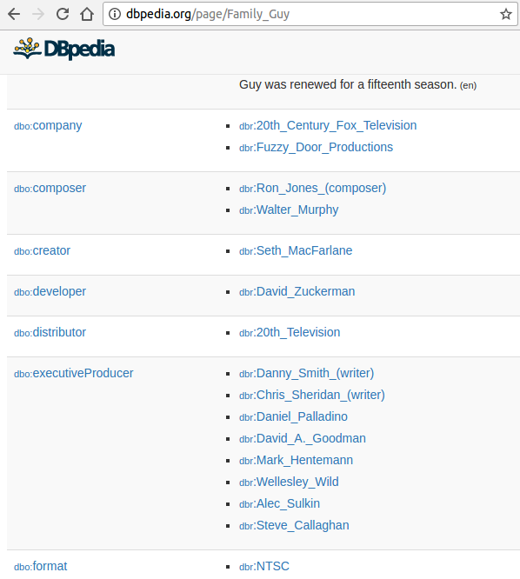
Inspiration
http://chat.dbpedia.org/

Slide 4
Basic Flow
Question: (...) X of Y of Z (currently)
Identify Z
Find out relationship Y
Find out relationship X
Provide an answer

Slide 5
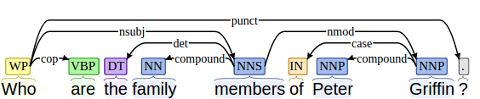
Dependency Parsing
Who are the family members of Peter Griffin?
((u'What', u'WP'), u'cop', (u'is', u'VBZ')) ((u'What', u'WP'), u'nsubj', (u'nationality', u'NN')) ((u'nationality', u'NN'), u'det', (u'the', u'DT')) ((u'nationality', u'NN'), u'nmod', (u'Griffin', u'NNP')) ((u'Griffin', u'NNP'), u'case', (u'of', u'IN')) ((u'Griffin', u'NNP'), u'compound', (u'Peter', u'NNP'))
members
Griffin

Slide 6
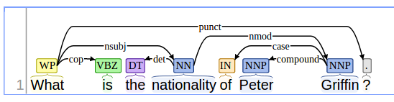
Entity Recognition
What are the family members of Peter Griffin?
Griffin
What are the family members of [Peter Griffin]?

Slide 7
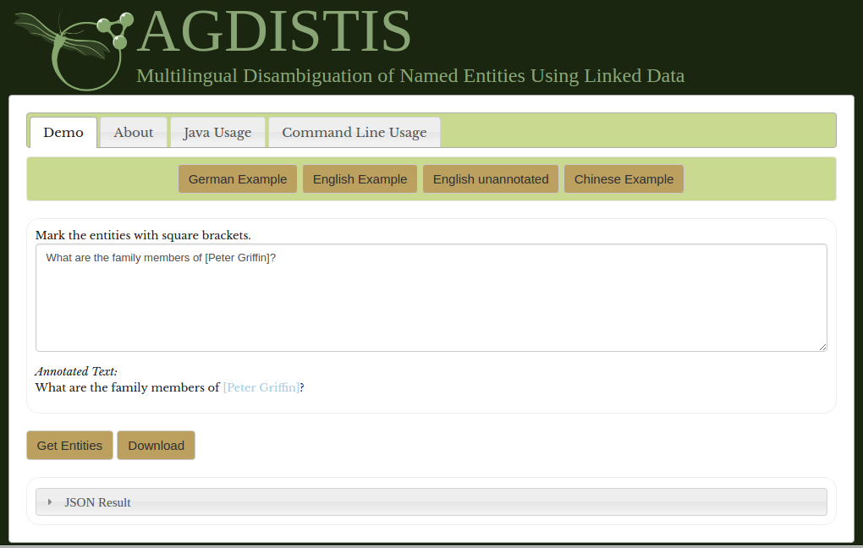
Entity Recognition
What are the family members of [Peter Griffin]?
http://dbpedia.org/resource/Peter_Griffin

Slide 8
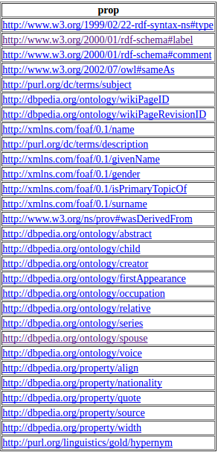
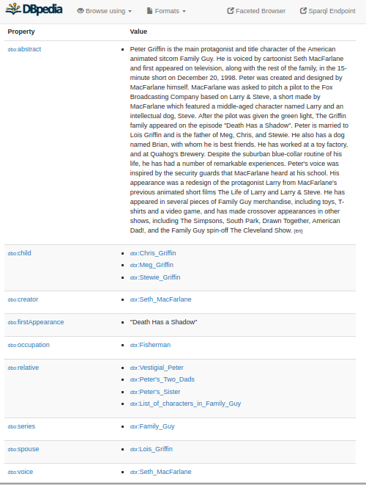
Relationship linking
http://dbpedia.org/resources/Family_Guy
select distinct ?prop
where {<http://dbpedia.org/resource/Peter_Griffin>
?prop ?ent }

Slide 9
Relationship linking
members
family members

Slide 10
Relationship linking
Phrase Matching: Using word2vec and cosine similarity
child
0.27
creator
0.06
first appearance
0.07
occupation
0.07
relative
0.22
family members
series
0.03
spouse
0.35
voice
0.12
align
0.05
nationality
0.18
quote
-0.02
source
0.13
width
0.03

Slide 11

Relationship linking
spouse ➔ property
http://dbpedia.org/resources/Lois_Griffin
Answer!!

Slide 12
Achievement
Simply structured questions of the given format yields correct result if
DBpedia has an answer for it
If the phrase matching yields a reliable result

Slide 13
Setback
Agisdistis does not always returns a correct entity URLs
What is [Family Guy]? (
Fails
correct: http://dbpedia.org/resources/Family_Guy
What are the satellites of [Earth]?
returns http://dbpedia.org/resource/Earth_2
correct: http://dbpedia.org/resource/Earth
Phrase matching fails sometimes
Who is the owner of Facebook?
Owner ➞ Subsidiary instead of Owner ➞ Founder

Slide 14
Setback
Entity Extraction and relationship extraction is crude.
All complicated questions fail.
“Who is the creator of Batman?” or “Who is Batman’s creator?” http://dbpedia.org/resource/Bob_Kane, http://dbpedia.org/resource/Bill_Finger
"Who is the artist who created Batman?"
“Failed to fetch answer”.

Slide 15
Things to do now...
Supervised Relation Extraction
Choose a set of relations to be extracted, a set of relevant entities and find and label data.
Find all pairs of named Entities, decide if 2 entities are related, classify the relation.
Using words or Bigrams and parse features to identify relations.
Using classifiers extract the features.

Slide 16
Thank you
Questions?

