Slide 1
Deep Learning with Python Bianca Furtuna @Fur_Bi

Slide 2
Workshop Content
Introduction to Deep Learning
Fully connected Neural Networks
Convolutional Neural Networks

Slide 3

What is Deep Learning?
Area of Machine Learning
Deep Neural Networks (DNNs)
Numbers of layers
Complexity of the architecture

Slide 4
What is a Neural Network?
Output Layer
Hidden Layers
Input Layer

Slide 5
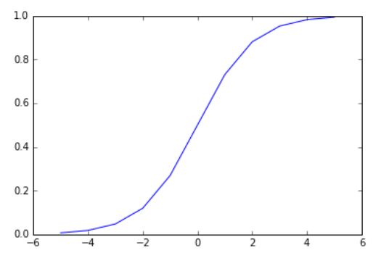















Single Neuron Model
Bias unit
$$x_{0}$$
$$z= \sum_{i=0}^{n}{w_{i}x_{i}}$$
$${ x}_{1}$$
$$w_{1}$$
$$w_{0}$$
$$x_{2}$$
$$w_{2}$$
$$Σ$$
$$z$$
$$σ$$
$$output= σ\left(z\right)= \frac{1}{1+e^{−z}}$$
Output
$$w_{3}$$
$$ε [0,1]$$
$$x_{3}$$
$$output=P\left(1\right|parameters)$$
Input features x

Slide 6

Single Neuron Model
$$Σ σ$$
Output Layer
Hidden Layers
Input Layer

Slide 7
How do Neural Networks learn?
Propagation
Error
Weight Update
= Backpropagation algorithm

Slide 8
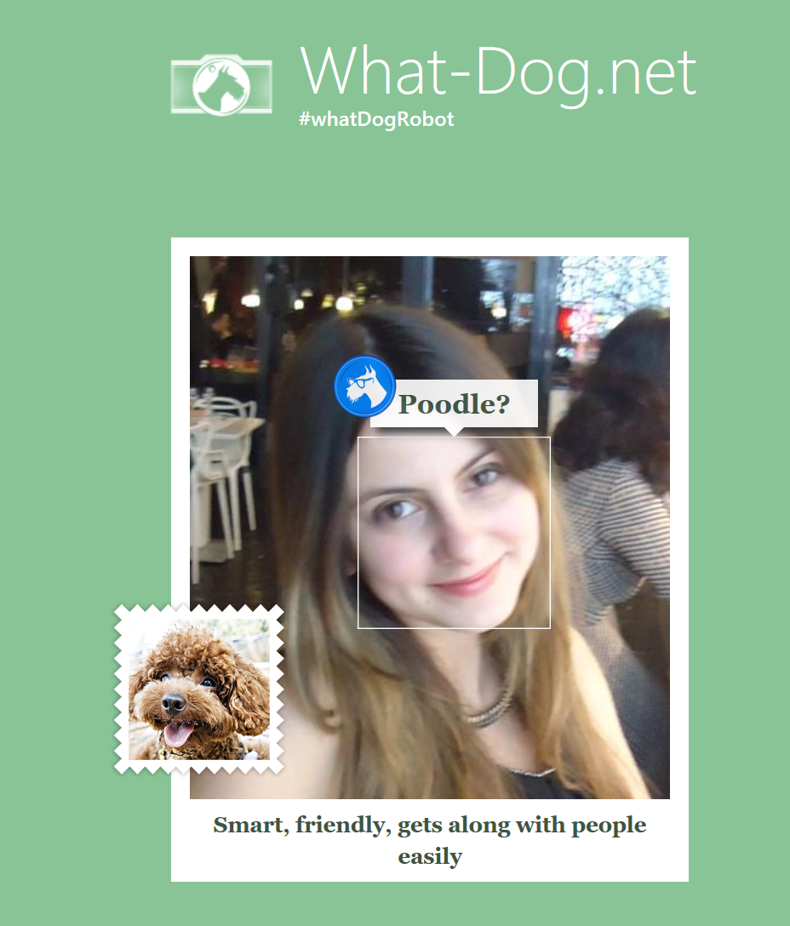
Application of DNNs
Image Processing
Speech Recognition
Machine Translation

Slide 9
Deep Learning Frameworks
Theano
Caffe
CNTK
Tensorflow
Chainer
Torch
Lasagne
Keras

Slide 10
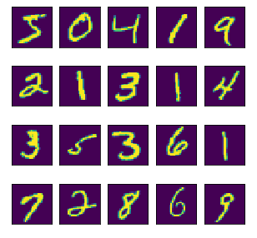
Deep Learning Scenario
MNIST dataset which consists of 70,000 grayscale images of hand-written digits
28x28 pixels

Slide 11
Let’s give it a go in Keras!

Slide 12
Convolutional Neural Networks (CNN)
Output Layer
Hidden Layers
Input Layer

Slide 13
Convolutional Neural Networks (CNN)
Softmax
Input image
Fully connected layer
Convolution
MaxPooling
Convolution
MaxPooling

Slide 14
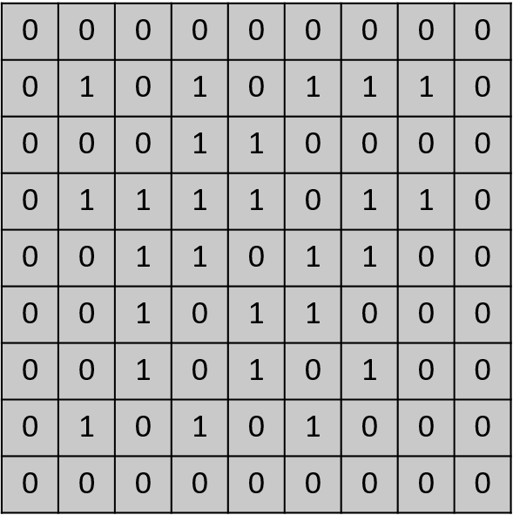
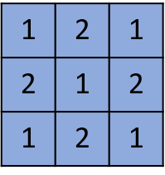
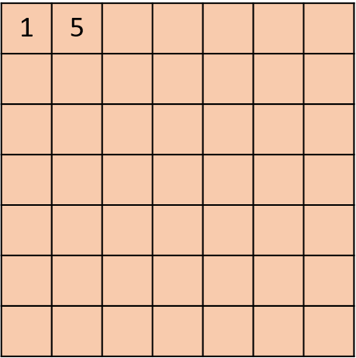
Convolutional Layer
Input Image
Kernel
Applying Kernel
Feature Map

Slide 15
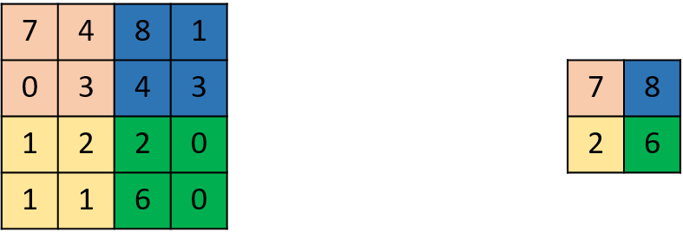
MaxPooling Layer

Slide 16
Let’s try Convolutional Neural Networks!

Slide 17

Thank you!
@Fur_Bi

