Slide 1
Smart Finux Labs
Verity
Supplier
Creates structured invoice and requests factoring
On-chain supply chain finance for Capital Due Value
Buyer
Validates evidence and confirms Due Value
Verity turns invoice claims into accounting-valid obligations, then coordinates factoring, USDC escrow, settlement, and payment profile evidence across suppliers, buyers, and investors.
Investor
Funds accepted receivable for yield
Escrow
Distributes advance, repayment, yield, and residual
PRODUCT PRINCIPLE
Make Capital Due Value is financeable.
Smart Finux Labs - Verity SCF
01
Notes:
Verity overview cover. Claim: Make Capital Due Value financeable across suppliers, buyers, investors, and escrow.

Slide 2
VALUE RESOLUTION LAYER
The platform resolves commercial value before it releases finance.
REQUEST
DELIVER
INVOICE
MATCH
DUE
SETTLE
PO intent
performance
Ask Value
evidence test
accepted payable
received value
Accounting truth
Risk control
Programmable settlement
PO, delivery, invoice, acceptance, and payment are distinct states.
Duplicate prevention and buyer acceptance block financing of weak claims.
USDC escrow distributes principal, yield, fees, and residual balances.
Smart Finux Labs - Verity SCF
02
Notes:
Claim: value states remain separate until commercial value is accepted. Proof: accounting truth, risk controls, programmable USDC settlement.

Slide 3
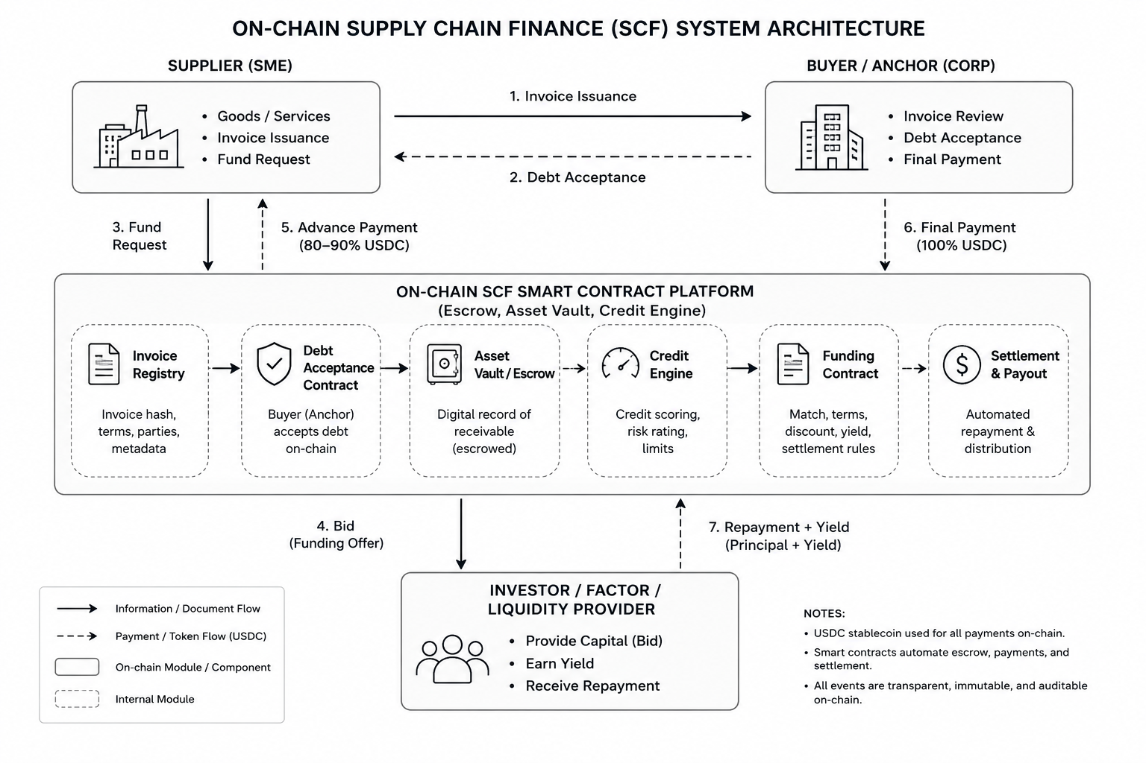
SYSTEM VISUALIZATION
Architecture connects invoice truth, wallet funding, and settlement execution.
What the architecture must prove
Invoice claims are not financeable until buyer validation creates Due Value.
Circle wallets and USDC settlement make the cash movement programmable.
Escrow state creates an auditable path from advance to maturity repayment.
Payment history becomes a reusable verifiable profile signal.
Required visual asset embedded
Smart Finux Labs - Verity SCF
03
Notes:
Claim: Verity architecture connects invoice truth, wallet funding, and settlement execution. Embedded architecture asset from docs/verity/assets.

Slide 4
OPERATING WORKFLOW
Three user surfaces converge on one accepted receivable marketplace.
Supplier / SME
Buyer / Enterprise
Investor / Factor
1
Create invoice
1
Review evidence
1
Discover receivable
2
Request factoring
2
Accept Due Value
2
Fund escrow
3
Receive USDC advance
3
Repay at maturity
3
Earn principal + yield
Control point
Accepted value is separated from face value, making the financed asset auditable.
Smart Finux Labs - Verity SCF
04
Notes:
Claim: supplier, buyer, and investor surfaces converge on a single accepted receivable marketplace. Control point: accepted value is separated from face value.

Slide 5
ROADMAP
MVP delivery proves the full Due Value-to-settlement loop.
0
1
2
3
4
5
Align
Invoice truth
Marketplace
Escrow
Risk
Demo
schemas, roles, state machine
supplier issue + buyer acceptance
factoring request + investor funding
advance, retention, maturity settlement
delinquency + payment profile evidence
end-to-end validation and polish
MVP acceptance rule
End-to-end demo must show accepted Due Value financed, advanced, repaid, and reconciled.
Traceability
Ideation -> Use Cases -> MVP Roadmap, with UC-001 through UC-014 validating the product thesis.
Smart Finux Labs - Verity SCF
05
Notes:
Claim: MVP proves the full Due Value-to-settlement loop. Roadmap phases: align, invoice truth, marketplace, escrow, risk, demo.

Slide 6
AI RISK ANALYSIS / WHY NOW
AI should accelerate risk judgment, not replace Verity's acceptance and policy controls.
Executive stance
Fraud risk
Credit risk
Use AI as a decision-support layer across invoice submission, buyer validation, funding eligibility, allocation, and settlement monitoring.
Detect near-duplicate invoices, semantic document mismatches, abnormal tenor shifts, and suspicious submission cadence earlier.
Score probability of delay or default using repayment timing, dispute history, and concentration across buyer obligations.
What rules miss
Static checks struggle with emerging buyer stress, low-grade dispute patterns, invoice manipulation signals, and portfolio drift that only becomes visible over time.
Operational risk
Portfolio risk
Surface supplier reliability issues from correction frequency, completeness gaps, and recurring workflow exceptions.
Track exposure drift across buyers, sectors, geographies, and funded assets before deterioration shows up in realized losses.
Business outcome
Faster credit decisions, earlier loss prevention, stronger investor confidence, and a smaller manual-review burden for risk operations.
Smart Finux Labs - Verity SCF + AI
06
Notes:
Claim: AI accelerates risk judgment while deterministic acceptance and policy controls remain primary. Signals: fraud, credit, operational, and portfolio risk.

Slide 7
AI RISK ANALYSIS / WORKFLOW FIT
Each workflow state gets an explainable AI output that improves prioritization, pricing, and monitoring.
1. Submission
2. Buyer review
3. Funding eligibility
Score document completeness, invoice-to-PO semantic fit, abnormal value or tenor, and suspicious supplier behavior.
Prioritize high-risk invoices, suggest hold reasons, and estimate dispute likelihood before acceptance becomes financeable.
Generate composite credit score, delay probability, expected loss, and pricing or advance-rate guidance.
Translate model outputs into investor-safe narratives like low-risk anchor receivable, operationally volatile, or high-yield high-dispute exposure.
Investor allocation
Continuously assign watchlists, trigger early warning alerts, and queue collections or operations attention before maturity is missed.
Settlement monitoring
Smart Finux Labs - Verity SCF + AI
07
Notes:
Claim: each workflow state gets an explainable AI output. Workflow: submission, buyer review, funding eligibility, investor allocation, settlement monitoring.

Slide 8
AI RISK ANALYSIS / OPERATING MODEL
The rollout should stay hybrid: deterministic controls first, explainable models second, human approval for material decisions.
Hard controls
Model layer
Explainability
Rollout path
Policy gates, eligibility rules, duplicate prevention, and acceptance states remain deterministic and auditable.
Prediction and anomaly models enrich buyer risk, supplier reliability, invoice fraud, and portfolio deterioration signals.
Every score should return reason codes, risk banding, and supporting factors that investors and operators can review.
Start with advisory scoring, then controlled underwriting assistance, then portfolio-level early warning as data quality matures.
Operating rule:
AI enriches Verity's credit and fraud analysis, but funding decisions must remain explainable, reviewable, and overrideable by policy owners.
Smart Finux Labs - Verity SCF + AI
08
Notes:
Claim: rollout should stay hybrid. Policy gates remain deterministic; models are explainable and human-reviewable.

