Slide 1
Smart Finux Labs
Verity
Supplier
Creates structured invoice and requests factoring
On-chain supply chain finance for Capital Due Value
Buyer
Validates evidence and confirms Due Value
Verity turns invoice claims into accounting-valid obligations, then coordinates factoring, USDC escrow, settlement, and payment profile evidence across suppliers, buyers, and investors.
Investor
Funds accepted receivable for yield
Escrow
Distributes advance, repayment, yield, and residual
Product principle
Make Capital Due Value is financeable.
Smart Finux Labs · Verity SCF
01

Slide 2
VALUE RESOLUTION LAYER
The platform resolves commercial value before it releases finance.
REQUEST
DELIVER
INVOICE
MATCH
DUE
SETTLE
PO intent
performance
Ask Value
evidence test
accepted payable
received value
Accounting truth
Risk control
Programmable settlement
PO, delivery, invoice, acceptance, and payment are distinct states.
Duplicate prevention and buyer acceptance block financing of weak claims.
USDC escrow distributes principal, yield, fees, and residual balances.
Smart Finux Labs · Verity SCF
02

Slide 3
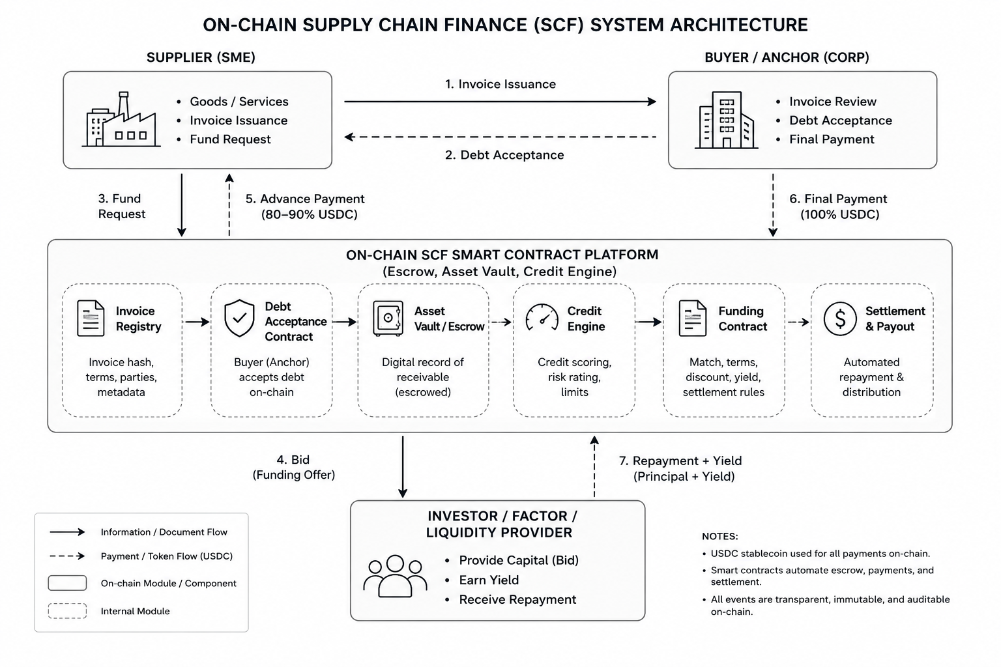
SYSTEM VISUALIZATION
Architecture connects invoice truth, wallet funding, and settlement execution.
What the architecture must prove
Invoice claims are not financeable until buyer validation creates Due Value.
Circle wallets and USDC settlement make the cash movement programmable.
Escrow state creates an auditable path from advance to maturity repayment.
Payment history becomes a reusable verifiable profile signal.
Required visual asset embedded
Smart Finux Labs · Verity SCF
03

Slide 4
OPERATING WORKFLOW
Three user surfaces converge on one accepted receivable marketplace.
Supplier / SME
Buyer / Enterprise
Investor / Factor
1
Create invoice
1
Review evidence
1
Discover receivable
2
Request factoring
2
Accept Due Value
2
Fund escrow
3
Receive USDC advance
3
Repay at maturity
3
Earn principal + yield
Control point
Accepted value is separated from face value, making the financed asset auditable.
Smart Finux Labs · Verity SCF
04

Slide 5
ROADMAP
MVP delivery proves the full Due Value-to-settlement loop.
0
1
2
3
4
5
Align
Invoice truth
Marketplace
Escrow
Risk
Demo
schemas, roles, state machine
supplier issue + buyer acceptance
factoring request + investor funding
advance, retention, maturity settlement
delinquency + payment profile evidence
end-to-end validation and polish
MVP acceptance rule
End-to-end demo must show accepted Due Value financed, advanced, repaid, and reconciled.
Traceability
Ideation -> Use Cases -> MVP Roadmap, with UC-001 through UC-014 validating the product thesis.
Smart Finux Labs · Verity SCF
05

