Slide 1

CONNEXTIUM.XYZ / FINUX LABS
D-SHARE
Concept
Global equity.
Stablecoin access.
Tokenized depository receipts.
For USDC and HSBC RedCoin holders.
Depository Securities Homing Access
to Receipted Equity
Raising US$3 million
Prime edition
USDC / USD HSBC RedCoin / HKD
Notes:
D-SHARE Concept. Depository Securities Homing Access to Receipted Equity is the founder-selected brand spelling. Connextium.xyz / Finux Labs seeks US$3m to build the first production receipt programme over a proposed 24-month horizon. The concept seeks global equity access through accountable institutions and approved stablecoin funding. The programme is pre-launch. USDC/USD is the first proposed route and HSBC RedCoin/HKD access is separately gated. No issuance, partnership, authorization or live integration is claimed.

Slide 2
High share prices and uneven global access
Six US-listed examples above US$1,000. Indicative quote snapshot, 30 October 2026.
Company | Ticker | US$ / share
NVR | NVR | 5,958.56
AutoZone | AZO | 3,169.82
Eli Lilly | LLY | 1,417.54
W.W. Grainger | GWW | 1,359.17
BlackRock | BLK | 1,147.54
Costco | COST | 1,012.28
A US$300 budget cannot buy
one whole share in these examples
Local access varies
Eligible accounts, overseas funding rules and local product coverage can limit global investing access.
Fractional brokerage already helps some investors. Broker, customer and product eligibility still vary.
D-SHARE / PRIME
02
Notes:
Price examples illustrate whole-share purchase costs, not company valuation, expected growth or investment recommendations. A hypothetical US$300 budget cannot purchase one whole share at any of the six displayed prices. Indicative USD quote feed, 30 October 2026: NVR 5,958.56, AZO 3,169.82, LLY 1,417.54, GWW 1,359.17, BLK 1,147.54, COST 1,012.28. Quote timestamps are from 30 October 2026 UTC and were checked again on 31 October 2026. Prices can change and should be refreshed before external use. Sources: ticker-specific finance market-data feed. Supporting quote/history pages: https://nvri.gcs-web.com/stock-information/stock-quote ; https://investors.autozone.com/investor-relations/stock-information ; https://stockanalysis.com/stocks/lly/history/ ; https://www.investing.com/equities/w-w-grainger-inc-historical-data ; https://stockanalysis.com/stocks/blk/history/ ; https://stockanalysis.com/stocks/cost/history/ . Existing fractional services address affordability for many investors, with availability varying by broker, client and security: https://www.investor.gov/introduction-investing/general-resources/news-alerts/alerts-bulletins/investor-bulletins/fractional-share-investing-buying-slice-instead-whole-share. Some international brokers accept residents from many countries, subject to eligibility and verification: https://www.interactivebrokers.com/en/accounts/individual.php. Overseas investing and funding rules differ by jurisdiction. India LRS permits overseas portfolio investment within applicable rules and is one example rather than a blanket emerging-market prohibition: https://www.rbi.org.in/Scripts/BS_ViewMasDirections.aspx?id=10192. D-SHARE must establish a permitted offering and local distribution route. The examples do not imply any company affiliation with D-SHARE.

Slide 3
Global equity access for stablecoin adoption
Leading payments engineering to capital markets
35% to 42%
+9.8%
Digital merchant payments among adults
in low- and middle-income countries,
2021 to 2024
Latin America crypto economic activity,
12 months to June 2026 versus the
previous 12 months
World Bank Global Findex 2025
Chainalysis 2026 adoption report
Market adoption of stablecoin to invest in global equity
through accountable financial structure.
Payments and crypto indicators support the thesis. Local DeFi use and D-SHARE demand need direct validation.
D-SHARE / PRIME
03
Notes:
Founder-provided mission and vision. Leading Payments Engineering to Capital Markets describes Connextium.xyz / Finux Labs expanding relevant payment integration, cash/FX orchestration, accounting and reconciliation capabilities into receipt programmes. It does not claim a licensed venue or live securities operation. World Bank Global Findex 2025 reports that digital merchant payment use among adults in low- and middle-income economies rose from 35% in 2021 to 42% in 2024: https://www.worldbank.org/en/news/press-release/2025/07/16/mobile-phone-technology-powers-saving-surge-in-developing-economies. This measures payments use, not brokerage access or investable wealth. Chainalysis reports 9.8% growth in Latin America crypto economic activity in the 12 months to June 2026 against the preceding 12 months: https://www.chainalysis.com/blog/2026-global-crypto-adoption-index/. That measure extends beyond DeFi. Global on-chain activity fell 1.6% in the same report, so the regional figure cannot establish universal growth. The inference is that familiarity with wallets and stablecoins may support eligible receipt distribution. Local product permission, customer demand and economics require direct validation.

Slide 4
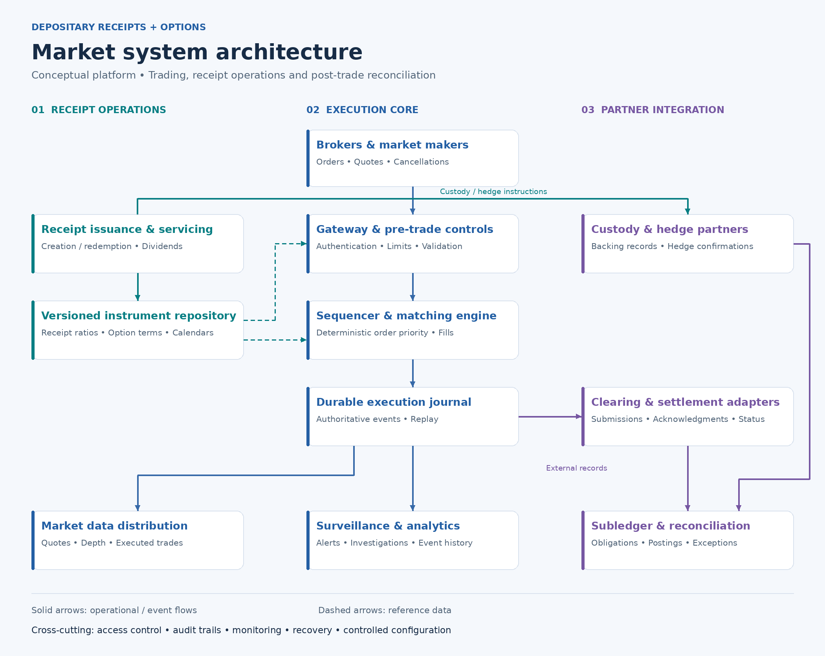
D-SHARE
One token records one receipt unit. Custody and programme documents establish backing and holder rights.
D-SHARE / PRIME
04
Notes:
D-SHARE expands to Depository Securities Homing Access to Receipted Equity, the founder-selected brand spelling. Concept remains highlighted because this is a proposed product. The connecting word to is outside the acronym. A receipt carries programme-defined rights linked to deposited underlying shares. An approved ratio allows a smaller unit than one underlying share. One token records one receipt unit and does not create another equity claim. A custodian holds settled backing. The issuer and registrar govern issuance, rights, transfers, distributions and cancellation. Binding documents determine dividend, voting, redemption and insolvency rights. USDC and RedCoin are proposed cash funding assets, distinct from the receipt security. Category context: https://www.bny.com/corporate/global/en/solutions/platforms/global-depositary-receipts.html. Tokenized-securities regulatory context, without choosing or authorizing a jurisdiction: https://apps.sfc.hk/edistributionWeb/api/circular/list-content?lang=EN&refNo=23EC52.

Slide 5
1. Create the product
Fictional GlobalTech series GT-01. One token records one programme receipt unit.
US$1,200
0.01
US$12
Underlying share price
Share per receipt
Indicative receipt value
100 receipts represent one underlying share
Programme design
The sponsor sets the ratio and holder rights. Custody evidence supports issuance. Brokers distribute to eligible investors.
Illustrative value = share price × receipt ratio. Market quotes, fees, taxes and FX can change the actual price.
D-SHARE / PRIME
05
Notes:
Step 1, fictional GlobalTech GT-01 illustration. Underlying share price US$1,200 and receipt ratio 0.01 share per unit give an indicative receipt value of US$12. One underlying share supports 100 receipt units. The sponsor sets programme terms and rights, the custodian supplies evidence and approved intermediaries distribute to eligible investors. This does not represent an issued or authorized GlobalTech programme. Market quotes, spreads, fees, taxes and FX can change actual execution value.

Slide 6
2. Issue receipts backed by shares
Illustrative: 1,000 shares / 0.01 share per receipt = 100,000 receipt tokens.
Blue = securities
Purple = instructions and confirmations
Green = stablecoin cash
Authorized
participant
Underlying
custodian
Issuer /
registrar
Permissioned
DLT register
1. 1,000 foreign shares
2. Settled backing proof
3. Signed mint approval
4. 100,000 receipt tokens to the AP’s eligible account
Redemption: lock and cancel receipt units, burn tokens, then release the backing.
D-SHARE / PRIME
06
Notes:
Step 2, fictional GlobalTech issuance. The authorized participant delivers 1,000 settled underlying shares to the custodian. At US$1,200 per share the backing has an indicative market value of US$1.2m. This creation inventory is separate from the startup US$3m operating raise. Custody evidence precedes issuer/registrar approval. At ratio 0.01, 1,000 shares support 100,000 receipt tokens. Dual authorization governs the mint instruction and the eligible AP account receives the units. Person icons identify institutional actors, linked blocks identify the DLT system and folded documents identify transferred securities or instructions/confirmations. Each actor stays in its column. The approved holder register must prevent double issuance. Redemption cancels and burns units before releasing backing.

Slide 7
3. An investor buys D-SHARE receipts
25 receipt units at US$12 = US$300, with a 0.25-share economic interest.
Blue = securities
Purple = instructions and confirmations
Green = cash or stablecoins
Eligible
investor
Broker /
liquidity partner
Cash / FX
operator
Receipt
register
1. Buy 25 units at US$12
2. 300 USDC or 2,340 RedCoin
3. Final cash + FX evidence
4. Transfer 25 receipt units
5. Confirm holding: 25 units = 0.25 share interest
US$300 before fees. Assumes USDC/USD 1, RedCoin/HKD 1 and 7.80 HKD/USD. Rail access remains proposed.
D-SHARE / PRIME
07
Notes:
Step 3, fictional investor purchase. HSDR was an earlier working name for the same D-SHARE receipt unit. An eligible investor buys 25 units at US$12 each, US$300 before fees. At ratio 0.01 the programme-defined economic exposure corresponds to 0.25 underlying share. A broker/liquidity partner supplies the receipt units. At assumed USDC/USD 1.00, funding is 300 USDC. An alternative approved RedCoin route would need 2,340 RedCoin at assumed RedCoin/HKD 1.00 and 7.80 HKD/USD. These are two alternative funding routes for one security claim. Actual execution quotes, FX, charges and finality checks precede holder-register delivery. The diagram summarizes logical interactions and does not assert atomic cross-network settlement. Secondary-purchase proceeds go to the seller or liquidity partner, rather than automatically funding newly created backing. USDC and RedCoin connections remain proposed.

Slide 8
4. The holding value rises in this example
Hypothetical positive scenario. Share price increases 10%, while 25 receipt units remain unchanged.
US$1,200 to US$1,320 per share
25 × 0.01 × US$1,320 = US$330
US$30 unrealized gain (+10%)
HKD reporting illustration | Value
Initial at 7.80 HKD/USD | 2,340.00
Later at 7.82 HKD/USD | 2,580.60
Change in HKD value | +10.28%
FX adds HK$6.60 versus an unchanged 7.80 rate.
Before fees and tax. A sale realizes cash proceeds. Equity and FX changes can also reduce value.
D-SHARE / PRIME
08
Notes:
Step 4, positive hypothetical scenario, not reported performance or a forecast. GlobalTech share price increases US$1,200 to US$1,320, +10%. The investor keeps 25 receipts and ratio 0.01 stays unchanged. Indicative unit value rises US$12 to US$13.20. The holding rises US$300 to US$330, an unrealized US$30 gain before charges and tax. No extra tokens arise from price growth. Actual receipt execution prices can differ from indicative backing values and a sale/settlement realizes cash. HKD reporting case: 300 × 7.80 = 2,340 initially; 330 × 7.80 = 2,574 with unchanged FX; 330 × 7.82 = 2,580.60 with hypothetical later FX. The total increase is HK$240.60 or 10.282051%, rounded 10.28%. FX adds HK$6.60 relative to unchanged-FX equity growth. Both FX rates are illustrative, not current quotes. HKMA describes the linked-rate band 7.75-7.85 HKD/USD: https://www.hkma.gov.hk/eng/key-functions/money/linked-exchange-rate-system/. Equity, FX and liquidity changes can also reduce value.

Slide 9
DLT architecture for the receipt lifecycle
USDC and RedCoin adapters are proposed. Register rights and rail access remain launch gates.
Investors /
brokers
APs / liquidity
providers
Issuer /
registrar
Custody, cash
and FX partners
D-SHARE receipt and cash orchestration
Eligibility and rights Receipt approvals Cash-asset / FX controls
Permissioned receipt register
Private records
Receipt units, transfer locks and validated events
Identity, quotes, accounting
Custodians hold shares. Cash partners transfer funds. Verified finality gates receipt release.
D-SHARE / PRIME
09
Notes:
Proposed production architecture. Investors/brokers, APs/liquidity providers, issuer/registrar and custody/cash/FX partners connect to the D-SHARE controller. It checks eligibility, programme rights, issuance approvals, payment-asset evidence and executable FX. A permissioned receipt register records the legally recognized receipt state when allowed by the chosen structure. Private operational records retain identity, quotes and accounting. Custodians remain authoritative for underlying shares and cash providers for their payment evidence. Minting follows confirmed backing. Receipt transfers follow agreed cash finality and recovery rules. The registry must reconcile supply, locks, cancellations and holder positions without duplicate claims. A private data store and tamper-evident evidence references support reconciliation. Contract audits, key recovery, operational ownership and exception handling are production gates. USDC/USD and RedCoin/HKD adapters are proposed. Neither network availability nor token recording alone establishes securities rights. Context: https://apps.sfc.hk/edistributionWeb/api/circular/list-content?lang=EN&refNo=23EC52. Cash-asset sources: https://www.circle.com/usdc and https://www.about.hsbc.com.hk/news-and-media/hsbc-redcoin-launches-today.

Slide 10
A sponsor-led revenue model
Proposed recurring servicing fees, plus a setup fee for each new sponsor.
Sponsor customer
US$150,000 setup
per new sponsor
0.30% annual servicing fee
0.15% variable service costs
Competitive focus
Receipt operations with
approved cash adapters
Contribution is before fixed costs and excludes setup fees. Pricing and partner terms require commercial validation.
D-SHARE / PRIME
10
Notes:
Illustrative, uncontracted business model. Target contracting customer is an issuer or sponsor. Distribution through brokers reaches eligible investors, while APs and liquidity partners arrange inventory, creation/redemption and quotes. Setup fee assumption US$150k for each new sponsor. Annual servicing assumption 0.30% of average serviced programme assets. Variable service cost assumption 0.15%, leaving a 0.15% contribution rate before fixed operating costs. At US$100m/500m/1bn average assets, gross fees are US$0.30m/1.50m/3.00m and contribution US$0.15m/0.75m/1.50m. Setup fees are excluded from the chart. At US$1.5m annual fixed spend, the recurring break-even requirement is US$1bn average assets at the assumed net margin. The proposed competitive focus combines receipt lifecycle operations, controlled token records and approved stablecoin cash/FX adapters. Established brokers, receipt banks and tokenization providers remain alternatives. Customer diligence must validate differentiation, service quality and economics. Stablecoin/FX charges, minimum fees and pass-through terms require priced partner scope.

Slide 11
Distribution through accountable partners
Planning sensitivity. Each series averages US$20M of serviced assets over a full measurement period.
USDC first
One approved native network
and eligible broker accounts
RedCoin access gated
Seek HSBC access
with agreed FX terms
Target partner group
1 sponsor, 2 brokers, 2 LPs
Targets are uncontracted. A launch-year ramp can produce lower average assets than its ending balance.
D-SHARE / PRIME
11
Notes:
Proposed distribution strategy. First route: an approved native USDC network and qualified intermediaries in selected permitted markets. Separate RedCoin workstream: seek HSBC investment-product/channel access, interface acceptance and agreed HKD/USD FX terms. No Circle or HSBC partnership is claimed. USDC reference currency is USD: https://www.circle.com/usdc. HSBC RedCoin is HKD denominated and its launch materials discuss tokenized-asset ambitions, without granting D-SHARE access: https://www.about.hsbc.com.hk/news-and-media/hsbc-redcoin-launches-today. Target one sponsor, two brokers and two liquidity providers, subject to contracts and market readiness. LP means liquidity provider. Five series averaging US$20m each produce US$100m average serviced assets, an assumption rather than a market-size estimate or demand forecast. A launch ramp can make first-year average assets much lower. The adoption case supports the financial assumptions on slide 13. Offering, eligibility, product permissions and local foreign-exchange rules continue to apply.

Slide 12
A launch plan with measurable gates
Pre-launch product development. Milestones begin at funding close.
Current foundation
Months 0-6
Sponsor and programme terms
Receipt concept and lifecycle models
Trade and ledger test harness
Target cash-rail architecture
Jurisdiction, rights and priced cash routes
Months 7-12
USDC route and receipt certification
Controls before launch
Custody, security and operating acceptance
Months 13-24
Programme rights and permissions
Custody proof and reconciliation
Cash finality, audits and recovery
Launch and eligible distribution
5 series, 2 brokers, 2 LPs as a planning target
Partner acceptance governs rollout. RedCoin access, capital and liquidity arrangements remain separate launch decisions.
D-SHARE / PRIME
12
Notes:
Management-reported source-deck progress comprises receipt concept/lifecycle models, an executable trade and ledger test harness and a target stablecoin architecture. These are design/development foundations, not completed market authorization or production certification. Proposed schedule starts at funding close: months 0-6 secure sponsor mandate and programme/cash-rail terms, months 7-12 complete accepted USDC, custody and receipt certification, months 13-24 launch and expand eligible distribution. The five-series/two-broker/two-liquidity-provider scope is a planning target. Permissions and signed partner terms determine actual timing. Principal launch risks include legal rights and distribution permission, backing/supply reconciliation, liquidity/FX, cash-asset finality, smart contracts/key control and adoption. Named institutional and internal owners must approve evidence, audits, recovery rules, exception handling and incident rehearsals before production. RedCoin access remains separately gated. Receipt inventory, required capital and settlement/FX liquidity need funded partner arrangements outside the operating envelope.

Slide 13
The 24-month planning cash case
US$3M funding, with customer revenue and variable service costs modeled in Year 2.
Cash bridge | US$M
Opening funding | 3.00
Add customer revenue | 0.45
Less fixed operating spend | -2.70
Less variable service costs | -0.15
Closing cash at Month 24 | 0.60
Year 2 revenue: US$450,000
US$100M × 0.30% = US$300k
+ one US$150k sponsor setup
Year 2 costs: US$1,650,000
US$1.50M fixed + US$150k variable
Variable = US$100M × 0.15%
US$0.60M closing cash includes the US$0.30M unspent contingency
Planning assumptions. Fixed budget: slide 14. Tax, required capital, cash timing and partner minimums remain unmodeled.
D-SHARE / PRIME
13
Notes:
Illustrative cash model, unchanged from the extended deck. USD millions: opening raise 3.00 + customer revenue 0.45 - fixed spending 2.70 - variable service costs 0.15 = 0.60 closing cash at Month 24. Year 1 assumes no revenue or asset-based variable fees and US$1.20m fixed spending, leaving US$1.80m. Year 2 assumes US$100m average serviced assets. Servicing revenue 100m × 0.30% = US$300k, plus one US$150k setup fee gives US$450k. Variable partner/service costs 100m × 0.15% = US$150k. Fixed spending US$1.50m plus variable US$0.15m gives US$1.65m total costs and US$1.20m operating cash outflow in Year 2. The result is US$0.60m cash including the US$0.30m unspent reserve. The reserve is inside the balance, not additional cash above it. No-revenue case with zero serviced assets and no variable fees leaves US$0.30m after the same fixed spending. These are assumptions rather than contracted sales or guaranteed runway. Taxes, mandatory capital, working-capital timing and partner minimums are excluded. Fixed integration/readiness allowances must not double-count variable asset-based service fees. Itemized first-two-year budget appears on slide 14.

Slide 14
The itemized 24-month fixed budget
Proposed operating allowances in US$ thousands, subject to priced scope.
Fixed operating line | Year 1 | Year 2 | 24M total
Engineering delivery capacity | 300 | 300 | 600
Product and integration lead | 150 | 150 | 300
Security audit and testing | 60 | 120 | 180
Cloud, data and development tools | 45 | 75 | 120
Securities counsel / programme docs | 240 | 120 | 360
Compliance and licensing readiness | 90 | 150 | 240
Operations and reconciliation capacity | 90 | 150 | 240
Partner certification and testing | 60 | 150 | 210
Partner development / account support | 120 | 180 | 300
Market launch and investor education | 45 | 105 | 150
Total fixed spending | 1,200 | 1,500 | 2,700
US$2.70M fixed + US$0.30M reserve = US$3M. Variable service costs and backing inventory are separate.
D-SHARE / PRIME
14
Notes:
Proposed itemized budget, not vendor quotes, signed contracts, audited costs or committed hires. USD thousands. Each row shows Year 1 / Year 2 / 24-month total: engineering delivery 300/300/600, product and integration lead 150/150/300, security audit/testing 60/120/180, cloud/data/tools 45/75/120, securities counsel/programme documents 240/120/360, compliance/licensing readiness 90/150/240, operations/reconciliation 90/150/240, partner certification/testing 60/150/210, partner development/account support 120/180/300, market launch/education 45/105/150. Totals 1,200/1,500/2,700. A US$300k contingency brings the funding envelope to US$3m and remains unspent in the model. Staffing and professional-service allowances require location, rate and scope validation. Fixed readiness/integration work excludes separately modeled asset-based service fees. Underlying inventory, mandatory capital, rail minimums and settlement/FX liquidity are outside this operating envelope. Year 3 is outside the funded 24 months and needs additional financing.

Slide 15
US$3 million for the first production programme
Expansion capital for delivery and programme readiness over 24 months.
24 months
US$125,000
average monthly funding
envelope, including reserve
US$112,500 fixed
+ US$12,500 reserve equivalent
Seeking investors and an anchor programme sponsor
Connextium.xyz / Finux Labs connextium.xyz
D-SHARE / PRIME
15
Notes:
US$3m expansion raise, with 24-month proposed horizon. Functional allocation of the same itemized fixed budget: product/security US$1.2m = engineering 600k + product lead 300k + audit/testing 180k + cloud/tools 120k. Programme structuring US$0.6m = securities counsel/docs 360k + compliance/licensing readiness 240k. Partner operations US$0.45m = operations/reconciliation 240k + certification/testing 210k. Distribution US$0.45m = partner development/account support 300k + launch/education 150k. Those four groups total US$2.7m. Add US$0.3m contingency to reach US$3m. US$2.7m/24 = US$112,500 average monthly fixed spend. US$0.3m/24 = US$12,500 reserve equivalent. Together the average monthly funding envelope is US$125,000. These are averages, not fixed monthly invoices or separate spending on top of the budget. The reserve stays unallocated/unspent in the planning cash model. The ask is investment capital plus an anchor sponsor mandate and accountable custody, distribution and liquidity relationships. Inventory, mandatory capital, cash-rail minimums and settlement/FX liquidity require separate arrangements. Funding targets a production product, with market permissions and signed partner acceptance as launch gates. Website: https://connextium.xyz/.

