Slide 1


CAPSTONE DEFENSE · BS INFORMATION SYSTEMS
UNIVERSITY OF SANTO TOMAS
SmartFlow NLEX
A Multisource Corridor Analytics and Decision-Intelligence System for Expressway Traffic Management
A Journey Toward Smarter Traffic Decisions
Kiarra Jem U. Dela Cruz
Project Manager
Jertz Avryll M. Naval
Quality Assurance
Hans E. Rocillo
Lead Developer
Ysabela B. Jabagat
Developer
Notes:
[0:00–0:25]
[Kiarra stands centre. Slide 1 is already showing when the panel is ready.]
KIARRA: Good [morning/afternoon], members of the panel. We are Group 4 of 3ISB, and this is SmartFlow NLEX: A Multisource Corridor Analytics and Decision-Intelligence System for Expressway Traffic Management.
[Pause]
KIARRA: Today we want to take you on a short journey — from a familiar problem on the expressway to a system you will see running live. Let me start with a moment many of us know.
[Advance slide]

Slide 2
01
EXIT · INTRODUCTION
Tomorrow
?
ILLUSTRATIVE SCENARIO
Friday, 5:00 PM.
A long weekend begins. Northbound from Balintawak (Km 12).
In 2 hours
?
Everyone can see the traffic now.
Who can see what comes next?
Now
Visible
Introduction
Objectives
Scope
Live Demo
Closing
Notes:
[0:25–1:05]
KIARRA: Picture this. It is Friday, five in the afternoon, at the start of a long weekend. You are heading north from Balintawak, at kilometre twelve. This is an illustrative scenario, not a recorded event — but the situation is familiar.
KIARRA: Right now, everyone can see the traffic. Navigation apps show red lines. Social media shows photos of the toll plaza.
[Pause — gesture to the 'In 2 hours' and 'Tomorrow' markers]
KIARRA: But the operator in the control room needs to answer a harder question. Not "What is happening?" — but "What is likely to happen next, and what should we do before it does?"
[Advance slide]

Slide 3


01
EXIT · INTRODUCTION
Two gaps between data and decisions
Looking back, not ahead
493,000
Traffic, incident and toll data are presented mainly as summaries of current or past conditions. There is no forecasting layer to anticipate surges from weather, holidays or events.
vehicles per day — the projected Holy Week 2025 peak across NLEX, SCTEX and the NLEX Connector
Data in separate lanes
vs. about 350,000 on a regular NLEX day
Toll records, incident logs, crowdsourced reports, weather and event schedules are held separately and are not combined in one analytical pipeline.
Source: Reyes-Estrope (2025), as cited in the manuscript, Ch. 1
Introduction
Objectives
Scope
Live Demo
Closing
Notes:
[1:05–1:50]
KIARRA: Our manuscript found two gaps behind that question.
KIARRA: The first gap: the data look backward. Traffic, incident and toll data are presented mainly as summaries of current or past conditions. There is no forecasting layer to anticipate surges from weather, holidays or events.
KIARRA: The second gap: the data travel in separate lanes. Toll records, incident logs, crowdsourced reports, weather and event schedules are held separately, never combined in one analytical pipeline.
KIARRA: And the stakes are real. For Holy Week 2025, traffic across NLEX, SCTEX and the NLEX Connector was projected to peak at about four hundred ninety-three thousand vehicles a day, against about three hundred fifty thousand on a regular NLEX day.
[Advance slide]

Slide 4









01
EXIT · INTRODUCTION
SmartFlow NLEX merges the lanes
Hourly toll records
Descriptive
What happened, and where it recurs
NLEX incident records
Predictive
What is likely next — with its accuracy
Operator Dashboard
TCC, incident operators, data analysts
Waze for Cities feed
One integrated
warehouse
Weather and air quality
Prescriptive
What response to consider
Commuter Mobile App
Drivers and commuters
Holiday calendar
Scenario Sandbox
Test an intervention before acting
Event calendar
The system advises. Operators decide.
Introduction
Objectives
Scope
Live Demo
Closing
Notes:
[1:50–2:40]
KIARRA: So we built SmartFlow NLEX to merge those lanes.
KIARRA: It brings six kinds of data into one warehouse — toll, incident, Waze, weather, holiday and event data — and answers four questions. What happened? What is likely next? What response should we consider? And can we test it before we act?
KIARRA: Operators see the results in a desktop dashboard. Commuters see them in a mobile app. One principle runs through all of it: the system advises — operators decide.
KIARRA: I am Kiarra, the project manager. With me are Jertz, our quality assurance lead; Hans, our lead developer; and Ysa, our developer.."] Jertz will now show you where this journey is headed.
[Handoff — Kiarra steps back; Jertz steps forward]
[Advance slide]

Slide 5

02
EXIT · OBJECTIVES
Our destination
GENERAL OBJECTIVE · Section 1.4.1
The general objective of this capstone project is to develop and evaluate SmartFlow NLEX, a centralized decision-intelligence platform that leverages a 4-year historical NLEX dataset alongside real-time crowdsourced and external data to optimize proactive traffic management and incident response. By reducing traffic congestion, the capstone project proposal will support SDG 9 (Industry, Innovation, and Infrastructure) through lower vehicular carbon emissions.
Introduction
Objectives
Scope
Live Demo
Closing
Notes:
[2:40–3:25]
JERTZ: Thank you, Kiarra. Every journey needs a destination. Ours is our general objective, which I will read exactly as approved.
[Read verbatim — do not paraphrase]
JERTZ: "The general objective of this capstone project is to develop and evaluate SmartFlow NLEX, a centralized decision-intelligence platform that leverages a 4-year historical NLEX dataset alongside real-time crowdsourced and external data to optimize proactive traffic management and incident response. By reducing traffic congestion, the capstone project proposal will support SDG 9 (Industry, Innovation, and Infrastructure) through lower vehicular carbon emissions."
JERTZ: In simple terms: use four years of history plus live data to help operators act earlier. To get there, we set four waypoints.
[Advance slide]

Slide 6
02
EXIT · OBJECTIVES
Four waypoints: specific objectives 1–2
SO 1
Agent-based simulation sandbox
SO 2
Next.js and TypeScript dashboard
To evaluate response strategies within an Agent-Based Simulation Sandbox in order to minimize expressway downtime and maximize vehicle throughput during incidents or demand surges, providing NLEX management with a risk-free, data-driven environment to test operational decisions before live deployment using a custom HTML5 Canvas-based simulation interface.
To develop the "SmartFlow NLEX" decision-intelligence system for NLEX operators using a custom-built Next.js and TypeScript web dashboard. This system aims to merge and visualize real-time, multi-source data streams across web and conversational channels. By doing so, we will provide operators with a highly usable, accessible platform that simplifies complex data, streamlines operational decision-making, and ensures widespread user adoption.
Objective text reproduced verbatim from Section 1.4.2; labels follow Table 1.4.3.1.
Introduction
Objectives
Scope
Live Demo
Closing
Notes:
[3:25–4:25]
JERTZ: Specific Objective 1:
JERTZ: "To evaluate response strategies within an Agent-Based Simulation Sandbox in order to minimize expressway downtime and maximize vehicle throughput during incidents or demand surges, providing NLEX management with a risk-free, data-driven environment to test operational decisions before live deployment using a custom HTML5 Canvas-based simulation interface."
JERTZ: In other words: try a response on a virtual road first.
JERTZ: Specific Objective 2:
JERTZ: "To develop the "SmartFlow NLEX" decision-intelligence system for NLEX operators using a custom-built Next.js and TypeScript web dashboard. This system aims to merge and visualize real-time, multi-source data streams across web and conversational channels. By doing so, we will provide operators with a highly usable, accessible platform that simplifies complex data, streamlines operational decision-making, and ensures widespread user adoption."
JERTZ: That is the dashboard you will see in a few minutes.
[Advance slide]

Slide 7
02
EXIT · OBJECTIVES
Four waypoints: specific objectives 3–4
SO 3
Historical analysis
SO 4
Multi-source predictive models
To analyze a 4-year historical NLEX dataset to map and identify recurring systemic inefficiencies and traffic congestion patterns for strategic capacity planning using Python and RStudio.
To deploy existing multi-source predictive models within the SmartFlow NLEX dashboard that forecast expressway conditions using integrating historical toll records, crowdsourced data, weather inputs, and event schedules using existing machine learning algorithms.
Objective text reproduced verbatim from Section 1.4.2; labels follow Table 1.4.3.1.
Introduction
Objectives
Scope
Live Demo
Closing
Notes:
[4:25–5:05]
JERTZ: Specific Objective 3:
JERTZ: "To analyze a 4-year historical NLEX dataset to map and identify recurring systemic inefficiencies and traffic congestion patterns for strategic capacity planning using Python and RStudio."
JERTZ: Specific Objective 4:
JERTZ: "To deploy existing multi-source predictive models within the SmartFlow NLEX dashboard that forecast expressway conditions using integrating historical toll records, crowdsourced data, weather inputs, and event schedules using existing machine learning algorithms."
JERTZ: Put simply: learn from the past, then forecast what comes next — and show how accurate each forecast is.
[Advance slide]

Slide 8



03
EXIT · SCOPE AND LIMITATIONS
Where this route runs
NLEX main line · 20 exits · about 76 km
Balintawak
Km 12
Bocaue
Km 27
San Fernando
Km 65
Sta. Ines
Km 87
Meycauayan
Km 20
Sta. Rita
Km 38
Angeles
Km 81
Who it serves
What it reads
What it does
TCC operators
Incident operators
NLEX data analysts
Commuters and drivers (mobile app)
Hourly toll records, Jan 2022 – Dec 2025
NLEX incident records
Waze archive + live feed (~2 min)
Weather, air quality, holidays, 159-event calendar
Descriptive analytics and live map
Forecasts: congestion 1–168 h; volume, incidents, CO₂
Recommendations and Scenario Sandbox
Emission estimates; commuter app
Introduction
Objectives
Scope
Live Demo
Closing
Notes:
[5:05–6:00]
JERTZ: Now, the route itself. SmartFlow NLEX covers the NLEX main line, from Balintawak at kilometre twelve to Sta. Ines at kilometre eighty-seven — twenty exits, about seventy-six kilometres.
JERTZ: It serves four kinds of users. On the dashboard: Traffic Control Center operators, incident operators and NLEX data analysts. On the mobile app: commuters and drivers.
JERTZ: It reads hourly toll records from January 2022 to December 2025, NLEX incident records, the Waze archive and a live feed refreshed about every two minutes, plus weather, air quality, holidays and a calendar of one hundred fifty-nine events.
JERTZ: And it does four things: it describes past patterns, it forecasts — including congestion for each exit from one to one hundred sixty-eight hours ahead — it recommends responses, and it lets operators test them in a sandbox. It also estimates emissions.
[Advance slide]

Slide 9





03
EXIT · SCOPE AND LIMITATIONS
Know the road conditions before we drive
Advisory only
Not yet in live operations
Data boundaries
It does not control barriers or signs, or dispatch units. Every recommendation needs an operator's decision.
Evaluated as a capstone demonstration. Benefits are estimated from history and simulation, not observed.
NLEX record: Jan 2022 – Dec 2025. Some clearance times are missing; Waze history has a gap (19 Apr – 3 Aug 2026).
Forecasts are estimates
Emissions are estimates
Live dependencies
Several models beat naive baselines only modestly. Beyond the validated horizons, forecasts are labelled unvalidated.
Fixed per-class factors (EMEP/EEA), not calibrated to the Philippine fleet or checked against roadside measurements.
Needs internet, the Waze feed, sign-in, language-model and map providers. The event calendar is updated by hand.
Introduction
Objectives
Scope
Live Demo
Closing
Notes:
[6:00–6:50]
JERTZ: Before we drive, a QA lead should tell you the road conditions. Here are the limits we want you to keep in mind during the demo.
JERTZ: First, the system is advisory. It does not control barriers, signs or patrol units. Second, it is evaluated as a capstone demonstration, not in live NLEX operations — so any reduction in congestion or emissions is estimated from history and simulation, not observed.
JERTZ: Third, forecasts are estimates. Several models beat simple baselines only modestly, and anything beyond the validated horizon is labelled unvalidated. Fourth, emissions are estimates from fixed European factors, not roadside measurements. And finally, live features depend on the internet and on outside providers.
JERTZ: With that, let's see it working. Hans?
[Handoff — Hans moves to the demo laptop]
[Advance slide]

Slide 10
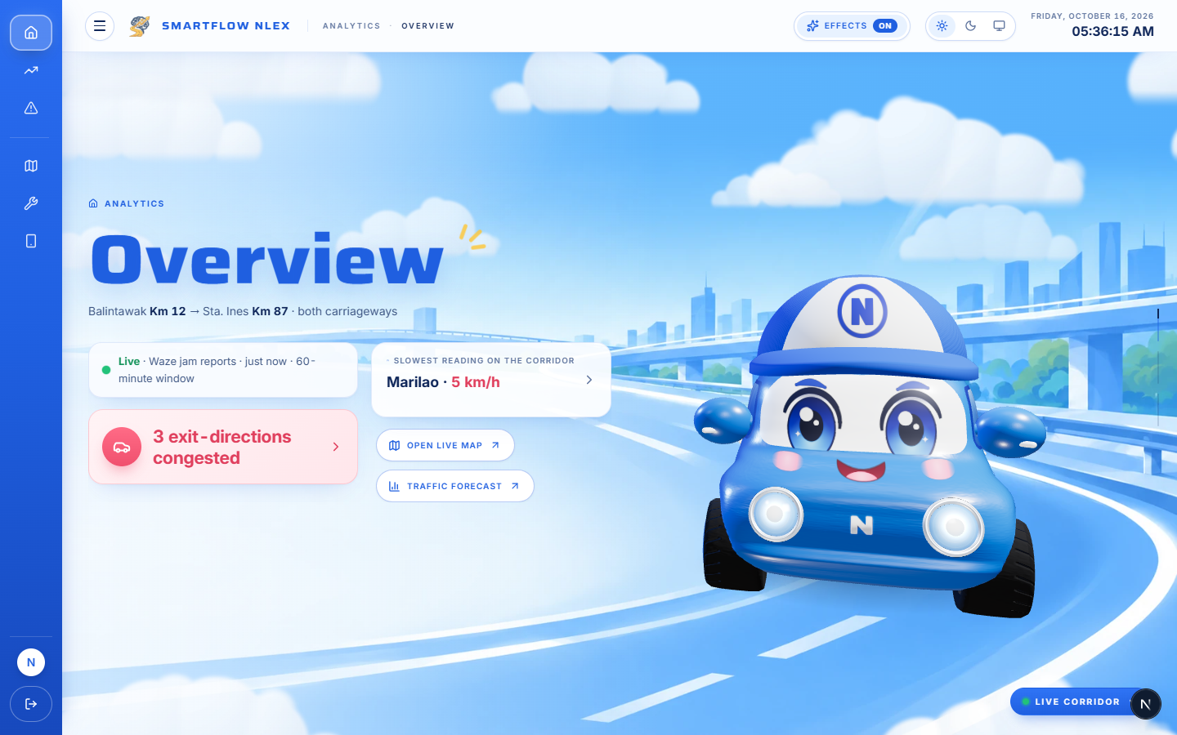
04
EXIT · LIVE DEMO
Actual System Demonstration
See SmartFlow NLEX in action.
Operator Dashboard · Overview
Introduction
Objectives
Scope
Live Demo
Closing
Notes:
CUE — ACTUAL SYSTEM DEMONSTRATION (one slide only). Target 12:30 (6:50–19:20).
Hans leads and speaks; Ysa operates the dashboard, then presents the mobile app; Jertz interprets accuracy and limits; Kiarra keeps time.
Hans: "Thank you, Jertz. For the next twelve minutes, we follow one operator through a shift — signing in, seeing what is happening, forecasting what comes next, and testing a response before acting. Then Ysa shows the commuter's side. Ysa drives the keyboard while I explain."
[Switch to live system]
Route: 1) Sign-in (two-step) · 2) Overview · 3) Live Map · 4) Traffic › Descriptive · 5) Traffic › Predictive · 6) Traffic › Prescriptive · 7) Incidents · 8) Scenario Sandbox · 9) Emissions · 10) Mobile Control Centre · 11) Commuter mobile app
Full narration and operator actions: SmartFlow_NLEX_Presenter_Script (Section D) and SmartFlow_NLEX_Demo_Run_Sheet.
Time checks: Kiarra gives a hand signal at 12:20 (should be on Traffic › Prescriptive), 14:05 (should be entering Scenario Sandbox) and 17:10 (should be on Mobile Control Centre). Optional lines are not counted in the timing. If behind at 14:05, skip the Confidence run; if behind at 17:10, skip the Assistant question.
[Return to PowerPoint] at 19:20 — operator switches back to the running slideshow (Alt+Tab) and advances to slide 11.

Slide 11
05
EXIT · CLOSING
Friday, 5:00 PM — again.
BEFORE
What is happening right now?
WITH SMARTFLOW NLEX
What is likely next, how reliable is that estimate, and what could we test before we act?
Integrated
Six data sources in one corridor warehouse
Benchmarked
Forecasts shown with their accuracy against naive baselines
Testable
Recommendations and a sandbox to try a response first
The best time to manage a queue is before it forms.
Introduction
Objectives
Scope
Live Demo
Closing
Notes:
[19:20–19:56]
KIARRA: Let's go back to Friday, five o'clock, at Balintawak.
KIARRA: Before, the only question anyone could answer was: what is happening right now? With SmartFlow NLEX, an operator can also ask: what is likely next, how reliable is that estimate, and what could we test before we act?
KIARRA: Our contribution: six data sources in one corridor warehouse; every forecast shown with its accuracy against a naive baseline; and recommendations, with a safe place to try them first.
[Pause]
KIARRA: Because on an expressway, the best time to manage a queue is before it forms.
[Advance slide]

Slide 12
Thank you —
Questions?
SmartFlow NLEX · Where Traffic Meets Intelligence
Dela Cruz · Naval · Rocillo · Jabagat
Notes:
[19:56–20:00]
KIARRA: Thank you. We would be glad to take your questions.
[All presenters stand in line. Keep the live system open on the second screen or one Alt+Tab away for questions.]

