Slide 1


CAPSTONE DEFENSE · BS INFORMATION SYSTEMS
UNIVERSITY OF SANTO TOMAS
SmartFlow NLEX
A Multisource Corridor Analytics and Decision-Intelligence System for Expressway Traffic Management
A Journey Toward Smarter Traffic Decisions
Kiarra Jem U. Dela Cruz
Project Manager
Jertz Avryll M. Naval
Quality Assurance
Hans E. Rocillo
Lead Developer
Ysabela B. Jabagat
Developer
Notes:
[0:00–0:20]
[Kiarra stands centre. Slide 1 is already showing when the panel is ready.]
KIARRA: Good [morning/afternoon], members of the panel. We are Group 4 of 3ISB, and this is SmartFlow NLEX: A Multisource Corridor Analytics and Decision-Intelligence System for Expressway Traffic Management.
[Pause]
KIARRA: Let me start with a moment many of us know.
[Advance slide]

Slide 2
01
EXIT · INTRODUCTION
Tomorrow
?
ILLUSTRATIVE SCENARIO
Friday, 5:00 PM.
A long weekend begins. Northbound from Balintawak (Km 12).
In 2 hours
?
Everyone can see the traffic now.
Who can see what comes next?
Now
Visible
Introduction
Objectives
Scope
Live Demo
Closing
Notes:
[0:20–0:55]
KIARRA: Picture this. It is Friday, five in the afternoon, at the start of a long weekend. You are heading north from Balintawak, at kilometre twelve. This is an illustrative scenario, not a recorded event — but it is familiar.
KIARRA: Right now, everyone can see the traffic. Navigation apps show red lines.
[Pause — gesture to the 'In 2 hours' and 'Tomorrow' markers]
KIARRA: But the operator in the control room needs a harder answer. Not "What is happening?" — but "What is likely to happen next, and what should we do before it does?"
[Advance slide]

Slide 3


01
EXIT · INTRODUCTION
Two gaps between data and decisions
Looking back, not ahead
WHY IT MATTERS
Traffic, incident and toll data are presented mainly as summaries of current or past conditions. There is no forecasting layer to anticipate surges from weather, holidays or events.
One road, two kinds of trips
NLEX carries goods between Metro Manila and the provinces, and the daily trips of workers and students. When it slows, deliveries and commutes are delayed together — most of all at rush hour, on long weekends and on holidays.
Data in separate lanes
Toll records, incident logs, crowdsourced reports, weather and event schedules are held separately and are not combined in one analytical pipeline.
Source: manuscript, Chapter 1 (Introduction)
Introduction
Objectives
Scope
Live Demo
Closing
Notes:
[0:55–1:40]
KIARRA: Behind that question are two gaps.
KIARRA: First, the data look backward. Traffic, incident and toll data are shown mainly as summaries of what already happened. There is no forecasting layer to warn about surges from weather, holidays or events.
KIARRA: Second, the data travel in separate lanes. Toll records, incident logs, crowdsourced reports, weather and event schedules are kept apart, never combined in one place.
KIARRA: And this matters, because NLEX is one road carrying two kinds of trips: goods moving between Metro Manila and the provinces, and the daily commute of workers and students. When the expressway slows, both are delayed together — most of all at rush hour, on long weekends and on holidays.
[Advance slide]

Slide 4









01
EXIT · INTRODUCTION
SmartFlow NLEX merges the lanes
Hourly toll records
Descriptive
What happened, and where it recurs
NLEX incident records
Predictive
What is likely next — with its accuracy
Operator Dashboard
TCC, incident operators, data analysts
Waze for Cities feed
One integrated
warehouse
Weather and air quality
Prescriptive
What response to consider
Commuter Mobile App
Drivers and commuters
Holiday calendar
Scenario Sandbox
Test an intervention before acting
Event calendar
The system advises. Operators decide.
Introduction
Objectives
Scope
Live Demo
Closing
Notes:
[1:40–2:25]
KIARRA: So we built SmartFlow NLEX to merge those lanes. It brings six kinds of data into one place — toll, incident, Waze, weather, holiday and event data — and answers four questions. What happened? What is likely next? What should we consider doing? And can we test it before we act?
KIARRA: Operators use a desktop dashboard. Commuters use a mobile app. And one rule runs through all of it: the system advises — operators decide.
KIARRA: I am Kiarra, the project manager. With me are Ysa, our developer, and Hans, our lead developer. Our quality assurance lead, Jertz, cannot be with us today. Ysa will now show you where this journey is headed.
[Handoff — Kiarra steps back; Ysa steps forward]
[Advance slide]

Slide 5

02
EXIT · OBJECTIVES
Our destination
GENERAL OBJECTIVE · Section 1.4.1
The general objective of this capstone project is to develop and evaluate SmartFlow NLEX, a centralized decision-intelligence platform that leverages a 4-year historical NLEX dataset alongside real-time crowdsourced and external data to optimize proactive traffic management and incident response. By reducing traffic congestion, the capstone project proposal will support SDG 9 (Industry, Innovation, and Infrastructure) through lower vehicular carbon emissions.
Introduction
Objectives
Scope
Live Demo
Closing
Notes:
[2:25–3:00]
YSA: Thank you, Kiarra. Every journey needs a destination. Ours is our general objective, which I will read exactly as approved.
[Read verbatim — do not paraphrase]
YSA: "The general objective of this capstone project is to develop and evaluate SmartFlow NLEX, a centralized decision-intelligence platform that leverages a 4-year historical NLEX dataset alongside real-time crowdsourced and external data to optimize proactive traffic management and incident response. By reducing traffic congestion, the capstone project proposal will support SDG 9 (Industry, Innovation, and Infrastructure) through lower vehicular carbon emissions."
[Advance slide]

Slide 6
02
EXIT · OBJECTIVES
Four waypoints: specific objectives 1–2
SO 1
Agent-based simulation sandbox
SO 2
Next.js and TypeScript dashboard
To evaluate response strategies within an Agent-Based Simulation Sandbox in order to minimize expressway downtime and maximize vehicle throughput during incidents or demand surges, providing NLEX management with a risk-free, data-driven environment to test operational decisions before live deployment using a custom HTML5 Canvas-based simulation interface.
To develop the "SmartFlow NLEX" decision-intelligence system for NLEX operators using a custom-built Next.js and TypeScript web dashboard. This system aims to merge and visualize real-time, multi-source data streams across web and conversational channels. By doing so, we will provide operators with a highly usable, accessible platform that simplifies complex data, streamlines operational decision-making, and ensures widespread user adoption.
Objective text reproduced verbatim from Section 1.4.2; labels follow Table 1.4.3.1.
Introduction
Objectives
Scope
Live Demo
Closing
Notes:
[3:00–3:55]
YSA: To get there, we set four specific objectives. Specific Objective 1:
YSA: "To evaluate response strategies within an Agent-Based Simulation Sandbox in order to minimize expressway downtime and maximize vehicle throughput during incidents or demand surges, providing NLEX management with a risk-free, data-driven environment to test operational decisions before live deployment using a custom HTML5 Canvas-based simulation interface."
YSA: Specific Objective 2:
YSA: "To develop the "SmartFlow NLEX" decision-intelligence system for NLEX operators using a custom-built Next.js and TypeScript web dashboard. This system aims to merge and visualize real-time, multi-source data streams across web and conversational channels. By doing so, we will provide operators with a highly usable, accessible platform that simplifies complex data, streamlines operational decision-making, and ensures widespread user adoption."
[Advance slide]

Slide 7
02
EXIT · OBJECTIVES
Four waypoints: specific objectives 3–4
SO 3
Historical analysis
SO 4
Multi-source predictive models
To analyze a 4-year historical NLEX dataset to map and identify recurring systemic inefficiencies and traffic congestion patterns for strategic capacity planning using Python and RStudio.
To deploy existing multi-source predictive models within the SmartFlow NLEX dashboard that forecast expressway conditions using integrating historical toll records, crowdsourced data, weather inputs, and event schedules using existing machine learning algorithms.
Objective text reproduced verbatim from Section 1.4.2; labels follow Table 1.4.3.1.
Introduction
Objectives
Scope
Live Demo
Closing
Notes:
[3:55–4:25]
YSA: Specific Objective 3:
YSA: "To analyze a 4-year historical NLEX dataset to map and identify recurring systemic inefficiencies and traffic congestion patterns for strategic capacity planning using Python and RStudio."
YSA: Specific Objective 4:
YSA: "To deploy existing multi-source predictive models within the SmartFlow NLEX dashboard that forecast expressway conditions using integrating historical toll records, crowdsourced data, weather inputs, and event schedules using existing machine learning algorithms."
[Advance slide]

Slide 8
02
EXIT · OBJECTIVES
How we met each objective
OBJECTIVE
WHAT WE BUILT
WHERE YOU WILL SEE IT
GO
One warehouse joining six data sources, with pages that explain the past, forecast the future and suggest responses — plus emission estimates
Every tab
SO 1
Scenario Sandbox on an HTML5 Canvas road: compare a response with doing nothing — speed, throughput, queue and CO₂
Simulator
SO 2
Next.js and TypeScript dashboard: two-step sign-in, role-based tabs, live map; a command box and a mobile assistant to talk to it
Login · Overview · Live Map · Maintenance · Mobile Control · Settings
SO 3
Python analysis of the Jan 2022 – Dec 2025 record: busy hours, holiday effects, incident hotspots, rain and emissions
Descriptive tabs
SO 4
Forecasts for traffic, congestion, incidents and CO₂ — each tested against a simple rule of thumb, retrained weekly
Predictive tabs · Live Map
Mapping follows Table 1.4.3.1 of the manuscript. Evaluation results (KPIs, usability testing) are reported in Chapter 4.
Introduction
Objectives
Scope
Live Demo
Closing
Notes:
[4:25–5:20]
YSA: Here is how each objective became something you can see — and where you will see it in the demo.
YSA: The general objective became one place that joins all six data sources, with pages that explain the past, forecast the future and suggest responses. You will see it in every tab.
YSA: Objective one became the Simulator: a virtual road where an operator compares a response with doing nothing. Objective two became the dashboard itself — secure sign-in, pages for each role, and a command box you can simply type to.
YSA: Objective three became the Descriptive tabs, built from our analysis of the 2022 to 2025 record. And objective four became the Predictive tabs, where every forecast is tested against a simple rule of thumb before we show it. Hans will tell you the boundaries.
[Handoff — Ysa steps back; Hans steps forward]
[Advance slide]

Slide 9



03
EXIT · SCOPE AND LIMITATIONS
Where this route runs
NLEX main line · 20 exits · about 76 km
Balintawak
Km 12
Bocaue
Km 27
San Fernando
Km 65
Sta. Ines
Km 87
Meycauayan
Km 20
Sta. Rita
Km 38
Angeles
Km 81
Who it serves
What it reads
What it does
TCC operators
Incident operators
NLEX data analysts
Commuters and drivers (mobile app)
Hourly toll records, Jan 2022 – Dec 2025
NLEX incident records
Waze archive + live feed (~2 min)
Weather, air quality, holidays, 159-event calendar
Descriptive analytics and live map
Forecasts: congestion 1–168 h; volume, incidents, CO₂
Recommendations and Scenario Sandbox
Emission estimates; commuter app
Introduction
Objectives
Scope
Live Demo
Closing
Notes:
[5:20–5:55]
HANS: Thanks, Ysa. SmartFlow NLEX covers the NLEX main line, from Balintawak at kilometre twelve to Sta. Ines at kilometre eighty-seven — twenty exits, about seventy-six kilometres.
HANS: It serves Traffic Control Center operators, incident operators and data analysts on the dashboard, and commuters on the mobile app. It reads toll and incident records from 2022 to 2025, the Waze feed, weather, holidays and an events calendar. And it describes, forecasts, recommends and simulates.
[Advance slide]

Slide 10





03
EXIT · SCOPE AND LIMITATIONS
Know the road conditions before we drive
Advisory only
Not yet in live operations
Data boundaries
It does not control barriers or signs, or dispatch units. Every recommendation needs an operator's decision.
Evaluated as a capstone demonstration. Benefits are estimated from history and simulation, not observed.
NLEX record: Jan 2022 – Dec 2025. Some clearance times are missing; Waze history has a gap (19 Apr – 3 Aug 2026).
Forecasts are estimates
Emissions are estimates
Live dependencies
Several models beat naive baselines only modestly. Beyond the validated horizons, forecasts are labelled unvalidated.
Fixed per-class factors (EMEP/EEA), not calibrated to the Philippine fleet or checked against roadside measurements.
Needs internet, the Waze feed, sign-in, language-model and map providers. The event calendar is updated by hand.
Introduction
Objectives
Scope
Live Demo
Closing
Notes:
[5:55–6:30]
HANS: Before we drive, here are the road conditions — the limits to keep in mind during the demo.
HANS: The system only advises; it does not control barriers, signs or patrol units. It has not been used in live NLEX operations, so any benefit is estimated from history and simulation. Forecasts and emission figures are estimates, not certainties. And live features need the internet and outside services.
HANS: With that, Kiarra will take us into the system.
[Handoff — Kiarra moves beside the screen; Hans goes to the demo laptop as operator]
[Advance slide]

Slide 11
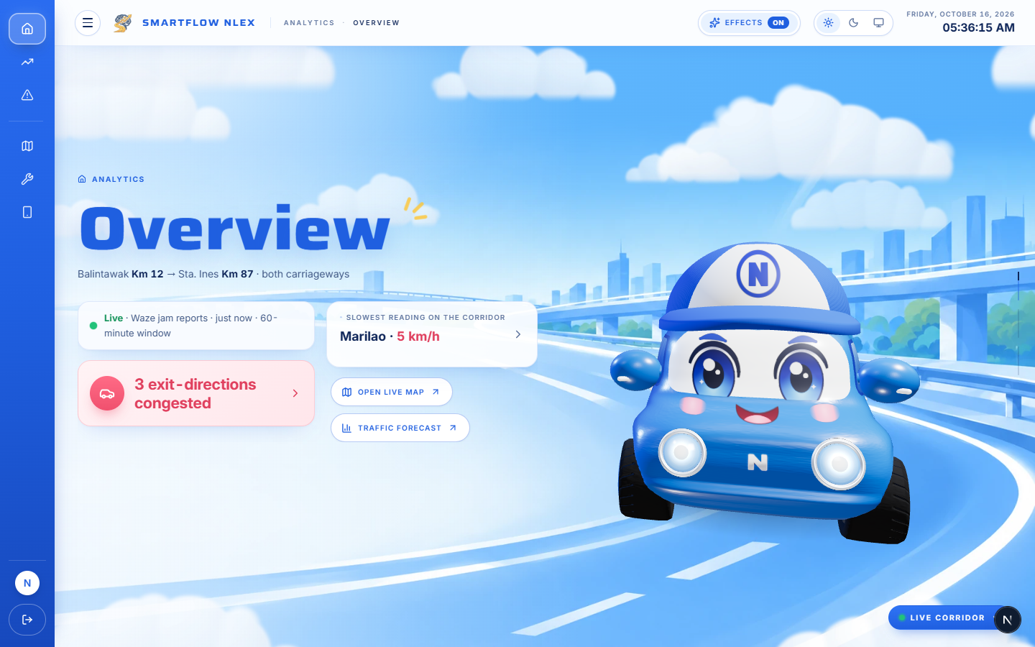
04
EXIT · LIVE DEMO
Actual System Demonstration
See SmartFlow NLEX in action.
Operator Dashboard · Overview
Introduction
Objectives
Scope
Live Demo
Closing
Notes:
CUE — ACTUAL SYSTEM DEMONSTRATION (one slide only). 6:30–30:25 (23:55).
Hans operates the laptop while Kiarra or Ysa speaks; Ysa operates while Hans speaks.
KIARRA: Now let's leave the slides and see it working. We will go tab by tab, the way an operator moves through a shift. For every screen, we will tell you the question it answers and the decision it helps with. Hans is at the keyboard.
[Switch to live system]
Tab order and speaker:
1. Login — Kiarra (6:50–7:25)
2. Overview — Kiarra (7:25–8:10)
3. Traffic › Descriptive — Kiarra (8:10–11:05)
4. Traffic › Predictive — Kiarra (11:05–13:20)
5. Traffic › Prescriptive — Kiarra (13:20–14:50)
6. Incidents › Descriptive — Ysa (14:50–17:25)
7. Incidents › Predictive — Ysa (17:25–18:50)
8. Incidents › Prescriptive — Ysa (18:50–20:05)
9. Emissions › Descriptive — Hans (20:05–22:20)
10. Emissions › Predictive — Hans (22:20–23:20)
11. Emissions › Prescriptive — Hans (23:20–24:40)
12. Live Map — Kiarra (24:40–25:30)
13. Maintenance — Ysa (25:30–26:20)
14. Mobile Control — Ysa (26:20–27:05)
15. Simulator (Scenario Sandbox) — Hans (27:05–28:55)
16. Data Management & Audit Log — Hans (28:55–29:55)
17. Settings — Kiarra (29:55–30:25)
How to explain each screen: Speak to the whole room, technical and non-technical. On every screen say three things in this order: the question this screen answers, what the audience is looking at, and the decision it helps with. Point at the chart while you say it. Do not read out numbers unless they help the point; a number is never the point.
Full narration and operator actions: SmartFlow_NLEX_Presenter_Script (Section D) and SmartFlow_NLEX_Demo_Run_Sheet.
Time checks: Whoever is neither speaking nor operating gives a hand signal at 14:50 (should be starting Incidents), 24:40 (should be starting Live Map) and 27:05 (should be starting the Simulator). Lines marked Optional are not counted in the timing. If behind at the Simulator, skip the Confidence run; if behind at Data Management, show only the Audit Log table.
[Return to PowerPoint] at 30:25 — Alt+Tab to the slideshow and advance to slide 12.

Slide 12
05
EXIT · CLOSING
Friday, 5:00 PM — again.
BEFORE
What is happening right now?
WITH SMARTFLOW NLEX
What is likely next, how reliable is that estimate, and what could we test before we act?
Integrated
Six data sources in one corridor warehouse
Benchmarked
Forecasts shown with their accuracy against naive baselines
Testable
Recommendations and a sandbox to try a response first
The best time to manage a queue is before it forms.
Introduction
Objectives
Scope
Live Demo
Closing
Notes:
[30:25–31:01]
KIARRA: Let's go back to Friday, five o'clock, at Balintawak.
KIARRA: Before, the only question anyone could answer was: what is happening right now? With SmartFlow NLEX, an operator can also ask: what is likely next, how reliable is that estimate, and what could we test before we act?
KIARRA: Our contribution: six data sources in one corridor warehouse; every forecast shown with how well it was tested; and recommendations, with a safe place to try them first.
[Pause]
KIARRA: Because on an expressway, the best time to manage a queue is before it forms.
[Advance slide]

Slide 13
Thank you —
Questions?
SmartFlow NLEX · Where Traffic Meets Intelligence
Dela Cruz · Naval · Rocillo · Jabagat
Notes:
[31:01–31:05]
KIARRA: Thank you. We would be glad to take your questions.
[Kiarra, Ysa and Hans stand in line. Keep the live system one Alt+Tab away for questions.]

