Slide 1

SMART HOME PROJECT

Slide 2
Problem Statement
Obtain a deep understanding around:
Connectedness
Personalization
Relationship type (partner/servant)
Privacy/Security
Trust
Critical incident analyses
Topic Modelling for text classification/Information Retrievial
Sentiment Analysis – Network Analysis
Goal:
Within a specific area, smart home, analyze consumers behavior.
Methodology

Slide 3
Datasets
Reddit submission and comments from the following subreddits:
https://files.pushshift.io/reddit/

Slide 4
Empirical Design Phase 1
Randomly select 5000 comments from each subreddit
(External validity)
Randomly select 5000 comments from each subreddit with query term (privacy, security, trust)
(Internal validity)
Topic Modeling
(exploratory/information retrieval tool to investigate what people are talking about⁴
Topic Modeling on short text⁵)
Potentially, this could help us with pattern interpretation and to validate our findings in the more general search
Pattern interpretation, Evaluation and Validation
Number of topics: distances and matrix factorization¹ , measures triangulation³,
Output topics: identify domain experts to validate the topics generated², coherence and relevance of topic models using human experiments⁴
- Similarity measure threshold (Jensen-Shannon Distance) ^{1, 3, 5}: threshold based on expert assessments² , statistical analyses²
Text Classification
(Classify comments to further research)
Notes:
(Kobayashi et al., 2017) http://journals.sagepub.com/doi/suppl/10.1177/1094428117722619
2. (Kaplan et al., 2014) https://doi.org/10.1002/smj.2294
3. (Choudhury et al, 2019) https://doi.org/10.1002/smj.3067
4. (Chang et al., 2009) http://users.umiacs.umd.edu/~jbg/docs/nips2009-rtl.pdf
5. (Hong et al., 2010) https://snap.stanford.edu/soma2010/papers/soma2010_12.pdf

Slide 5
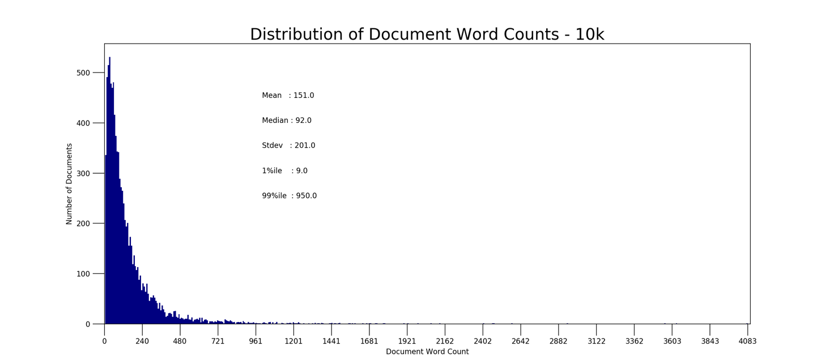
NLP pipeline (https://github.com/morena-au/Smart-House/tree/reddit)
N. Comments | Unique words (dictionary length) | Descriptive Statistics: word used in how many comments?
9308 | 11108 (6001 -54%- after filtering out words that occur less than in 2 comments) | mean 16.369553 (0.18%) std 71.812963 min 1.000000 25% 1.000000 50% 2.000000 75% 6.000000 max 2075.000000 (22.29%)
46609 | 23529 (12775 -54%- after filtering out words that occur less than in 2 comments) | mean 38.875473 (0.08%) std 252.560218 min 1.000000 25% 1.000000 50% 2.000000 75% 7.000000 max 10429.000 (22.38%)
Preprocessing
Remove comments with less than 2 words.
Remove URL.
Remove NLTK stop words.
Remove RemindMeBot!.
Remove html formatting.
Remove punctuation and underscore.
Substitute digits with string ‘digit’.
Substitute $ with string ‘dollar’.
Remove non-English comments.
Lemmatize with spaCy English model, removing NUM and PRON tags.
Create bigrams and trigrams with Gensim.
Case specific assumptions:
We are dealing with sparsity
(the same word is rarely used)
2. People write relative short
comments

Slide 6
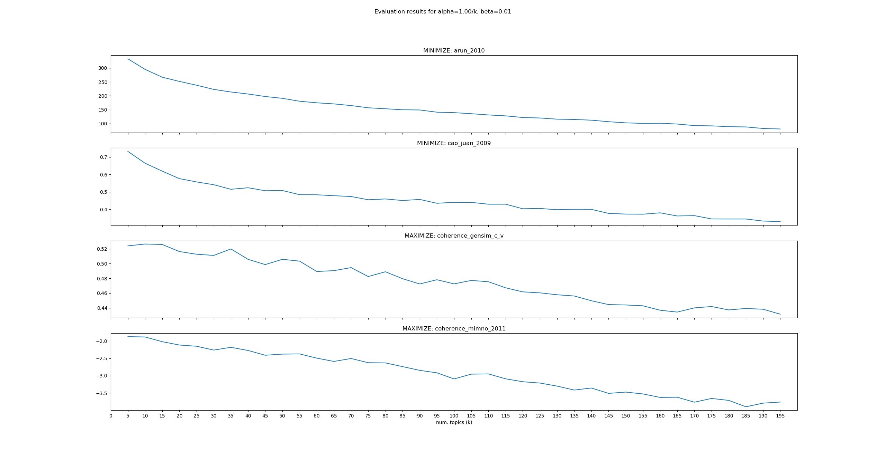
NLP pipeline (https://github.com/morena-au/Smart-House/tree/reddit)
Parameters tuning: 9308 comments > NO CONVERGENCE
EVALUATION METRICS | ALPHA=1/k BETA=0.01 TOPICS=(5, 200, 5) | ALPHA=10.00/k BETA=0.1 TOPICS=(5,200,5) | ALPHA=50.00/k BETA=0.5 TOPICS=(5, 200, 5)
Min: Arun 2010 | 80.5942 @topic:195 | 205.7174 @topic:195 | 326.0647 @topic: 115
Min: Cao Juan 2009 | 0.33034 @topic:195 | 0.9357 @topic:195 | 0.9754 @topic: 40
Max: Coherence gensim c_v | 0.5266 @topic:10 | 0.5483 @topic:190 | 0.5482 @topic: 195
Max: Coherence Mimno 2011 | -1.8766 @topic:5 | -1, 7143 @topic:5 | -1.71347 @topic: 35
LDA Modelling + Evaluation
LDA Mallet implementation.
LDA Gensim Implementation.
Evaluation metrics:
- Arun 2010
- Cao Juan 2009
- Coherence gensim c_v
- Coherence Mimno 2011
NOTE:
1. Topics created are highly impacted by top frequency words.
2. The single comment is not a good source for the analysis.

Slide 7
Hyperparameters tuning
ALPHA: set the prior on the per-document topic distribution.
Do people talk about many topics when commenting?
BETA: set the prior on the per-topic word distribution.
Are topics interrelated? Same word used in different contexts.
LOW ALPHA: | HIGH ALPHA:
Each comment covers only few topics (higher impact on topic sparsity) | Each comment covers many topics
LOW BETA: | HIGH BETA:
Each topic consists of few words. Result in more topics and more specific. (Higher impact on word sparsity) | Each topic consists of many words. Few topics, more general

Slide 8
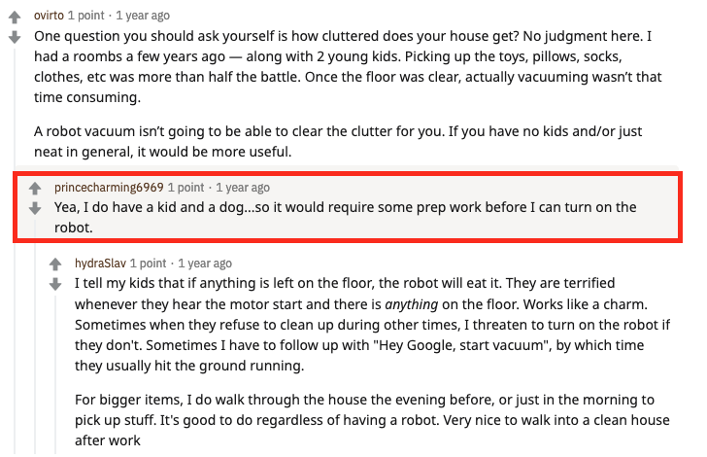
Example
Parent + children
Comment
NOTE:
Red message alone is hard to understand the topics the author is talking about (Family + robot).
Reading the parent and the children context get clearer (Robot vacuum functionality)
Notes:
Red is the focal message. Its alone is hard to understand the topics the author is talking about.
If you read all the parents’ comments, thus the comments within the green box, it gets clear that they are talking about ROBOT VACUUM AND THEIR USEFULNESS WITH YOUNG KIDS AROUND.

Slide 9
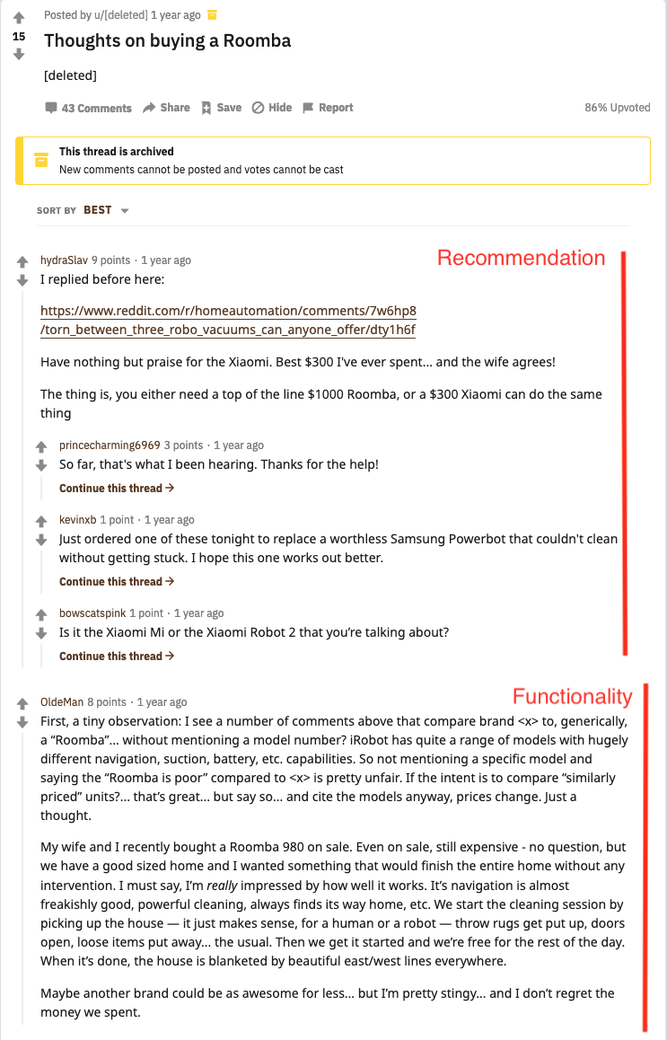

Notes:
Red is the focal message. Its alone is hard to understand the topics the author is talking about.
If you read all the parents’ comments, thus the comments within the green box, it gets clear that they are talking about ROBOT VACUUM AND THEIR USEFULNESS WITH YOUNG KIDS AROUND.

Slide 10

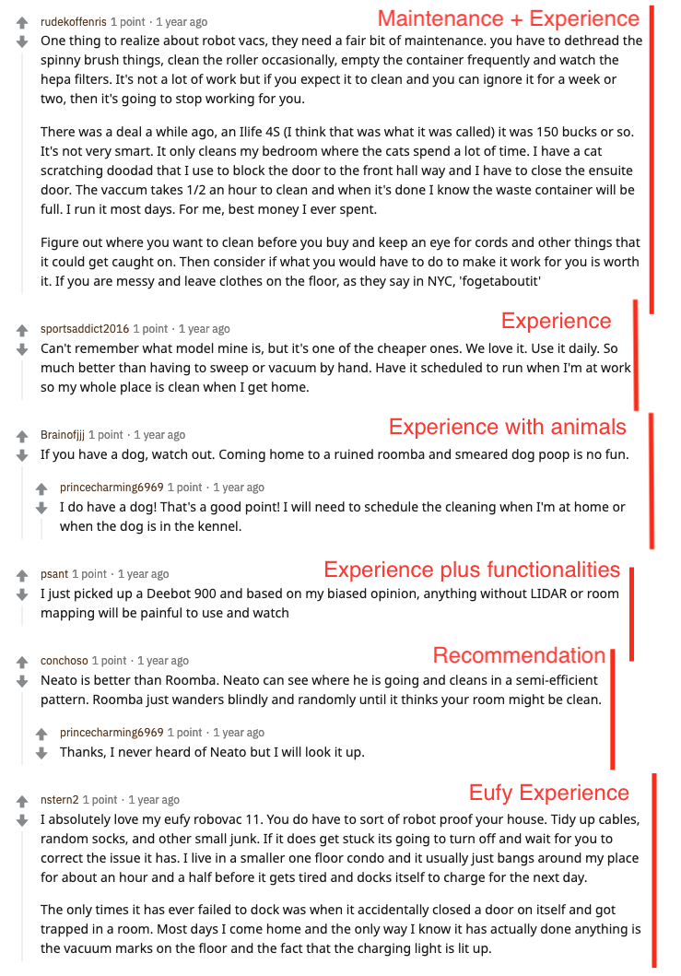

Slide 11
