Slide 1
SMART HOME PROJECT

Slide 2
Problem Statement
Obtain a deep understanding around:
Connectedness
Personalization
Relationship type (partner/servant)
Privacy/Security
Trust
Critical incident analyses
Topic Modelling for text classification
Sentiment Analysis – Network Analysis
Methodology

Slide 3
Datasets
For Topic Modelling:
Reddit submission and comments from the following subreddit:
https://pushshift.io/
https://github.com/pushshift/api
For Sentiment Analysis:
Labelled train set or already trained model capable of decting POSITIVE, NEGATIVE, NEUTRAL sentiment

Slide 4
Smart home - topic modelling (LDA) Source Data¶ 2904 reddit comments form the subreddits smarthome and homeautomation extracted with pushshift API using privacy, trust and security as query terms and size equal 500 (maximum allowed for each request). Here, topic modelling is used as exploratory/information retrieval tool to investigate what people are talking about when privacy, trust and security are involved.
Pre-processing¶
Strip out hyperlinks and copy thme in a new column URL
Find all words with a hyphen between them and consider them as a unique word ('technical vocabulary')
Remove common stop words
Remove previous comments (copied text) within the comment
Remove punctuation
Remove digits
Remvoe word that are less then 2 characters
Keep only noun, adjectives, verbs and proper nouns
Apply lemmantization

Slide 5
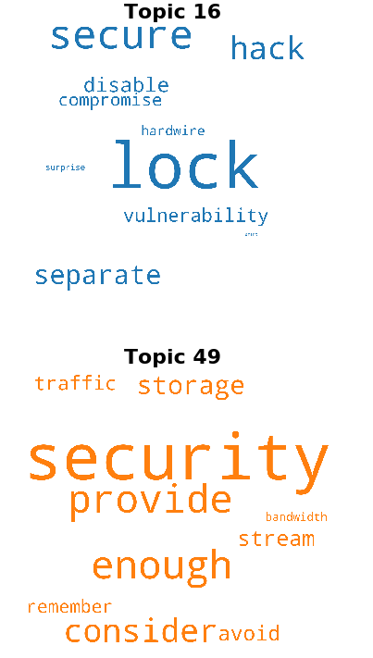
LDA¶ The observations are words collected into documents, it posits that each document is a mixture of a small number of topics and that each word's presence is attributable to one of the document's topics. LDA is an example of a topic model.
Number of topics considered from 5 until 150.
With number of topics equal 100:
SECURITY TOPICS with security within the 20th words by weight:

Slide 6
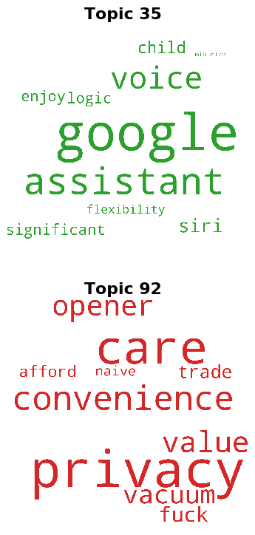
PRIVACY TOPICS with privacy within the 20th words by weight:

Slide 7
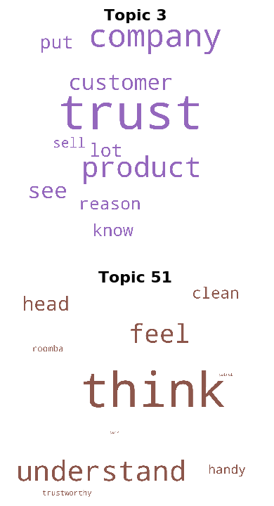
TRUST TOPICS with privacy within the 20th words by weight:

Slide 8
Jensen-Shannon Distance
A measure that we can use to find the similarity between the two probability distributions. 0 indicates that the two distributions are the same, and 1 would indicate that they are nowhere similar.
We use JSD to find comments related to the above selected topics, given that a comment is a collection of topics probabilities.
Topic | Reference comment | Related comments | JSD score
16 | https://www.reddit.com/r/homeautomation/comments/blubx0/psa_dont_put_your_google_homealexa_near_a_window/emuxcya/ | https://www.reddit.com/r/homeautomation/comments/bfrefo/additional_smart_lock_or_automation_for_pool/elg48gp/ | 0.38
 |  | https://www.reddit.com/r/homeautomation/comments/d57eoq/we_bought_this_at_costco_my_bro_in_law_came_home/f0lig28/ | 0.39
 |  | https://www.reddit.com/r/homeautomation/comments/df7gec/why_is_that_is_it_really_so_easy_to_hack_in_or/f326dgp/ | 0.39

Slide 9
Topic | Reference comment | Related comments | JSD score
49 | https://www.reddit.com/r/homeautomation/comments/dudb0j/in_need_of_internet_solution_to_cover_huge_indoor/f77bm09/ | https://www.reddit.com/r/homeautomation/comments/7heaqo/what_is_the_best_system_for_wirelessly_unlocking/dqqmqqp/ | 0.40
 |  | https://www.reddit.com/r/smarthome/comments/e1qlzl/should_i_invest_in_the_google_or_amazon_ecosystem/f8v6hs1/ | 0.40
 |  | https://www.reddit.com/r/homeautomation/comments/d4k3db/alfred_camera_app_that_turns_old_cameras_into/f0fopvt/ | 0.41
35 | https://www.reddit.com/r/homeautomation/comments/9d03oy/rhomeautomation_is_worth_5400_or_how_a_company/e5ehiy0/ | https://www.reddit.com/r/homeautomation/comments/9jkixw/lets_face_it_iot_is_killing_privacy_and_were_okay/e6twz5t/ | 0.46
 |  | https://www.reddit.com/r/smarthome/comments/ck01v4/home_automation_what_is_your_setup_and_why/evl3h67/ | 0.47
 |  | https://www.reddit.com/r/smarthome/comments/e1qlzl/should_i_invest_in_the_google_or_amazon_ecosystem/f8rpfga/ | 0.47
92 | https://www.reddit.com/r/smarthome/comments/e1qlzl/should_i_invest_in_the_google_or_amazon_ecosystem/f8re21x/ | https://www.reddit.com/r/homeautomation/comments/9ezwv2/is_it_possible_to_use_alexa_or_googles_doohicky/e5t2bn9/ | 0.34
 |  | https://www.reddit.com/r/smarthome/comments/a5qtez/im_still_apprehensive_using_google_or_amazon/ebp51oe/ | 0.35
 |  | https://www.reddit.com/r/smarthome/comments/e1qlzl/should_i_invest_in_the_google_or_amazon_ecosrystem/f8rdcxd/ | 0.35

Slide 10
Topic | Reference comment | Related comments | JSD score
3 | https://www.reddit.com/r/smarthome/comments/e1qlzl/should_i_invest_in_the_google_or_amazon_ecosystem/f8re21x/ | https://www.reddit.com/r/homeautomation/comments/9ezwv2/is_it_possible_to_use_alexa_or_googles_doohicky/e5t2bn9/ | 0.34
 |  | https://www.reddit.com/r/smarthome/comments/a5qtez/im_still_apprehensive_using_google_or_amazon/ebp51oe/ | 0.35
 |  | https://www.reddit.com/r/smarthome/comments/e1qlzl/should_i_invest_in_the_google_or_amazon_ecosystem/f8rdcxd/ | 0.36
51 | https://www.reddit.com/r/homeautomation/comments/dfktco/a_different_take_on_robotic_vacuum_reviews_the/f37rrpr/ | https://www.reddit.com/r/homeautomation/comments/dwnhj8/how_can_make_my_lightbulb_turn_on_at_a_specific/f7kke4e/ | 0.32
 |  | https://www.reddit.com/r/homeautomation/comments/cqhqpv/google_forcing_nest_cameras_visual_indicator/ewx8stk/ | 0.33
 |  | https://www.reddit.com/r/homeautomation/comments/bln93u/home_surveillance_with_inhome_dvr_and_app/emrgqkh/ | 0.33

Slide 11
NEXT:
Randomly collect comments within the two subreddits. With query and not within a timeframe of 3 years?
Fine tune the model to get the most significant topics base on the research at hand
Leverage other information provided: authors name, comment scores, number of comments. E.g. network analysis and sentiment analysis.

Slide 12
Randomly select 5000 comments from each subreddit
(So both subreddits have equal representation and extraction are time independent)
Randomly select 5000 comments from each subreddit with query term (privacy, security, trust)
(So both subreddits have equal representation, extractions are time independent and biased to the target topics)
Topic Modeling
(exploratory/information retrieval tool to investigate what people are talking⁴)
Topic Modeling on short text⁵
Potentially this could help us with pattern interpretation and to validate our findings in more general search
Pattern interpretation, Evaluation and Validation
Number of topics: distances and matrix factorization¹ , measures triangulation³,
Output topics: identify domain experts to validate the topics generated², coherence and relevance of topic models using human experiments⁴
- Similarity measure threshold (Jensen-Shannon Distance) ^{1, 3, 5}: threshold based on expert assessments² , statistical analyses²
Text Classification
(Classify comments to further research)

