Slide 1
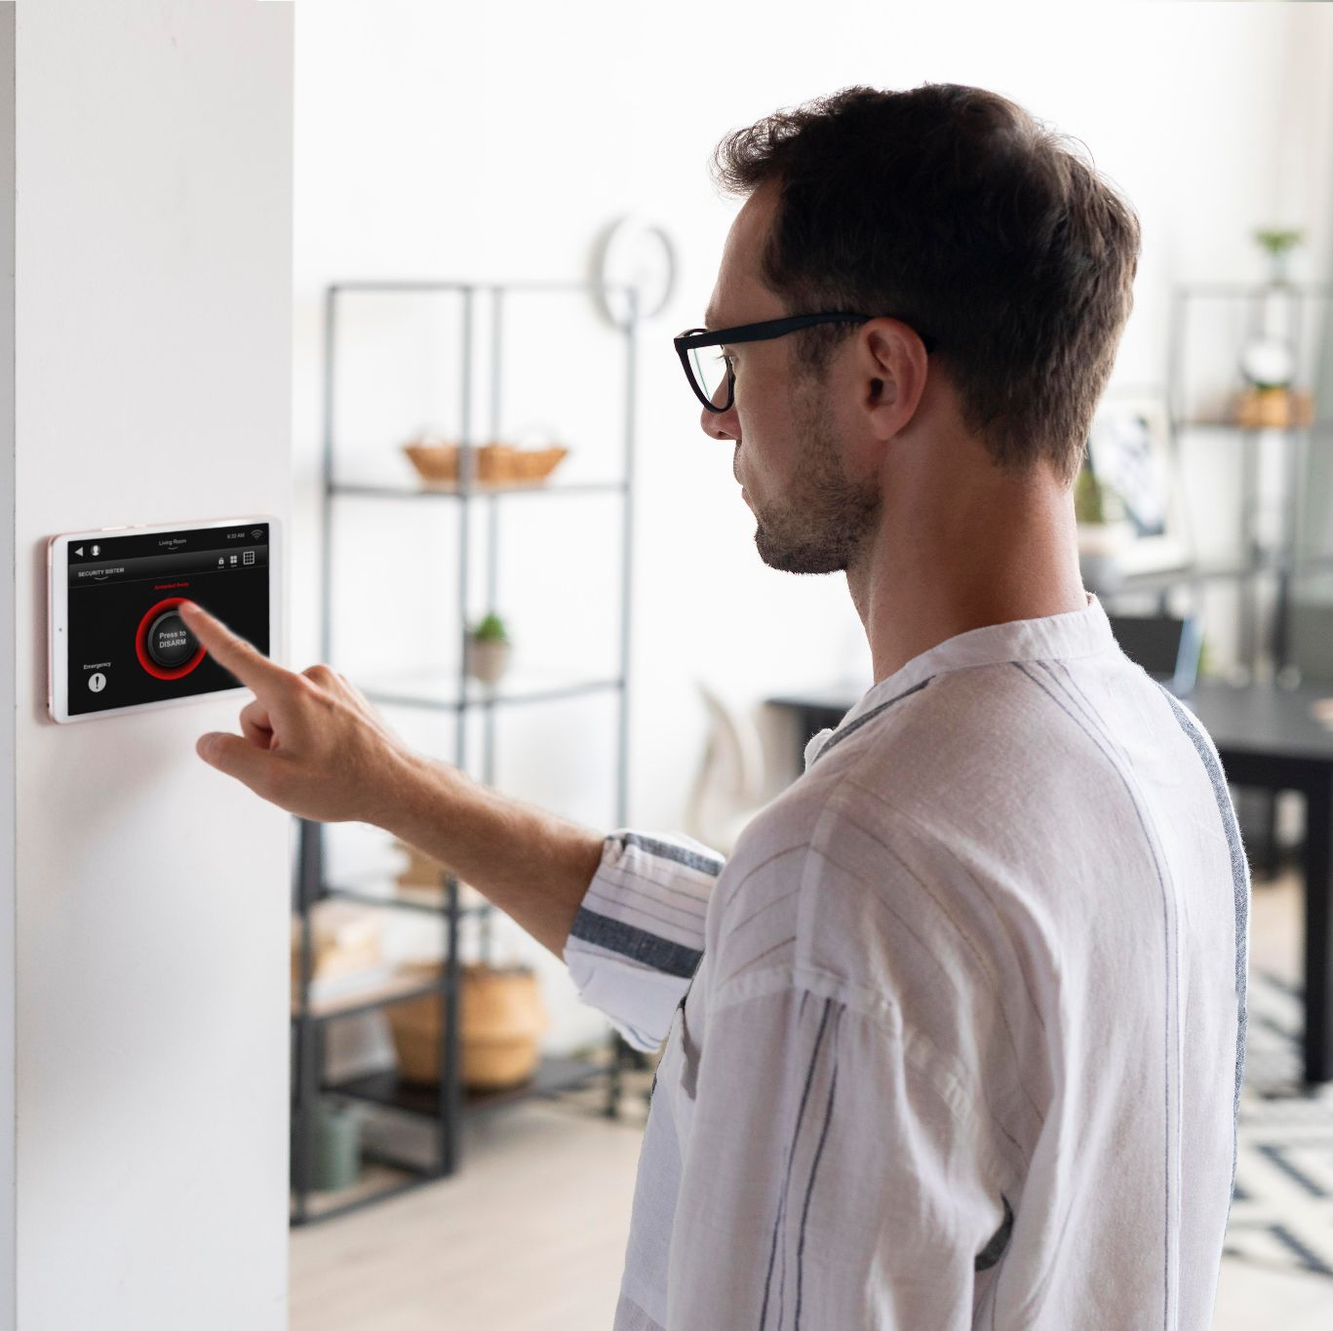
ISHE Phat Dat
Building and Installing Smart Home Equipment

Slide 2
Team Member
Supervisor
Member
Mr.Nguyễn Trí Thông
Hoang Le Duy ( FE )
Do Thanh Tu ( Mobile )
Truong Thanh Trung ( BE )
Nguyen Tuan Tu ( BE )

Slide 3
TABLE OF CONTENTS
01
03
Overview
Technologies
02
04
Features
Conclusion

Slide 4
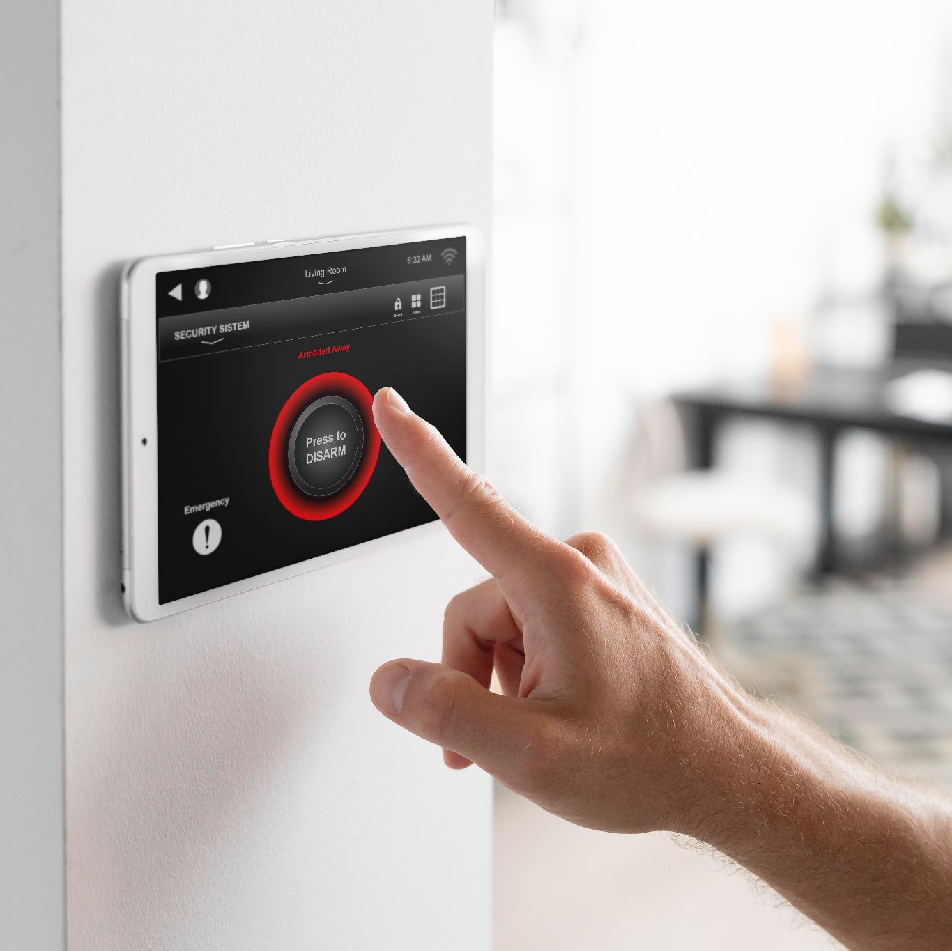
01.
OVERVIEW

Slide 5
Context & Solution
Smart home business ideas are booming as technology becomes a bigger part of our lives. You can start a business by creating cool gadgets that make homes safer and more energy-efficient.
As the market expands, homeowners seek professional advice to navigate the vast array of intelligent technologies and make informed decisions about integrating them into their homes. ?
By offering consultancy services, entrepreneurs can assist clients in identifying suitable intelligent home solutions that align with their lifestyles, budget, and goals.
From recommending energy-efficient devices to designing comprehensive automation plans, intelligent home consultants can play a pivotal role in helping homeowners optimise their living spaces.

Slide 6
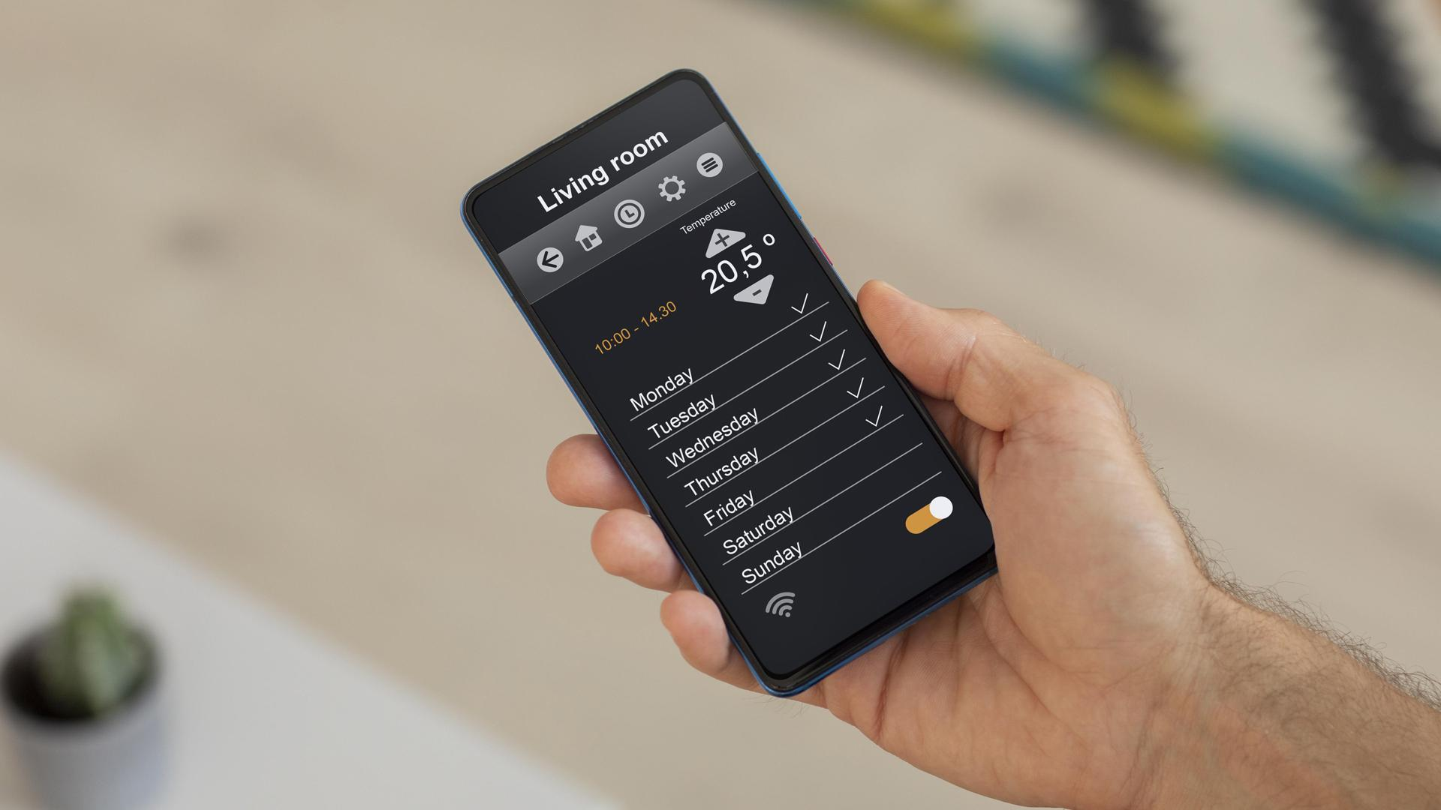
A PICTURE IS WORTH A THOUSAND WORDS

Slide 7
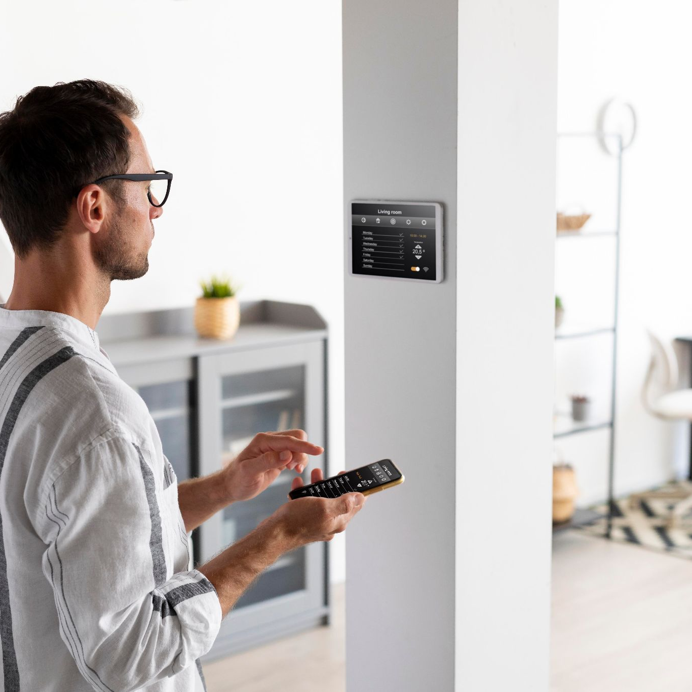
02.
TECHNOLOGY

Slide 8
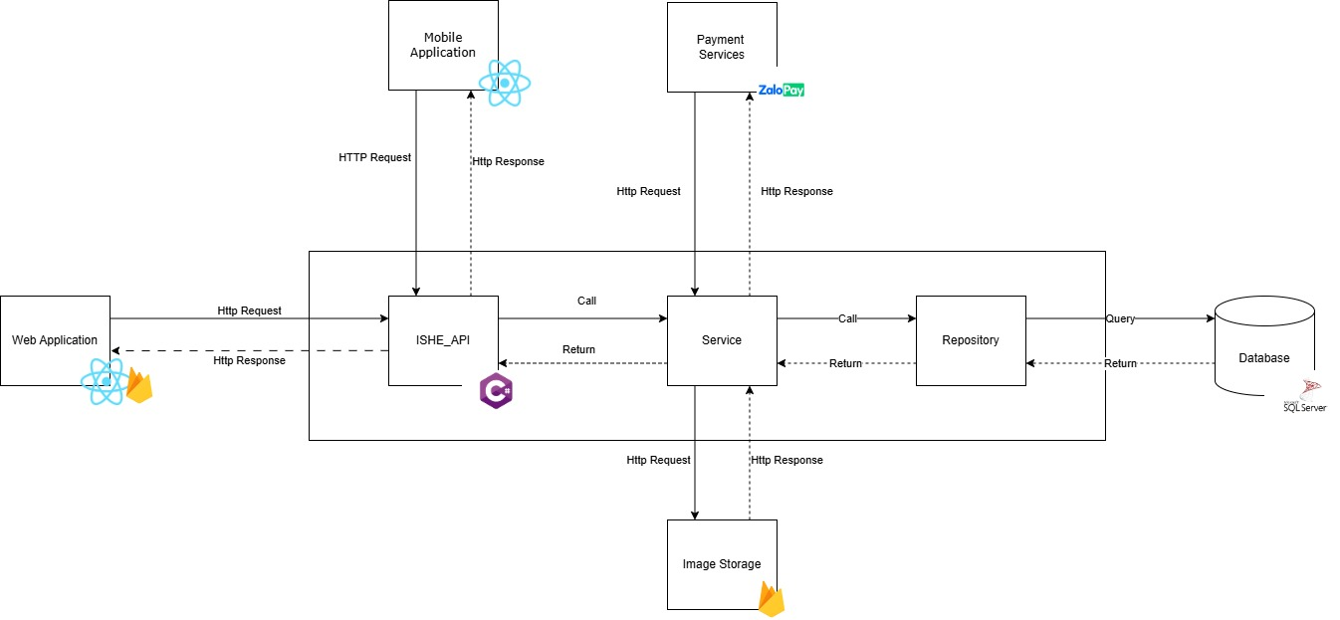
Technologies

Slide 9
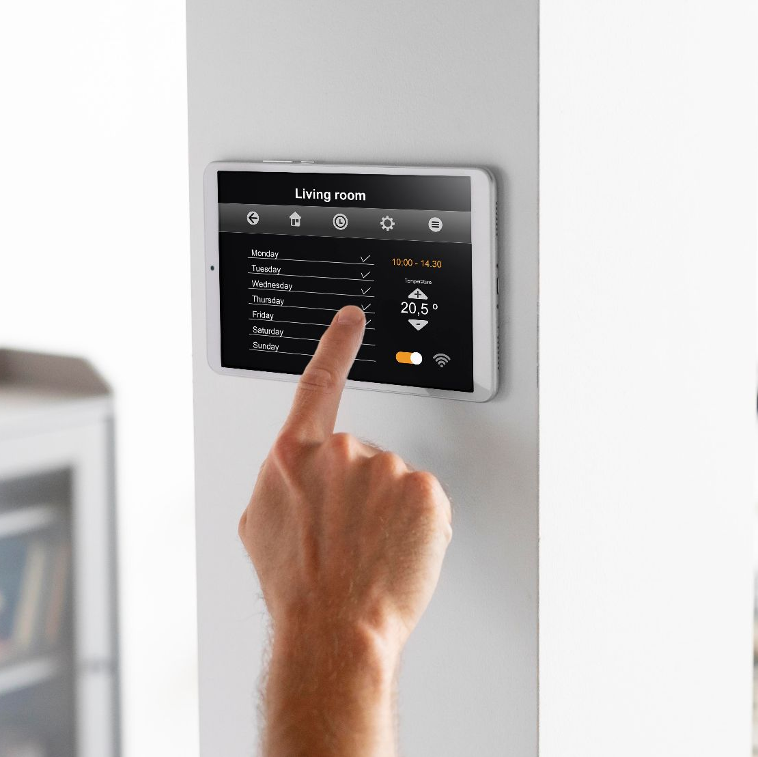
03.
FEATURES

Slide 10
MAJOR ACTOR
Teller
Customer
Web App
Mobile App
Staff
Owner

Slide 11
Owner
Manage Staff
Manage Device
Manage Package
Manage Promotion
Manage Manufacturer

Slide 12
Owner create DEVICES & PACKAGE
Create device
View device list
Update device
login
Web
Deactive device
Owner
View package list
Create device
Update device
Deactive device

Slide 13
Demo

Slide 14
Customer
Request Survey / Request Cancel
Payment
View Package / Device
Send Feedback
View Contract

Slide 15
Customer – send request
Send request survey
Search package
login
Mobile
Customer
View package list
Chat with Teller
View contract
Contract Complete
Payment
Deposit

Slide 16
Demo

Slide 17
Teller
Manage Contract
Manage Request
Assign Staff
Manage Survey
View Promotion / Device / Package

Slide 18
Teller – Assign Staff – Create Contract
Receive survey report
login
Web
View request list
Assign Staff
Create contract
Teller

Slide 19
Demo

Slide 20
Staff
Manage Contract
View request
Manage Report
Manage Survey
View Promotion / Device / Package

Slide 21
Staff – View Request – Update Contract – Send Report
login
Mobile
View request list
Send report
Update contract
Staff

Slide 22
Demo

Slide 23
Conclusion
The Project successfull developed the following features:
Successfully completed the device package management function and other manage functions
Offer device packages in a clear and concise way for customers to find accourding to their needs.\
Successfully completed the construction and acceptance process of a contract

Slide 24
Limitations
Regional limitation: ISHE is currently only available in Ho Chi Minh City.
Limited platforms: ISHE only supports customer by Mobile App.
Limited product: ISHE only support customer buy package through App only.

Slide 25
FUTURE PLANS
Expand service area: Provide service nationwide.
E-business: Support buy single devices.
More platform: Develop for IOS.
More feature: Add revenuce reporting feature and so on

Slide 26
THANKS
PLEASE KEEP THIS SLIDE FOR ATTRIBUTION

