Slide 1

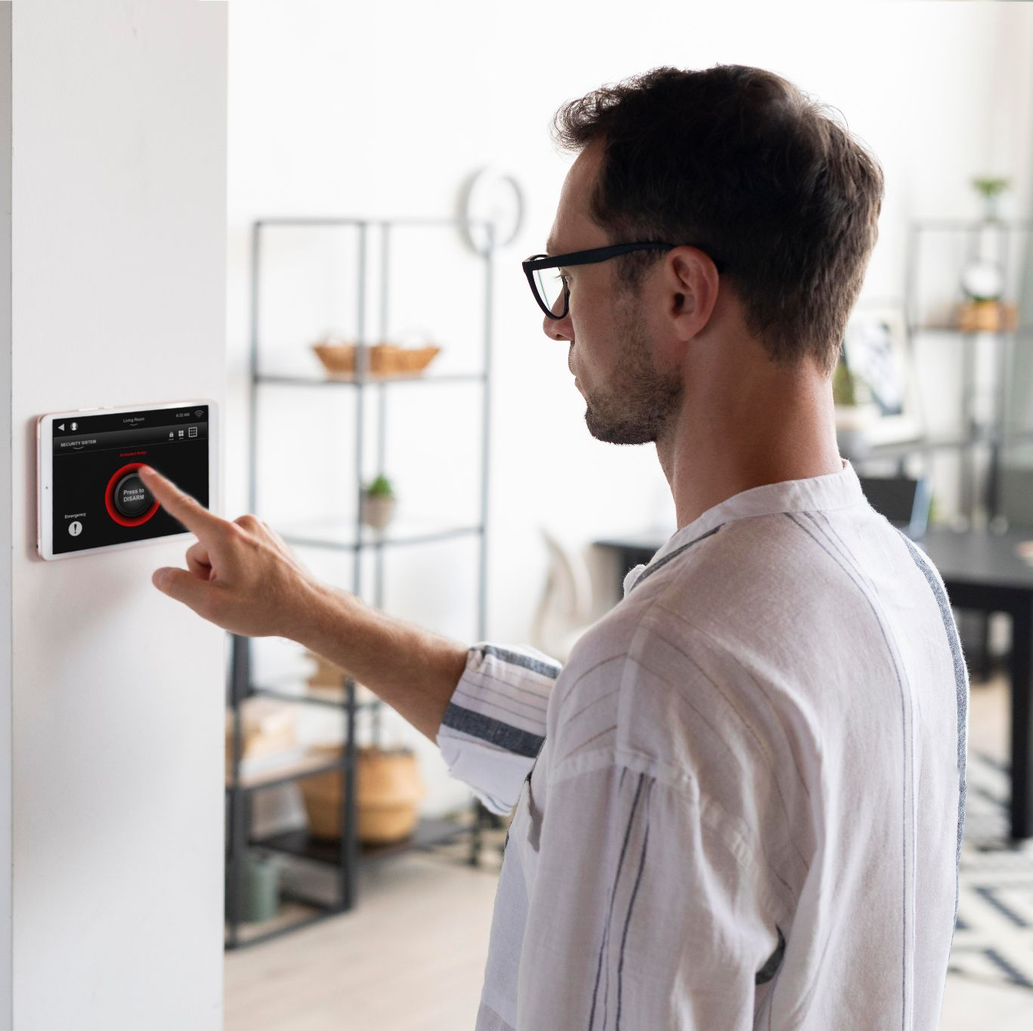
ISHE Phat Dat
Building and Installing Smart Home Equipment

Slide 2
Team Member
Supervisor
Member
Mr. Nguyễn Trí Thông
Hoàng Lê Duy ( FE )
Đỗ Thành Tú ( Mobile )
Trương Thành Trung ( BE )
Nguyễn Tuấn Tú ( BE )

Slide 3
TABLE OF CONTENTS
01
02
Overview
Technologies
03
04
Features
Demo
05
Conclusion

Slide 4
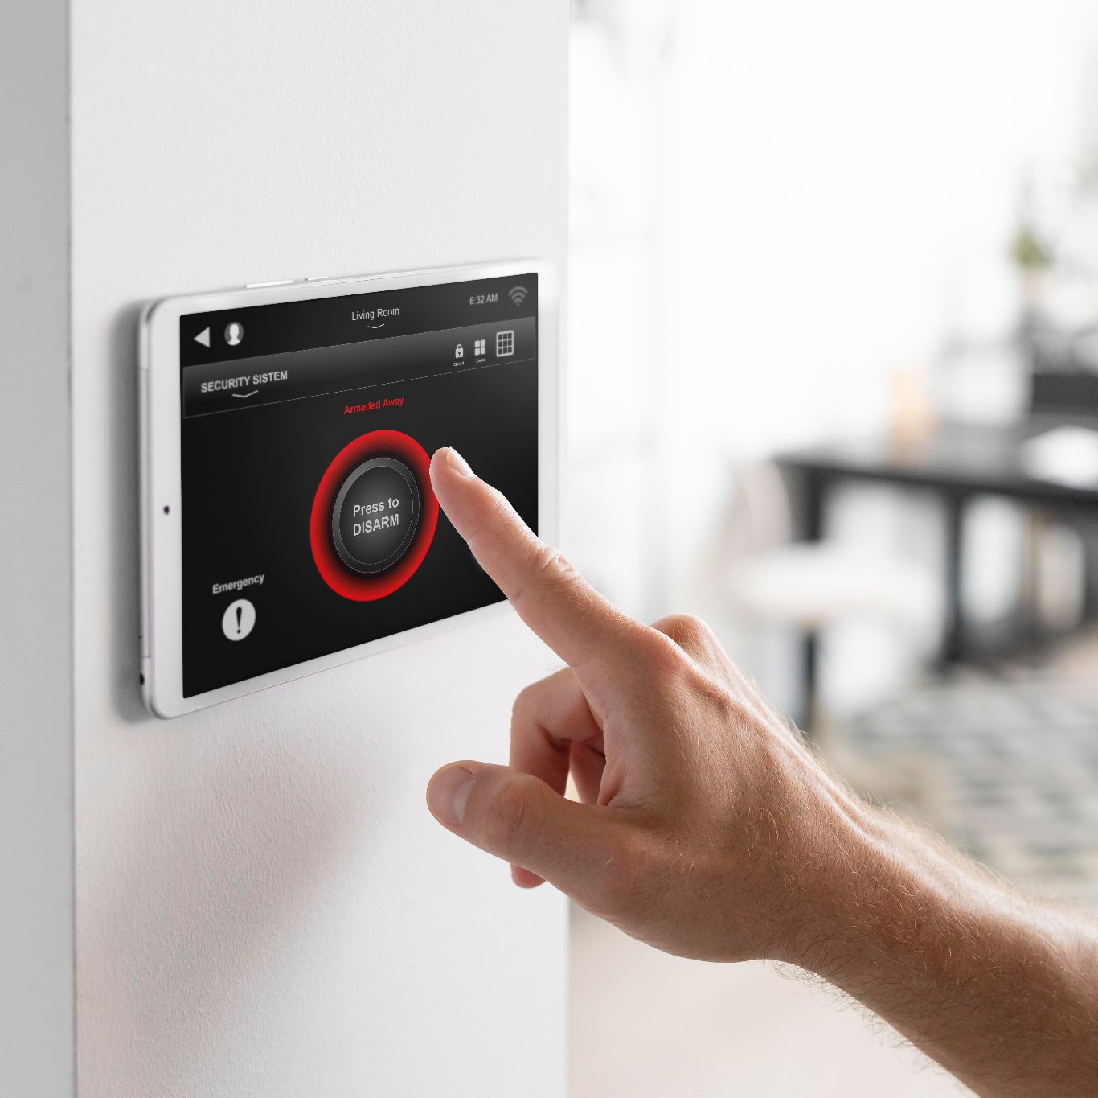
01.
OVERVIEW

Slide 5
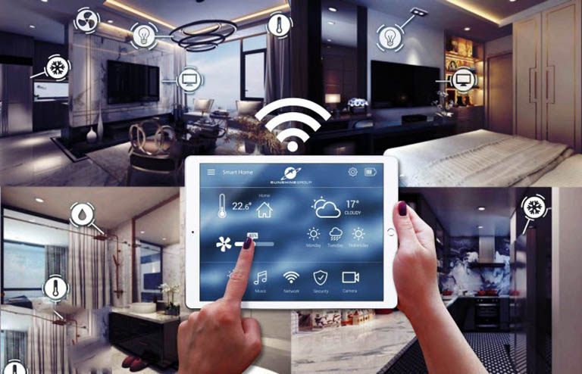

Context
The need to using the modern technologies
The need to improve quality of life

Slide 6

Is the sales management system for Phat Dat store in Ho Chi Minh City
Specializes in providing services:
Building & installing equipment
Survey at home
Consulting Conscientiously

Slide 7
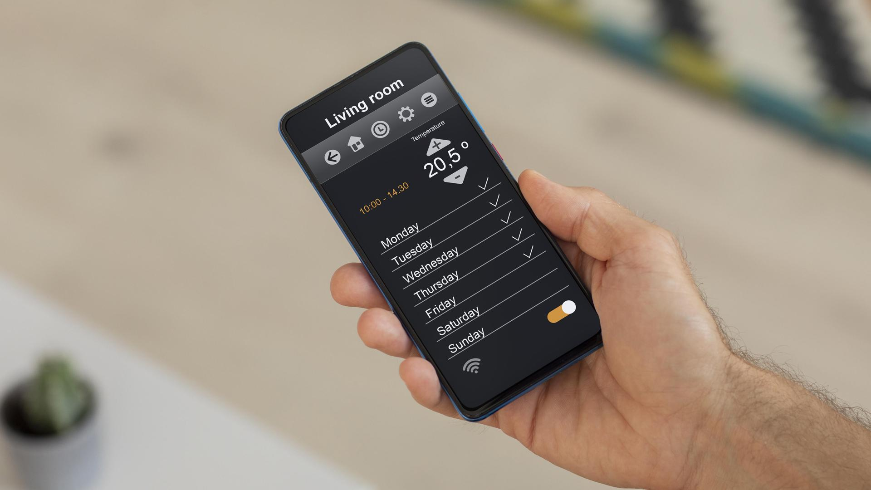
A PICTURE IS WORTH A THOUSAND WORDS

Slide 8
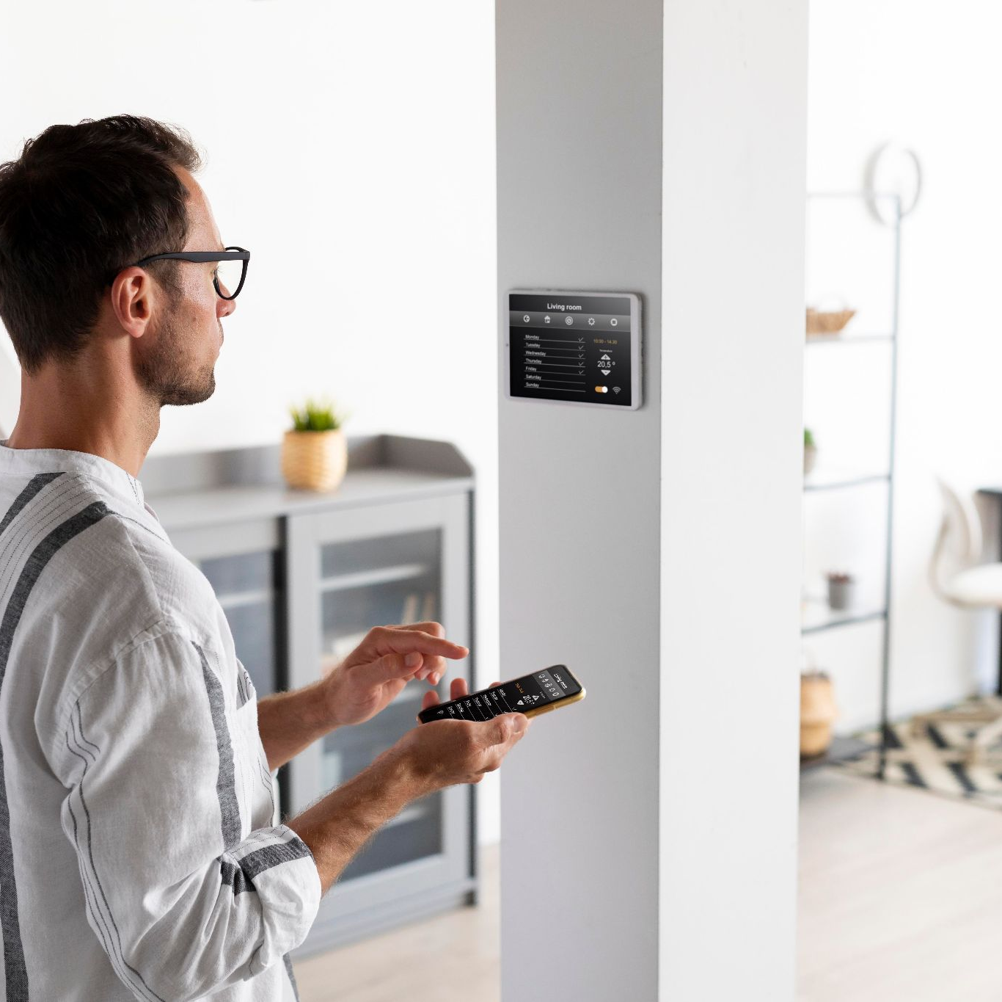
02.
TECHNOLOGY

Slide 9
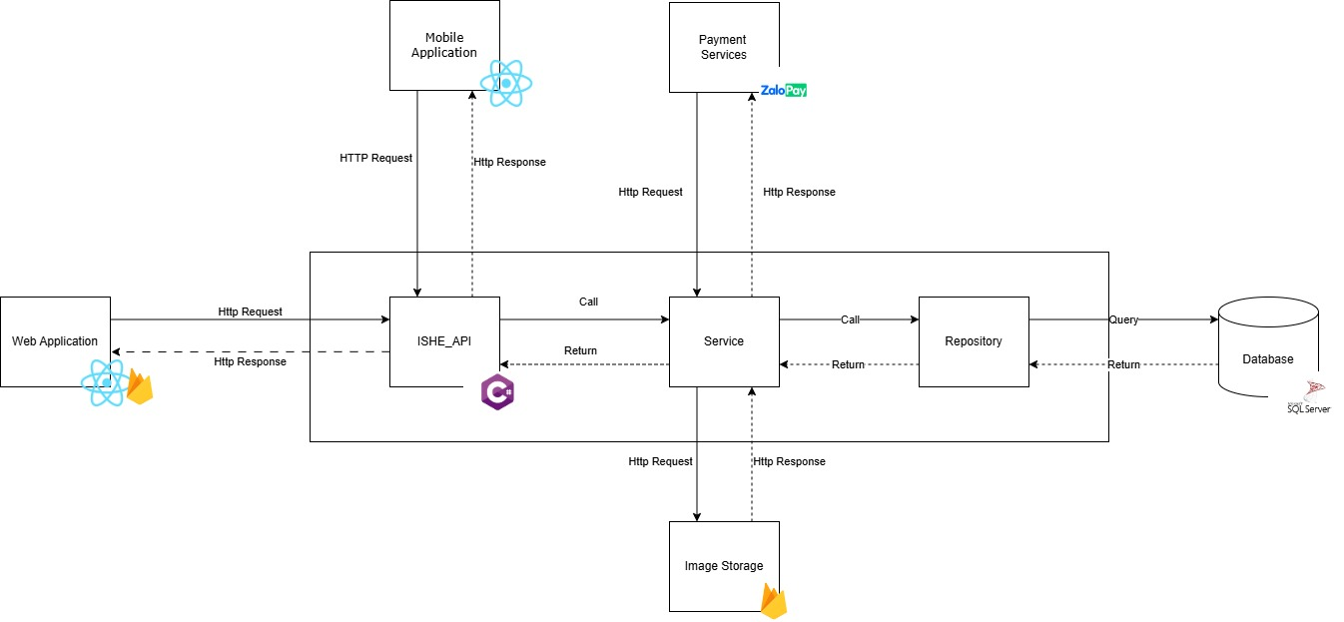
Technologies

Slide 10
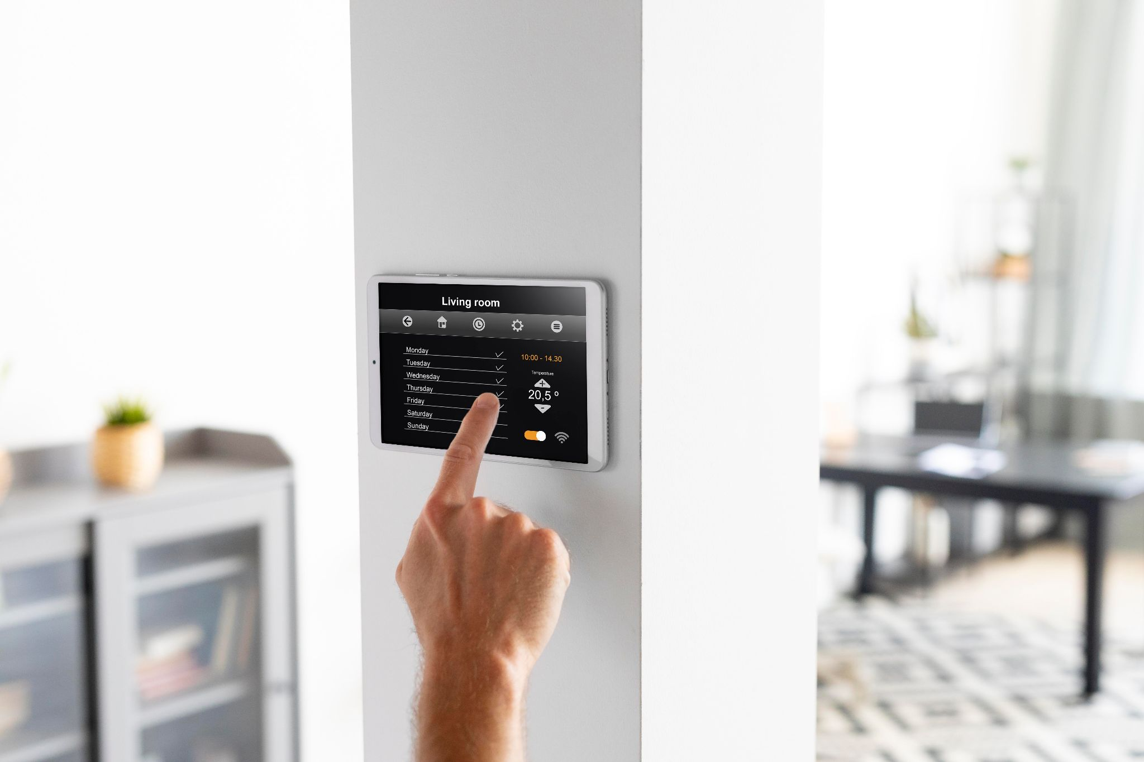
03.
FEATURES

Slide 11






MAJOR ACTOR
Web Application
Mobile Application
Owner
Teller
Customer
Staff

Slide 12
Owner
Manage Device
Manage Package
Manage Staff
Manage Promotion
View Revenue

Slide 13
Teller
Manage Request
Manage Contract
Assign Staff
Manage Survey
Chat

Slide 14
Staff
View / Update Request
View / Update Contract
Manage Report

Slide 15
Customer
Send Request
View Contract
Send Feedback
Payment
Chat

Slide 16
04.
Demo

Slide 17
Owner create Device
Manage device
View list device
Create device
Owner

Slide 18
Demo

Slide 19
Owner create Promotion
Manage promotion
View list promotion
Create promotion
Owner

Slide 20
Demo

Slide 21
Owner create Package
Manage package
View list package
Create package
Owner

Slide 22
Demo

Slide 23
Customer – send request
View package list
View package details
Send request survey
Customer
Chat
Teller

Slide 24
Demo

Slide 25


Teller & Staff assign staff & survey flow
View request list
Assign Staff
View request
Staff
Teller
Send report
Survey Succesfully
Teller

Slide 26
Demo

Slide 27

Teller & Customer create contract flow
View report list
Chat
Create contract
Teller
Customer
Teller

Slide 28
Demo

Slide 29


Staff & Customer deposit flow
Deposit
Upload Contract
Customer
Staff
Staff
Customer

Slide 30
Demo

Slide 31

Staff & Customer upload acceptance & payment flow
Payment
Upload acceptance
Staff
Staff
Customer

Slide 32
Demo

Slide 33
05.
Conclusion

Slide 34
Conclusion
The Project successfully developed the following features:
Successfully completed the device package management function and other manage functions
Offer device packages in a clear and concise way for customers to find according to their needs.
Successfully completed the construction and acceptance process of a contract

Slide 35
Limitations
Regional limitation: ISHE is currently only available in Ho Chi Minh City.
Limited platforms: ISHE only supports customer by Mobile App.
Limited product: ISHE only support customer buy package through App only.

Slide 36
FUTURE PLANS
Expand service area: Provide service nationwide.
E-business: Support buy single devices.
More platform: Develop for IOS.
More feature: Add revenue reporting feature and so on

Slide 37
THANKS
PLEASE KEEP THIS SLIDE FOR ATTRIBUTION

