Slide 1

All languages use datatypes
Type
Example
What is it?
numeric values with a fractional part, even if the fractional part is .0
float
3.14
or
3.0
int
42
10**100
integers – Python has infinite precision ints!
or
the T/F results from a test or comparison:
bool
True
or
False
==, !=, <, >, <=, >=
Hey! Someone can't spelle !
"Boolean values"
"Boolean oeprators"
George Boole
type( x )
Notes:
Electric: from www.staticfreesoftware.com
My tutorial is at:
http://odin.ac.hmc.edu/~harris/class/chipdesign/electric.pdf
Lasergene (a molecular biology suite of programs for aligning and comparing
DNA sequences, etc.)
Statview (statistical analysis)
KaleidaGraph (plotting & graphing)
Populus (programs that simulate ecological and evolutionary processes)

Slide 2
Python operators
higher precedence
( )
parens
**
power
-
negate
* / % //
times, mod, divide
add, subtract
+ -
> == <
compare
=
assign
It's not worth remembering all these %+/* things! I’d recommend parentheses over precedence.
Notes:
Electric: from www.staticfreesoftware.com
My tutorial is at:
http://odin.ac.hmc.edu/~harris/class/chipdesign/electric.pdf
Lasergene (a molecular biology suite of programs for aligning and comparing
DNA sequences, etc.)
Statview (statistical analysis)
KaleidaGraph (plotting & graphing)
Populus (programs that simulate ecological and evolutionary processes)

Slide 3
the "equals" operators
= != ==
This is true – but what is it saying!?
Notes:
Electric: from www.staticfreesoftware.com
My tutorial is at:
http://odin.ac.hmc.edu/~harris/class/chipdesign/electric.pdf
Lasergene (a molecular biology suite of programs for aligning and comparing
DNA sequences, etc.)
Statview (statistical analysis)
KaleidaGraph (plotting & graphing)
Populus (programs that simulate ecological and evolutionary processes)

Slide 4
the "equals" operators
= != ==
SET equals
isn't equal to
TEST equals
I want === !
Notes:
Electric: from www.staticfreesoftware.com
My tutorial is at:
http://odin.ac.hmc.edu/~harris/class/chipdesign/electric.pdf
Lasergene (a molecular biology suite of programs for aligning and comparing
DNA sequences, etc.)
Statview (statistical analysis)
KaleidaGraph (plotting & graphing)
Populus (programs that simulate ecological and evolutionary processes)

Slide 5
how = works
"Quiz"
name(s)
x = 41
y = x + 1
z = x + y
Run
these lines
x
y
z
What are x, y, and z at this time?
Then run this line
x = x + y
x
y
z
What are x, y, and z at this time?
Extra!
a = 11//2
b = a%3
c = b** a+b *a
What are the values of a, b, and c after the 3 lines, at left, run?
a
b
c

Slide 6
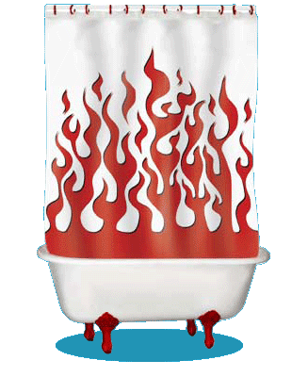
Inside the machine…
x = 41
y = x + 1
z = x + y
x = x + y
What's happening in python:
What's happening behind the scenes (in memory):
Computation
Memory (Data Storage)
41
42
name: x
type: int
LOC: 312
name: y
type: int
LOC: 324
83
83
name: z
type: int
LOC: 312
name: x
type: int
LOC: 324
id, del

Slide 7
Are numbers enough for everything?
Yes and no…
You need lists of numbers, as well!
and strings - lists of characters - too.
Both of these are Python sequences…

Slide 8
Data, data everywhere…
Data

Slide 9
strings: textual data
s = 'scripps'
strings
c = 'college'
type...
type(s)
len
len(s)
add!
s + c
multiply!!
2*s + 3*c
What did you say!?!

Slide 10
strings: textual data
s1 = 'ha'
Given
s2 = 't'
What are
s1 + s2
2*s1 + s2 + 2*(s1+s2)
What did you say!?!

Slide 11
Lists ~ collections of any data
M = [ 4, 7, 100, 42, 5, 47 ]
Notes:
Electric: from www.staticfreesoftware.com
My tutorial is at:
http://odin.ac.hmc.edu/~harris/class/chipdesign/electric.pdf
Lasergene (a molecular biology suite of programs for aligning and comparing
DNA sequences, etc.)
Statview (statistical analysis)
KaleidaGraph (plotting & graphing)
Populus (programs that simulate ecological and evolutionary processes)

Slide 12
Lists ~ collections of any data
Square brackets tell python you want a list.
Commas separate elements.
M = [ 4, 7, 100, 42, 5, 47 ]
len(M)
M[0]
M[0:3]
top-level length
indexing
slicing
Notes:
Electric: from www.staticfreesoftware.com
My tutorial is at:
http://odin.ac.hmc.edu/~harris/class/chipdesign/electric.pdf
Lasergene (a molecular biology suite of programs for aligning and comparing
DNA sequences, etc.)
Statview (statistical analysis)
KaleidaGraph (plotting & graphing)
Populus (programs that simulate ecological and evolutionary processes)

Slide 13
Lists ~ collections of any data
string
L = [ 3.14, [2,40], 'third', 42 ]
len(L)
L[0]
L[0:1]
top-level length
indexing
slicing
only counts top-level elements
could return a different type
always returns the same type, and always returns a substructure!
Notes:
Electric: from www.staticfreesoftware.com
My tutorial is at:
http://odin.ac.hmc.edu/~harris/class/chipdesign/electric.pdf
Lasergene (a molecular biology suite of programs for aligning and comparing
DNA sequences, etc.)
Statview (statistical analysis)
KaleidaGraph (plotting & graphing)
Populus (programs that simulate ecological and evolutionary processes)

Slide 14
Indexing uses [ ]
s = 'harvey mudd college'
0
1
2
3
4
5
6
7
8
9
10
11
12
13
14
15
16
17
18
index
Read as "s-of-zero" or "s-zero"
s[0]
'h'
is
s[17]
is
s[6]
is
s[ ]
'e'
is
Notes:
Selena's estoy contigo
Spanish was Selena's scond language

Slide 15
Negative indices…
In a negative mood ? Python's there for you !
0
1
2
3
4
5
6
7
8
9
10
11
12
13
14
15
16
17
18
s = 'harvey mudd college'
-19
-17
-15
-13
-11
-9
-7
-5
-3
-1
-18
-16
-14
-12
-10
-8
-6
-4
-2
Negative indices count backwards from the end!
s[-1]
'e'
is
s[-18]
is
s[-7]
is
s[-0]
is
Notes:
Selena's estoy contigo
Spanish was Selena's scond language

Slide 16
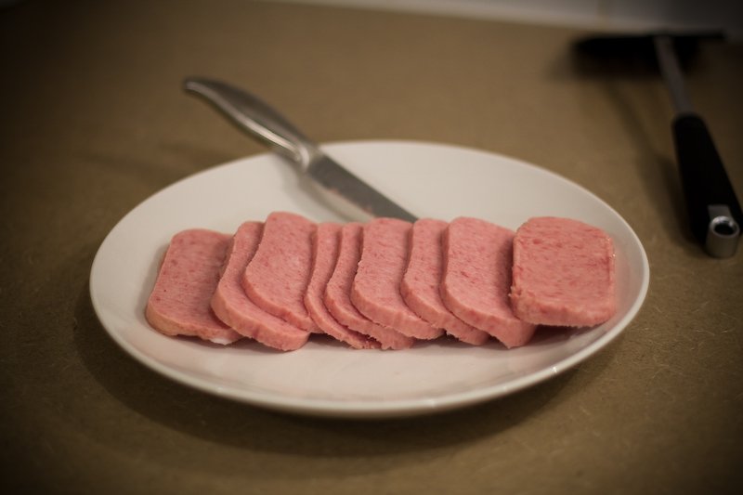
Slicing
s = 'harvey mudd college'
0
1
2
3
4
5
6
7
8
9
10
11
12
13
14
15
16
17
18
s[ : ]
slices the string, returning a substring
What's going on here?
s[0:6]
is
'harvey'
s[12:18]
is
'colleg'
s[17:]
is
'ge'
s[:]
is
'harvey mudd college'

Slide 17
Slicing
s = 'harvey mudd college'
0
1
2
3
4
5
6
7
8
9
10
11
12
13
14
15
16
17
18
start
end+1
s[ : ]
slices the string, returning a substring
first index is the first character
second index is ONE AFTER the last character
a missing index means that end of the string
s[0:6]
is
'harvey'
s[12:18]
is
'colleg'
s[17:]
is
'ge'
s[:]
is
'harvey mudd college'

Slide 18
Slicing
0
1
2
3
4
5
6
7
8
9
10
11
12
13
14
15
16
17
18
s = 'harvey mudd college'
-19
-18
-17
-16
-15
-14
-13
-12
-11
-10
-9
-8
-7
-6
-5
-4
-3
-2
-1
start
end+1
s[15:-1]
is
What are these slices?
s[:2]
is
is
'mud'
and these?
is
'e'
Don't wor'e'-
Be hap'e' !

Slide 19

Skip-Slicing
s[ : : ]
the third index is the stride length
default is +1
start
end+1
s = 'harvey mudd college'
0
1
2
3
4
5
6
7
8
9
10
11
12
13
14
15
16
17
18
s[0:8:2]
'hre '
is
s[17:12:-1]
is
s[::-1]
is
G. Garcia Marquez
is
'doe'
s[1::6]
is
I love this one.

Slide 20
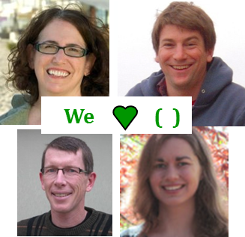
pi = [3,1,4,1,5,9]
Try it!
L = [ 'pi', "isn't", [4,2] ]
M = 'You need parentheses for chemistry !'
0
4
8
12
16
20
24
28
32
Part 1
Part 2
6
'pi'
What is len(pi)
What is L[0]
These three are all different
What is len(L)
What is L[0][1]
What is len(L[1])
What is L[0:1]
What slice of M is 'try'?
What is pi[2:4]
What slice of M is 'shoe'?
What slice of pi is [3,1,4]
pi[0:3]
What is M[9:15]
What slice of pi is [3,4,5]
What is M[::5]
Extra! Mind Muddler
What are pi[0]*(pi[1]+pi[2]) and pi[0]*(pi[1:2]+pi[2:3]) ?
These two are different!
Notes:
Prof. Aaron Laconte; Prof. Katie Purvis-Roberts

Slide 21




pi = [3,1,4,1,5,9]
Try it!
L = [ 'pi', "isn't", [4,2] ]
We ( )
M = 'You need parentheses for chemistry !'
0
4
8
12
16
20
24
28
32
Part 1
Part 2
6
'pi'
What is len(pi)
What is L[0]
These three are all different
3
'i'
What is len(L)
What is L[0][1]
['pi']
What is len(L[1])
What is L[0:1]
[4,1]
What slice of M is 'try'?
M[31:34]
or
M[-5:-2]
What is pi[2:4]
pi[:3]
What slice of M is 'shoe'?
What slice of pi is [3,1,4]
'parent'
What is M[9:15]
pi[::2]
What slice of pi is [3,4,5]
What is M[::5]
Extra! Mind Muddlers
What are pi[0]*(pi[1]+pi[2]) and pi[0]*(pi[1:2]+pi[2:3]) ?
These two are different!
15
[1,4,1,4,1,4]
Notes:
Prof. Aaron Laconte; Prof. Katie Purvis-Roberts

Slide 22
Python slices - it dices...
( data, at least )
… but wait, there's more!

Slide 23
Python slices - it dices...
( data, at least )
Python functions
… but wait, there's more!

Slide 24
Functioning in Python
# my own function!
def dbl( x ):
""" returns double its input, x """
return 2x
This doesn't look quite right…

Slide 25
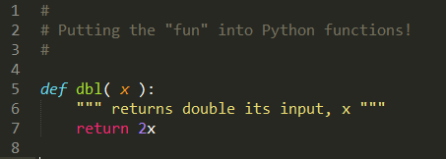
Functioning in Python
IDLE vs Monokai colorschemes
Still broken… !

Slide 26
Functioning in Python
comment for other coders
# my own function!
def dbl( x ):
""" returns double its input, x """
return 2*x
documentation string for all users
Python's keywords
Some of Python's baggage…

Slide 27
Function Fun !
def undo(s):
""" this "undoes" its input, s """
return 'de' + s
>>> undo('caf')
'decaf'
>>> undo(undo('caf'))
strings, lists, numbers … all data are fair game

Slide 28
Functioning in Python
Some basic, built-in functions:
abs
max
min
sum
range
round
bool
float
int
long
list
str
absolute value
of lists
these change data from one type to another
creates lists
only as accurately as it can!
You call that a language?!
These are the most important:
help
dir

Slide 29
Functioning in Python
Far more are available in separate files, or modules:
import math
math.sqrt( 1764 )
dir(math)
accesses math.py's functions
lists all of math.py's functions
from math import *
pi
sin( pi/2 )
same, but without typing math. all of the time…
help()
help modules

Slide 30
while we're here…
import random
while True:
x = random.choice( range(0,100) )
print 'I got a', x
control-c is good to remember!

Slide 31
random thoughts
import random
random.choice( [41,42,43] )
random.choice( range(0,100) )
These are the most important:
help
dir

Slide 32
print vs. return
# is it dis-0 or dis-O, anyway?
def undo(s):
""" this "undoes" its string input, s """
return 'de' + s
>>> undo(undo('caf'))
# !?
def undopr(s):
""" hmmm """
print 'de' + s

Slide 33
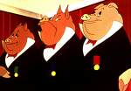
Any real computing with strings/lists?
Some strings are more equal than others…

Slide 34
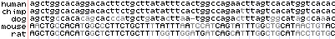
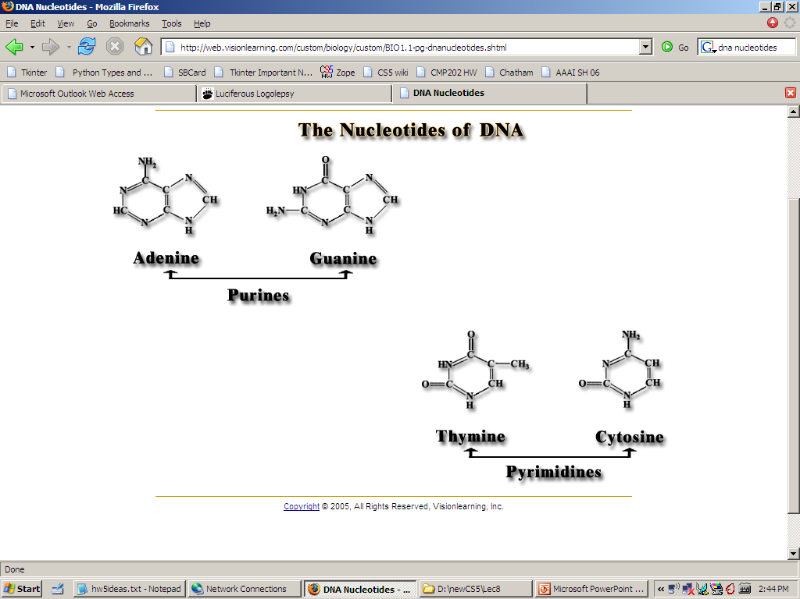
DNA
Our DNA's nucleotides:
http://genome.ucsc.edu/cgi-bin/hgGateway
AGCT
Notes:
building blocks!
Electric: from www.staticfreesoftware.com
My tutorial is at:
http://odin.ac.hmc.edu/~harris/class/chipdesign/electric.pdf
Lasergene (a molecular biology suite of programs for aligning and comparing
DNA sequences, etc.)
Statview (statistical analysis)
KaleidaGraph (plotting & graphing)
Populus (programs that simulate ecological and evolutionary processes)

Slide 35
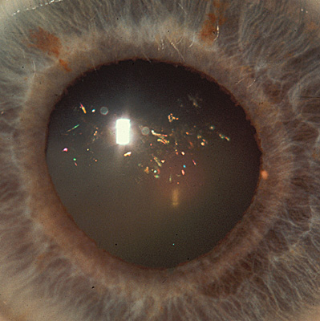
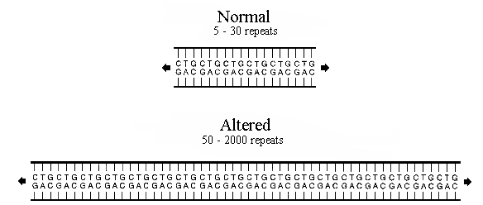
DNA
Genetic disease expression
Myotonic Dystrophy
neuromuscular weakness in the face/torso
"Christmas Tree cataracts"
www.neuro.wustl.edu/neuromuscular/musdist/pe-eom.html#myd
Its computational basis
CTG repeats
in the 3' UTR (three prime untranslated region), a particular section of messenger RNA
Notes:
http://www.neuro.wustl.edu/neuromuscular/musdist/pe-eom.html#myd
this is the link
Lasergene (a molecular biology suite of programs for aligning and comparing
DNA sequences, etc.)
Statview (statistical analysis)
KaleidaGraph (plotting & graphing)
Populus (programs that simulate ecological and evolutionary processes)

Slide 36
One sequence-checking algorithm…
def check(geneseq):
""" seeks evidence of Myo. Dys.
"""
if 'ctg'*50 in geneseq:
return True
else:
return False
checks if one string is contained in another
Can we make this algorithm more concise?
Why problems might this algorithm run into?
What information might we prefer to know?
What if we hadn't discovered the CTG-repeats yet?

Slide 37

The in thing
>>> 3*'i' in 'alien'
False
python is badly confused here…
>>> 'i' in 'team'
False
but otherwise it seems pretty perceptive!
>>> 'cs' in 'physics'
True
>>> 'sleep' not in 'harvey mudd'
True
>>> 42 in [41,42,43]
True
a little bit different for lists…
>>> 42 in [ [42], '42' ]
False

Slide 38
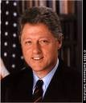
Do you remember?
This time…
strings
Way back in the '90s?!
lists
indexing
slicing
more on functions…
docstrings
comments
Next time…
Making up one's mind

Slide 39

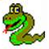
Data types
Python maintains data by type :
Not enough snakes for my taste…
Numeric types
float
>>> type(3.14)
<type ‘float’>
long
int
bool
>>> type(True)
<type ‘bool’>
Sequence types
list
>>> type(‘writer’)
<type ‘str’>
str
?
( tuple )
>>> type([1,2,3])
<type ‘list’>
Notes:
python as a rather orwellian overlord…

Slide 40
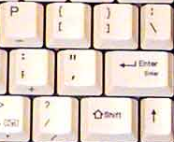
str(ing)ing us along
typing strings from scratch
"double quotes"
'single quotes'
triple-quoted strings allow line breaks…
"""
triple
double
quotes!
"""
'''triple
single
quotes!'''
Give me a (line) break!
Why two types of quote character?

Slide 41
'something's wrong here!'

Slide 42
'something's wrong here!'
"but now we're all right…"

