Slide 1
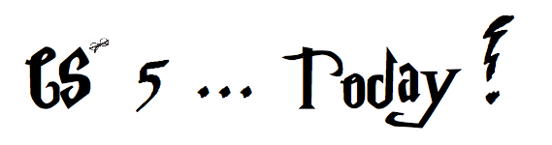
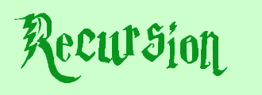

MAGIC!?
As close as CS gets to magic
a.k.a., CS's version of mathematical induction
Tutoring hours: LOTS!
Hw #1 due this Monday, 9/12, at 11:59 pm
This is the last CS 5 lecture you’ll ever "need"!*
HMC's legal counsel requires us to include these footnotes…
On Warner Brothers' insistence, we affirm that this 'C' does not stand for 'Chamber' and 'S' does not stand for 'Secrets.'
*
Caution: do not take this statement too literally or it is possible find yourself in twice as many CS 5 lectures as you need!
Notes:
recursion -- seems like magic
Gilderoy Lockhart

Slide 2
Python is… in
MAGIC!
>>> 'i' in 'team'
False
>>> 'cs' in 'physics'
True
I guess Python's the in thing
>>> 'i' in 'alien'
True
>>> 3*'i' in 'alien'
False
>>> 42 in [41,42,43]
True
>>> 42 in [[42], '42']
False

Slide 3
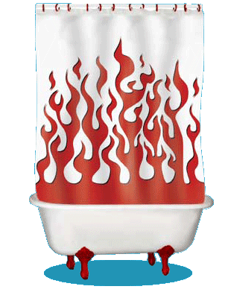
Computation's Dual Identity
Computation
Data Storage
41
42
name: x
type: int
LOC: 300
name: y
type: int
LOC: 304
memory location 300
memory location 304
variables ~ boxes
Last time
But what does the stuff on this side look like ?

Slide 4

Computation's Dual Identity
accessed through functions…
Computation
Data Storage
41
42
name: x
type: int
LOC: 300
name: y
type: int
LOC: 304
memory location 300
memory location 304
Functions!
variables ~ boxes
It's no coincidence this starts with fun!

Slide 5
Functioning across disciplines
procedure
structure
def g(x):
return x**100
g(x) = x¹⁰⁰
CS's googolizer
Math's googolizer
defined by what it does
defined by what it is
+ what follows behaviorally
+ what follows logically
Notes:
my foreign language teachers always tried to convince me that the skill of speaking, reading and writing a foreign language…
I didn’t believe them then and I don’t believe them now -- but I do believe that reading and writing a computer language is the way to get a strong intuitive understanding of how machines think -- it’s also important for getting them to do what you want them to, but even if you forget everything this course (hopefully) teaches about Java (compiler, datatypes, Classes and Objects), the real goal is that you take away a deeper insight into how machines think
familiar and sometimes not so familiar… deceptively easy
you mean I have to type all that!!

Slide 6
Giving names to data helps f'ns
def flipside(s):
""" flipside(s): swaps s's sides!
input s: a string
"""
x = len(s)//2
return s[x:] + s[:x]
This idea is the key to your happiness!
Notes:
show help!

Slide 7

Use variables!
I'm happy about this, too!
def flipside(s):
x = len(s)//2
return s[x:] + s[:x]
def flipside(s):
return s[len(s)//2:] + s[:len(s)//2]
Aargh!
Why would computers "prefer" the top version, too?
Notes:
show help!

Slide 8
Test!
def flipside(s):
""" flipside(s): swaps s's sides!
input s: a string
"""
x = len(s)/2
return s[x:] + s[:x]
#
# Tests!
#
print("workhome ~", flipside('homework'))
print(" petscar ~", flipside('carpets'))
print(" cs5! ~", flipside('5!cs'))
(1) function definition
(2) function tests
We provide tests (for now…)
Notes:
show help!

Slide 9
Using variables…
This program uses variables constantly!
def convertFromSeconds(s): # total seconds
""" convertFromSeconds(s): Converts an
integer # of seconds into a list of
[days, hours, minutes, seconds]
input s: an int
"""
days = s // (24*60*60) # total days
s = s % (24*60*60) # remainder s
hours = s // (60*60) # total hours
s = s % (60*60) # remainder s
minutes = s // 60 # total minutes
s = s % 60 # remainder s
return [days, hours, minutes, s]
Notes:
show help!

Slide 10
Using variables…
This program uses variables constantly!
name
signature line
def convertFromSeconds(s): # total seconds
""" convertFromSeconds(s): Converts an
integer # of seconds into a list of
[days, hours, minutes, seconds]
input s: an int
"""
days = s // (24*60*60) # total days
s = s % (24*60*60) # remainder s
hours = s // (60*60) # total hours
s = s % (60*60) # remainder s
minutes = s // 60 # total minutes
s = s % 60 # remainder s
return [days, hours, minutes, s]
docstring
comments –these are mostly optional in CS 5
code block
return statement
Notes:
show help!

Slide 11
return vs. print
def dbl(x):
""" dbls x? """
return 2*x
def dblPR(x):
""" dbls x? """
print(2*x)
In[1]: ans = dbl(20)
In[1]: ans = dblPR(20)
What's the difference ?!

Slide 12
return > print
def dbl(x):
""" dbls x? """
return 2*x
def dblPR(x):
""" dbls x? """
print(2*x)
>>> ans = dbl(20)+2
>>> ans = dblPR(20)+2
yes!
ouch!
print changes pixels on the screen...
… which the shell then prints!
return yields the function call's value …

Slide 13
Name(s):
Quiz
15
How f'ns work…
What is demo(15) here?
def demo(x):
y = x/3
z = g(y)
return z + y + x
def g(x):
result = 4*x + 2
return result
I might have a guess at both of these…
What is f(2) here?
def f(x):
if x == 0:
return 12
else:
return f(x-1) + 10*x
Notes:
vault 713?

Slide 14
How functions work…
15
"the stack"
def demo(x):
y = x/3
z = g(y)
return z + y + x
def g(x):
result = 4*x + 2
return result
they stack.
Notes:
vault 713?

Slide 15
How functions work…
15
"the stack"
def demo(x):
y = x/3
z = g(y)
return z + y + x
call: demo(15)
stack frame
local variables:
x = 15
y = 5
z = ?????
def g(x):
result = 4*x + 2
return result
they stack.
Notes:
vault 713?

Slide 16
How functions work…
15
"the stack"
def demo(x):
y = x/3
z = g(y)
return z + y + x
call: demo(15)
stack frame
local variables:
x = 15
y = 5
z = ?????
def g(x):
result = 4*x + 2
return result
call: g(5)
stack frame
local variables:
x = 5
result = 22
returns 22
they stack.
Notes:
vault 713?

Slide 17
How functions work…
15
"the stack"
def demo(x):
y = x/3
z = g(y)
return z + y + x
call: demo(15)
stack frame
local variables:
x = 15
y = 5
z = ?????
def g(x):
result = 4*x + 2
return result
call: g(5)
stack frame
local variables:
x = 5
result = 22
returns 22
they stack.
Notes:
vault 713?

Slide 18
How functions work…
15
"the stack"
def demo(x):
y = x/3
z = g(y)
return z + y + x
call: demo(15)
stack frame
local variables:
x = 15
y = 5
z = 22
def g(x):
result = 4*x + 2
return result
they stack.
Notes:
vault 713?

Slide 19
How functions work…
15
"the stack"
def demo(x):
y = x/3
z = g(y)
return z + y + x
call: demo(15)
stack frame
local variables:
x = 15
y = 5
z = 22
return 42
def g(x):
result = 4*x + 2
return result
they stack.
Notes:
vault 713?

Slide 20
How functions work…
15
"the stack"
42
def demo(x):
y = x/3
z = g(y)
return z + y + x
afterwards, the stack is empty…, but ready if another function is called
output
def g(x):
result = 4*x + 2
return result
they stack.
Notes:
vault 713?

Slide 21
How functions work…
2
what's f(2) ?
"the stack"
def f(x):
if x == 0:
return 12
else:
return f(x-1) + 10*x
Notes:
vault 713?

Slide 22
How functions work…
2
"the stack"
def f(x):
if x == 0:
return 12
else:
return f(x-1) + 10*x
call: f(2)
stack frame
local variables:
x = 2
need f(1)
Notes:
vault 713?

Slide 23
How functions work…
1
"the stack"
def f(x):
if x == 0:
return 12
else:
return f(x-1) + 10*x
call: f(2)
stack frame
local variables:
x = 2
need f(1)
call: f(1)
stack frame
local variables:
x = 1
need f(0)
Notes:
vault 713?

Slide 24
How functions work…
0
"the stack"
def f(x):
if x == 0:
return 12
else:
return f(x-1) + 10*x
call: f(2)
stack frame
local variables:
x = 2
need f(1)
call: f(1)
stack frame
local variables:
x = 1
need f(0)
call: f(0)
stack frame
local variables:
x = 0
returns 12
Notes:
vault 713?

Slide 25
How functions work…
0
"the stack"
def f(x):
if x == 0:
return 12
else:
return f(x-1) + 10*x
call: f(2)
stack frame
local variables:
x = 2
need f(1)
call: f(1)
stack frame
local variables:
x = 1
need f(0)
call: f(0)
stack frame
local variables:
x = 0
returns 12
Notes:
vault 713?

Slide 26
How functions work…
1
"the stack"
def f(x):
if x == 0:
return 12
else:
return f(x-1) + 10*x
call: f(2)
stack frame
local variables:
x = 2
need f(1)
call: f(1)
stack frame
local variables:
x = 1
f(0) = 12
result =
How do we compute the result?
Notes:
vault 713?

Slide 27
How functions work…
1
"the stack"
def f(x):
if x == 0:
return 12
else:
return f(x-1) + 10*x
call: f(2)
stack frame
local variables:
x = 2
need f(1)
call: f(1)
stack frame
local variables:
x = 1
f(0) = 12
result = 22
Where does that result go?
Notes:
vault 713?

Slide 28
How functions work…
1
"the stack"
def f(x):
if x == 0:
return 12
else:
return f(x-1) + 10*x
call: f(2)
stack frame
local variables:
x = 2
need f(1)
call: f(1)
stack frame
local variables:
x = 1
f(0) = 12
result = 22
Notes:
vault 713?

Slide 29
How functions work…
2
"the stack"
def f(x):
if x == 0:
return 12
else:
return f(x-1) + 10*x
call: f(2)
stack frame
local variables:
x = 2
f(1) = 22
result =
What's this return value?
Notes:
vault 713?

Slide 30
How functions work…
2
"the stack"
def f(x):
if x == 0:
return 12
else:
return f(x-1) + 10*x
call: f(2)
stack frame
local variables:
x = 2
f(1) = 22
result = 42
which then gets returned…
Notes:
vault 713?

Slide 31
How functions work…
2
"the stack"
def f(x):
if x == 0:
return 12
else:
return f(x-1) + 10*x
call: f(2)
stack frame
local variables:
x = 2
f(1) = 22
result = 42
the result then gets returned…
Notes:
vault 713?

Slide 32
How functions work…
2
42
"the stack"
def f(x):
if x == 0:
return 12
else:
return f(x-1) + 10*x
output
again, the stack is empty, but ready if another function is called…
functions stack.
Notes:
vault 713?

Slide 33
How functions work…
2
42
"the stack"
def f(x):
if x == 0:
return 12
else:
return f(x-1) + 10*x
output
again, the stack is empty, but ready if another function is called…
Functions are like cells: software's building blocks…
… each one, a self-contained computational unit!
functions stack.
Notes:
vault 713?

Slide 34
function design
Notes:
vault 713?

Slide 35
Thinking sequentially
factorial
5 ! = 120
math
fac(5) = 5*4*3*2*1
CS
fac(N) = N*(N-1)* … *3*2*1

Slide 36
Thinking sequentially
factorial
5 ! = 120
math
October + beyond…
fac(5) = 5*4*3*2*1
CS
fac(N) = N*(N-1)* … *3*2*1

Slide 37
Thinking recursively
factorial
5 ! = 120
fac(5) = 5*4*3*2*1
fac(5) =
can we express fac w/ a smaller version of itself?
fac(N) = N*(N-1)* … *3*2*1
fac(N) =

Slide 38
Thinking recursively
Recursion ~ self-similarity
factorial
5 ! = 120
fac(5) = 5*4*3*2*1
fac(5) = 5 * fac(4)
can we express fac w/ a smaller version of itself?
fac(N) = N*(N-1)* … *3*2*1
fac(N) = N * fac(N-1)

Slide 39
overall goal
fac(5)
output value of 5*4*3*2*1
Recursion, the process
fac(5)
starting from 5, decreasing to 1
5*4*3*2*1
integers from 5 down to 1, multiplied together
fac(5)
Notes:
recursion -- seems like magic
Gilderoy Lockhart

Slide 40
overall goal
fac(5)
output value of 5*4*3*2*1
is
fac(5)
overall goal
value of 5
output value of 4*3*2*1
*
combined with
fac(4)
one, small piece
self-similar "rest"
Recursion, the process
Notes:
recursion -- seems like magic
Gilderoy Lockhart

Slide 41
overall goal
fac(N)
output value of N*(N-1)*...*2*1
is
fac(N)
overall goal
value of N
output value of (N-1)*...*2*1
*
combined with
fac(N-1)
one, small piece
self-similar "rest"
Recursion, the process
Notes:
recursion -- seems like magic
Gilderoy Lockhart

Slide 42

Recursion's conceptual challenge?
You need to see BOTH the self-similar pieces AND the whole thing simultaneously!
Nature loves recursion!

Slide 43
overall goal
fac(N)
output value of N*(N-1)*...*2*1
is
fac(N)
overall goal
value of N
output value of (N-1)*...*2*1
*
combined with
fac(N-1)
one, small piece
self-similar "rest"
fac(N)
Recursion, the code!
Notes:
recursion -- seems like magic
Gilderoy Lockhart

Slide 44
Warning: this is legal!
def fac(N):
return N * fac(N-1)
I wonder how this code will STACK up!?
def facBad(N):
return N * facBad(N-1)
Notes:
Was that Gandalf or Dumbledore that "fell forever" ?

Slide 45
legal != recommended
def facBad(N):
return N * facBad(N-1)
calls to facBad will never stop: there's no BASE CASE
Make sure you have a base case
a.k.a. "escape hatch"
How about an escape from recursion itself!?!

Slide 46
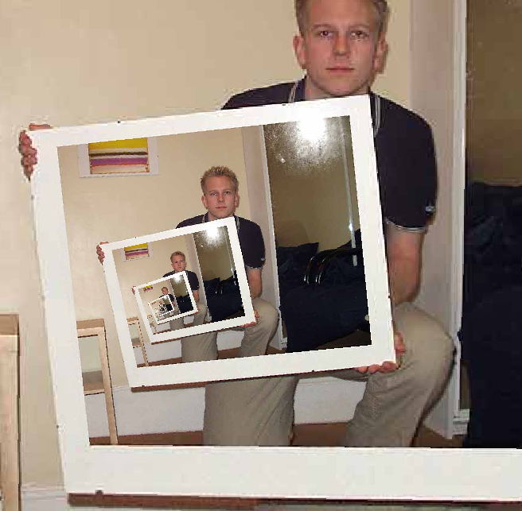
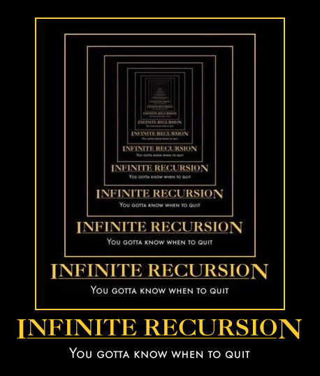
This "works" ~ but doesn't work!
def fac(N):
return fac(N)
Recursion
the dizzying dangers of having no base case!

Slide 47
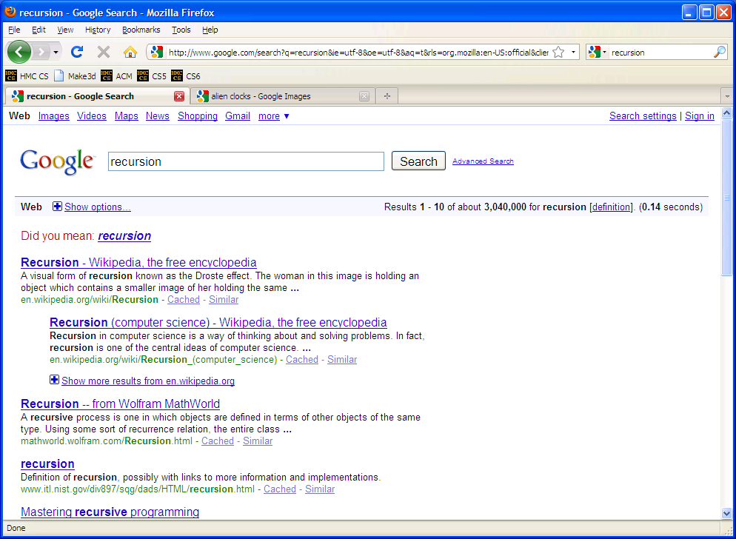

Slide 48
overall goal
fac(N)
output value of N*(N-1)*...*2*1
is
fac(N)
overall goal
value of N
output value of (N-1)*...*2*1
*
combined with
fac(N-1)
one, small piece
self-similar "rest"
fac(N)
base case:
output for fac(0) is 1
smallest possible input
its output
Notes:
recursion -- seems like magic
Gilderoy Lockhart

Slide 49
Thinking recursively...
def fac(N):
if N == 0:
return 1
else:
return N*fac(N-1)
Base case
Recursive case
(too short?)

Slide 50
Acting recursively
def fac(N):
if N <= 1:
return 1
else:
return N*fac(N-1)
def fac(N):
if N <= 1:
return 1
else:
rest = fac(N-1)
return N*rest
this recursion happens first!
hooray for variables!
Conceptual
Actual

Slide 51
Behind the curtain:
how recursion works...
def fac(N):
if N <= 1:
return 1.0
else:
return N * fac(N-1)
fac(5)
5 * fac(4)
4 * fac(3)
3 * fac(2)
2 * fac(1)
1.0

Slide 52
Behind the curtain:
how recursion works...
def fac(N):
if N <= 1:
return 1.0
else:
return N * fac(N-1)
fac(5)
5 * fac(4)
stack frame with N = 5
4 * fac(3)
stack frame with N = 4
3 * fac(2)
stack frame with N = 3
2 * fac(1)
stack frame with N = 2
1.0
stack frame with N = 1

Slide 53
Behind the curtain:
how recursion works...
def fac(N):
if N <= 1:
return 1.0
else:
return N * fac(N-1)
fac(5)
5 * fac(4)
stack frame with N = 5
4 * fac(3)
stack frame with N = 4
3 * fac(2)
stack frame with N = 3
2 * 1.0
stack frame with N = 2

Slide 54
Behind the curtain:
how recursion works...
def fac(N):
if N <= 1:
return 1.0
else:
return N * fac(N-1)
fac(5)
5 * fac(4)
stack frame with N = 5
4 * fac(3)
stack frame with N = 4
3 * 2.0
stack frame with N = 3

Slide 55
Behind the curtain:
how recursion works...
def fac(N):
if N <= 1:
return 1.0
else:
return N * fac(N-1)
fac(5)
5 * fac(4)
stack frame with N = 5
4 * 6.0
stack frame with N = 4

Slide 56
Behind the curtain:
how recursion works...
def fac(N):
if N <= 1:
return 1.0
else:
return N * fac(N-1)
fac(5)
5 * 24.0
stack frame with N = 5

Slide 57
Behind the curtain:
how recursion works...
def fac(N):
if N <= 1:
return 1.0
else:
return N * fac(N-1)
fac(5)
complete!
120.0

Slide 58
Behind the curtain:
how recursion works...
def fac(N):
if N <= 1:
return 1.0
else:
return N * fac(N-1)
fac(5)
complete!
120.0
Recursion, the design process

Slide 59
Recursive Design: the 3 i's
Eye approve!
identify
self-similarities & base cases
intuition
implement

Slide 60
Recursive Design: the 3 i's
Eye approve!
What's the self-similarity?
Examples!
identify
self-similarities & base cases
Python...
intuition
implement

Slide 61
overall goal
fac(5)
output value of 5*4*3*2*1
fac(5)
starting from 5, decreasing to 1
Examples!
5*4*3*2*1
integers from 5 down to 1, multiplied together
fac(5)
Notes:
recursion -- seems like magic
Gilderoy Lockhart

Slide 62
overall goal
fac(5)
output value of 5*4*3*2*1
is
fac(5)
overall goal
value of 5
output value of 4*3*2*1
*
combined with
fac(4)
one, small piece
self-similar "rest"
Examples!
What's the self-similarity?
Notes:
recursion -- seems like magic
Gilderoy Lockhart

Slide 63
overall goal
fac(N)
output value of N*(N-1)*...*2*1
is
fac(N)
What's the self-similarity?
overall goal
value of N
output value of (N-1)*...*2*1
*
combined with
fac(N-1)
one, small piece
self-similar "rest"
What's the base case?
base case:
output for fac(0) is 1
smallest possible input
its output
Notes:
recursion -- seems like magic
Gilderoy Lockhart

Slide 64
Python...
def fac(N):
if N == 0:
return 1
else:
return N*fac(N-1)
Base case
Recursive case
(too short?)

Slide 65
Recursive Design: the 3 i's
Aye, aye, eye!
rec.
fac(5) is 5*4*3*2*1
fac(N) is
rec.
self-similarities
fac(4) is 4*3*2*1
fac(3) is 3*2*1
identify
base cases
base cases
self-similarities & base cases
fac(2) is 2*1
fac(1) is 1
base case
def fac(N):
if N <= 1:
return 1.0
else:
return N * fac(N-1)
fac(0) is 1
rec.
base case(s)
intuit
implement

Slide 66
Recursive Design: the 3 i's
rec.
fac(5) is 5*4*3*2*1
fac(N) is N*fac(N-1)
rec.
self-similarities
the order of base cases and recursive cases usually doesn't matter
fac(4) is 4*3*2*1
fac(3) = 3*2*1
identify
base cases
base cases
self-similarities & base cases
fac(2) = 2*1
fac(1) = 1
rec.
def fac(N):
if N > 0:
return N * fac(N-1)
else:
return 1.0
fac(0) is 1
base case(s)
base case
intuit
implement

Slide 67
Recursive Design: the 3 i's
rec.
fac(5) is 5*4*3*2*1
fac(N) is N*fac(N-1)
rec.
self-similarities
Let's try two more examples together – and then try 2-3 on your own...
fac(4) is 4*3*2*1
fac(3) = 3*2*1
identify
base cases
base cases
self-similarities & base cases
fac(2) = 2*1
fac(1) = 1
rec.
def fac(N):
if N > 0:
return N * fac(N-1)
else:
return 1.0
fac(0) is 1
base case(s)
base case
intuit
implement

Slide 68
Recursive Design: the 3 i's
rec.
plusone(4) is 1+1+1+1
plusone(N)
recursion?
self-similarities
plusone(3) is 1+1+1
plusone(2) is 1+1
identify
base cases
base cases
self-similarities & base cases
plusone(1) is 1
plusone(0) is 0
base case
def plusone(N):
if _______:
return ___
else:
return ______________
rec.
base case(s)
intuit
implement

Slide 69
overall goal
plusone(4)
output value of 1+1+1+1
plusone(4)
4 times
1+1+1+1
+1 added together, 4 times
plusone(4)
Notes:
recursion -- seems like magic
Gilderoy Lockhart

Slide 70
overall goal
plusone(4)
output value of 1+1+1+1
is
plusone(4)
overall goal
value of 1
output value of 1+1+1
+
combined with
plusone(3)
one, small piece
self-similar "rest"
example with concrete values
Notes:
recursion -- seems like magic
Gilderoy Lockhart

Slide 71
overall goal
plusone(N)
output value of 1+1+...+1
is
plusone(N)
overall goal
value of 1
output value of 1+...+1
+
combined with
plusone(N-1)
one, small piece
self-similar "rest"
base case:
output of plusone(0) is 0
smallest possible input
its output
Notes:
recursion -- seems like magic
Gilderoy Lockhart

Slide 72
Recursive Design: the 3 i's
rec.
plusone(4) is 1+1+1+1
plusone(N)
recursion?
self-similarities
plusone(3) is 1+1+1
plusone(2) is 1+1
identify
base cases
base cases
self-similarities & base cases
plusone(1) is 1
plusone(0) is 0
base case
def plusone(N):
if _______:
return ___
else:
return ______________
rec.
base case(s)
intuit
implement

Slide 73
Recursive Design: the 3 i's
rec.
plusone(4) is 1+1+1+1
plusone(N) is 1+plusone(N-1)
recursion?
self-similarities
plusone(3) is 1+1+1
plusone(0) is 0
plusone(2) is 1+1
identify
base cases
base cases
self-similarities & base cases
plusone(1) is 1
plusone(0) is 0
base case
def plusone(N):
if N == 0:
return 0
else:
return 1 + plusone(N-1)
rec.
base case(s)
intuit
implement

Slide 74
Recursive Design: leng(L)
rec.
leng( [5,42,7] ) is 3
leng(L)
recursion?
self-similarities
leng( [42,7] ) is 2
leng( [7] ) is 1
identify
base cases
base cases
self-similarities & base cases
leng( [ ] ) is 0
base case
def leng(L):
if ______________:
return ___
else:
return ______________
base case(s)
rec.
leng( 'and me?' )
intuit
implement

Slide 75
Recursive Design: leng(L)
rec.
leng( [5,42,7] ) is 3
leng(L) is 1+leng(L[1:])
recursion?
self-similarities
leng( [42,7] ) is 2
leng( [ ] ) is 0
leng( '' ) is 0
leng( [7] ) is 1
identify
base cases
base cases
self-similarities & base cases
leng( [ ] ) is 0
base case
def leng(L):
if L==[] or L=='':
return 0
else:
return 1 + leng(L[1:])
base case(s)
rec.
leng( 'and me?' )
intuit
implement

Slide 76
Design patterns…
Recursion's a design - not a formula, BUT, these pieces are common:
Handle base cases, with if …
Do one piece of work: L[0] or s[0]
Recurse with the rest: L[1:] or s[1:]
Combine + make sure the types match!

Slide 77

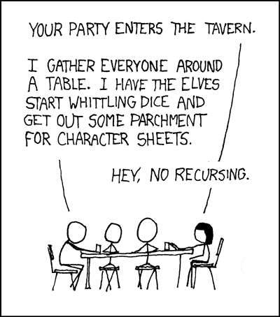

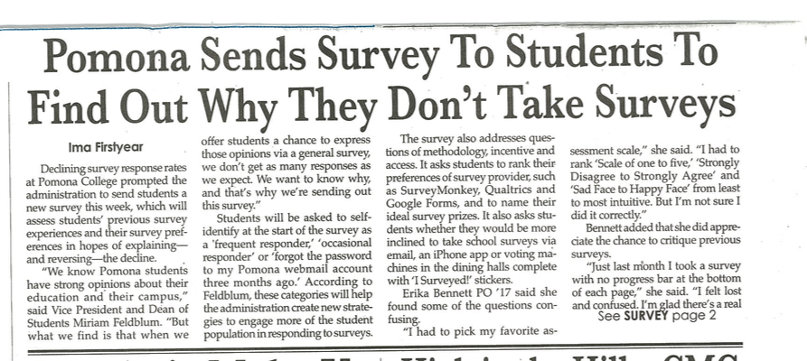
Recursion's advantage:
It handles arbitrary structural depth – all at once + on its own!
As a hat, I'm recursive, too!
Notes:
I don’t know if this really works...

Slide 78
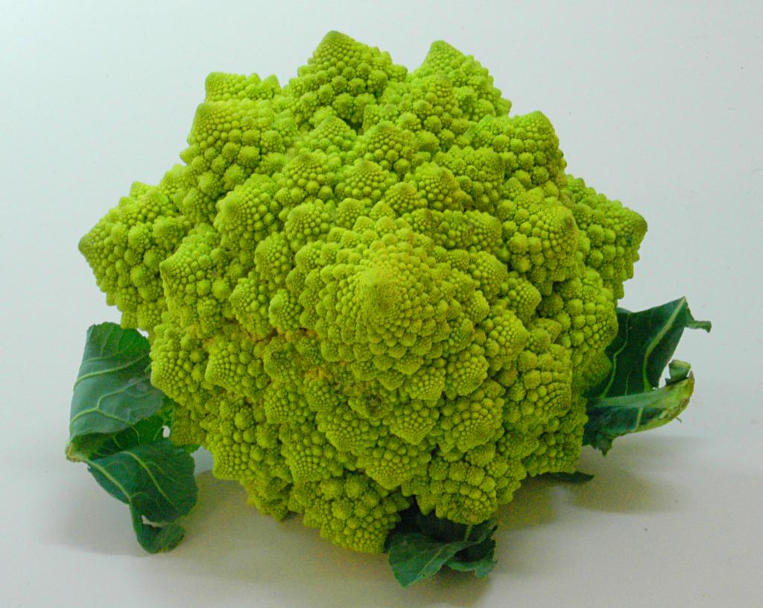
romanesco broccoli

Slide 79
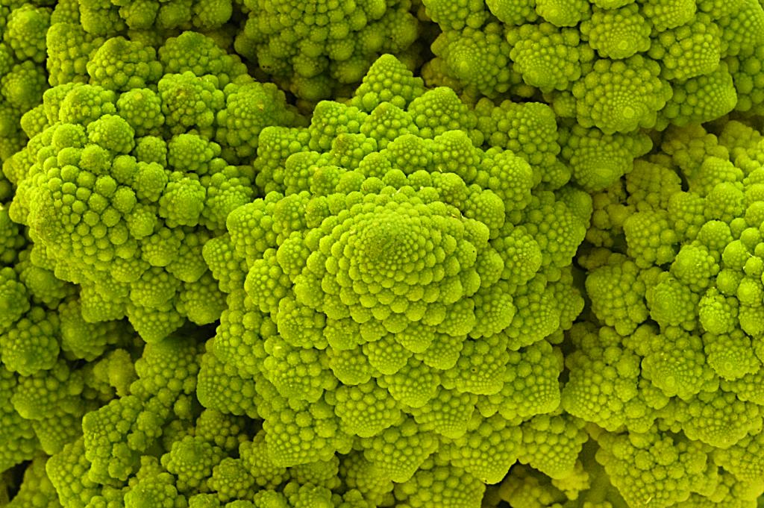
Are these rules for real?
Yes... and no.

Slide 80
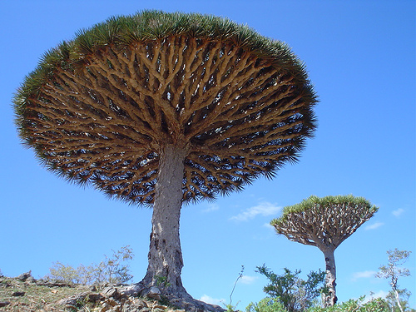
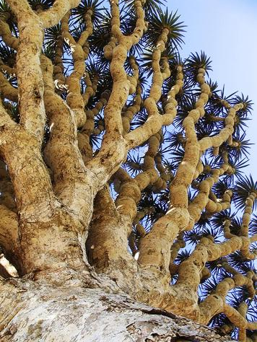
Dragon's-blood Tree

Slide 81

There still has to be a base case…

Slide 82
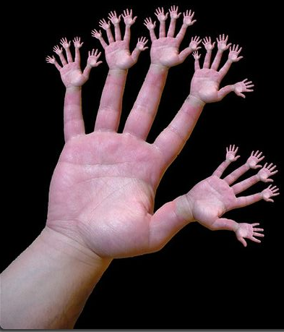
or else!

Slide 83
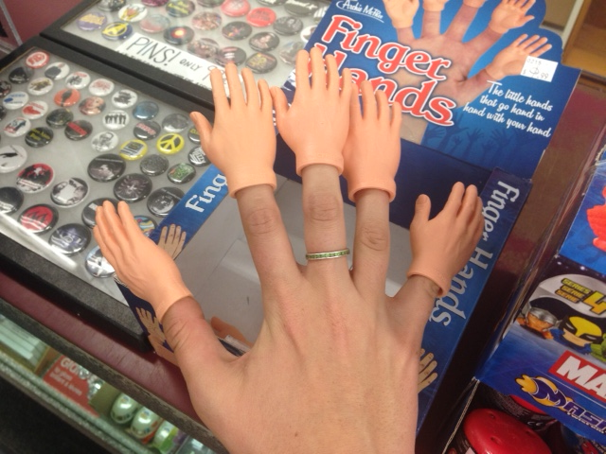
or one layer up!?

Slide 84

pow(b,p)
pow(b,p)
returns b**p, but using only multiplication times b
pow(2,4) ~ 2*2*2*2
pow(b,p)
= 16
self-similarities
pow(2,3) ~ 2*2*2
= 8
identify
base cases
self-similarities & base cases
pow(2,2) ~ 2*2
def pow(b,p):
if ________:
return ____
else:
return _____________
pow(2,1) ~ 2
pow(2,0) ~ 1
anything to the zero power is 1.0
intuit
Extra! See if you can also handle negative powers...
implement

Slide 85
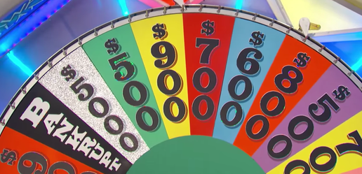
vwl(s)
vwl(s)
returns the number of vowels in the string s, s may or may not be empty.
let's count y!
vwl( 'crazy' ) ~ 2
IF
vwl(s)
vwl( 'razy' ) ~ 2
IF
self-similarities
vwl( 'azy' ) ~ 2
multiple possibilities!
identify
vwl( 'zy' ) ~ 1
base cases
self-similarities & base cases
vwl( 'y' ) ~ 1
def vwl(s):
if
elif
else:
vwl( '' ) ~ 0
What is the really simplest base case!?
intuit
Extra! What 7-letter English word maximizes vwl(s) ?
implement

Slide 86
Python is… in
I guess Python's the in thing
>>> 'i' in 'team'
False
>>> 'cs' in 'physics'
True
>>> 'i' in 'alien'
True
>>> 3*'i' in 'alien'
False
>>> 42 in [41,42,43]
True
>>> 42 in [[42], '42']
False

Slide 87
Answer: pow
pow(b,p)
return b**p, but using only multiplication times b
pow(2,4) ~ 2*2*2*2
pow(b,p) = pow(b,p-1) * b
= 16
self-similarities
pow(2,3) ~ 2*2*2
= 8
pow(b,0) = 1.0
identify
base cases
self-similarities & base cases
pow(2,2) ~ 2*2
def pow(b,p):
if p == 0:
return 1.0
else:
return pow(b,p-1) * b
pow(2,1) ~ 2
pow(2,0) ~ 1
anything to the zero power is 1.0
intuit
Extra! See if you can also handle negative powers...
implement

Slide 88
Answer: vwl
vwl(s)
return the number of vowels in the string s, s may or may not be empty.
let's count y!
vwl( 'crazy' ) ~ 2
vwl(s[1:]), if s[0] is not a vowel
1+vwl(s[1:]), if s[0] is a vowel
vwl(s) =
vwl( 'razy' ) ~ 2
self-similarities
vwl( 'azy' ) ~ 2
vwl( '' ) = 0
identify
vwl( 'zy' ) ~ 1
base cases
self-similarities & base cases
vwl( 'y' ) ~ 1
def vwl(s):
if s == '':
return 0
elif s[0] in 'aeiouy':
return 1+vwl(s[1:])
else:
return vwl(s[1:])
vwl( '' ) ~ 0
What is the really simplest base case!?
intuit
Extra! What 7-letter English word maximizes vwl(s) ?
implement

Slide 89
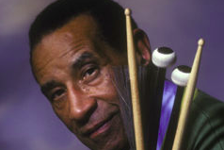
max( L )
max(L)
return the biggest element in L, given that L has at least one element!
max( [ 9,8,5 ] ) ~ 9
max(L)
max( [ 8,5 ] ) ~ 8
self-similarities
identify
base cases
self-similarities & base cases
max( [ 2,8,5 ] ) ~ 8
def max(L):
max( [ 8,5 ] ) ~ 8
max( [ 5 ] ) ~ 5
intuit
implement

Slide 90
zeroest( L )
zeroest(L)
return the element of L closest to 0; L will have at least one element
Consider these examples:
zeroest(L)
zeroest( [4,-3,42] ) ~ -3
self-similarities
zeroest( [1,-3,42] ) ~ 1
identify
base cases
self-similarities & base cases
def zeroest(L):
zeroest( [-3,42] ) ~ -3
zeroest( [42] ) ~ 42
don't forget the base case!
intuit
Note: The function abs is built-in to Python….
implement

Slide 91
The key to understanding recursion is, first, to understand recursion.
- former CS 5 student
It's the eeriest!
Good luck with Homework #1
tutors @ LAC + 4C's Th/F/Sa/Su/Mon.

Slide 92
Answer: max
max(L)
return the biggest element in L, given that L has at least one element!
max( [ 9,8,5 ] ) ~ 9
L[0], if L[0] > max(L[1:])
max(L[1:]), otherwise
max(L) is
max( [ 8,5 ] ) ~ 8
self-similarities
max( L ) is L[0]
identify
base cases
if len(L) == 1
self-similarities & base cases
max( [ 2,8,5 ] ) ~ 8
def max(L):
if len(L) == 1:
return L[0]
elif L[0] > max(L[1:])
return L[0]
else:
return max(L[1:])
max( [ 8,5 ] ) ~ 8
max( [ 5 ] ) ~ 5
intuit
implement

Slide 93
zeroest( L )
zeroest(L)
return the element of L closest to 0; L will have at least one element
Consider these examples:
L[0], if abs(L[0]) < abs(zeroest(L[1:]))
zeroest(L[1:]), otherwise
zeroest( [4,-3,42] ) ~ -3
zeroest(L)
self-similarities
self-similarities
zeroest( L ) is L[0]
zeroest( [1,-3,42] ) ~ 1
identify
base cases
if len(L) == 1
self-similarities & base cases
def zeroest(L):
if len(L) == 1:
return L[0]
rest = zeroest(L[1:])
if abs(L[0]) < abs(rest):
return L[0]
else:
return rest
zeroest( [-3,42] ) ~ -3
zeroest( [42] ) ~ 42
don't forget the base case!
intuit
Note: The function abs is built-in to Python….
implement

Slide 94
Notes:
recursion -- seems like magic
Gilderoy Lockhart

Slide 95
Recursion: the challenge
total # of vowels in 'college'
# of vowels in 'c'
total # of vowels in 'ollege'
+
Decompose
&
Recompose
Notes:
recursion -- seems like magic
Gilderoy Lockhart

Slide 96
Recursion: the big idea
value of 5*4*3*2*1
is
value of 4*3*2*1
value of 5
*
Decompose
&
Recompose
Notes:
recursion -- seems like magic
Gilderoy Lockhart

Slide 97
Big idea:
total # of vowels in s
# of vowels in s[0]
total # of vowels in s[1:]
Notes:
recursion -- seems like magic
Gilderoy Lockhart

Slide 98
overall goal
plusone(4)
output value of 1+1+1+1
plusone(4)
4 times
1+1+1+1
+1 added together, 4 times
plusone(4)
Notes:
recursion -- seems like magic
Gilderoy Lockhart

Slide 99
overall goal
plusone(4)
output value of 1+1+1+1
is
plusone(4)
overall goal
value of 1
output value of 1+1+1
+
combined with
plusone(3)
one, small piece
self-similar "rest"
example with concrete values
Notes:
recursion -- seems like magic
Gilderoy Lockhart

Slide 100
overall goal
plusone(N)
output value of 1+1+...+1
is
plusone(N)
overall goal
value of 1
output value of 1+...+1
+
combined with
plusone(N-1)
one, small piece
self-similar "rest"
base case:
output of plusone(0) is 0
smallest possible input
its output
Notes:
recursion -- seems like magic
Gilderoy Lockhart

Slide 101
Python function for plusone(N)
def plusone(N):
if _______:
return _______
else:
return _______________
Base case
Recursive case

Slide 102
Python function for plusone(N)
def plusone(N):
if N == 0:
return 0
else:
return 1 + plusone(N-1)
Base case
Recursive case

Slide 103
overall goal
pow(2,5)
output value of 2*2*2*2*2
pow(2,5)
5 times
2*2*2*2*2
five 2's multiplied together – 5 factors total
pow(2,5)
Notes:
recursion -- seems like magic
Gilderoy Lockhart

Slide 104
overall goal
pow(2,5)
output value of 2*2*2*2*2
pow(2,5)
overall goal
value of 2
output value of 2*2*2*2
*
combined with
pow(2,4)
one, small piece
self-similar "rest"
example with concrete values
Notes:
recursion -- seems like magic
Gilderoy Lockhart

Slide 105
overall goal
pow(b,p)
output value of b*b*...*b
p times
pow(b,p)
overall goal
value of b
output value of b*...*b
*
combined with
pow(b,p-1)
one, small piece
self-similar "rest"
base case:
output of pow(b,0) is 1
smallest possible input
its output
Notes:
recursion -- seems like magic
Gilderoy Lockhart

Slide 106
Python function for plusone(N)
def pow(b,p):
if _______:
return ______
else:
return _______________
Base case
Recursive case

Slide 107
Python function for plusone(N)
def pow(b,p):
if p == 0:
return 1.0
else:
return b*pow(b,p-1)
Base case
Recursive case

Slide 108
Python function for plusone(N)
def pow(b,p):
if p == 0:
return 1
elif p < 0:
return 1/pow(b,-p)
else:
return b*pow(b,p-1)
Base case
Recursive case
Recursive case

Slide 109
overall goal
leng( [7,42,9] )
output value for [7,42,9]
leng( [7,42,9] )
length is 3
[7,42,9]
3
this list has length of 3 – it has three top-level elements
leng( [7,42,9] )
Notes:
recursion -- seems like magic
Gilderoy Lockhart

Slide 110
overall goal
leng( [7,42,9] )
output value for [7,42,9]
leng( [7,42,9] )
overall goal
value of 1
output value for [42,9]
+
combined with
leng( [42,9] )
one, small piece
self-similar "rest"
example with concrete values
Notes:
recursion -- seems like magic
Gilderoy Lockhart

Slide 111
leng( L )
overall goal
output value for [7,42,...,9]
leng( [7,42,...,9] )
leng( L )
overall goal
value of 1
output value for [42,...,9]
+
combined with
leng( L[1:] )
one, small piece
self-similar "rest"
base case:
output of leng([]) is 0
smallest possible input
its output
Notes:
recursion -- seems like magic
Gilderoy Lockhart

Slide 112
Python function for plusone(N)
def leng( L ):
if _______:
return ______
else:
return _______________
Base case
Recursive case

Slide 113
Python function for leng( L )
def leng( L ):
if L == []:
return 0
else:
return 1 + leng(L[1:])
Base case
Recursive case

Slide 114
overall goal
has( 3, [4,5] )
output value for [7,42,9]
leng( [7,42,9] )
length is 3
[7,42,9]
3
this list has length of 3 – it has three top-level elements
leng( [7,42,9] )
Notes:
recursion -- seems like magic
Gilderoy Lockhart

Slide 115
overall goal
leng( [7,42,9] )
output value for [7,42,9]
leng( [7,42,9] )
overall goal
value of 1
output value for [42,9]
+
combined with
leng( [42,9] )
one, small piece
self-similar "rest"
example with concrete values
Notes:
recursion -- seems like magic
Gilderoy Lockhart

Slide 116
leng( L )
overall goal
output value for [7,42,...,9]
leng( [7,42,...,9] )
leng( L )
overall goal
value of 1
output value for [42,...,9]
+
combined with
leng( L[1:] )
one, small piece
self-similar "rest"
base case:
output of leng([]) is 0
smallest possible input
its output
Notes:
recursion -- seems like magic
Gilderoy Lockhart

Slide 117
Python function for plusone(N)
def leng( L ):
if _______:
return ______
else:
return _______________
Base case
Recursive case

Slide 118
Python function for leng( L )
def leng( L ):
if L == []:
return 0
else:
return 1 + leng(L[1:])
Base case
Recursive case

Slide 119
recursive design
Notes:
vault 713?

Slide 120
Recursive Design: the 3 i's
Eye approve!
identify
self-similarities & base cases
intuition
implement

Slide 121
Recursive Design: the 3 i's
fac(5) = 5*4*3*2*1
fac(4) = 4*3*2*1
fac(3) = 3*2*1
identify
self-similarities & base cases
fac(2) = 2*1
fac(1) = 1
fac(0) = 1
Examples!
intuition
implement

Slide 122
Recursive Design: the 3 i's
fac(5) = 5*4*3*2*1
fac(N) =
rec.
self-similarities
fac(4) = 4*3*2*1
fac(3) = 3*2*1
identify
base cases
self-similarities & base cases
fac(2) = 2*1
fac(1) = 1
fac(0) = 1
base cases
Examples!
intuit
implement

Slide 123
Recursive Design: the 3 i's
Eye approve!
fac(5) = 5*4*3*2*1
fac(N) =
rec.
self-similarities
fac(4) = 4*3*2*1
fac(3) = 3*2*1
identify
base cases
self-similarities & base cases
fac(2) = 2*1
fac(1) = 1
fac(0) = 1
base cases
intuit
implement

Slide 124
Recursive Design: the 3 i's
Eye approve!
rec.
fac(5) = 5*4*3*2*1
fac(N) =
rec.
self-similarities
fac(4) = 4*3*2*1
fac(3) = 3*2*1
identify
base cases
base cases
self-similarities & base cases
fac(2) = 2*1
fac(1) = 1
def fac(N):
if
return
else:
return
fac(0) = 1
base cases
intuit
implement

Slide 125
Recursive Design: the 3 i's
rec.
fac(5) = 5*4*3*2*1
fac(N) =
rec.
self-similarities
fac(4) = 4*3*2*1
fac(3) = 3*2*1
identify
base cases
base cases
self-similarities & base cases
fac(2) = 2*1
fac(1) = 1
base case
def fac(N):
if N <= 1:
return 1.0
else:
return N * fac(N-1)
fac(0) = 1
rec.
base cases
intuit
implement

Slide 126
Recursive Design: the 3 i's
rec.
fac(5) = 5*4*3*2*1
fac(N) =
the order of base cases and recursive cases usually does not matter!
rec.
self-similarities
fac(4) = 4*3*2*1
fac(3) = 3*2*1
identify
base cases
base cases
self-similarities & base cases
fac(2) = 2*1
fac(1) = 1
def fac(N):
if N > 1:
return N * fac(N-1)
else:
return 1.0
rec.
fac(0) = 1
base cases
base case
intuit
implement

Slide 127
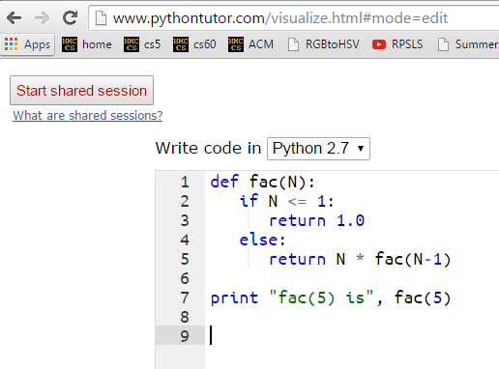
A look behind the curtain…
http://www.pythontutor.com/visualize.html

Slide 128

Recursive Design
add(m,n)
return m+n, but using only m and +1's …
m n
add(7,3) ~ 7+1+1+1
add(m,n) =
self-similarities
add(7,2) ~ 7+1+1
identify
add(7,1) ~ 7+1
base cases
self-similarities & base cases
def add(m,n):
if
return
else:
return
add(7,0) ~ 7
intuit
implement

Slide 129
def add(m,n):
if n == 0:
return m
else:
return 1 + add(m,n-1)
add(38,4)
1 + add(38,3)
stack frame with n = 4
1 + add(38,2)
stack frame with n = 3
1 + add(38,1)
stack frame with n = 2
1 + add(38,0)
stack frame with n = 1
stack frame with n = 0
38

Slide 130
Recursive Design
len(L)
return the length of the list or string L
len( [ 7,8,5 ] ) ~ 3
len(L) =
len( [ 8,5 ] ) ~ 2
self-similarities
len( [ 5 ] ) ~ 1
identify
len( [ ] ) ~ 0
base cases
self-similarities & base cases
lists
strings
def len(L):
if
return
else:
return
intuit
implement

Slide 131
def len(L):
if L == [] or L == '':
return 0
else:
return 1 + len(L[1:])
len('cs5!')
1 + len('s5!')
stack frame
1 + len('5!')
stack frame
1 + len('!')
stack frame
1 + len('')
stack frame
0
stack frame

Slide 132
Design patterns…
Recursion's a design - not a formula, BUT, these pieces are common:
Handle base cases, with if …
Do one piece of work: L[0] or s[0]
Recurse with the rest: L[1:] or s[1:]
Combine + make sure the types match!

Slide 133
Recursion's advantage:
It handles arbitrary structural depth – all at once + on its own!
As a hat, I'm recursive, too!
Notes:
I don’t know if this really works...

Slide 134
romanesco broccoli

Slide 135
Are these rules for real?
Yes... and no.

Slide 136
Dragon's-blood Tree

Slide 137
There still has to be a base case…

Slide 138
or else!

Slide 139
or else!

Slide 140
Recursive design…
fun! easy!?
(1) Program the base case.
(2) Find the self-similarity.
cool!
(3) Do one step!
indexing and slicing
(4) Delegate the rest to recursion…
Aha!

Slide 141
Try it!
pow(b,p)
return b**p, but using only multiplication times b
pow(2,4) ~ 2*2*2*2
pow(b,p) =
= 16
self-similarities
pow(2,3) ~ 2*2*2
= 8
identify
base cases
self-similarities & base cases
pow(2,2) ~ 2*2*1.0
def pow(b,p):
if
else:
pow(2,1) ~ 2*1.0
pow(2,0) ~ 1.0
anything to the zero power is 1.0
intuit
Extra! See if you can also handle negative powers...
implement

Slide 142
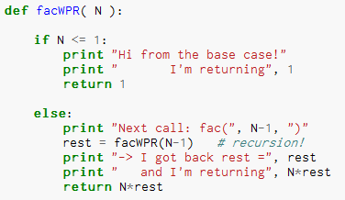
Thinking recursively…
What will print when facWPR(5) is called?

Slide 143
Let recursion do the work for you.
Exploit self-similarity
Less work !
Produce short, elegant code
You handle the base case – the easiest case!
def fac(N):
if N <= 1:
return 1
else:
rest = fac(N-1)
return rest * N
Recursion does almost all of the rest of the problem!
You specify one step at the end

Slide 144
Python is… in
I guess Python's the in thing
>>> 'i' in 'team'
False
>>> 'cs' in 'physics'
True
>>> 'i' in 'alien'
True
>>> 3*'i' in 'alien'
False
>>> 42 in [41,42,43]
True
>>> 42 in [[42], '42']
False

Slide 145
How functions work…
2
"the stack"
def f(x):
if x == 0:
return 12
else:
return f(x-1) + 10*x
call: f(2)
stack frame
local variables:
x = 2
f(1) = 22
result = 42
the result then gets returned…
Notes:
vault 713?

Slide 146
How functions work…
"the stack"
def f(x):
if x == 0:
return 12
else:
return f(x-1) + 10*x
call: f(2)
stack frame
local variables:
x = 2
need f(1)
call: f(1)
stack frame
local variables:
x = 1
need f(0)
call: f(0)
stack frame
local variables:
x = 0
returns 12
they stack.
Notes:
vault 713?

Slide 148
def power(b,p):
""" inputs: base b and power p (an int)
implements: b**p
"""
if p == 0:
return 1.0
elif p < 0:
return ____________________
else:
return b * power(b,p-1)
Recursion is power!

Slide 149
Recursive design #1
'cs5'
def mylen(s):
""" input: any string, s
output: the number of characters in s
"""
if :
else:
base case test!
Ask yourself:
"How could I use the length of anything smaller than s?" Then do!

