Slide 1
COURSE PROJECT PRESENTATION
41
Protein Structure Knowledge QA Agent
knowledge assets
20
benchmark questions
An agentic RAG platform for deep learning and life-science research questions.
0.985
Group 6：Tangmingyang Malongguang
2026/6/29
average benchmark score
Protein Structure Knowledge QA Agent
01

Slide 2
PROJECT MOTIVATION
Why this agent exists
A research QA platform for protein-structure learning needs to answer with evidence, not just fluent text.
Course goal
Research topic
Design principle
Build a Knowledge QA Project for Deep Learning and Life Sciences: assets, benchmark, and optional modules.
Protein structure: experimental PDB entries plus modern deep-learning methods such as AlphaFold, ESMFold, DiffDock, and RFdiffusion.
Every answer should expose citations, retrieved evidence, validation status, and agent trace for inspection.
Protein Structure Knowledge QA Agent
02

Slide 3
DATA LAYER
Knowledge assets
41
17
20
4
complete knowledge sets
academic papers
PDB knowledge entries
textbook, course, encyclopedia assets
Each asset is normalized into summary.md, keywords.json, and source.json; PDB assets also store local entry.json snapshots for offline fallback.
This gives the retriever a stable local evidence layer while preserving source IDs for citations.
Protein Structure Knowledge QA Agent
03

Slide 4
FIVE-AGENT ORCHESTRATION
System architecture
Question
Analyzer
->
Retrieval
Planner
->
Knowledge
Retriever
->
Answer
Generator
->
Evidence
Validator
Validation can loop back to the planner for one additional retrieval round when coverage or citations are insufficient.
Workflow mode: sequential-with-validation-loop; max retrieval rounds: 2.
Protein Structure Knowledge QA Agent
04

Slide 5
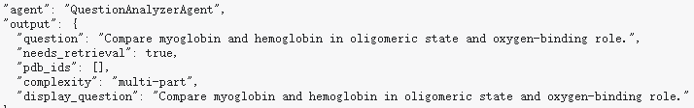
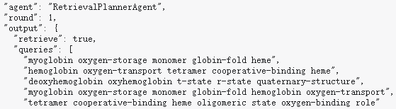
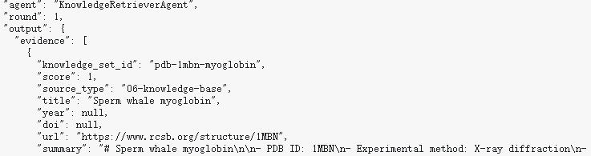
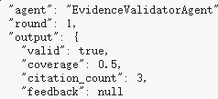
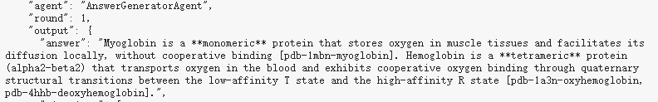
Agent Trace Panel
Frontend: Agent Trace for Debugging
The trace view records intermediate agent decisions, including retrieval planning, evidence selection, generated answer metadata, and validation feedback.
Protein Structure Knowledge QA Agent
09

Slide 6
AGENT ROLES
What each agent contributes
QuestionAnalyzerAgent
Detect retrieval need, PDB IDs, complexity, and display question.
RetrievalPlannerAgent
Convert intent into structured queries, forced evidence IDs, and retry plans.
KnowledgeRetrieverAgent
Search local assets, call or fall back from the PDB skill, deduplicate evidence.
AnswerGeneratorAgent
Use MiMo-V2.5-Pro or deterministic fallback to produce cited answers.
EvidenceValidatorAgent
Check coverage, citation count, and whether citations are grounded in evidence.
Protein Structure Knowledge QA Agent
05

Slide 7
RETRIEVAL LOGIC
Agentic RAG, not a one-shot retriever
1. Analyze
2. Retrieve
3. Validate
The system first decides whether the question needs grounded retrieval. Explicit entities override stale chat context.
Planner creates targeted queries and forced IDs. Retriever filters very low confidence hits and accumulates evidence.
Validator checks citation grounding and coverage. Failed validation triggers one retry with feedback.
Recent fix: citations are normalized after generation, so displayed citations must come from retrieved evidence.
Protein Structure Knowledge QA Agent
06

Slide 8
ASSET TAXONOMY
Knowledge organization
01-academic
17
Deep-learning methods and review papers
02-textbook
2
Protein folding and structural biology background
03-course
1
Open course material
04-encyclopedia
1
Domain overview
06-knowledge-base
20
Curated RCSB PDB structures
Protein Structure Knowledge QA Agent
07

Slide 9
OPTIONAL MODULES
Skills and model integration
PDB Skill
MiMo-V2.5-Pro
Difficulty total
- search_structures(query, limit)
- get_structure_metadata(pdb_id)
- get_polymer_entities(pdb_id)
- Local entry.json fallback
- Primary LLM for answer synthesis
- OpenAI-compatible chat API
- 4096 default completion budget
- Deterministic fallback when unavailable
- Skills Lv.2: PDB Skill
- Memory Lv.1: Agentic RAG
- Orchestration Lv.1: static workflow
- Total difficulty = 4
Protein Structure Knowledge QA Agent
08

Slide 10
FRONTEND AND TRACEABILITY
User-facing QA platform
Chat interface
Evidence transparency
- Multi-turn chat history in browser localStorage
- Chat list with create and delete actions
- Follow-up questions include recent context
- MiMo model badge and fallback visibility
- Inline knowledge_set_id citations
- Retrieved evidence panel
- Full agent trace per response
- Knowledge asset and benchmark browser
Protein Structure Knowledge QA Agent
09

Slide 11
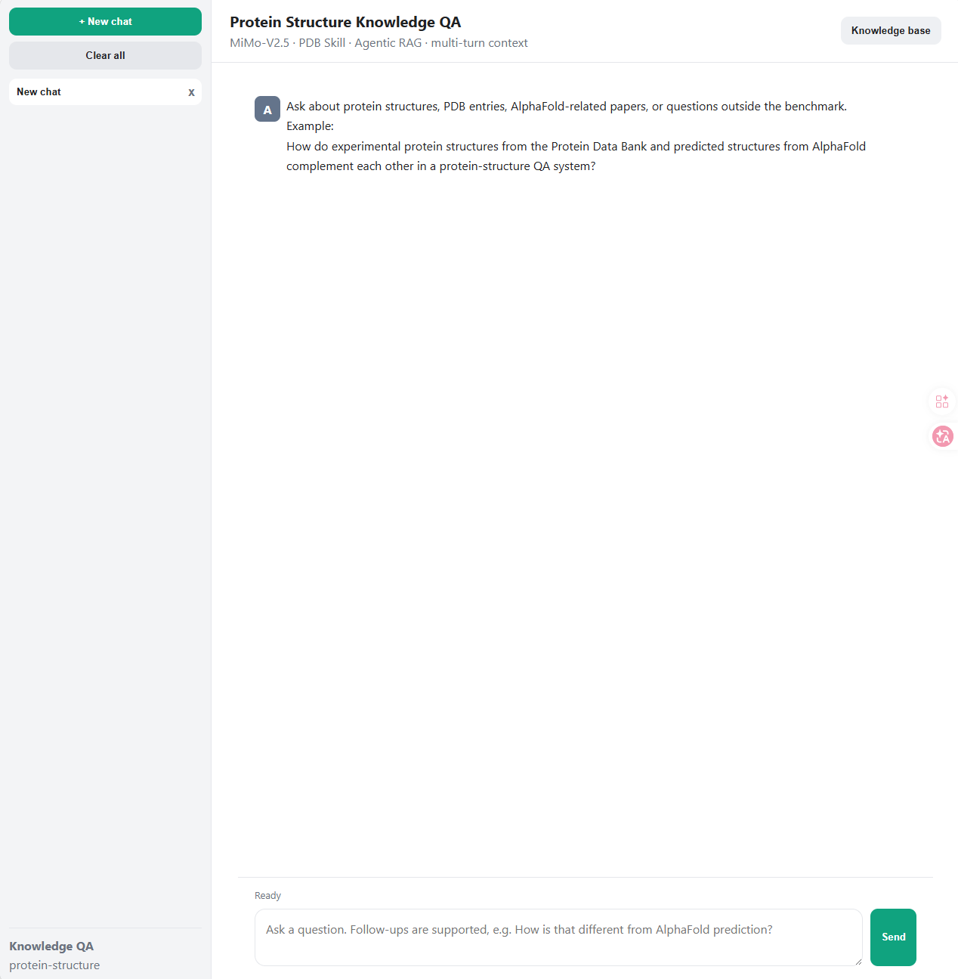
Main Chat interface
Frontend: Chat-Based Research QA
Main Chat interface
The web interface provides a ChatGPT-style workflow for asking protein-structure questions, managing browser-local chat sessions, and submitting follow-up questions with recent context.
Protein Structure Knowledge QA Agent
09

Slide 12
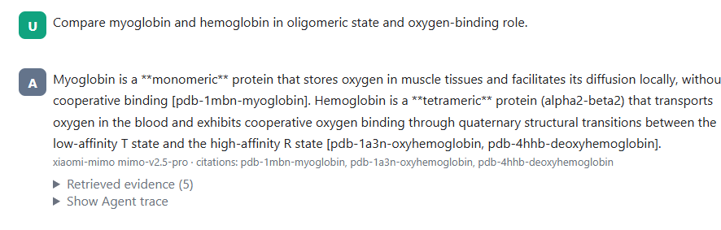
Answer With Citations
Frontend: Evidence-Grounded Answers
Each answer is grounded in retrieved knowledge assets. The system exposes citation IDs so the user can trace claims back to specific PDB entries or papers.
Protein Structure Knowledge QA Agent
09

Slide 13
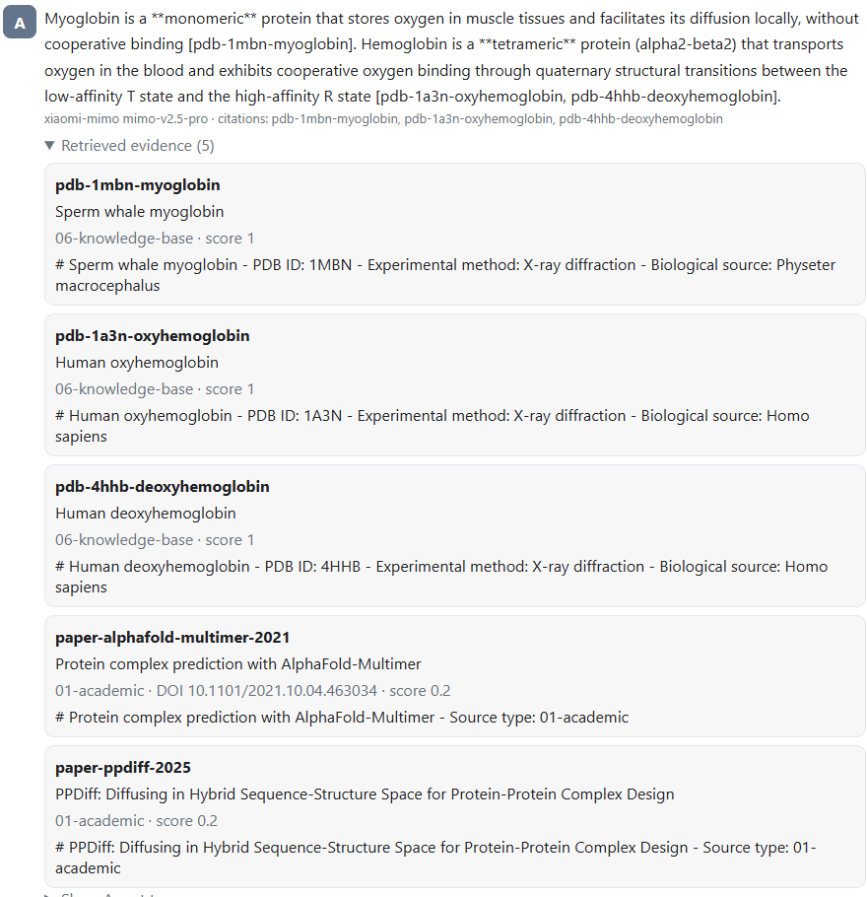
Retrieved Evidence Panel
Frontend: Inspectable Retrieval Evidence
The retrieved evidence panel makes the RAG process inspectable by showing which assets were selected, their retrieval scores, source types, and short summaries.
Protein Structure Knowledge QA Agent
09

Slide 14
EXPERIMENT SETUP
Benchmark design
The benchmark contains 20 sourced questions designed to test factual grounding over specific protein structures and functions.
Coverage
Scoring
Reproducibility
PDB entries cover enzymes, oxygen-binding proteins, viral complexes, fluorescent proteins, chaperonins, and structural benchmarks.
Each question defines expected keypoints. Evaluation checks matched keypoints, citations, and validator status.
run_evaluation.py disables online LLM calls by default to avoid API cost and produce deterministic results.
Protein Structure Knowledge QA Agent
10

Slide 15
BENCHMARK OUTCOME
Experimental results
20
0.985
17/17
2
benchmark questions
average score
unit tests passing
max retrieval rounds
Most benchmark items pass with grounded citations. The remaining score loss is concentrated in one question where extra evidence was retrieved, but the expected keypoint set was only partially matched.
Current result file: results/benchmark_report.json and results/benchmark_report.md.
Protein Structure Knowledge QA Agent
11

Slide 16
CONCLUSION
Takeaways and demo path
The project demonstrates a compact but inspectable research QA agent: curated assets, explicit orchestration, PDB tooling, MiMo generation, citation validation, and benchmark evidence.
Suggested live demo
- Ask: Compare myoglobin and hemoglobin in oligomeric state and oxygen-binding role.
- Open Retrieved evidence and citations.
- Open Agent trace to show analyzer, planner, retriever, generator, and validator.
Final message: the agent is not only answering; it is making its evidence path inspectable.
Protein Structure Knowledge QA Agent
12

