Slide 1

GitHub Copilot Hackathon
Team Name- PyNam
Team Leader Name- Namitha
Team Leader Email Address- namithasendil79@gmail.com

Slide 2

Brief Summary of Project:
Leveraging the use of Github copilot a command-line tool is written in Python.
It accepts a city's name and returns the current weather forecast. OpenWeatherMap API was used to fetch weather data.

Slide 3
Business Challenge /Use Cases
Create a command-line tool that accepts a city's name and returns the current weather forecast.

Slide 4
Proposed Solution
A command line utility was implemented using Python.
The program fetches the weather data for a given city by making an API call to OpenWeatherMap API service
Github co pilot was used with Pycharm to help with usage of API, data parsing and error handling.
City Name
Command Line tool
Weather
API Call
OpenWeatherMap API

Slide 5
Technology/Tool Stack Used:
Python 3.9
Github CoPilot with PyCharm Community Edition
OpenWeatherMap API

Slide 6
Mention of usage of Github Copilot
Github Copilot was installed as a plugin of PyCharm community edition.
Github Copilot was used for code suggestions from comments.
For example to help write code to make an API call.
Convert the program to a command line tool that takes arguments using argparse
Github copilot was used to suggest code for data parsing
The response from the API call was parsed to get the weather data.
Github Copilot was used to suggest code to handle error.
When a city name was not passed as argument
When a valid city name was not passed.

Slide 7
Source code in zip file / Github link :
https://github.com/SmartNamDevoloper/GetWeather.git

Slide 8
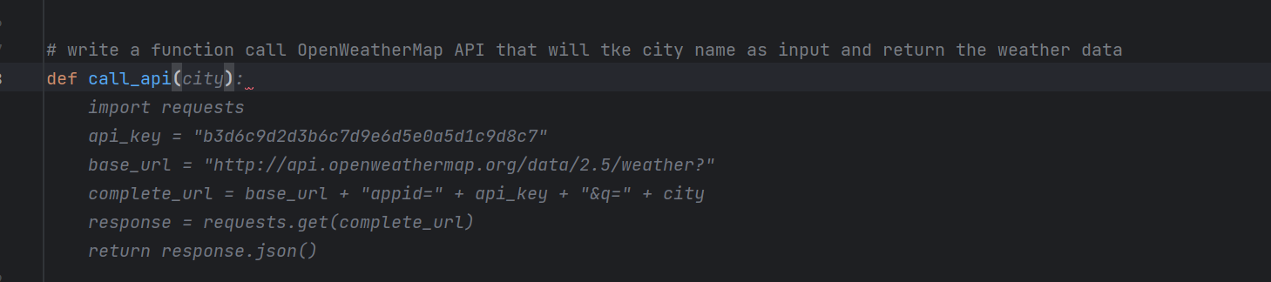
Using Github Copilot to suggest code by writing a comment for a function that makes an API call to OpenWeatherMap

Slide 9
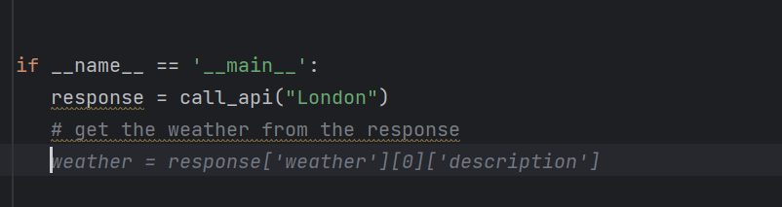
Using Github Copilot to suggest code by writing a comment for parsing the data returned by the API call to OpenWeatherMap

Slide 10
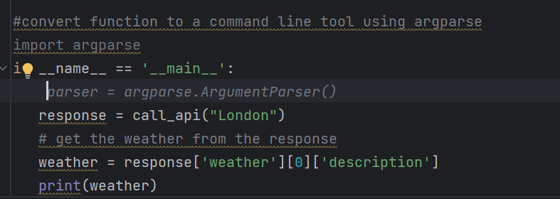
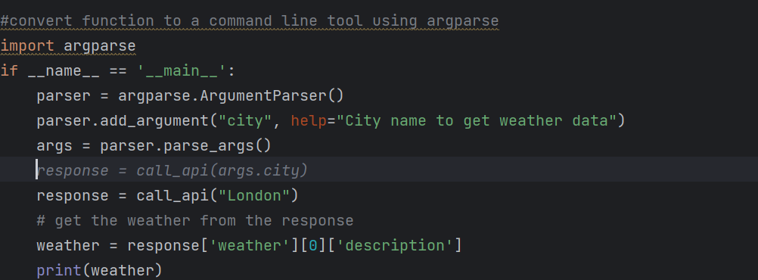
Using Github Copilot to suggest code by writing a comment for a converting the function to a command line tool using argparse.

Slide 11
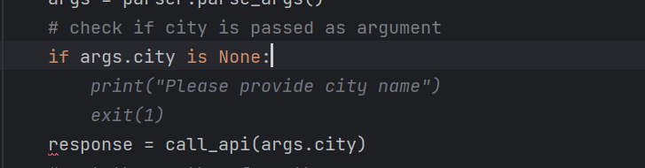
Using Github Copilot to suggest code by writing a comment for checking if a city argument is passed.

Slide 12
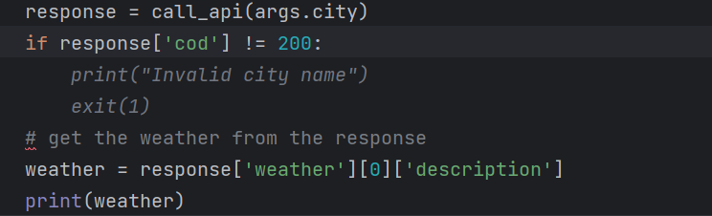
Using Github Copilot to suggest code by writing a comment for checking if a valid city argument is passed.

Slide 13
THANK YOU

