Slide 1
SmartPlastic
HauserLenz

Slide 2
The LiP WebApp
Part 1

Slide 3
Main parts of the app
Newsline
Articles published by students
Tracker
Possibility to track ones plastic usage
Comparing scoreboard school-, country- and EU-wide
Map
Places with ideas to buy smart
Places that sell smart products
Information
About the schools
About the Erasmus project
About the app

Slide 4
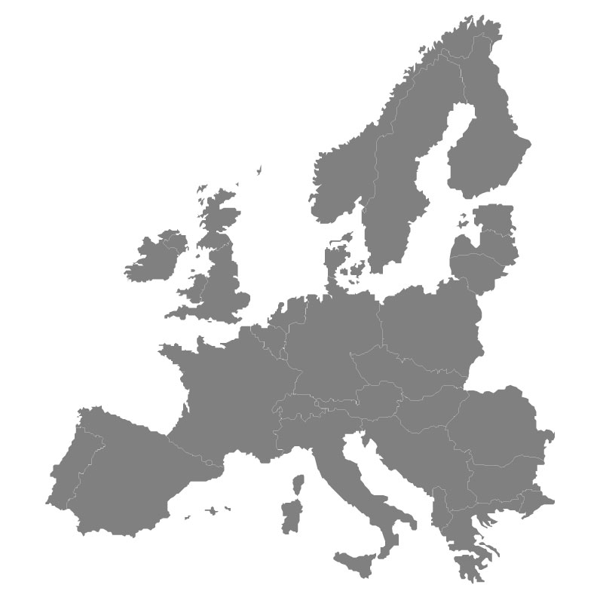
Server and domain
mbgdierdorf.de (Dierdorf)
lifeinplastic.mbgdierdorf.de
smartplastic.eu (Berlin)
interface.smartplastic.eu
published.smartplastic.eu

Slide 5
The WebApp Interface
Part 2

Slide 6
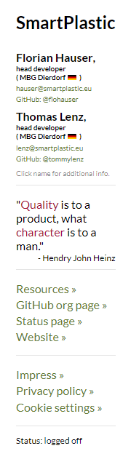
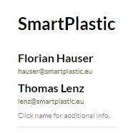
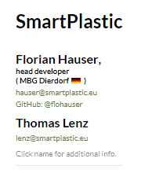
Interface content
Compact version - Extendet version

Slide 7
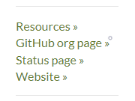
Interface content
Resources
„Press Kit“: Logos, Pictures, Texts, Colors, …
non-code-related tutorials for teachers and students
Important notes, regulations, …
GitHub org page
Code, issues, changelog, code-related tutorials
Status page
Status of the services (server, webapp, components, …)
Website
SmartPlastic official public website
Information content for public only

Slide 8
How do I upload content?
Part 2

Slide 9





WebApp
2
2
Asks for latest version
Create article
Interface
Server
User's mobile app
Updates article
Sends latest version

Slide 10
Further steps
Part 3

Slide 11
Timeline
Joint staff training in Germany, first prototyp of the app is being revealed
Florian and Thomas finish their scientific work and the participation with the app
Public Release
Alpha
Beta
NOV 18
DEC 18
v0.3a
FEB 19
v0.4b
APR 19
v1.0
MAY 19
v1.1
JUN 19
v0.2.1
v1.2

Slide 12
Working collaboratively online
Part 4

Slide 13
Working collaboratively online
Images (.png , .jpeg/.jpg , .gif)
Use .jpeg whenever you can
Use .png over .gif whenever you can
Do not use animations
Texts (plain text)
Write where/how you like, paste into the box and it gets formatted automatically

