Slide 1
IBM Hack Challenge 2020

Slide 2
Team Name - Nodex
Team leader - Vijoy Paul
Team Members
Vijoy paul
Sohail Mansoori
Sandesh Jain

Slide 3
Our Problem Statement
Sentiment Analysis of COVID-19 Tweets – Visualization Dashboard
Develop a twitter sentiment analysis model to understand the following
1. Get to know people’s sentiment towards the epidemic
2. Understand the sentiments of people on govt. decision to extend the lockdown

Slide 4
What is twitter Sentiment Analysis ?
Sentiment Analysis is a technique widely used in text mining. Twitter Sentiment Analysis, therefore means, using advanced text mining techniques to analyze the sentiment of the text (here, tweet) in the form of positive, negative and neutral

Slide 5
What we did..?
we used IBM cloud platform to analysis COVID-19 data set to get the reaction/sentiment of the user that is positive, negative, neutral towards the pandemic

Slide 6
In IBM cloud firstly created Watson Studio service and Machine Learning service instance

Slide 7
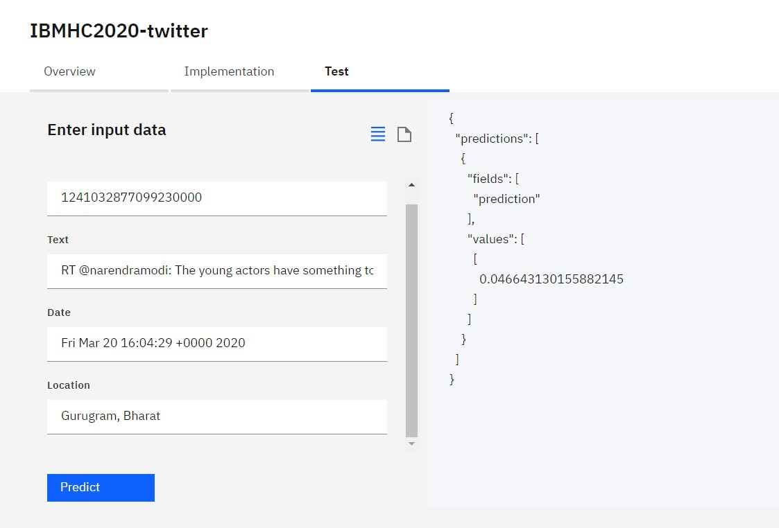
Under Watson studio service we create an AutoAI project and did the Analysis of our Data set And deployed the Model

Slide 8
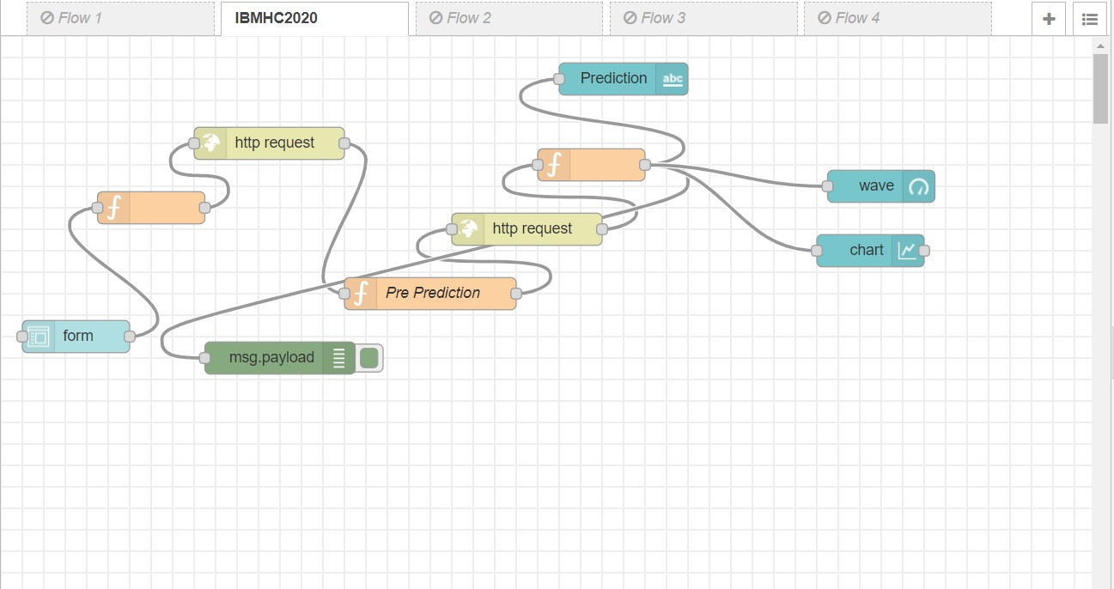
Then we Created Our node-red service and worked on our flow

Slide 9
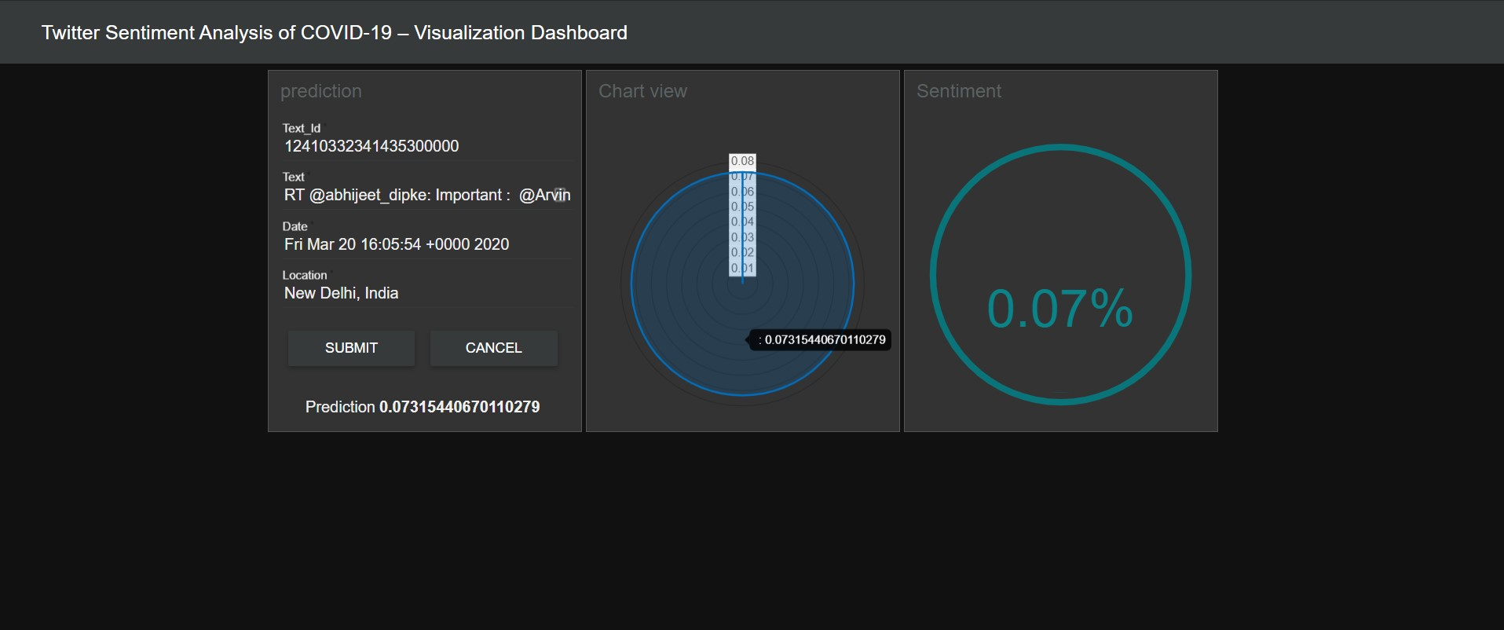
DashBoard

Slide 10
Thank You.!!

