Slide 1
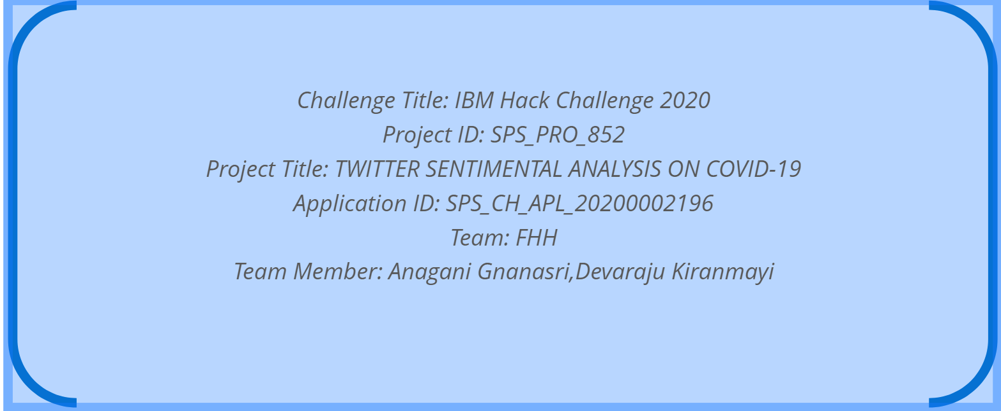
PROJECT DETAILS

Slide 2

TWITTER SENTIMENTAL ANALYSIS ON COVID-19
100+ days since the first COVID-19 case all across the globe and 45+ days into the earliest Lockdown Order, how have you been feeling through this special time? Do you know how others are responding to the pandemic?
The Corona Virus endangers our physical health indeed, but alongside, social distancing also poses a threat to our emotional stability. Thus, it is crucial to understand public sentiments under COVID-19.

Slide 3
Abstract :
Keywords: Twitter Sentiment Analysis, Twitter API, TextBlob, NLTK, Tweepy, COVID-19,Coronavirus.
Social networks are the main resources to gather information about people's opinions and sentiments towards different topics and issues. People spend hours daily on social media to share their ideas, opinions, and reactions with others, so in this paper, we analyze the sentiments regarding corona virus disease(COVID-19) because many peoples of different countries are affected by a corona virus that is a very critical issue in these days, so analyze the sentiments of different people's opinion for this disease, we are fetching the twitter streaming tweets related to corona virus using twitter API and analyze these tweets using machine learning techniques and tools as positive, negative, and neutral. In this paper, we run experiments through Python programming on different tweets using twitter API and NLTK, the library is used for pre-processing of tweets and then analyze the tweets dataset by using Textblob and after that show the interesting results in positive, negative, neutral sentiments through different visualizations.

Slide 4
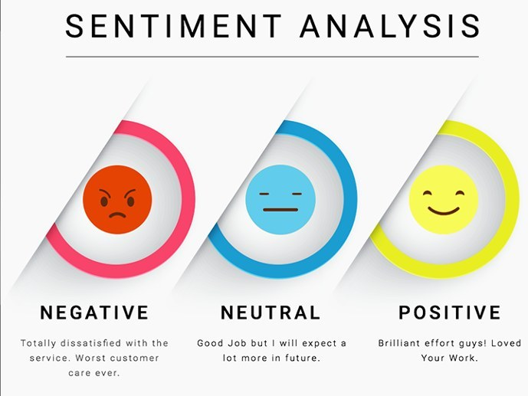
Sentiment Analysis
Sentiment analysis is the interpretation and classification of emotions (positive, negative and neutral) within text data using text analysis techniques.
Sentiment analysis tools allow businesses to identify customer sentiment toward products, brands or services in online feedback.

Slide 5
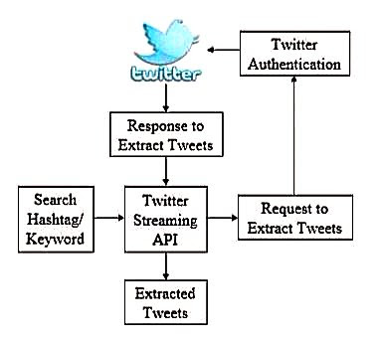
Analysis Process
To study public sentiments, we chose Twitter as our target field. As one of the world’s biggest social network platforms, Twitter hosts abundant user-generated posts, which closely reflect the public’s reactions towards this pandemic with low latency. By deploying Natural Language Processing (NLP) methods on it, we were able to extract and quantify the public sentiments over time. The tools we used are Text Blob, IBM Watson Tone Analyzer, BERT, and Mallet.

Slide 6
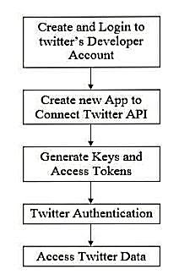
Accessing Twitter Data AND Authentication :
In order to fetch tweets through Twitter API, one needs to register an App through their twitter account.
After the authentication, we need to connect with Twitter Streaming API. Tweepy a python library enables us to connect with Twitter and download data.
Once the Twitter Authentication service authenticates the API, a token is generated and made available to the API for each Twitter server transaction. Using this token, tweets are mined using hashtags or keywords.

Slide 7
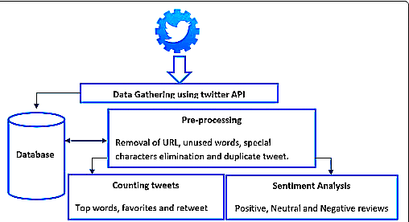
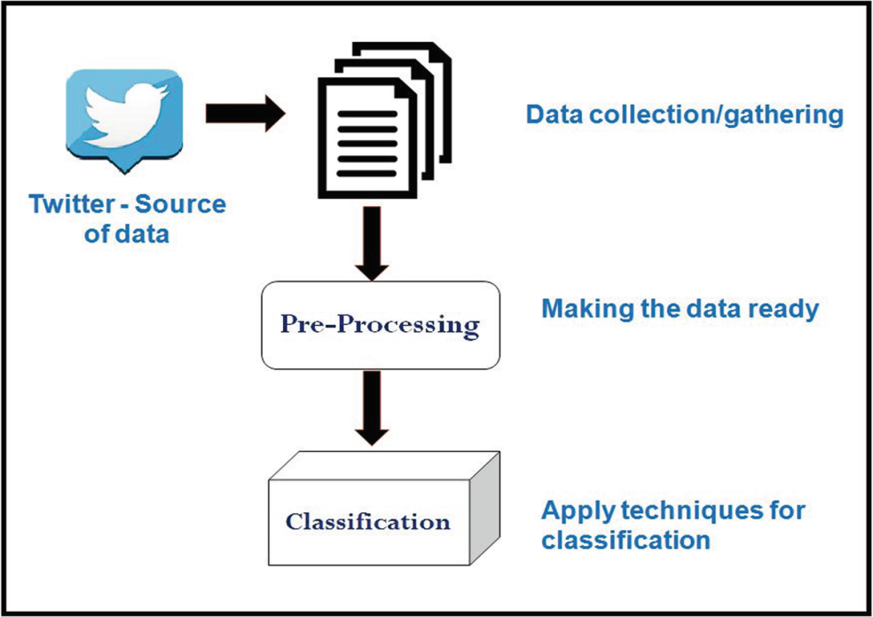
Data Collection Process :
At first, we used Text Blob to explore public sentiments, which showed an upward trend in being steadily more positive.
At first, we used Text Blob to explore public sentiments, which showed an upward trend in being steadily more positive. Then we dove in to analyze the sentiments on a more detailed level, in a multi-dimensional way, to reveal the trend more comprehensively.

Slide 8

Sentiment Identification :
After feature extraction, we identify the positive and negative orientation of words. These features are searched into opinion word list from the huge set of corpora in Text Blob Library to find out the sentiments. Features are searched into positive and negative word list of the dictionary. If the word is present in the positive opinion word list, then the positive Sentiment is assigned to the corresponding feature. If the word is present in the negative Word list, then the negative sentiment is assigned to the corresponding feature. If the word is not present in both the word list, then the sentiment is considered as neutral.

Slide 9
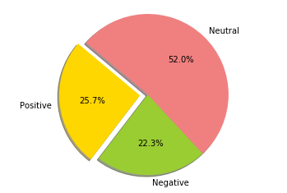
Output Presentation:
The final phase of our sentiment analysis is the visualization of the results. We use Pie charts, Trend Graphs and tables to view the results. We use a python library Matplotlib to plot Pie charts and a trend graph to plot these charts and charts. Its numerical extension to mathematics is NumPy.
This figure shows the result of tweets for Corona Virus(COVID19) based on 2000 tweets from Twitter.
Positive tweets percentage 25.7%
Negative tweets percentage 22.3%
Neutral tweets percentage 52.0%

Slide 10
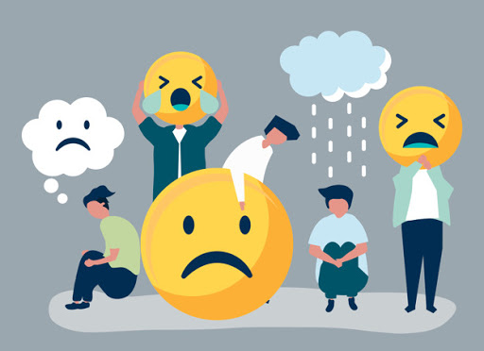
Advantages
The analysis of texts to determine the writer or speaker’s opinion and attitude expressed, and how the results can be used.
Sentiment analysis provides some answers into what the most important issues are, from the perspective of people, at least. Because sentiment analysis can be automated, decisions can be made based on a significant amount of data rather than plain intuition that isn’t always right.

Slide 11

Applications And Benefits:
Sentiment analysis has many applications and benefits to your business and organization. It can be used to give your business valuable insights into how people feel about your product brand or service.
When applied to social media channels, it can be used to identify spikes in sentiment, thereby allowing you to identify potential product advocates or social media influencers.
It can be used to identify when potential negative threads are emerging online regarding your business, thereby allowing you to be proactive in dealing with it more quickly.
Sentiment analysis could also be applied to your corporate network, for example, by applying it to your email server, emails could be monitored for their general “tone”.

Slide 12

Conclusion:
In this research, the opinion of different peoples of different countries on coronavirus the affect various countries has been discussed. The main focus of this paper is on Twitter ,Twitter API and have implemented the python programming language and write code in Jupyter notebook to implement the sentimental analysis as positive , negative and neutral. The results are shown by using Matplotlib library. It has been realized that the neutral sentiments are significantly high which shows there is a need to improve Twitter sentiment analysis.

Slide 13


