Slide 1
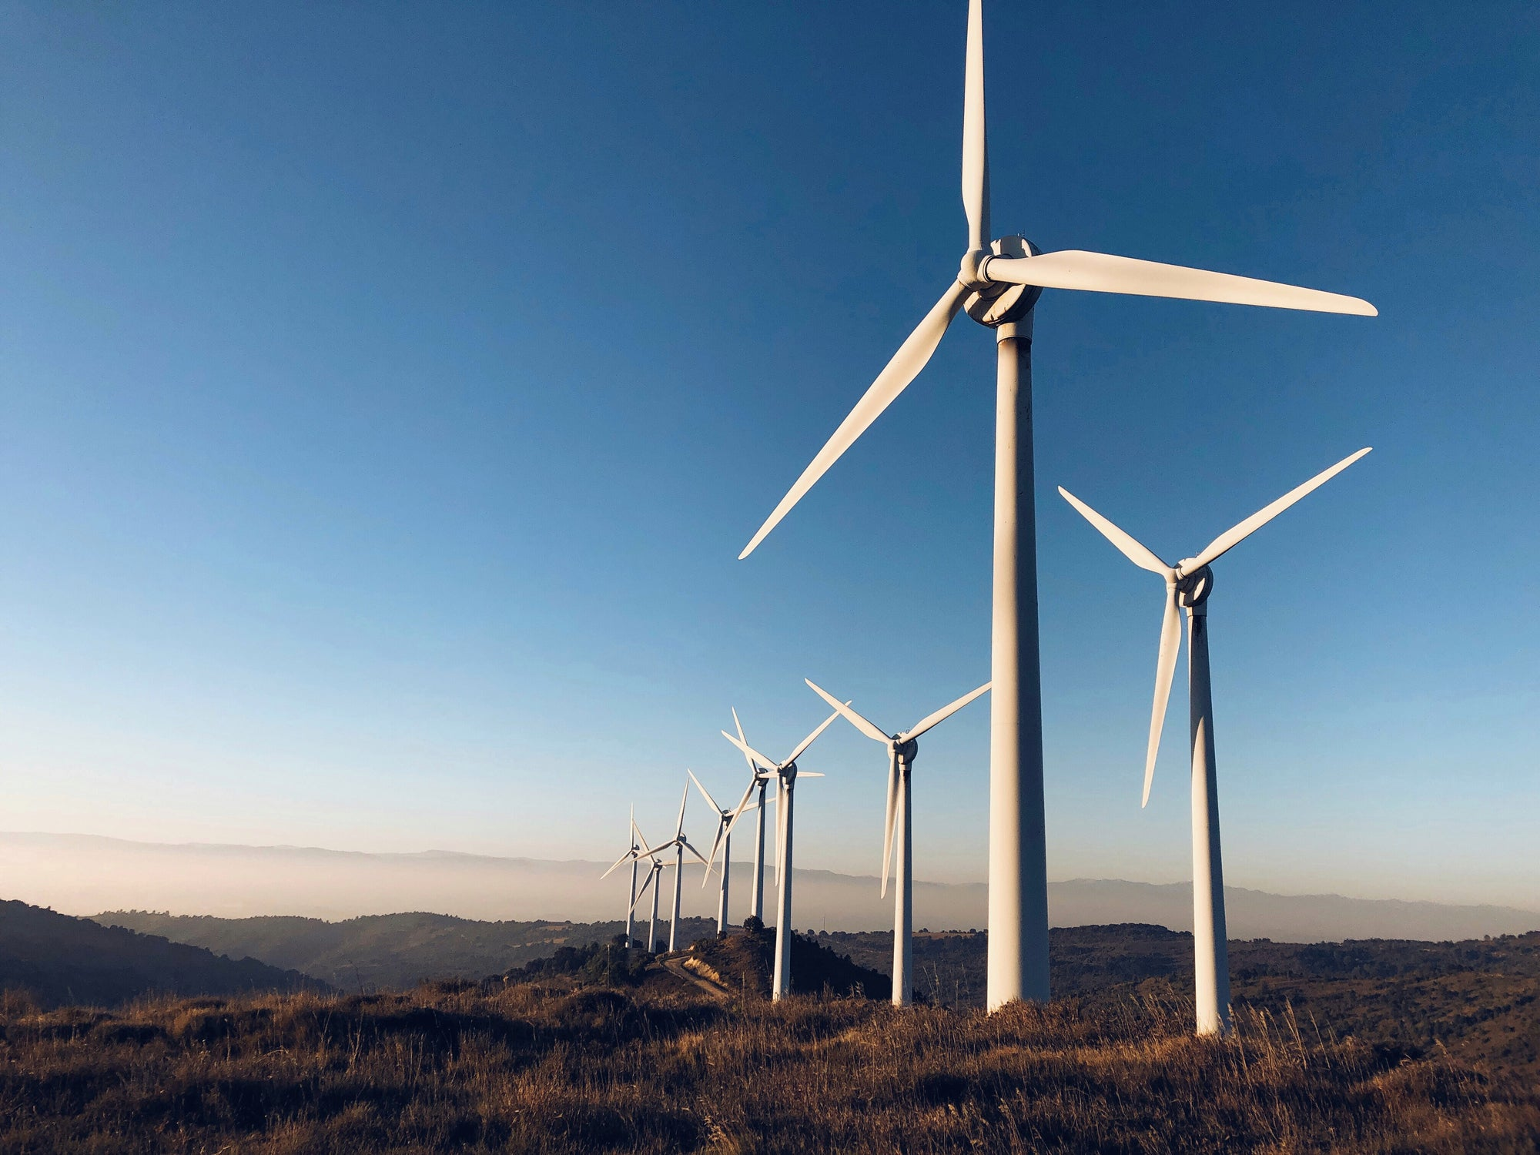
Wind farm power output predictor
Developed By: ProConspiracy
Project ID: SPS_PRO_745

Slide 2
TEAM PROCONSPIRACY
SWAPNIL NEMA
APPLICATION DESIGN
FRONTEND
PRESENTATION
UDAY RAJORIYA
MACHINE LEARNING MODEL
BACKEND
DOCUMENTATION

Slide 3
Problem statement
Predicting the energy output of wind turbine based on weather condition
Wind energy plays an increasing role in the supply of energy world-wide. The energy output of a wind farm is highly dependent on the wind conditions present at its site. If the output can be predicted more accurately, energy suppliers can coordinate the collaborative production of different energy sources more efficiently to avoid costly overproduction.

Slide 4
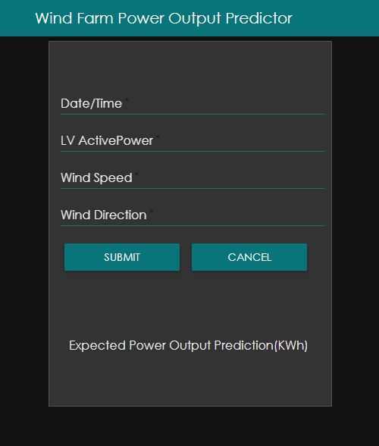
01
Website interface

Slide 5
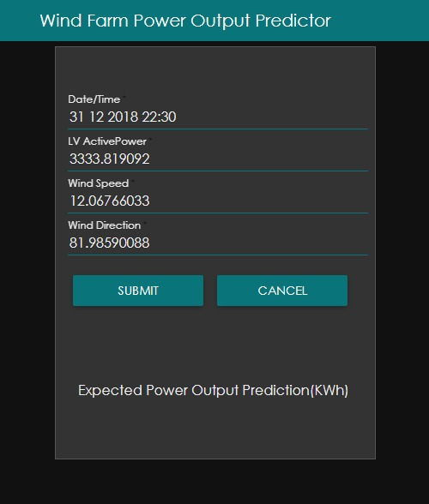
02
User Fills the given fields
And clicks the submit button.

Slide 6
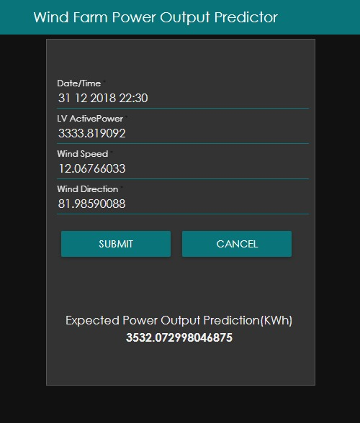
03
Predicted output is
then displayed

Slide 7
Advantages of windfarm power output predictor
Controls the cost of over-production.
It is economically feasible.
Wind Energy can replace many non-environment friendly sources as it is so economical.
It makes production of energy more efficient.
More reliable technology as compared to the present technology.

Slide 8
Links
APPLICATION/WEBSITE
http://node-red-qlgrg.eu-gb.mybluemix.net/ui
SOURCE/GITHUB
https://github.com/SmartPracticeschool/SBSPS-Challenge-1100-Wind-Farm-Power-Output-Predictor

Slide 9
A huge THANKS from team proconspiracy

