Slide 1
PROJECT REPORT
INTELLIGENT POST-LOCK DOWN MANAGEMENT SYSTEM FOR PUBLIC TRANSPORTATION
CONTRIBUTORS
SNIGDHA
AKSHET PATEL

Slide 2
Existing Problem
As per social distancing advisory issued by MOHFW, the operators have to maximize social distancing in public transport besides ensuring regular and proper disinfection of surfaces.
All front-line personnel are required to be equipped with protective materials such as masks and suits, and many have been trained to prevent cross infection between staff and vehicles.
The Ministry of Railways has made it mandatory for passengers to download Aarogya Setu app in their mobile phones, before commencing their journey. While Aarogya Setu provides many ways to deal with the coronavirus crisis, there are still many challenges that can be expected post-lockdown.

Slide 3
Solution
Our strategy is to design a smart transit platform that can analyse crowd distribution inside public transport and public spaces in near-real time and identify two metrics- space occupancy and space utilization.
As a preventive measure, a non-contact infrared thermometer can be attached in a secure location at the entrance of public transport vehicle so that temperature of each passenger is measured before boarding.
A Chabot is designed that can take user information and suggests the person whether he/she is fit for traveling or not.
Our solution ensures that transportation businesses work within the hygiene and space constraints which will cause a new changed market dynamic that will be catered by the ‘vehicle sanitation’ business.
If a passenger is a stranded in an unfamiliar place, instead of asking the people around, he/she can directly search for the place and it will be shown in the map and then the user can click on it to directly get the directions in the google maps.

Slide 4

PROJECT DELIVERABLES
For the passenger
A smart transit platform that can analyse crowd distribution inside public transport and public spaces in near-real time.
The application can also prompt the user whenever the space under consideration has an occupancy of, say, more than 55% and alert the user.
Provide alternatives to the user such as alternate routes, transit stations, etc. by utilizing the google maps API service.
Access to useful information like current statistics related to coronavirus situation in the country, hospitals or pharmacies nearby, etc.
A chat bot that can take user information and process it to intelligently suggest the person whether he/she is fit for traveling or not.

Slide 5
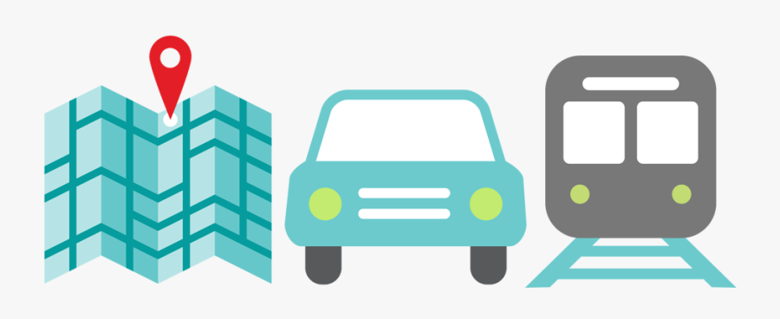
PROJECT DELIVERABLES
For the transport provider
A mask detection model that can detect if the person is wearing a mask or not, and allow only those to enter a vehicle, or any premise, if they are found to be wearing a mask.
As a preventive measure, a non-contact infrared thermometer can be attached in a secure location at the entrance of public transport vehicle so that temperature of each passenger is measured before boarding and if body temperature of the person is detected to be higher than normal, it should trigger an alarm and he/she should not be allowed to board the vehicle.
The data from contactless thermometer to be stored in a database along with the date and timestamp, so that it can be utilized later during contact tracing.

Slide 6
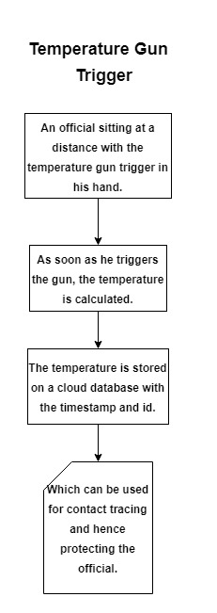
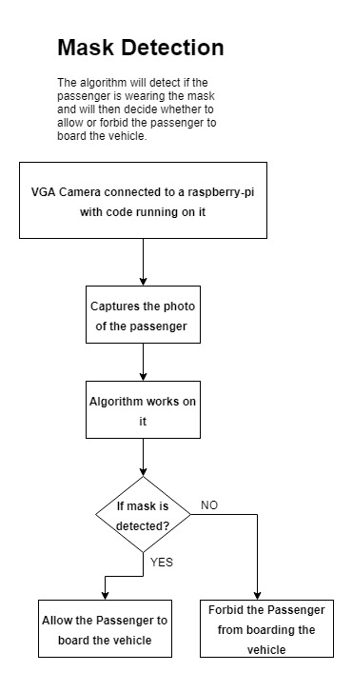
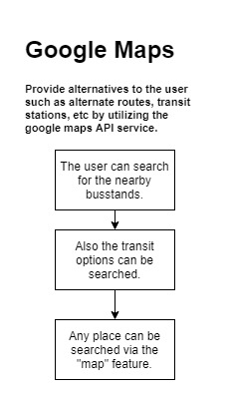
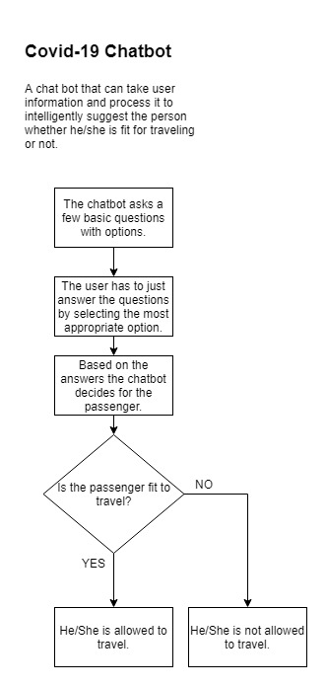
Flowcharts

Slide 7
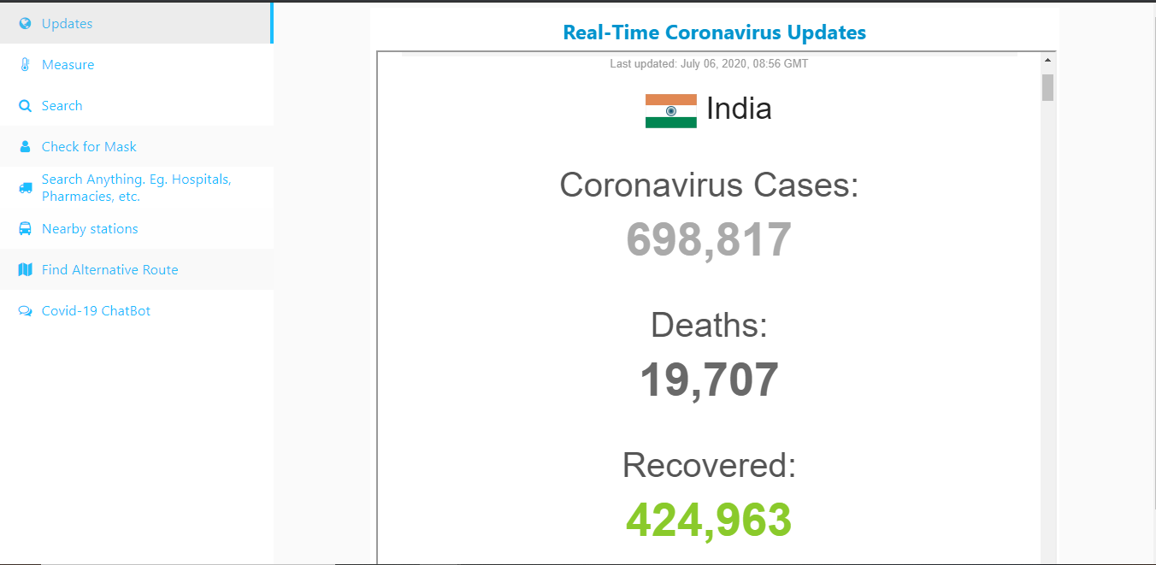
This tab helps provide the user/traveller with all the real-time updates regarding the coronavirus throughout the world.

Slide 8
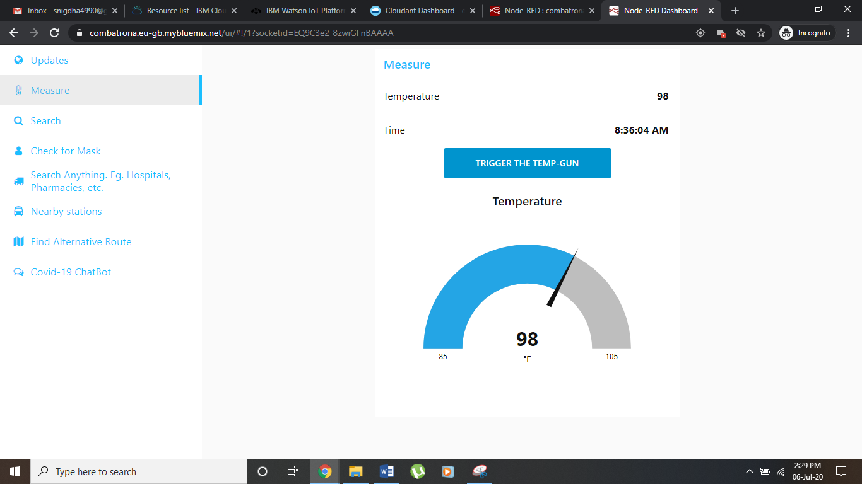
A simulation of a physical trigger button which can be triggered as the passenger enters the station. As soon as the button is triggered the temperature of the person is sent to the IBM Cloudant Database.

Slide 9
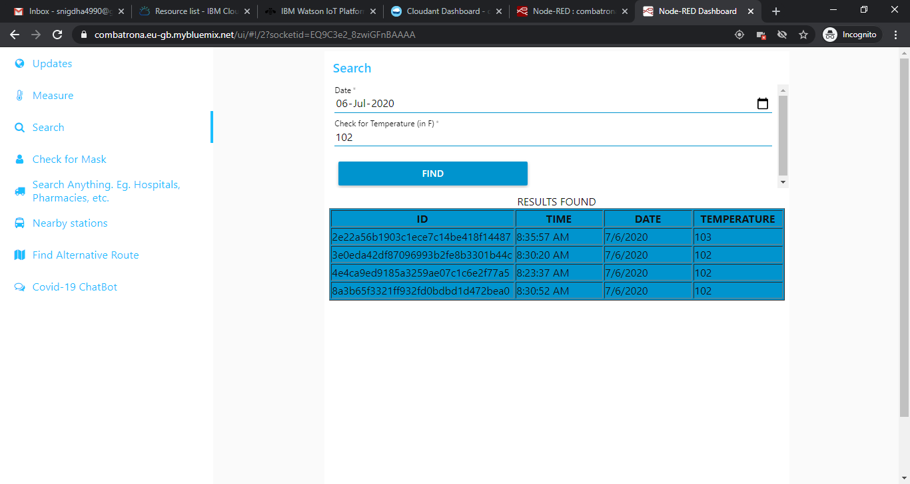
The search tab will enable the authorities to access the temperature data of the passengers while contact tracing and the only input variables are the temperature and date.

Slide 10
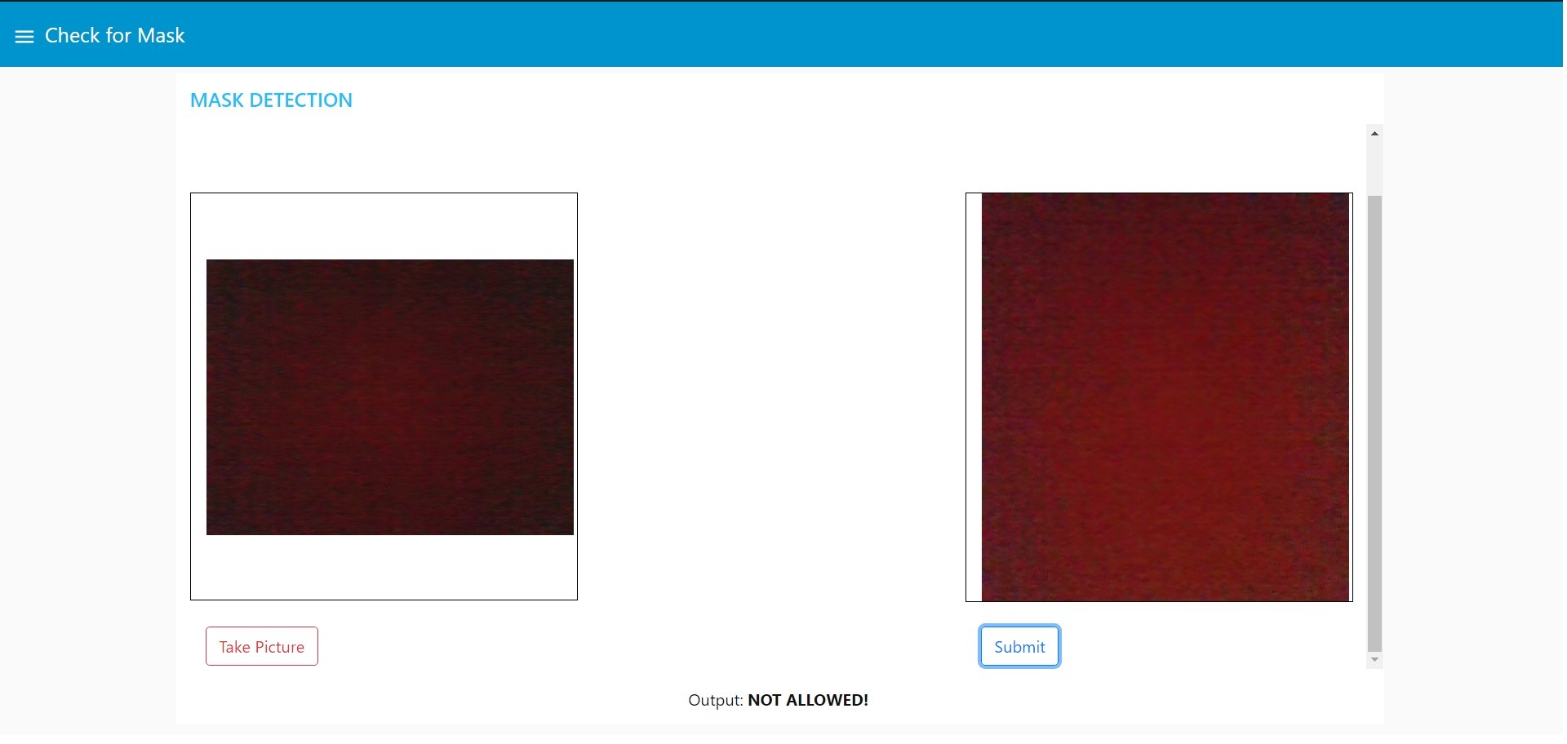
The model detects the mask and only allows the person to enter if the mask is on. So this system can be implemented at various check points which will reduce human labour for checking the masks.

Slide 11
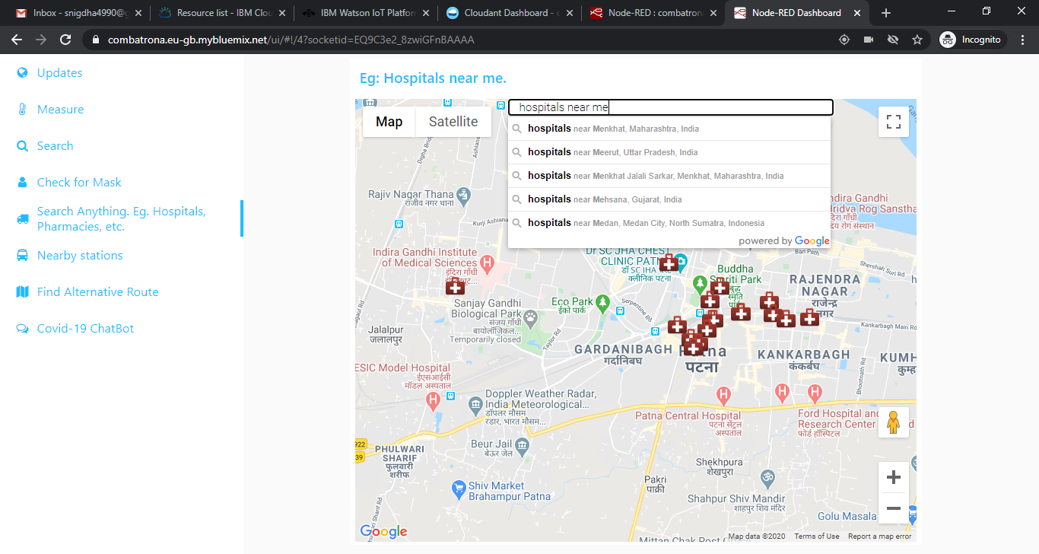
It can be used to search for a place and it will be shown in the map and then the user can click on it to directly get the directions on the google maps.

Slide 12
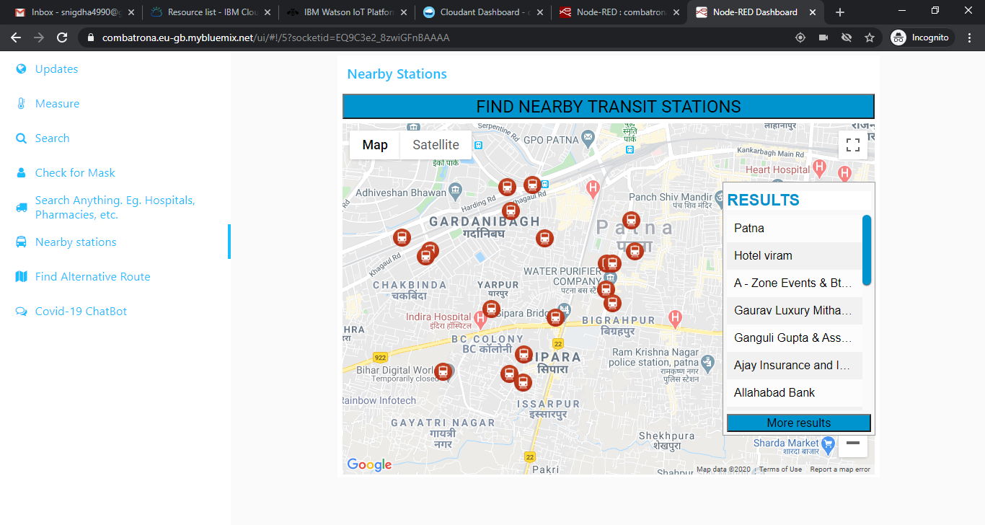
Just by clicking on the “Find Nearby Transit Stations”, the user can get all the transit station like metro stations, bus stands, railway stations, etc. and then find the directions to the nearby one.

Slide 13
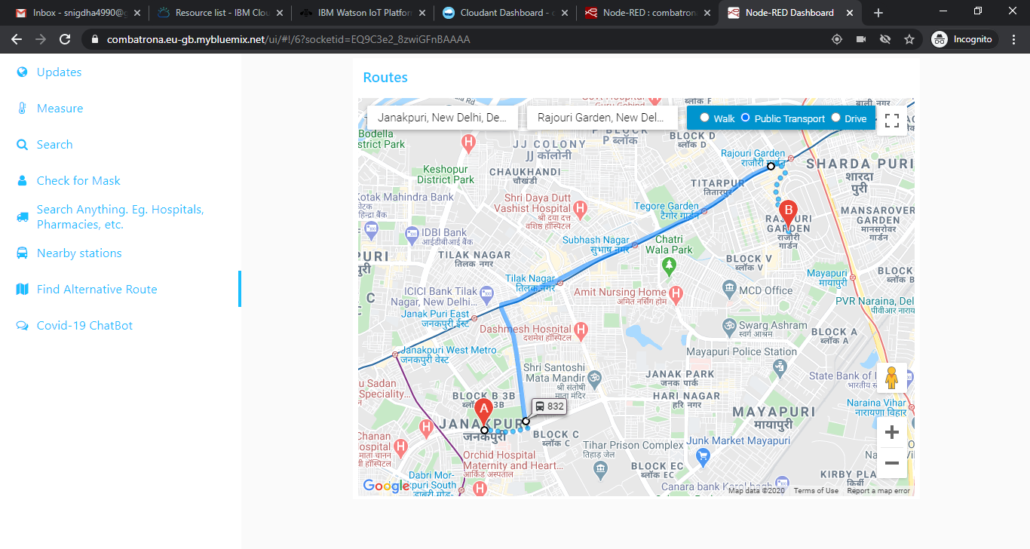
If the user needs to find an alternative route to any destination, he/she just need to enter the origin and the destination and it will show the alternative route to reach there via public transport/walking/driving.

Slide 14
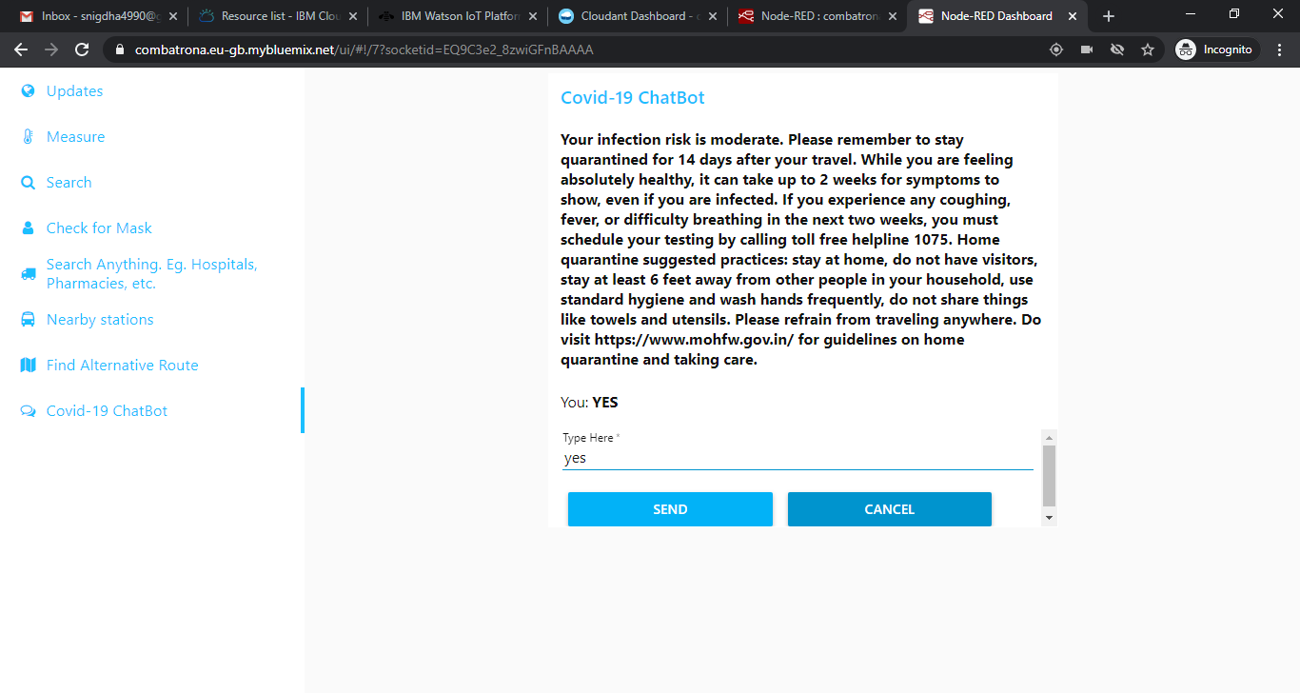
This Chatbot asks basic questions and the user has to select the most appropriate option so that it can advise the user whether it is safe for them to travel or not.

Slide 15
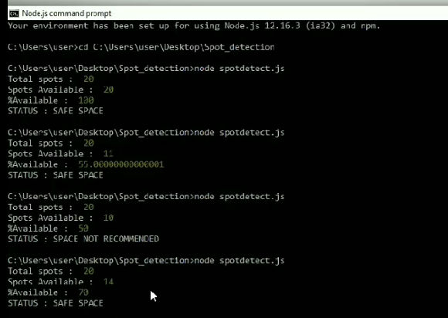
The service of visual recognition is used to analyse the crowd distribution. An object detection model is trained to detect the red dots in an image.

Slide 16
ADVANTAGES
DISADVANTAGES
Offers a real contactless way for maintaining social distancing norms.
Contact tracing is made easier and efficient.
Gives information about the nearby hospitals, pharmacy, bus stands, hotels, etc.
User-friendly interface makes it easy for the user to understand and navigate through the application.
The IBM services are under free trial so this cannot be implemented without buying the services.
The object detection model on IBM visual recognition is still a beta-version. Hence, more development is required to obtain precise results.
The cost of sensors and the software can be expensive for the transport providers.
Application failure when the network disconnects.

Slide 17
FUTURE SCOPE
The face detection system can be redesigned and can be used at airports and places of high security.
The other features supported by this system can be taken into use always as the users are always in need of such facilities that provide them information about the nearby paramedical centres and transport services.
A Chabot can serve the user with the information whenever and wherever.
The crowd distribution analysis model can be trained for real life scenarios and used in public spaces like bus stations, train stations, malls, offices, etc.
The costs associated can be reduced when the system is fully implemented.

Slide 18
THANK YOU

