Slide 1
Team Name : TECHDROIDS
Problem Statement : Sentiment Analysis of COVID19 tweets- Visualisation Dashboard
Team Captain Name: Sivani Voonna
Team Captain Email : sivanivoonna123@gmail.com
No of Team members : 2
Team Details:
1. Sivani Voonna
2. V Pawan Kumar Senapati

Slide 2
PROBLEM STATEMENT
The sentiment analysis of Indians after the extension of lockdown announcements to be analyzed with the relevant #tags on twitter and build a predictive analytics model to understand the behavior of people if the lockdown is further extended. Also develop a dashboard with visualization of people reaction to the govt announcements on lockdown extension .

Slide 3
PROPOSED SOLUTION :
We have developed a web application that makes sentiment analysis of COVID-19 tweets and developed a visualization dashboard to know about people's sentiments about the epidemic and extension of lockdown.
It mainly consists of 2 parts:
Dashboard for sentimental analysis of coronavirus tweets and people reaction on extension of lockdown.
Statistics Dashboard

Slide 4
TECHNOLOGY STACK :
HTML5
CSS3
JAVASCRIPT
Node js
Mongo DB
PYTHON
Flask

Slide 5
IBM CLOUD SERVICES :
IBM Cloud Account
IBM DB2 Database
IBM Natural Language Understanding Service
IBM Watson Studio
IBM Cognos Dashboard Embedded

Slide 6
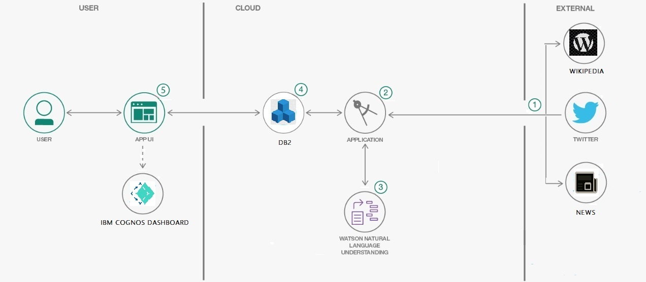
BLOCK DIAGRAM :

Slide 7
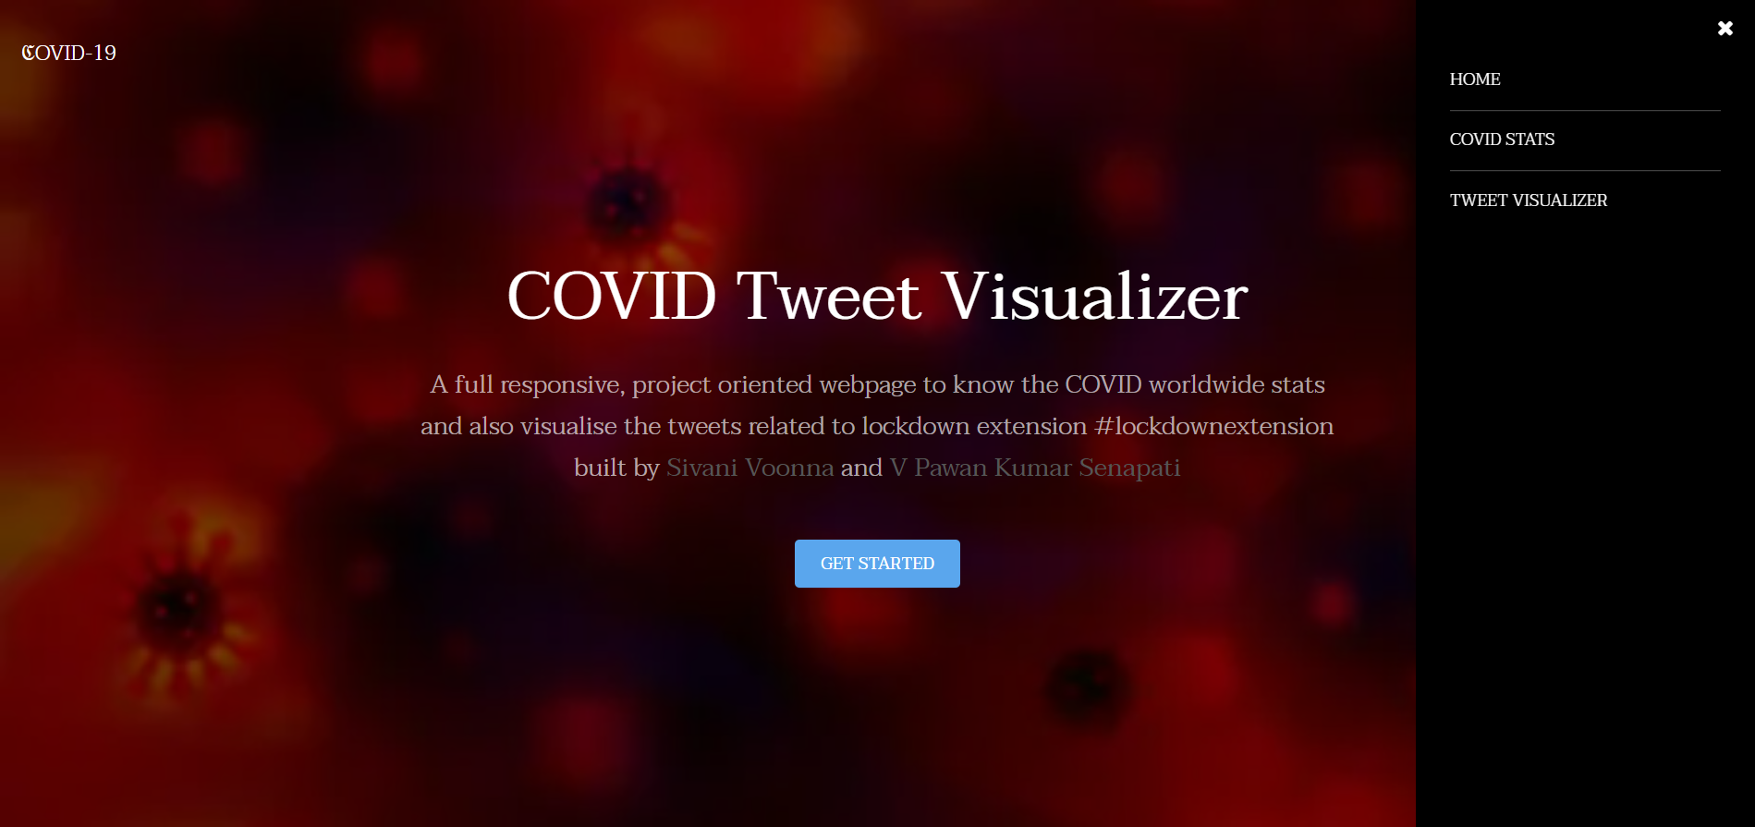
WEB APPLICATION :
(Page-01)

Slide 8
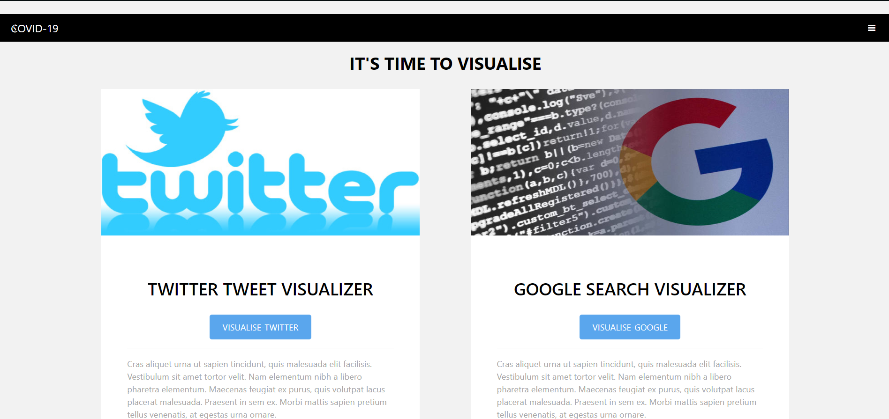
WEB APPLICATION :
( Page-02 Dashboard Redirection page )

Slide 9
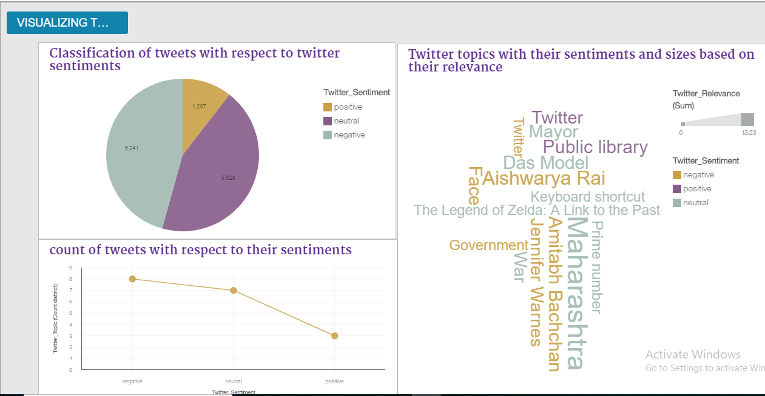
Results for Twitter Analysis :

Slide 10
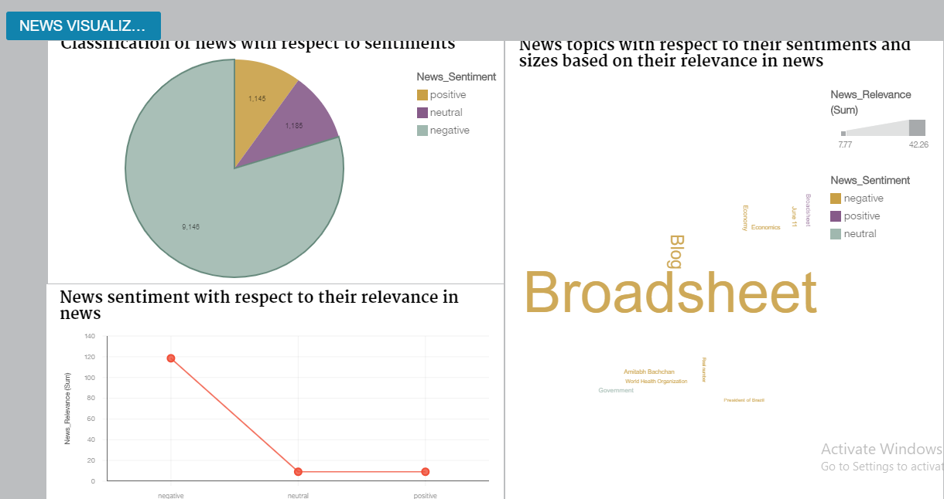
Results for News Analysis :

Slide 11
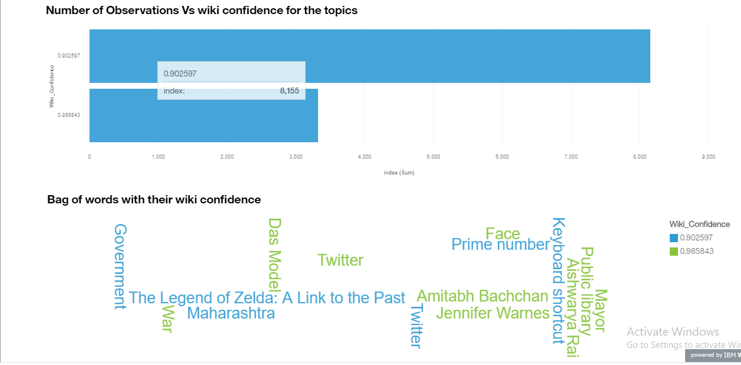
Results for Wikipedia Analysis :

Slide 12
ADVANTAGES :
1. The Dashboard gets updated each time we run the flask application thus giving live analysis.
2. The User Interface is simple, consistent and easy to use .
3. As Watson NLU is used , sentiment Analysis accuracy is high.
4. As DB2 database is used to store data ,data is very well structured and easy to understand.
DISADVANTAGES :
1.As the problem statement was about corona virus and lockdown extension , we predefined the required hashtags (#tags) in the code itself.

Slide 13
SCOPE OF WORK
This project can be implemented to visualize the sentiments of people on any sort of topic.
It will help to know people’s opinion on kind of decision taken by the Government.
Adding any kind of additional features to the dashboard is possible. Hence it is very dynamic.
Due to the above mentioned features of our project we can say that our work has a great scope in the future as well.

Slide 14
CONCLUSION :
We have addressed issues surrounding public sentiment reflecting deep concerns about Coronavirus and COVID-19, leading to the identification of growth in fear sentiment and negative sentiment. We also demonstrated the use of exploratory and descriptive textual analytics using Watson NLU and data visualization using IBM Cognos Analytics dashboard to discover early stage insights, such as by grouping of words by levels of a specific non-text.
The Conclusion is that we identified the growth in negative sentiment is gradual and a word cloud that consists of all the trending topics on twitter and news.

Slide 15
BIBILIOGRAPHY :
1. https://www.geeksforgeeks.org/twitter-sentiment-analysis-using-python/
2. Watson Natural Language Understanding
https://www.youtube.com/watch?v=WDItryHZ3JI
https://cloud.ibm.com/apidocs/natural-language-understanding
3. DB2 database
https://www.youtube.com/watch?v=J9xtw0zjDLY
https://www.ibm.com/in-en/products/db2-database
4. Flask using python
https://www.youtube.com/watch?v=Z1RJmh_OqeA
5. IBM Cognos Dashboard Embedded
https://www.youtube.com/watch?v=FCQ6GAcyQ7E

Slide 16
THANK YOU

