Slide 1

IBM Hack Challenge 2020
Project ID : SPS_PRO_1081 Project Title : Sentiment Analysis of COVID-19 Tweets – Visualization Dashboard. Team Name : Covid19 Warriors
Problem Statement: The sentiment analysis of Indians after the extension of lockdown announcements to be analyzed with the relevant #tags on twitter and build a predictive analytics model to understand the behavior of people if the lockdown is further extended. Also develop a dashboard with visualization of people reaction to the govt announcements on lockdown extension.
Objective : 1. To develop a software solution which can analyze the sentiments and reaction of people on current pandemic situation.
2. To develop a visualization dashboard to visualize the live sentiments of people.
WebSite : https://covid19-sentiments-analysis.herokuapp.com/

Slide 2
Existing Problem
India is a population rich country. In order to get reactions over any decision from people the Government used to depend highly on News Channels, Social Media, etc.
The Limitation of News Channels is that they cannot cover whole country and it becomes very difficult for Government to track people on Social Media.
If negative reactions of the people increases beyond a certain limit then it becomes very difficult to handle the situation of huge population with respect to government decision.
Proposed Solution
In order to solve above problem, We have build predictive system to understand the reactions from sentiments of people from Live Tweets. For building this model we have used sentiment140 dataset. It contains 1,600,000 tweets extracted using the Twitter API. The tweets have been annotated (positive = 1 ,neutral = 0 ,negative= -1)
The system automatically extract tweets on a live basics and analysis it accordingly positive ,negative or neutral sentiment.
So, with the help of visualization of these Live sentiments we get prior notice of increasing negative sentiments percentage.

Slide 3



Technology Stack
Frontend –
HTML & CSS
js
Backend –
Python
Flask Framework
Tensorflow
Keras
MySql Database

Slide 4
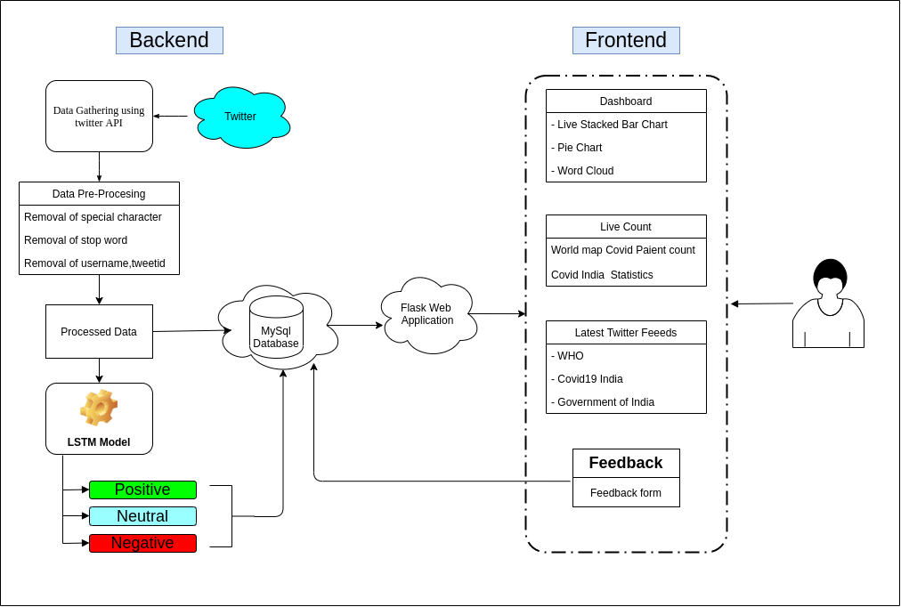
Flowchart

Slide 5
Advantages
By using sentiment analysis, one can analyze different areas of a particular situation without having to depend on thousands of sources at once.
The Sentiments can be visualized on a live basics
It gives an detailed analysis over the situation
The Dashboard is easily accessible from anywhere in the world
Disadvantages
The Model will only predict sentiments of English Language
While sentiment analysis is useful, it is not a complete replacement for news and other media. Often, there are useful nuances in the comments themselves. Where sentiment analysis can help you further is by identifying which of these comments you should read.

Slide 6
Application
The main Application of this project is to analyze current situation of public and their reaction towards the pandemic situation.
As the Model is Robust, it can be used on any other application of Sentiment Prediction.
Future scope
Currently, We have developed system which can analyze the Live tweets and predicts sentiment of people across the India through Twitter but this can be extended to other social media platform as well as across the Globe.
This system is not only based for Coronavirus health issue but it can also predict sentiment for the future similar cases as well as on any other Sentiment Prediction.
Using Time Series Analysis number of future patients can be predicted.

Slide 7

References
https://flask.palletsprojects.com/en/1.1.x/
https://www.ncbi.nlm.nih.gov/pmc/articles/PMC7152888
http://docs.tweepy.org/en/latest/

