Slide 1
Food Availability and Access Predictor - FAAP
Visualization Dashboard
Team Name : CodeBrothers
Team Members :
V. Mohan Kalyan
T. Nikhil Yadav

Slide 2
General Description
The COVID-19 pandemic is the defining health crisis of our time and the greatest challenge that we have ever faced since world war II. But it is not just a health crisis it is more than that, affecting people all over the world in many ways. Of all the problems, the food supply-chain network will be affected widely. To mitigate the effects, many organizations and countries are shifting their focus to stabilize the supply chain.
Our proposed solution for the above concern is committed to the government bodies of the agriculture sector by creating machine learning models that will predict the “Production” and “Demand” for crop yields considering the specified area and time. From the model predictions, officials can estimate the demand and supply gap present in an area and will be able to take the required actions. As we can predict the future demand for products, it makes us control the supply chain and provide the products/goods at an affordable price to the consumers.

Slide 3
Novelty
Our proposed solution has its novelty in many ways :
We provide various visualizations for demand and supply thereby giving the user a lucid clarity on the demand-supply gap.
User has the options to view the demand and supply either in a generalized way or in a specific way. The demand and supply for 3 main crops is the default view for the user. But he/she can view the same for other staple crops/food products by using the options provided.
Along with predicting the demand-supply gap, a visualization is provided that connects two areas/regions, specifying the required flow of the goods based on the receiver’s demand requirement and senders surplus availability.
We provide additional priority and visualization to the states/areas which are already under certain crisis (like natural disasters, malnutrition, high poverty levels, etc.,) and term them as “Crisis within a Crisis”. So that they will be taken with acute attention.

Slide 4
Social Impact
Our proposed solution has its impact in various sectors :
User (Officials): By predicting the demand-supply gap, they understand the supply patterns and thereby will be able to take the required actions in filling the demand gap.
Consumer: By filling the demand gap and making the supply chain stable, the consumers i.e., all sectors of people can acquire their essential products at an affordable price thereby mitigating food insecurity.
Farmers: Because of the predictive mapping of products between the states/areas the farmers produced yield is not left unattended. Underprivileged: We prioritize the existing underprivileged people such as people in poverty, malnutrition, and people affected by natural calamities. So, they are given more preference.

Slide 5
Technology Stack
We use different technologies in a collaborative approach for the application:
Programming Languages: Python Database: MySQL Web framework: Flask Machine Learning Models: Random forest Regression, Holt-winters method(Time series analysis) Data for ML models: CSVs collaborated from different sources

Slide 6
Scope of Work
There are total modules for the proposed solution:
Data Processing: In this part, we assure that the data is consistent and reliable by removing the redundant values, filling the missing values, and performing the feature scaling to represent the entire data at one scale.
Crop_Module: This module is for predicting the crop yield production when specified in the required time and area. The data related to crop-yield is considered from data processing and the model is trained using the random forest regression algorithm. by which we can predict the crop yield for the future specified time.
Demand_Module: This module is for predicting the “Demand” of essential commodities when time and area are specified. The data related to demand(consumption of essential commodities) is considered for training the model with Holts winter method. By which we can predict the crop yield for the future specified time.
Web_Userinterface: This module is to come up with a dashboard of data visualizations that help the user to understand the demand and supply gaps, identify the patterns in future and current trends. We use google APIs and other tools for visualizing the content for the user.

Slide 7
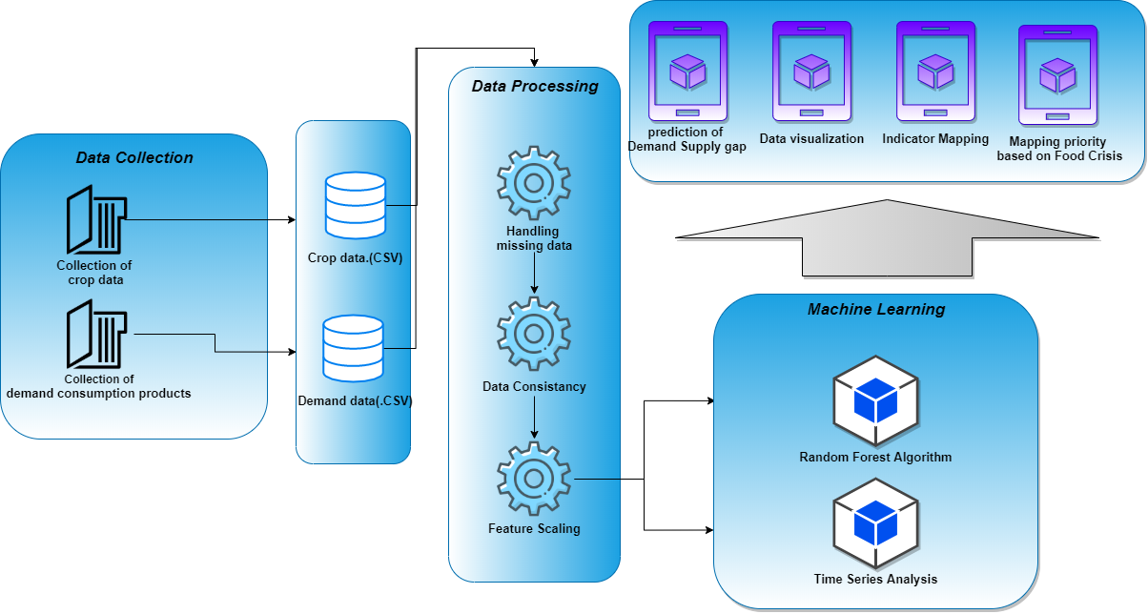
Architecture

Slide 8
Scope of Work:
There are total modules for the proposed solution:
Data Processing: In this part, we assure that the data is consistent and reliable by removing the redundant values, filling the missing values, and performing the feature scaling to represent the entire data at one scale.
Crop_Module: This module is for predicting the crop yield production when specified in the required time and area. The data related to crop-yield is considered from data processing and the model is trained using the random forest regression algorithm. by which we can predict the crop yield for the future specified time.
Demand_Module: This module is for predicting the “Demand” of essential commodities when time and area are specified. The data related to demand(consumption of essential commodities) is considered for training the model with Holts winter method. By which we can predict the crop yield for the future specified time.
Web_Userinterface: This module is to come up with a dashboard of data visualizations that help the user to understand the demand and supply gaps, identify the patterns in future and current trends. We use google APIs and other tools for visualizing the content for the user.

Slide 9
Thank You

