Slide 1
Sentiment Analysis of COVID-19 Tweets
IBM Hack Challenge 2020
Project ID : SPS_PRO_1134
Team name : Smart-hack
Team members : Sharon Dev s, Krishna s m, Mathew prince manjooran, George manjooran

Slide 2
Introduction
With more than 321 million active users, sending a daily average of 500 million Tweets, Twitter allows businesses to reach wide set of audience and connect with customers without intermediaries.
On the downside, it’s harder for brands to quickly detect negative content, and if it goes viral you might end up with an unexpected PR crisis on your hands.
This is one of the reasons why social listening ― monitoring conversation and feedback in social media ― has become a crucial process in social media marketing.
The analysing and visualizing of these "sentiments" from the twitter pool can serve as a powerful tool to study and understand the behaviour of the target audience ( geographically /timeline/ community based etc.) and know what were the parameters that lead to a specific conclusion.

Slide 3
purpose
This proposal is for the sentiment analysis of Indians after the announcements pertaining to the extension of lockdown, from relevant #tags on twitter and build a predictive analytics model to understand the behaviour of people if the lockdown is further extended.
This is also followed by visualization of the prediction and then a dashboard is also displayed with regards to the people’s reaction and emotion towards the government's decision.
This can be used to derive personal interests and the person’s preference in matters, so that the company or the organization can strategize towards developing a more profitable & reliable solution and also to serve the customers better.
The speciality of the proposed solution is that we are utilizing up data extracted from the internet and coupling it with NLP techniques supported by Deep learning (Deep NLP).
This helps to make our model more robust in functioning, thereby giving it a dynamic behaviour thus giving better outputs as compared to other methods of analysis.

Slide 4
Software designing
Here we have factored our project in 3 phases : TWITTER DATA EXTRACTON(including pre-processing) , SENTIMENTAL ANALYSIS USING AN NLP MODEL(RoBERTa) and VISUALIZING IT .
The user will be prompted to enter the parameter ,that he/she is willing to access, in the main UI.
The values entered will then be used to extract the pertaining data and is then forwarded to the model to generate the sentiment analysis .
The output is then displayed in the dashboard along with some information about COVID-19's status in India.
These 'phases' are handled by separate independent scripts , wherein a "main.py" is treated as the file where all these scripts are imported and the functions that are defined in them are applied in it.

Slide 5
1. TWITTER DATA EXTRACTION : -
In this phase a python script is written to use "tweepy " library .
It basically queries over twitter based on the keyword and number of tweets specified in the search bar.
But these extracted tweets contains a lot of unnecessary data henceforth it becomes a major concern to clean and pre-process this data before loading it into the model.
Followed this pre-processing , the clean is now ready to be given to the model for analysis.
' CLEANER DATA PROJECTS TO CLEANER OUTPUT '

Slide 6
2. SENTIMENT ANALYSIS USING AN NLP MODEL :-
The RoBERTa model was proposed in RoBERTa: A Robustly Optimized BERT Pre-training Approach by Yinhan LiuIt is based on Google’s BERT model released in 2018.
It builds on BERT and modifies key hyper parameters, removing the next-sentence pre-training objective and training with much larger mini-batches and learning rates.
We managed to train this model with an accuracy of 94.79%. RoBERTa is developed based on BERT, they share lots of configs. Still it performs better then BERT cause of the following adjustments : * Bigger training data (16G vs 161G) . * Using dynamic masking pattern (BERT use static masking pattern). * Replacing the next sentence prediction training objective. * Training on longer sequences.
This model has the caliber to classify textual data to SAD , JOY , ANGER , SURPRISE, LOVE and FEAR emotions. The generated analysis is then displayed on a PIE chart as well as on a bar graph using matplotlib.

Slide 7
3. VISUALIZING :-
A form is displayed in the main page where the user can input ' Custom Keyword' , ' Maximum Number of Tweets ' , ' Maximum Number of Words in Wordcloud ' and ' Date ' .
Followed by this search indices there are 2 search options ' Search ' and 'Search for COVID-19' .
'Search ' will give the sentiment analysis for the custom keyboard that has been provided by the user and specfied by other parameters while 'Search for COVID-19' will give sentiment analysis for COVID in India based on other parameters ( by default number of tweets is 100).

Slide 8
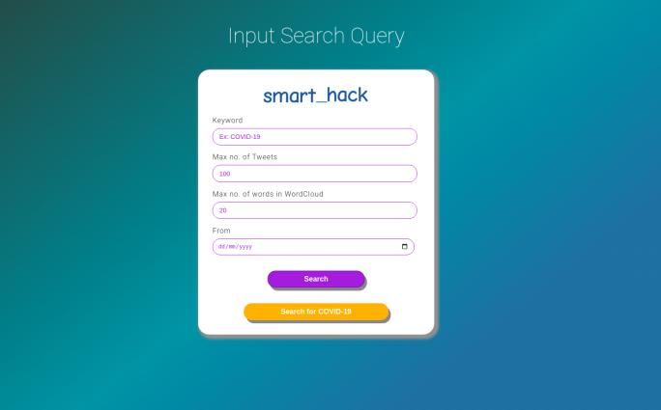

Slide 9
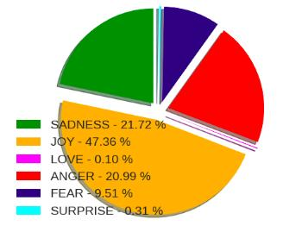
PIE - CHART : Its depicts the percentage of the emotions that has classified by the model from the data

Slide 10
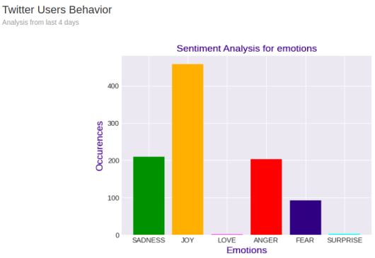
BAR CHART : It basically projects the sentiments on a graph.

Slide 11
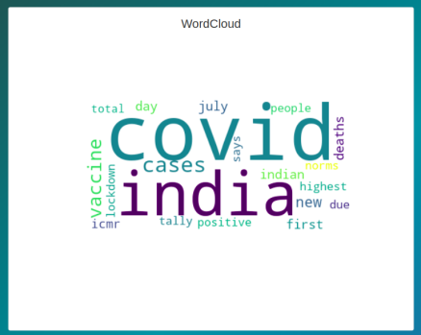
WORDCLOUD : Displays words based on their frequency of occurence and number of words in wordcloud specified as a parameter.

Slide 12
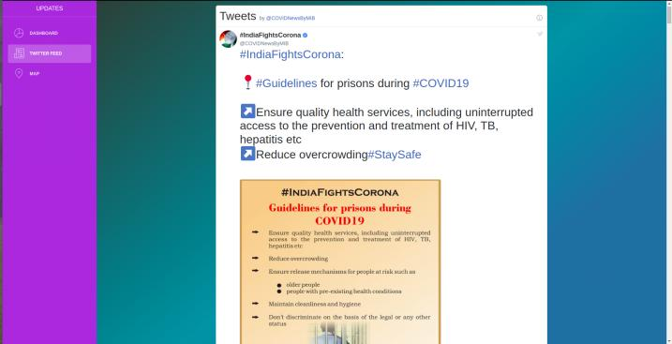
TWITTER FEED : A widget which displays latest tweets made by @COVIDNewsByMIB.

Slide 13
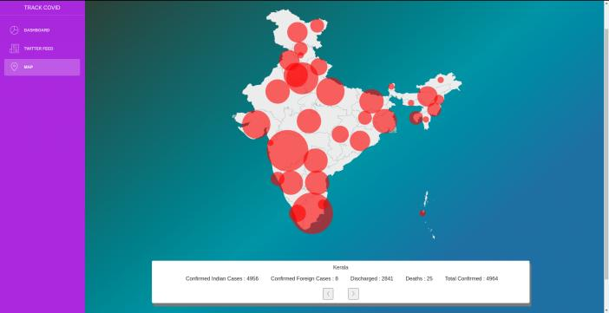
MAP : A map depicting the spread of corona virus across India . The RED circles shows the degree of spread based on confirmed cases , across 35 union-territories/states.

Slide 14
EXPERIMENTAL INVESTIGATIONS
After many iterations of testing and inferring the data that we got, most of the "REACTIONS" that we got from Twitter regarding COVID 19 in India is mainly composed of " JOY " and "SAD " .
It can be inferred that netizens are happy about how our Govt is tackling this epidemic, discussing about their lockdown activities and at the same time a large portion is sad because of the way COVID -19 is affecting their daily lifestyle especially that of daily wage workers.
The map works efficiently in displaying day to day COVID spread in India. Higher the number to tweets extracted, better will be the analysis.

Slide 15
ADVANTAGES OF THIS PROJECT :
This project not only gives a sentiment analysis of COVID 19 in India , but it can also give sentiment analysis of any feasible word for querying.
Unlike general sentiment analysis , this gives out analysis based on 6 different emotions .
Our visualization dashboard also gives a WordCloud for getting to know trending words amongst the tweets we scrapped .
There also a section which gives us day to day details about newly confirmed cases , recent deaths , cumulative cases , total recovered and active cases .
A twitter feed is there which gives us latest tweets made by @COVIDNewsByMIB for letting us know what all steps are being taken to combat the virus .
The map feature shows a general view about how the virus is branched among states and union territories . There is also a small form below this map which can be used to access information regarding confirmed Indian cases ,confirmed foreign cases , total recovered and total death of corresponding states and union territories .

Slide 16
DISADVANTAGES OF THIS PROJECT :
The data which is being extracted from twitter is in its raw form , so for that it is essential to pre-process it which takes some time.
The data which is being displayed for daily COVID status is from an API, so if any problem occurs in accessing the internal server of the database or value updation in the database , then the displayed data on the corresponding section becomes unreliable.

Slide 17
RESULT :
The project is able to scrape , pre-process and analyse the tweets made by the users in a reasonable period of time.
The output is displayed successfully on the main page along with the update COVID status in India.
Overall this project helps the user who are wanting to know more about people's views about COVID , status about COVID and news about COVID.

Slide 18
APPLICATIONS:
This project as a prototype perfroms well enough in :-
1. Generating sentiment analysis of COVID 19 in India ( apparently the location constraint can also be changed by adjusting the keyword ) .
2. As mentioned earlier the scope of this project not only limits to 'COVID 19‘ but can be expanded to any special keyword for scraping data.
3. The data which is being displayed in dashboard can be easily accessed and understood by any Entrepreneur / Researcher/ Enthusiast / Student or anyone who requires sentiment analysis for their Project / Knowledge / Reasearch / Documentation .
4. If anyone wishes to know latest COVID status in India, for any state or union territory then he/she can access it at ease along with a dependable representation of the spread , projected on a map of India .
5. Recent progress by the government can be tracked by visiting the the twitter feed widget from dashboard which linked with the official twitter account of @COVIDNewsByMIB.
6. Based on the sentiment analyis the user can strategize and can come up with a tweak of an application , a scheme for an organisation , a conclusion of a decesion , an inisight about a personality etc. from a target community .

Slide 19
Thank you

