Slide 1
SENTIMENT ANALYSIS OF COVID19 VISUALISATION DASHBOARD
By: Shivam Sarathe
Team name: Invincible united

Slide 2
What is SENTIMENT ANALYSIS?
Sentiment analysis is a machine learning technique that detects polarity (e.g. a positive or negative opinion) within text, whether a whole document, paragraph, sentence, or clause
TYPES OF SENTIMENT ANALYSIS
Fine-grained Sentiment Analysis
Emotion detection
Aspect-based Sentiment Analysis
Multilingual sentiment analysis

Slide 3
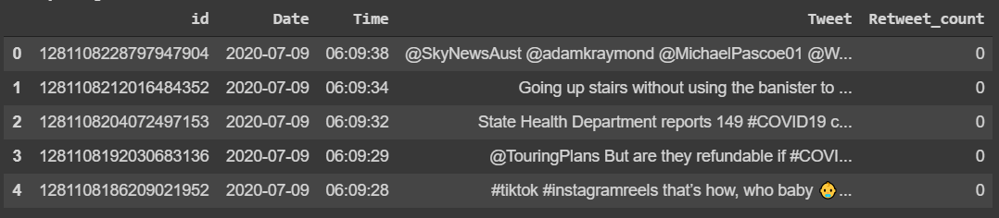
DATASET CREATION
IMPORTING TWEETS FROM TWITTER
Creation of dataframe

Slide 4
SENTIMENT ANALYSIS OF COVID19 VISUALISATION DASHBOARD
Aim: The sentiment analysis of Indians after the extension of lockdown announcements to be analyzed with the relevant #tags on twitter and build a predictive analytics model to understand the behavior of people if the lockdown is further extended. Also develop a dashboard with visualization of people reaction to the govt announcements on lockdown extension
Overview: This PPT is based upon some basic concepts of Natural Lang. Processing (NLP) that is used to acquire the sentiment analysis of tweet. NLP recently gained pretty much attention in order to analyse human lang. computationally. NLP covers a wide variety of feild like machine translation, spam ham detection, summarization, information extraction, sentiment analysis, and auto-predict, speech recognition etc.
Data used: first we need a proper dataset where we divide the dataset into the ratio 1:3 as we want to test and train the same data set but of different values.However In our project we create our own dataset because we have to fetch live tweets. By using the pandas we convert the fetched tweet to a well organized dataset.

Slide 5
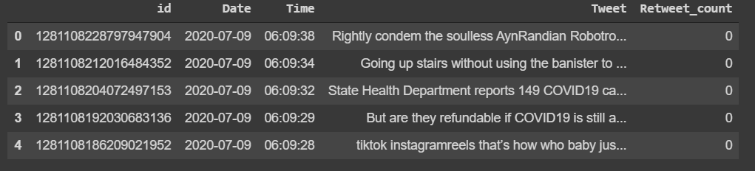
Data PREPROCESSING:
REMOVING MENTIONED PEOPLE
REMOVING SPECIAL CHARACTERS AND PUNCTUATION
removing link in Tweet if present
to remove ascii characters

Slide 6
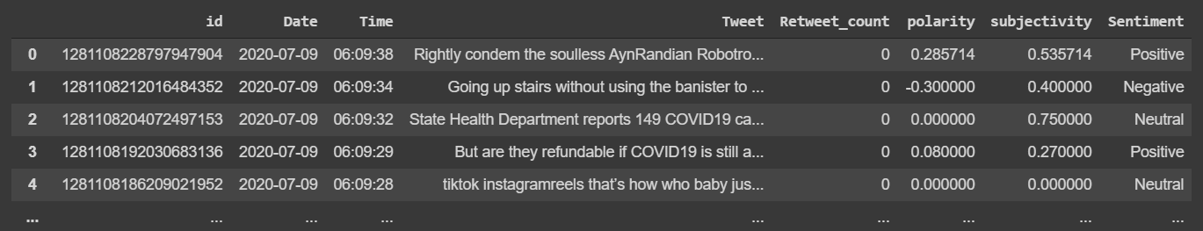
ADDING POLARITY AND SENTIMENT :
If polarity > 0,then it is positive sentiment
If polarity<0,then it is negative sentiment
If polarity=0,then it is neutral sentiment

Slide 7
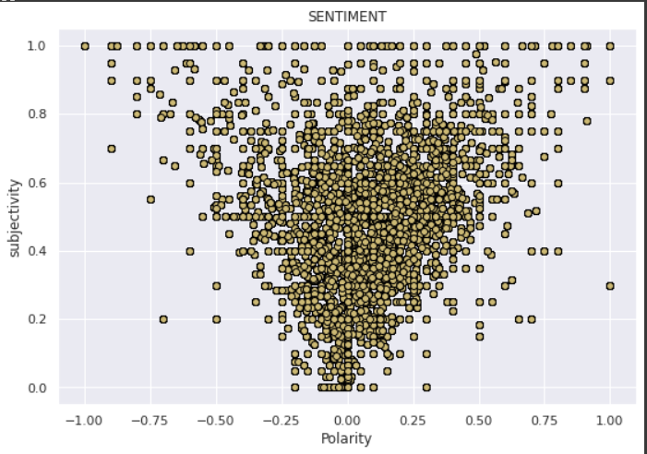
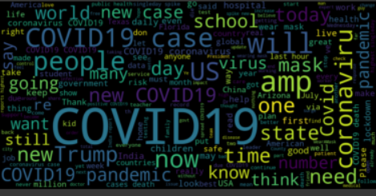
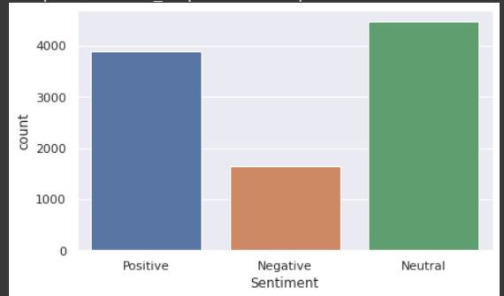
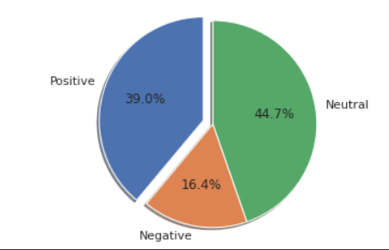
Data VISUALISATION:
WORDCLOUD
COUNTPLOT
POLARITY VS SUBJECTIVITY GRAPH
PIE CHART

Slide 8
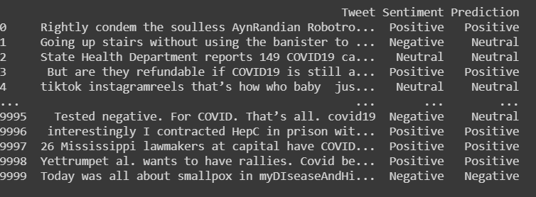
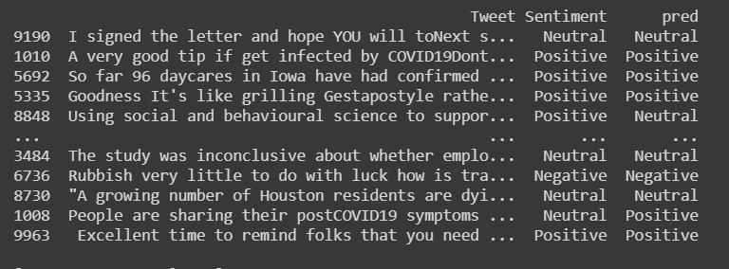
CLASSIFICATION PART:
MultinomialNB
Random forest classifier

Slide 9
~Fin~

