Slide 1
PROJECT ID- SPS_PRO_1538
APPLICATION ID- SPS_CH_APL_20200004120 APPLICATION ID- SPS_CH_APL_20200004121
1
INTRODUCTION
  Overview
  Purpose
LITERATURE SURVEY
  Existing problem
  Proposed solution
THEORITICAL ANALYSIS
  Block diagram
  Hardware / Software designing EXPERIMENTAL INVESTIGATIONS FLOWCHART
RESULT
ADVANTAGES & DISADVANTAGES APPLICATIONS
CONCLUSION FUTURE SCOPE BIBILOGRAPHY APPENDIX
A. Source code
2
3
4
5
6
7
8
9
10
11

Slide 2
Introduction
  Overview We will build a web app that calculate the similarity between Company Specific Resume with Given Candidate given Resume
Project Requirements : Python 3.X,Flask framework,Web Browser
Functional Requirements : SK Learn ,Numpy ,Pandas
Technical Requirements : python with required library
Software Requirements :Web Browser
Project Deliverables : AI Resume Selector(Resume Matcher)
Project Team : Rizvi’s
Project Id: SPS_PRO_1538
1.2 Purpose the HR will get hectic to select a resume of a candidate with company job profile so our project will help HR to select a candidate with the given job description
Literature Survey
  Existing Problem HR will get hectic to select a resume with a candidate with a company job profile so our project will help HR to select a candidate with the given job description and it’s a manual process so definitely in takes time.

Slide 3
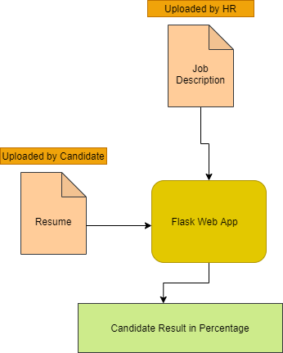
2.2 Proposed Solution In this project, we built a web app that calculates the similarity between two resumes using Cosine Similarity and it will automate the task
3. Theoretical Analysis
Block / Flow Diagram

Slide 4
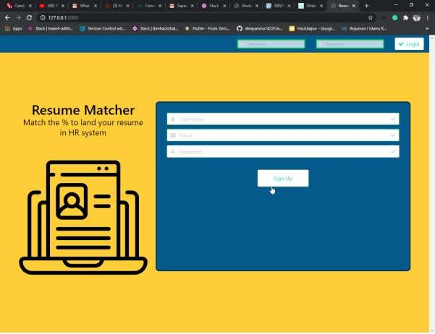
Hardware / Software Designing
Created a UI
Used a SQL Alchemy Database to store a data. 3.Make a app.py and put the 5.
Configure Watson Assistant.
Integrate Watson Discovery with Watson Assistant using webhook.
Build Node-RED flow to integrate Watson Assistant and Web Dashboard.
4. Experimental Investigation

Slide 5
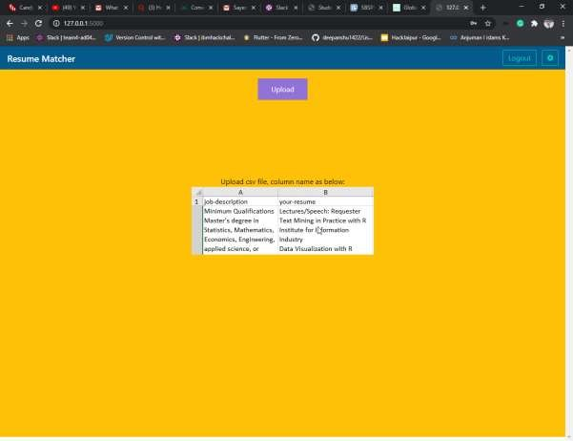

Slide 6
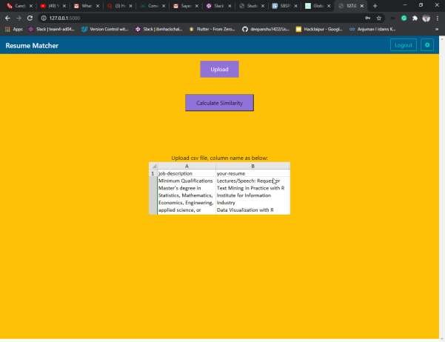

Slide 7
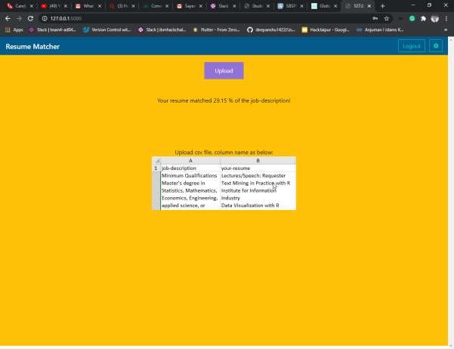

Slide 8
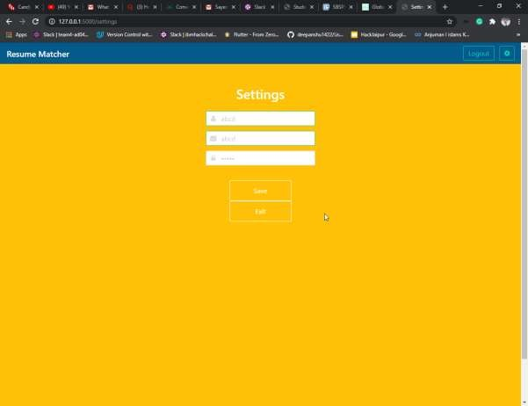
5. Flowchart
Insert the following nodes into the flow in Node-RED.
UI
Login/ SignUp
Upload a Resume
Calculate Similarity

Slide 9
6. Results
Web based UI was been developed using HTML with jinja Template.
Run app.py (command :python app.py) After that visit given url below
http://127.0.0.1:5000/

Slide 10
7. Advantages & Disadvantages
Advantages
Reduces Man Power.
Cost Efficient.
Take Less time .
Disadvantages
Supported extension is .csv.
Web Design is not much responsive.
Applications
It can be used in every various industry as well as a startup it will reduce the cost and benefit for the startup as well as big MNC's.
Conclusion
It will be created in a flask that uses WSGI server that is a lite server and makes application faster.
Future Scope
In the future, various other Watson services like Text-To- Speech and Speech-To-Text can be integrated our Web app

Slide 11
and we can implement Watson Assistant Chatbot. We can use a visual recognition or NLP also in our project.
11. Bibliography
Resume matcher model:- https://www.youtube.com/watch?v=bkigzpBLN6o
flask documentation:- https://flask.palletsprojects.com/en/1.1.x/

Slide 12
Appendix
Source Code App.py
from scripts import tabledef from scripts import forms from scripts import helpers
from flask import Flask, redirect, url_for, render_template, request, session import json
import sys import os
import pandas as pd
from werkzeug.utils import secure_filename
from sklearn.preprocessing import PolynomialFeatures from sklearn.linear_model import Ridge
from sklearn.model_selection import train_test_split
from sklearn.pipeline import make_pipeline
from sklearn.metrics.pairwise import cosine_similarity
from sklearn.feature_extraction.text import CountVectorizer import numpy as np
import pandas as pd
import jieba
import jieba.analyse import csv
import ast
app = Flask( name ) app.secret_key = os.urandom(12)
@app.route('/', methods=['GET', 'POST'])
def login():

Slide 13
if not session.get('logged_in'):
form = forms.LoginForm(request.form) if request.method == 'POST':
username = request.form['username'].lower() password = request.form['password']
if form.validate():
if helpers.credentials_valid(username, password): session['logged_in'] = True
session['username'] = username
return json.dumps({'status': 'Login successful'}) return json.dumps({'status': 'Invalid user/pass'})
return json.dumps({'status': 'Both fields required'})
return render_template('login.html', form=form) user = helpers.get_user()
return render_template('home.html', user=user)
@app.route('/signup', methods=['GET', 'POST'])
def signup():
if not session.get('logged_in'):
form = forms.LoginForm(request.form) if request.method == 'POST':
username = request.form['username'].lower()
password = helpers.hash_password(request.form['password']) email = request.form['email']
if form.validate():
if not helpers.username_taken(username): helpers.add_user(username, password, email) session['logged_in'] = True session['username'] = username
return json.dumps({'status': 'Signup successful'}) return json.dumps({'status': 'Username taken'})
return json.dumps({'status': 'User/Pass required'})

Slide 14
return render_template('login.html', form=form)
return redirect(url_for('login'))
@app.route('/settings', methods=['GET', 'POST'])
def settings():
if session.get('logged_in'):
if request.method == 'POST':
password = request.form['password'] if password != "":
password = helpers.hash_password(password) email = request.form['email']
helpers.change_user(password=password, email=email) return json.dumps({'status': 'Saved'})
user = helpers.get_user()
return render_template('settings.html', user=user) return redirect(url_for('login'))
@app.route('/login_page', methods=['POST'])
def login_page():
if session.get('logged_in'):
user = helpers.get_user() try:
user.active = True
return render_template('home.html', user=user) except error:
return render_template('error.html')
@app.route("/logout")
def logout(): session['logged_in'] = False

Slide 15
return redirect(url_for('login'))
@app.route('/predict', methods=['GET', 'POST'])
def upload():
if request.method == 'POST': f = request.files['file']
basepath = os.path.dirname( file )
file_path = os.path.join(
basepath, 'uploads', secure_filename(f.filename)) f.save(file_path)
df = pd.read_csv(file_path)
seg_list01 = df['job-description'] seg_list02 = df['your-resume']
item01_list = seg_list01 item01 = ','.join(item01_list)
item02_list = seg_list02
item02 = ','.join(item02_list)
documents = [item01, item02]
count_vectorizer = CountVectorizer()
sparse_matrix = count_vectorizer.fit_transform(documents)
doc_term_matrix = sparse_matrix.todense() df = pd.DataFrame(doc_term_matrix,
columns=count_vectorizer.get_feature_names(), index=['item01', 'item02'])

Slide 16
answer = cosine_similarity(df, df)
answer = pd.DataFrame(answer)
answer = answer.iloc[[1], [0]].values[0] answer = round(float(answer), 4)*100
return "Your resume matched " + str(answer) + " %" + " of the job-description!" return None
if name == " main ":
app.run(debug=True, use_reloader=True)
https://github.com/SmartPracticeschool/SBSPS-Challenge- 2083-AI-resume-Selector

