Slide 1
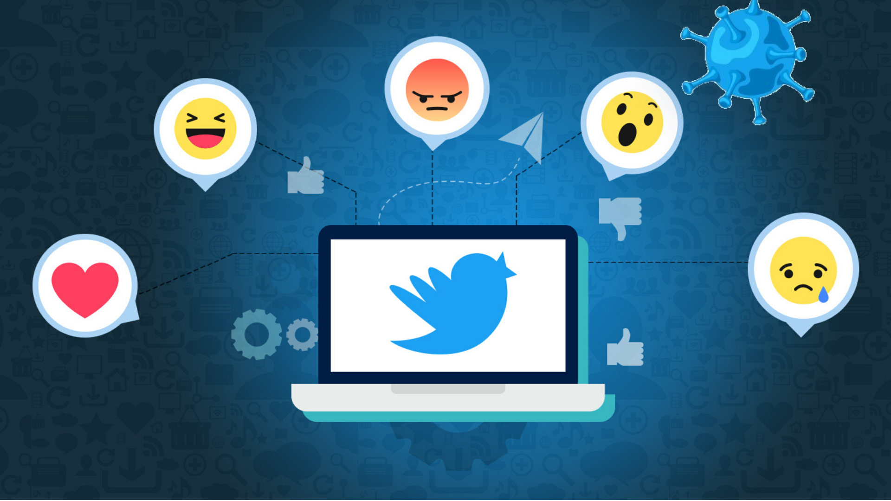
Twitter Covid-19 Sentimental Analysis
Team Name: - X Æ A-4
Jay Jhaveri
Abhay Gupta
Prem Chhabria
Prasad Govekar
Notes:
Good Evening Sirs,
We X ash 4 will now present our project of topic Twitter Sentimental Analysis Of Covid 19 Tweets.

Slide 2

Introduction
The Problem
COVID-19 outbreak was first reported in Wuhan, China, and has spread to more than 50 countries. WHO declared COVID-19 as a Public Health Emergency of International Concern (PHEIC) on 30 January 2020. Currently, people are staying inside their homes for 4 months for self-quarantine purposes. This has led to a sharp increase in mental health problems and suicide rates all across the globe.
311,806
Affected
23,727
Deaths
72,112
recovered
Notes:
As y’all know, at the moment our world is in the middle of a crisis! People have been stuck in their homes due to the COVID-19 pandemic and are eagerly waiting for a vaccine to be discovered so that they can go back to their normal life.
According to the studies, this self isolation have started to affect people’s mind in a negative and harmful way.
This have directly led to increase in suicide rates, as we can clearly see the wrong effects of isolation on our beloved actor Sushant Singh Rajput.

Slide 3
Introduction
The Solution
We plan to combat this issue by using sentiment analysis on people’s tweets and hence to recognize one’s leaning towards mental health problems.
We plan on making our model on a live dataset i.e. We would be continuously getting new tweets from all over the world using the twitter API and using the model we create we will be able to predict their sentiments using natural language processing models.
Our future model will be like a twitter bot which will reply to people’s tweet which indicates fear, sadness, scared with funny memes/gifs / motivating lines and a hotline for suicide help based on their geo-location supplied by twitter API.
Notes:
We plan to combat this rise in mental health problems by analyzing the public tweets from the time period of this lockdown.
We further enhance it by using it on a live dataset, which gives us a good idea of the current mind set of people around the world.
Our future plan includes to make a twitter bot which replies to “sad or depressed” detected tweets with a motivational quote/meme and mental health helpline numbers.

Slide 4
Technology Stack
Twitter Api
IBM Cloud Technologies
Angular Js
Twitter Sentimental Analysis
Notes:
This is the technology used in our project.
First we use the Twitter Api to get the live tweets from the twitter database.
Next we use the IBM Cloud technologies to analyze these tweets which I will explain in further detail while going over the flow of the project.
We use Angular JS to design and display the visualization Dashboard showing the graphs of the recorded and analyzed data.
We will now see the flow of the project in greater detail.

Slide 5
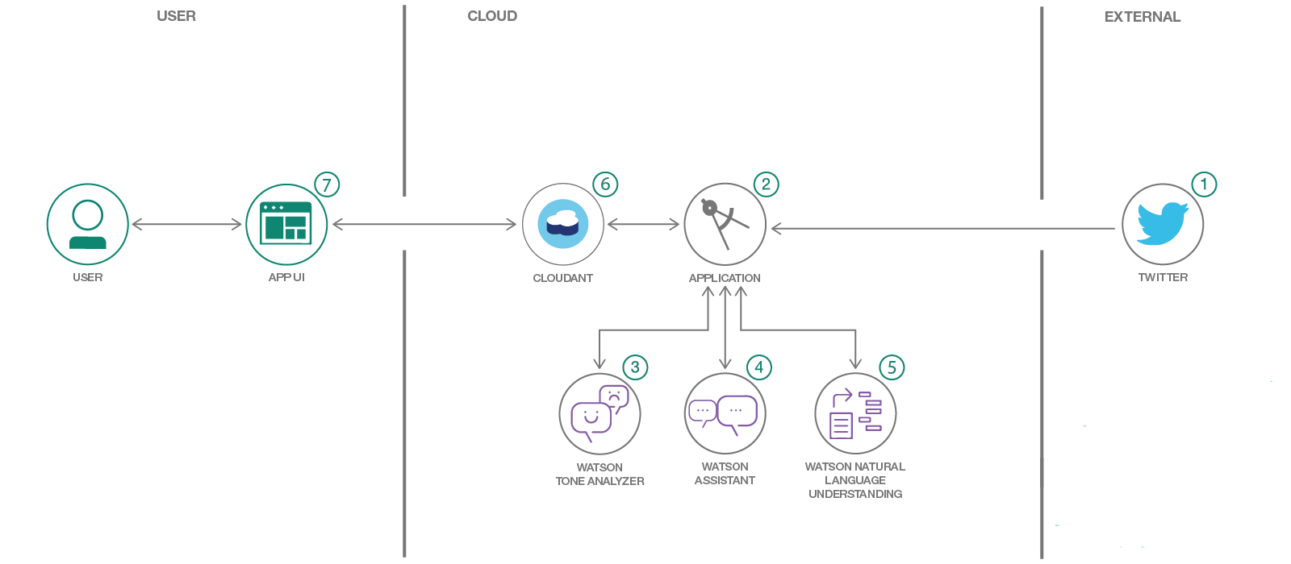
Flow Of The Project
Notes:
Going further in our project
We first get live tweets using the twitter API.
Coming to the IBM Cloud technologies: -
We first use
Watson Tone analyzer which helps us detect the tone/ sentiment of the tweets we get.
We then use
Watson Natural Language Understanding which is IBM cloud product to extract the metadata from text such as entities, keywords, categories, etc.
This metadata is used by the Watson Assistant to categorize the new data based on previous data hence making the model more efficient as new data is added.
Finally all the tweets and sub final products are stored on the IBM Cloudant data storage.
As the end product of this, we display the tweets with their emotions on the dashboard with their sentiments.
I will now show you the main features of our project which distinguishes our project from others ☺: -

Slide 6
Result
Main Features
Real Time Sentimental Analysis (LIVE)
Multi-Lingual support
Multi-Sentiments divisions i.e.: -
Our project does not only shows if a tweet is positive/negative/neutral.
It goes into more depth and recognizes whether a said tweet has a particular emotion attached to it like happy/anger/fear/depressed.
One can easily see the emotion of the public over the lockdown period and compare it to the previous periods.
Notes:
So the unique features of our project are: -
1) All the analyzing is done live on new tweets tweeted by users all around the world.
2) It also supports all the major world languages(43).
3) According to our research, all the sentimental analysis products available on the market only shows if a text/tweet is positive/-ve/neutral.
We take it on an whole different level by showing the exact emotion a person is feeling like anger/sad/fear/happy/etc. which helps us to differentiate our audience and target different people for the twitter bot we plan to use.
4) We also provide with an easy to use UI to compare new tweets and old tweets i.e. b4 lockdown and after lockdown.
I will now show you the Final design we came up with: -

Slide 7
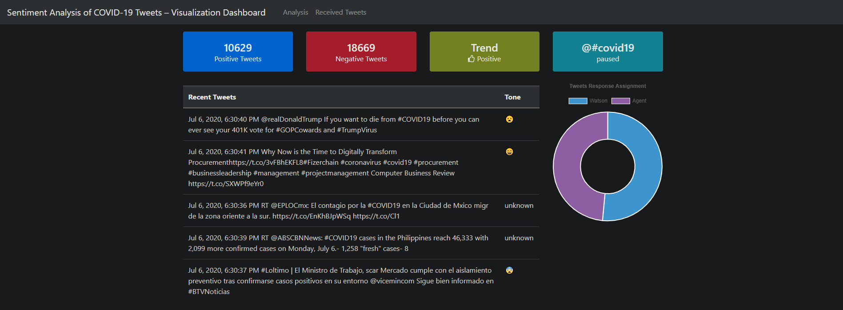
Result
Notes:
On the homepage we see the latest tweets by user along with the sentiments attached.
As we scroll down: -

Slide 8
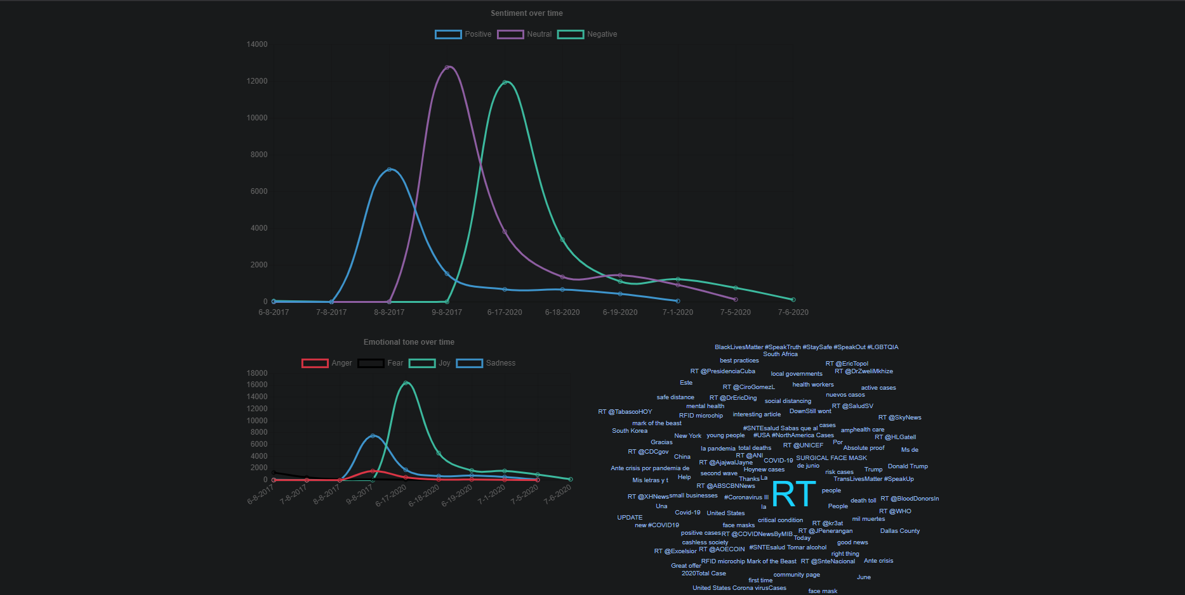
Result
Notes:
We see the graphs which shows the data from before the lock-down upto present.
Optional: -
Explain the wordcloud.

Slide 9
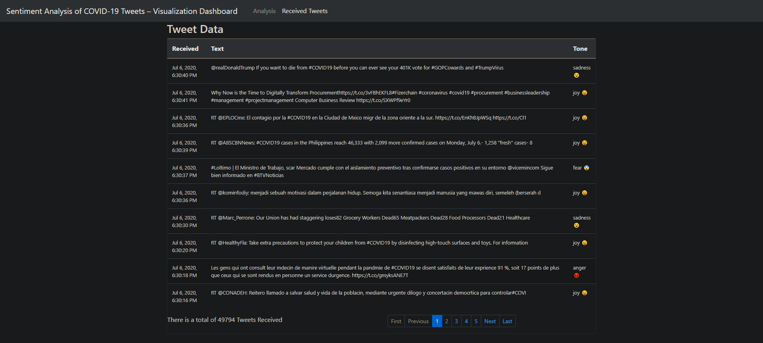
Result
Notes:
We also display all the data captured by our model since the beginning with their sentiments.

Slide 10
Conclusion
Considering the importance of understanding public emotions and the affects on psychological state of people during a crisis, we present a web portal to identify the mood of the world during the current Covid-19 pandemic.
The emotions of tweets are identified by ranking tweets based on comparison of words in the tweets with preloaded list of keywords for each emotion.
Also, graphs depicting percentage of tweets expressing specific emotions are presented to the users.
Furthermore, the existing portal could be improved to display mood of population with more specificity, which could include districts and cities of each state.
Notes:
Understanding the importance of public emotions and the effects of the crisis on the psychological state of people, we present a user-friendly dashboard to display the tweets.
We can improve our project if we use the paid version of the IBM cloud technologies.
We also would love to add the twitter bot idea we mentioned before.
Finally, I would like to conclude by saying that I hope this project helps someone somewhere combat his/her mental issues and trust the world around them ☺.

Slide 11
Thank You! Stay Safe Stay Happy!!
Notes:
Thank you ☺

Slide 12
DASHBOARD https://cognitive-social-crm-persistent-quokka-ch.eu-gb.mybluemix.net/
Notes:
Now I will show you the live site: -

