Slide 1

Team Name: - X Æ A-4
Jay Jhaveri
Abhay Gupta
Prem Chhabria
Prasad Govekar

Slide 2
Introduction
The Problem
COVID-19 outbreak was first reported in Wuhan, China, and has spread to more than 50 countries. WHO declared COVID-19 as a Public Health Emergency of International Concern (PHEIC) on 30 January 2020. Currently, people are staying inside their homes for 3 months for self-quarantine purposes. This has led to a sharp increase in mental health problems and suicide rates all across the globe.
311,806
Affected
23,727
Deaths
72,112
recovered
Notes:
© Copyright PresentationGO.com – The free PowerPoint template library

Slide 3
Introduction
The Solution
We plan to combat this issue by using sentiment analysis on people’s tweets and hence to recognize one’s leaning towards mental health problems.
We plan on making our model on a live dataset i.e. We would be continuously getting new tweets from all over the world using the twitter API and using the model we create we will be able to predict their sentiments using natural language processing models.
Our model will be like a twitter bot which will reply to people’s tweet which indicates fear, sadness, scared with funny memes/gifs / motivating lines and a hotline for suicide help based on their geo-location supplied by twitter API.
Notes:
© Copyright PresentationGO.com – The free PowerPoint template library

Slide 4
Technology Stack
Twitter Api
IBM Cloud Technologies
Angular Js
Twitter Sentimental Analysis
Notes:
© Copyright PresentationGO.com – The free PowerPoint template library

Slide 5
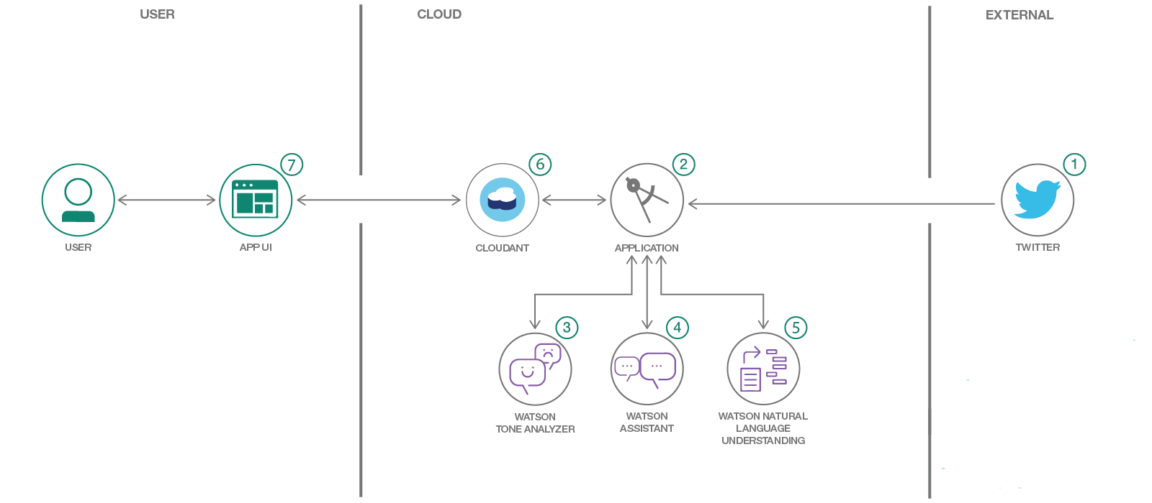
Flow Of The Project
Notes:
© Copyright PresentationGO.com – The free PowerPoint template library

Slide 6
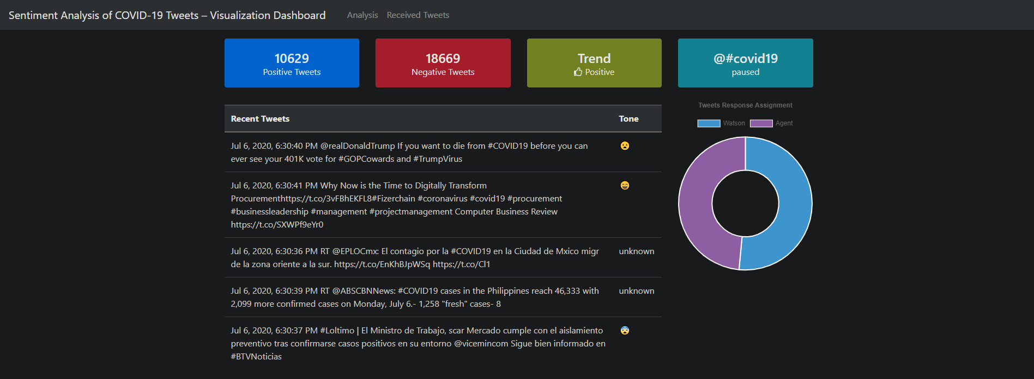
Result
Notes:
© Copyright PresentationGO.com – The free PowerPoint template library

Slide 7
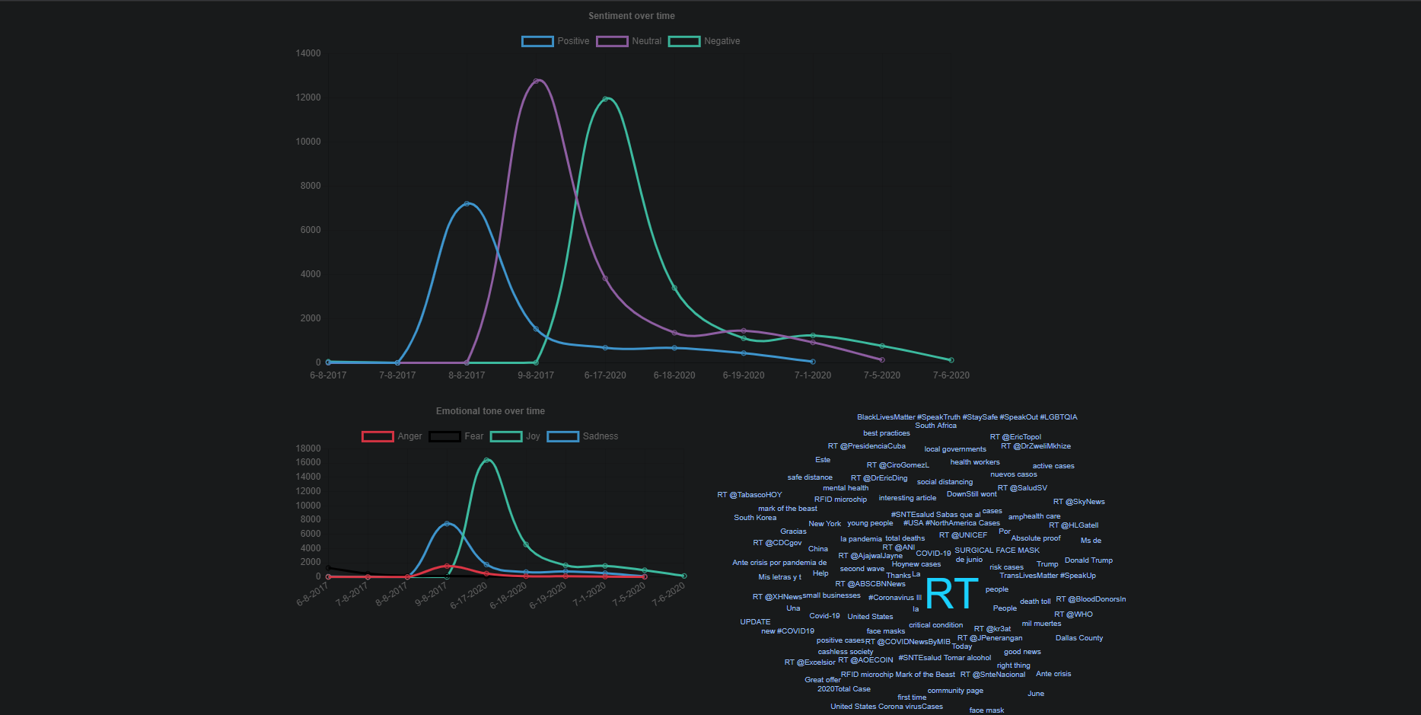
Result
Notes:
© Copyright PresentationGO.com – The free PowerPoint template library

Slide 8
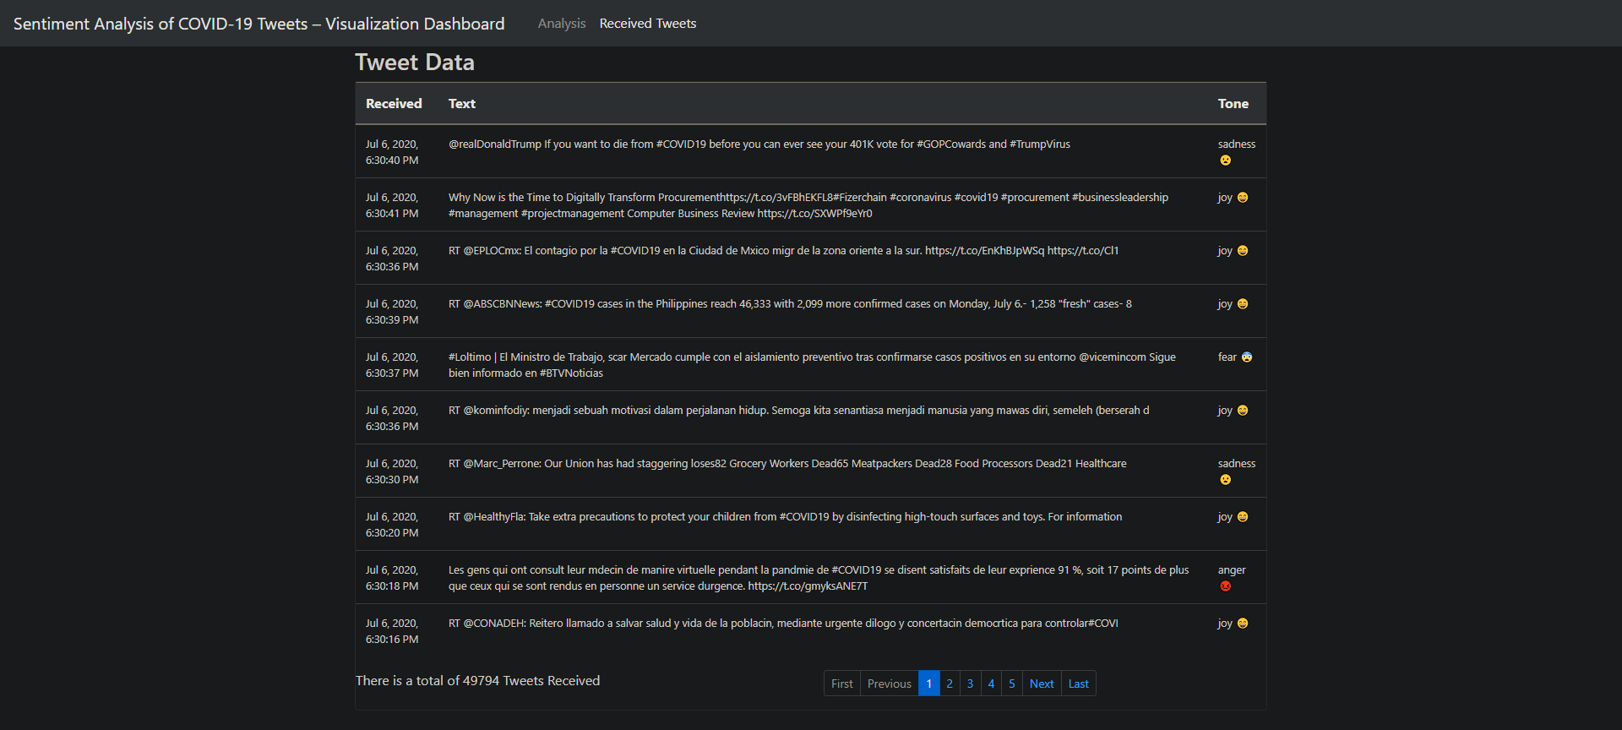
Result
Notes:
© Copyright PresentationGO.com – The free PowerPoint template library

Slide 9
Conclusion
Considering the importance of understanding public emotions and the affects on psychological state of people during a crisis, in this paper, we present a web portal to identify the mood of the world during the current Covid-19 pandemic. The emotions of tweets are identified by ranking tweets based on comparison of words in the tweets with preloaded list of keywords for each emotion. Also, bar graphs depicting percentage of tweets expressing specific emotions are presented to the users. Viewing the world map on any specific day could help users in understanding the emotion of the region with respect to number of Covid-19 cases reported in the region. In the future versions, we plan to increase the number of tweets being considered for emotion analysis. Also, we plan to mine more number of tweets related to Covid-19 in the country during the two month period of March and June to increase the accuracy of emotions being displayed. We also plan to improve the accuracy of classification model by exploring newer NLP and ML based approaches that could classify the tweets based on emotions. Furthermore, the existing portal could be improved to display mood of population with more specificity, which could include districts and cities of each state.
Notes:
© Copyright PresentationGO.com – The free PowerPoint template library

Slide 10
Thank You! Keep Tweeting!!
Notes:
© Copyright PresentationGO.com – The free PowerPoint template library

