Slide 1
Sentiment Analysis of COVID-19 Tweets

Slide 2
Team : Catalyst
Members : Unnimaya M
Ananya R
Manasa Radhakrishnan

Slide 3
TASKS | ASSIGNED TO
Project Scope Understanding | Manasa R
Assigning The Team | Unnimaya M
Create Cloud Account | Manasa R
Importing Packages | Ananya R
Learning About Framework | Ananya R , Unnimaya M
Deploy | Unnimaya M

Slide 4
DESCRIPTION
The sentiment analysis of Indians after the extension of lockdown announcements is analyzed with the relevant tags on twitter and a predictive analytics model is built to understand the behavior of people if the lockdown is further extended.
A dashboard with visualization of people reaction to the govt announcements on lockdown extension is also developed.
The twitter sentiment analysis model helps to understand the following:
Get to know people’s sentiment towards the epidemic.
Understand the sentiments of people on govt. decision to extend the lockdown

Slide 5
PROCESS FLOW
The user enters the keyword into the search bar.
Tweets of the last 7 days are stored in the database and the tweets matching the keyword are taken.
Related searches and trending keywords are displayed below the search bar.
2 graphs : Live sentiment and Long term sentiment about the keyword are displayed.
A table of tweets are displayed which refreshes every 10 seconds.
A pie chart showing the overall sentiment is displayed.

Slide 6
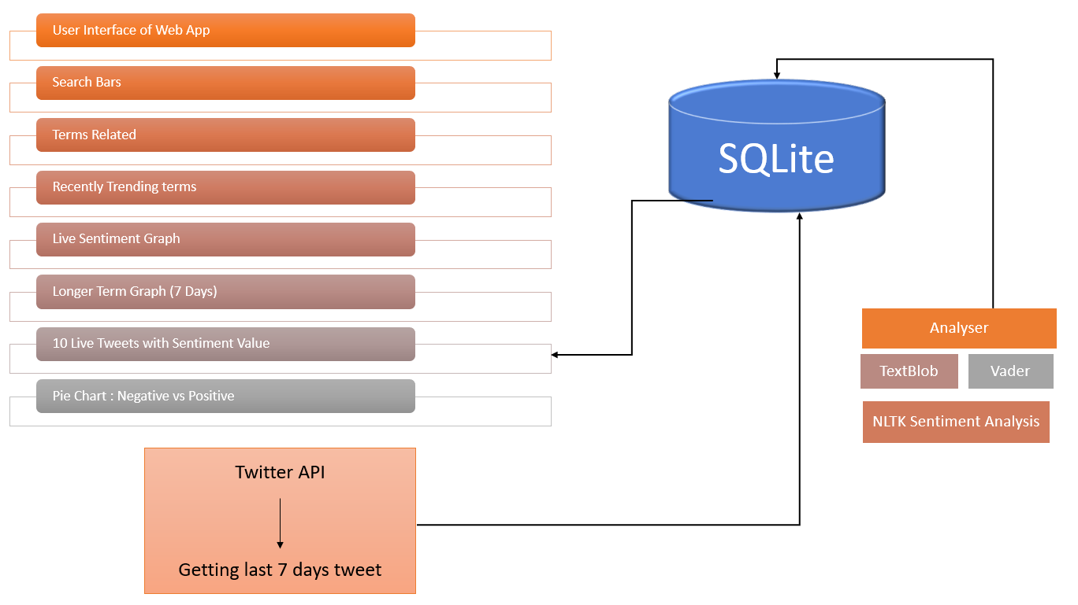
ARCHITECTURE

Slide 7
TECHNOLOGY STACK
Programming Languages : Python
Dash
Twitter API
Database : SQLite

Slide 8
KEY FUNCTIONALITIES OF DEVELOPED SOLUTION
Our project will show the different sentiments from tweets in the form 2 graphs showing live sentiment and long term sentiments.
The graphs will be updated according to the live tweets every 10 seconds.
A pie chart showing the positive and negative tweets will also be displayed along with a table showing the tweets.
On clicking each part of the graph, more details about the tweets will be shown.
The latest updates about the corona virus and related topics will be displayed on a single website to make it easier to observe the changes related to this socially relevant topic.

Slide 9
SOCIAL IMPACT
During this lockdown, people have taken social networks to express their feelings and find a way to calm themselves down.
The project helps to address the concerns of the citizens.
The new requirements of the people during the pandemic are analyzed.
Based on the changing requirements of various products, the amount of products to be produced by different sectors of business can be identified.

Slide 10
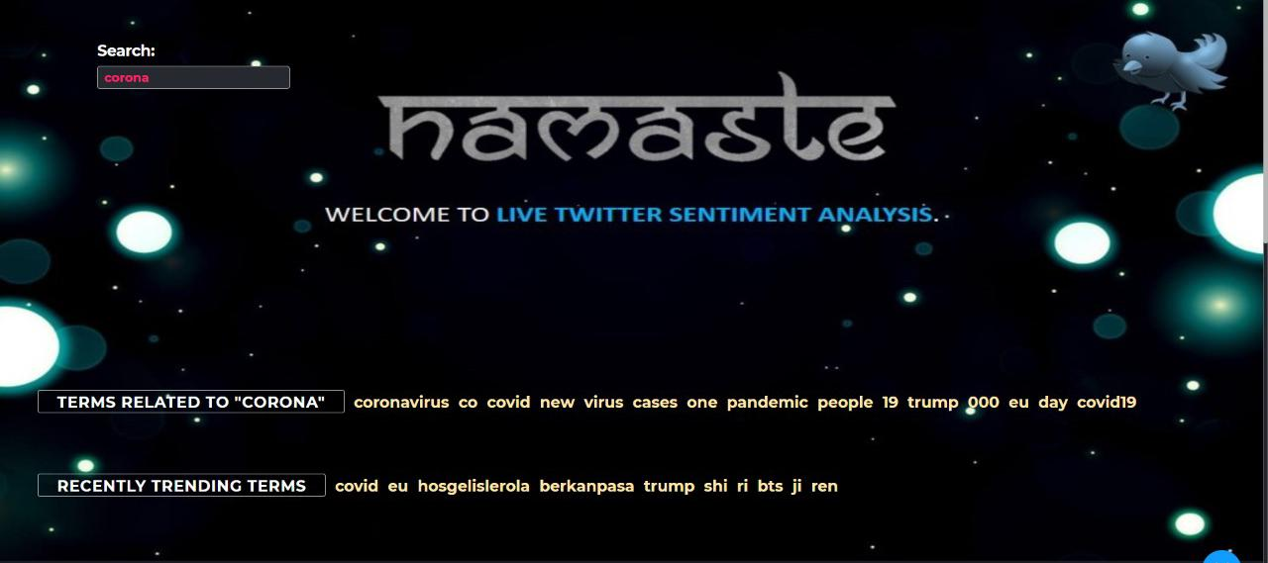
SCREENSHOTS

Slide 11
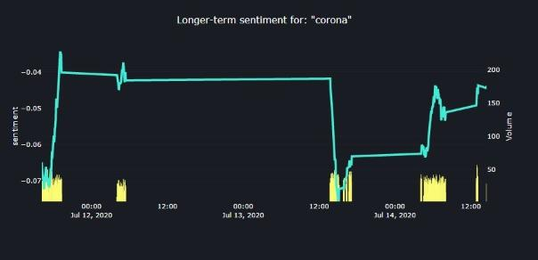
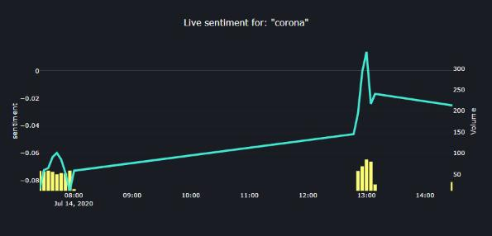

Slide 12
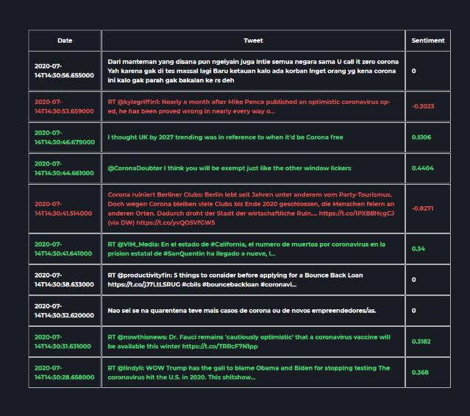
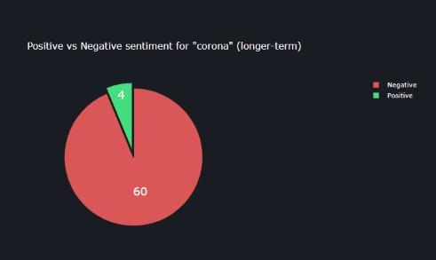

Slide 13
THANK YOU

