Slide 1
Limited seating and safety

Slide 2
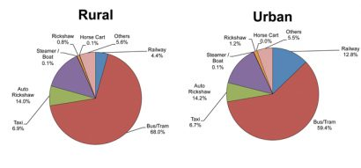
According to the survey in 2014-2015 which was conducted by NSSO(NATIONAL SAMPLE SURVEY OFFICE) has stated that around 54% of the people in rural area and 59.4% of the people in the urban area use bus/train as their primary source of travelling and it's even more important to maintain the safety of the people. Even it reduces the manpower over the bus for ticket collectors because of the automated ticket booking feature.

Slide 3
Purpose of the project
The main purpose of the project is that after the pandemic there should be safety concerns because in the public transport there would be different kinds of people travelling in it from different places so we should be a step ahead in our safety concerned so that it doesn't affect us. So the main focus of the project, that a person in advance would be knowing whether there are any vacant seats available in the bus through scanning the QR code if available they can book the seat and even pay through online gateways which would be cash free transactions.

Slide 4
Existing problem
So as we know the present situation of the world due to pandemic and we know the importance of how we should be in a crowed or a public space. As we know the transport facilities in our country how crowded they are and the safety issues related to that especially public transport where different kinds of people enter where we don't know. In COVID current situation we are facing the transport problem. In our country, as we know people travel in public transport more than its capacity. That will be one of the most crowded places in future. There we can’t even and the suspect people who are COVID victims, so this is the place where we should be more careful about our life
Proposed solution
So we have developed an app. So that people can know how many seats are available in the bus using QR code scanner which would be displayed on each bus with different QR code but there will be the same function for every bus the only difference would be the seating capacity. And also they can know that what is the cost from one point to another point and, when will the next bus arrives. if the seats are vacant they can book their tickets through the app and do their payment which is also an important fact that even the corona may spread through the exchange of cash so the app will be supporting the online gateways cashless, Which could be used for the situation after the pandemic.

Slide 5
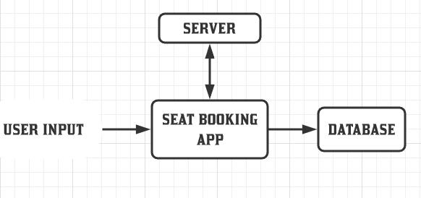
Block Diagram

Slide 6
Main Function
This app is developed to book a seat for each passenger whoever is trying to travel on the bus. As soon as the app is opened it asks to choose the source and destination locations on your mobile. The seat which is booked updates the status of the seat whether the seat is occupied or vacant is connected to the internet at each bus stop and with the help of the pressure sensor that would be connected at every seat of the bus will be updating the status at every stop. Before implementing the project to Real-time, the partial prototype of the model is designed to test and validate. The app called BSB app is developed to book the ticket .

Slide 7
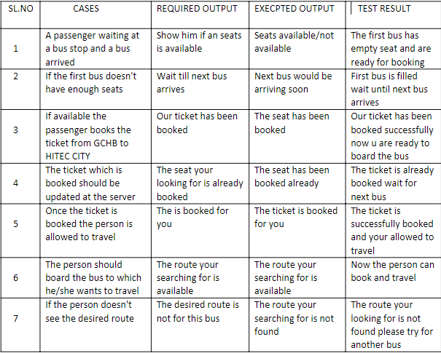
Possible cases

Slide 8
Advantages
Disadvantages
In the coming days, the safety is more important so with this only limited seats are reserved and there wouldn't be any crowding.
There won't be required of manpower for vending tickets everything would be done through the internet.
It would be more effective if this would be done on the buses which will be having more seats and would be effective on double-deckers and long buses.
There won't be need of physical cash, payments can be done through online gateways.
Everyone should be having a smartphone with internet connectivity.
Jobs of the physical conductors would be lost.
Implementation of the project cost is high at the installation process.
Whoever willing to travel should have online payment options to book the seat

Slide 9
Conclusion
The overall conclusion of the project is that there would be any crowding further if this application is implemented only available seats would be booked and every passenger will get a seat to sit and if the bus is full they will be waiting for the next bus with this concept there won't be any crowding and even there won't be any requirement of the physical conductors for issuing of tickets.

Slide 10
THANK YOU
DONEBY:Mukkara Bhaskar Reddy

