Slide 1
IBM Hack Challenge 2020
Sentiment Analysis of Covid-19 Tweets
Visualisation Dashboard
Project ID: SPS_PRO_746
Team Name: Code-inators

Slide 2

Ritika Bhagchand Sethiya
(Team Leader)
College : Vivekanand Education Society’s Institute of Technology, Mumbai.
Education : BE, 2020.

Slide 3

Reema Gopal Israni
College : Vivekanand Education Society’s Institute of Technology, Mumbai.
Education : BE, 2020.

Slide 4

Rahul Prakash Sawra
College : Vivekanand Education Society’s Institute of Technology, Mumbai.
Education : BE, 2020.

Slide 5
Problem Statement

Slide 6


Slide 7







Slide 8
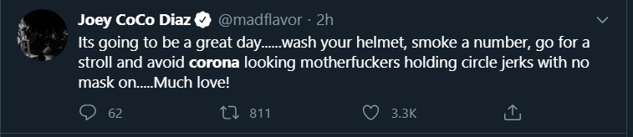
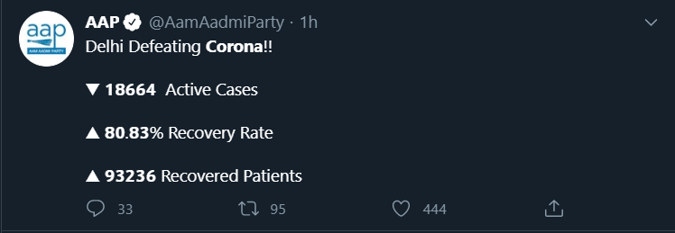
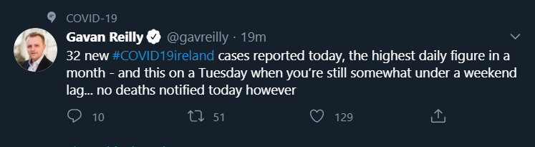
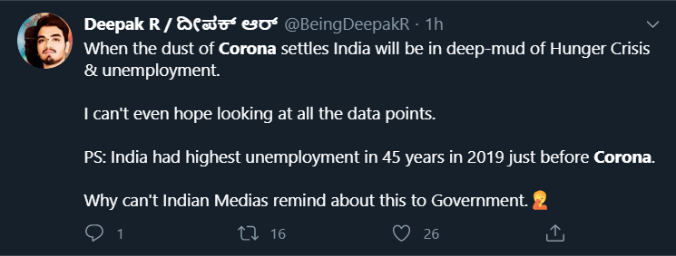
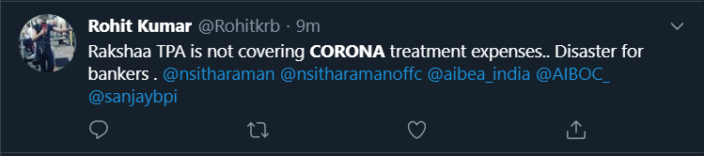

Slide 9







Joy
Fear
Neutral
Sad
Anger

Slide 10
Solution Implemented
The project uses Machine learning and Data Visualisation techniques to analyse and present useful insights on sentiments of Indians during the Coronavirus Pandemic.
The analysis consists of:
Sentiment and emotion analysis for a period of 3 months Feb-Apr
Sentiment analysis on critical topics like hospitals, PM Relief fund, problems faced by workers and job issues, lockdown situation and economic crisis
Topics discussed and Trending Hashtags
Predictive analytics on lockdown situation
Live Sentiment analysis

Slide 11
Module Implementation
Sentiment Analysis
The tweets are labelled in 3 ways:
Emotion (Fear, Anger, Joy, Sadness, Neutral)
Semi-supervised Self Training is applied in 2 iterations.
Steps are as follows:
1. Generation of an initial labelled dataset using datasets EmoInt, Daily Dialog, Emotion Stimulus and Isear and 1500 manually labelled neutral tweets from the collected tweet set. (Train: Test ratio 75:25)
2. Fine-tuning BERT in 3 iterations to obtain first self-training iteration accuracy of 83.92% on the test set.
3. Using the first iteration trained BERT model to label tweets of Covid-19.
4. Filtering tweets having label confidence > 95%
5. Generation of second iteration dataset
6. Fine-tuning BERT in 3 iterations to obtain second self-training iteration accuracy of 93.38% on the test set.
7. Using trained BERT to label all tweets.
Final Accuracy on Validation set : 93.38%

Slide 12
2) Sentiment (Positive, Negative, Neutral)
This classification was performed using Vader. The compound score was obtained for individual tweets and the compound scores were converted to labels 0 (Neutral), 1 (Positive) and -1 (Negative) using the threshold values:
Positive sentiment: compound score >= 0.05
Neutral sentiment: (compound score > -0.05) and (compound score < 0.05)
Negative sentiment: compound score <= -0.05
3) Positivity score (Measure of positivity)
Positivity score (1 day period) = Sum of individual compound scores/tweet count
The positivity score indicates rise and fall in positivity among people regarding lockdown. So the value each day would indicate how positive will the people be if the government decides to extend lockdown on that day.

Slide 13
2. Topics and Trending Hashtags
Topic Modelling:
Algorithm Used: LDA (Latent Dirichlet Allocation)
Count Vectorized bigrams and trigrams are given as input to LDA and the output is set to 10 top words each for 10 topics.
Trending Hashtags:
Hashtags are extracted from tweets and the count of top 5 hashtags is plotted for 5 days time interval.

Slide 14
3. Sentiment analysis on critical topics
The tweets related to the critical topics like hospitals, workers, economy, PM Relief Fund and lockdown are filtered.
These filtered tweets are then labelled with emotions fear, anger, joy, sadness, neutral; sentiment positive, negative, neutral and the positivity score graphs.

Slide 15
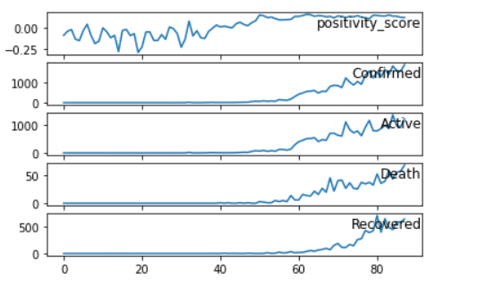
4. Predictive analytics on lockdown situation
Gradient Boosting Regression model was used to predict the positivity score (daily) if the government decides to extend lockdown.
Input Features:
Confirmed Cases
Active Cases
Deaths
Recovered Cases
Output: Positivity score indicating how positive will the people be if the government decides to extend lockdown.
Evaluation metrics : Mean Absolute Error - 0.0312
Root Mean Square Error (RMSE) - 0.0496
Mean Squared Error (MSE) - 0.0025
R2 score - 0.8214
The output provided is dynamic and depends on current Covid-19 Cases in India.
A Python REST API is built to plot dynamic results on UI

Slide 16
5. Live Sentiment Analysis
Live Tweets are extracted using the Twitter API according to the keywords/hashtags provided by the user.
The Tweets are then labelled as positive, negative and neutral and the visualisations are provided along with tweets text and word cloud.
Python REST API is built which can be called from the User dashboard. The user can provide keywords or hashtags for which analysis in needed. The API uses Twitter API (Tweepy) to fetch the tweets and the labels the tweets using trained sentiment classifier. The results are then sent back to UI for plotting visualisations.

Slide 17
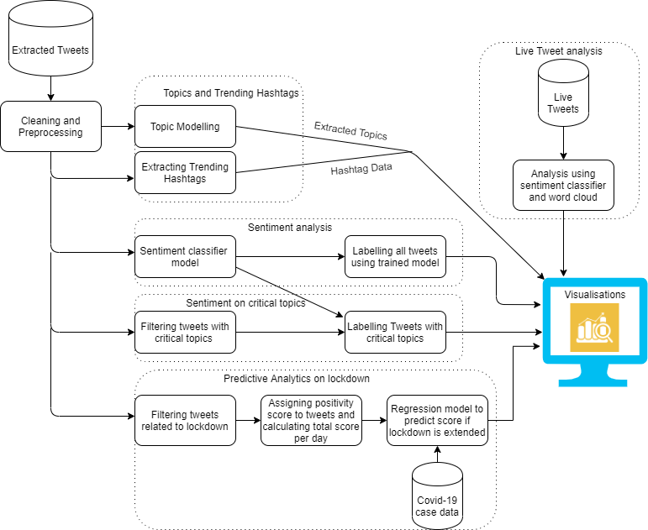

Slide 18
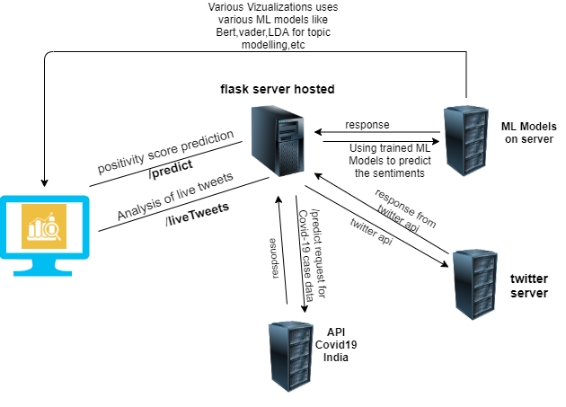
Software design

Slide 19
Team Contribution
Data gathering and processing - Reema Israni & Rahul Sawra
Modules implementation - Reema Israni
Website Backend - Rahul Sawra & Ritika Sethiya
Website Frontend - Ritika Sethiya
Website Hosting - Ritika Sethiya

Slide 20
Difficulties faced
Processing power issues: There were a huge amount of tweets on coronavirus each day. Processing tweets took a huge amount of time.
Low RAM availability: Maximum RAM availability was 13 GB on Google Colaboratory so we divided the data into partitions to avoid running out of available RAM.

Slide 21
Limitations
The analysis is over a period of 3 months from February - April. More data and computational power is required for further analysis.
The Live sentiment analysis takes into account current 100 tweets as increasing the number would lead to slower results.
There might be other factors like Occupation of people on which the sentiment of people regarding lockdown depends. These demographics like occupation were not considered while training the predictive analytics model due to unavailability of data.

Slide 22
Conclusion
The results include different visualizations for emotion (fear, anger, neutral, joy, sadness), sentiment (positive, negative, neutral), and positivity score (positivity measure) of people during the Covid-19 pandemic.
Visualisations also include sentiment analysis on critical topics like hospitals, economy, PM care fund, workers and lockdown.
Topics discussed, trending hashtags, prediction of social sentiment if lockdown is further extended and sentiment analysis of live tweets is also included in the built visualisation dashboard. Thus, analysis and visualisations provided of Covid-19 tweets will help in quick understanding of social sentiment and provide useful insights into the situation.

Slide 23
Future Scope
Analysis can be extended further in the timeline.
Number of critical topics currently considered is 5. Number of topics can be increased to understand social sentiment on those topics.
Occupation and other demographic data can be considered to increase the accuracy of predictive analytics model (For obtaining sentiment if lockdown is extended).
More number of live tweets can be considered for live sentiment analysis.

