Slide 1

Covid-19 Twitter Sentimental Analysis
Team- Red Hat
1. Garud Shubham
2.Staffin T Shabu

Slide 2
Problem Statement
The sentiment analysis of Indians after the extension of lockdown announcements to be analyzed with the relevant #tags on twitter and build a predictive analytics model to understand the behavior of people if the lockdown is further extended. Also develop a dashboard with visualization of people reaction to the govt announcements on lockdown extension.

Slide 3
Solution
The complete project is done using Node-Red in IBM Cloud
Node-RED is a flow-based development tool for visual programming developed originally by IBM for wiring together hardware devices, APIs and online services as part of the Internet of Things. IBM Tone analyzer is used for analyzing the sentiment of each tweets.
For sentimental analysis IBM Tone Analyzer is used. The twitter data is streamed using twitter in node. The data is pre-processed and then sent to the Tone analyzer node. From there the the scores and sentiments are classified and sent to respective output nodes.
Using IBM Watson Text To Speech the project further has a feature which converts the text(tweets) to speech(audio) and helps the visually challenged to know about the tweets based on the given input hashtag/trend

Slide 4
Technology Stack
IBM Cloud
The entire project is done in IBM Cloud platform
IBM WatsonTone Analyzer
The IBM Watson Tone Analyzer service uses linguistic analysis to detect emotional and language tones in written text. The User Interface displays the sentiment score for the respective live tweets.

Slide 5
IBM Watson Text To Speech
Using IBM Watson Text To Speech the project further has a feature which converts the text(tweets) to speech(audio) and helps the visually challenged to know about the tweets based on the given input hashtag/trend.

Slide 6

Node-Red Flows

Slide 7
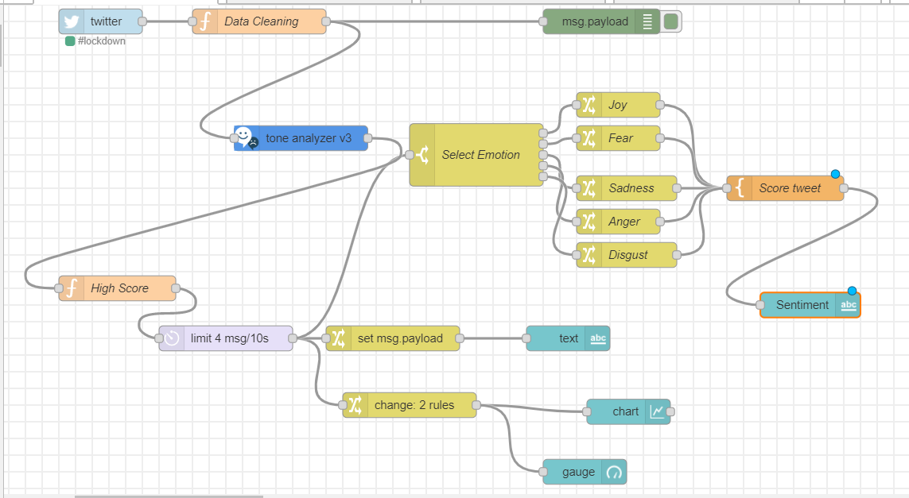
i)Live feed
Live feed

Slide 8
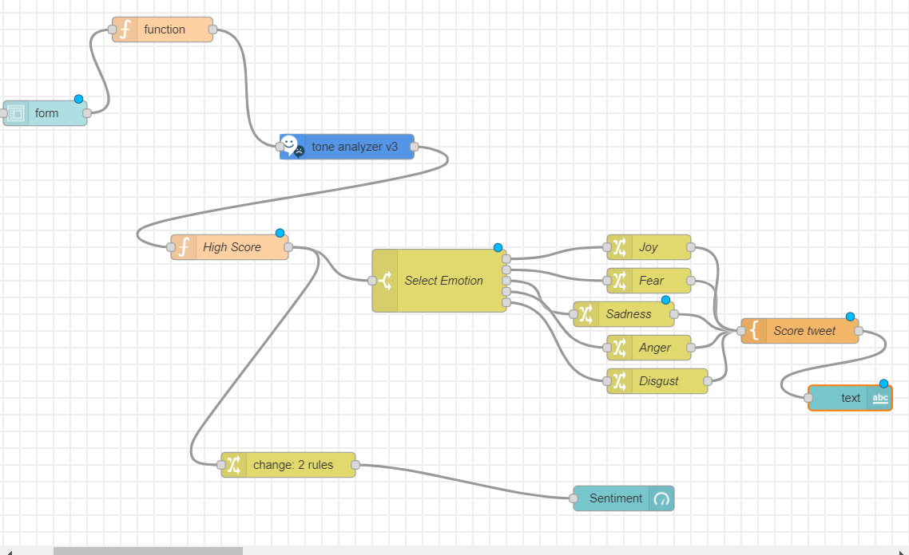
ii)Manual Input

Slide 9
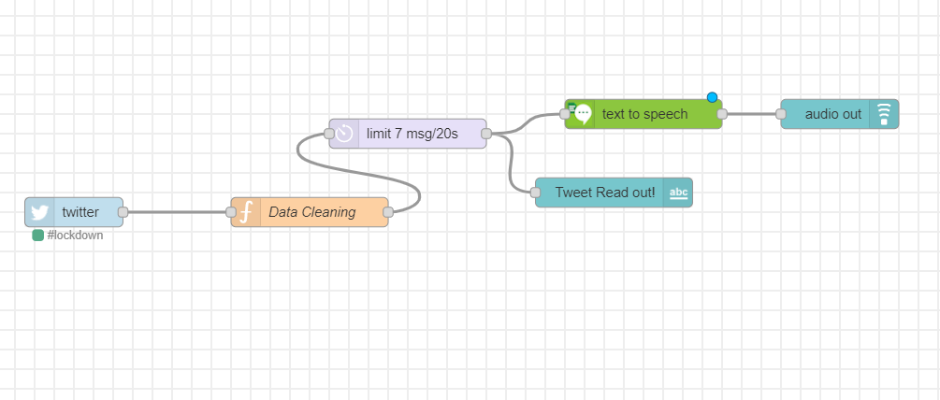
iii)Assistance For Visually challenged

Slide 10

Output/UI

Slide 11
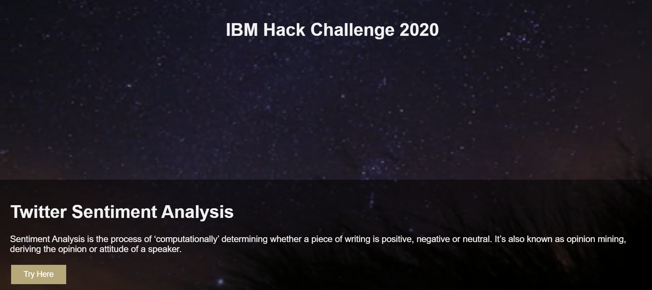
I)Home Page

Slide 12
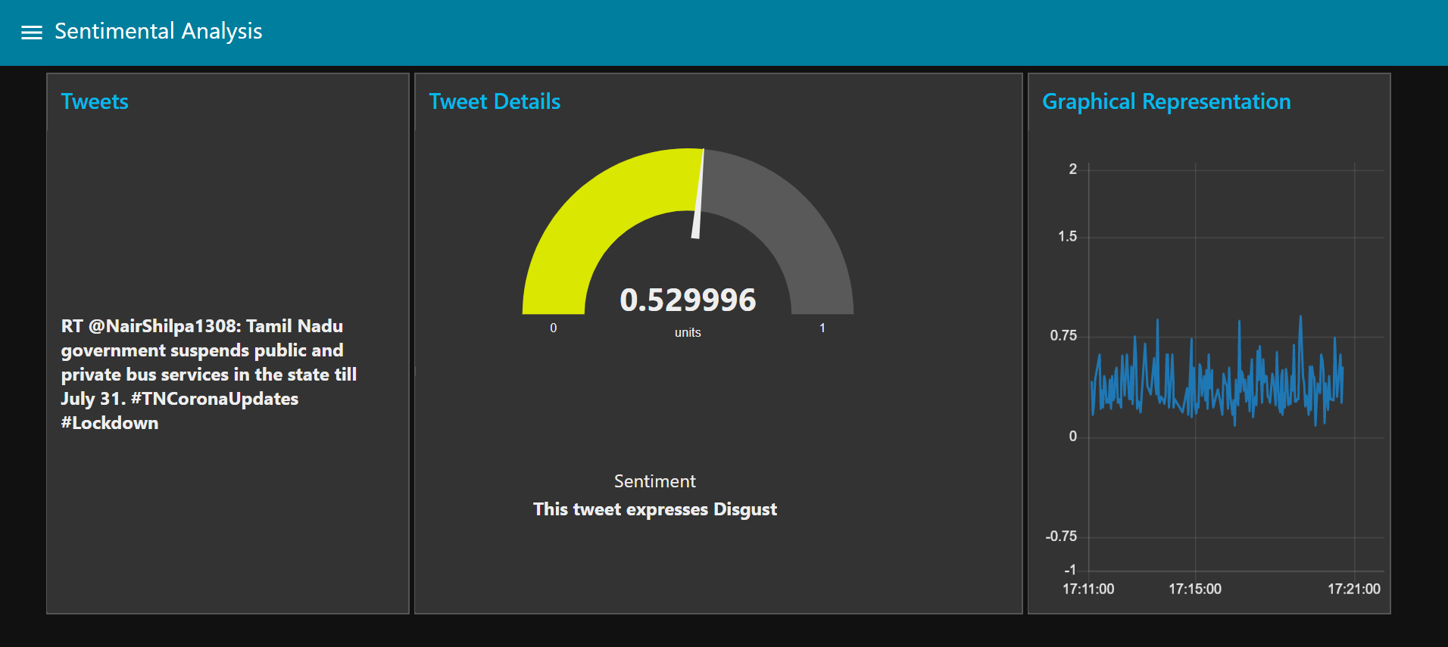
ii) Main UI

Slide 13
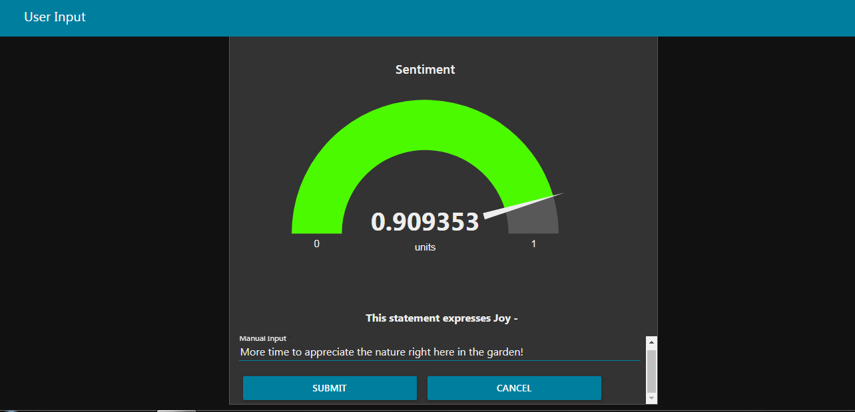
iii) User Input

Slide 14

iv)Audio Output

Slide 15

ADVANTAGES
➤ Its easy to analyze the user's sentiment.
➤ It can provide valuable insights and thus help organizations to formulate effective business strategies.
➤ It can help firms to monitor brand and product performances, handle customer grievances, get in-depth information for strategic analysis.
➤ Helps government in strategic planning.

Slide 16
DISADVANTAGES
➤ The efficiency of results is relatively poor in the case of sarcastic statements.
➤ The configuration of nodes can be little complex.

Slide 17
APPLICATIONS:
➤ Can be used by government authorities.
➤ Can be used in business planning.
➤ Analyze trends and patterns.
➤ Historical track of public opinions.

Slide 18
CONCLUSION:
We have tried different types of libraries and tools and finally arrived at a conclusion that IBM Tone analyzer was more accurate in the sentiment prediction. Using this we have performed further analysis on the extracted data from twitter and the results were visualized in the dashboard.

Slide 19
Thank you!
Done by:-
Staffin T Shabu
Garud Shubham

