Slide 1

Covid-19 Tweets Sentiment Analysis
Team: Sherlocks Working With Watson

Slide 2
Understanding and processing the dataset
Deciding criteria for analysis
Selecting visualization methods
Performing sentiment analysis
Designing the UI
Key Steps

Slide 3
Block Diagram

Slide 4
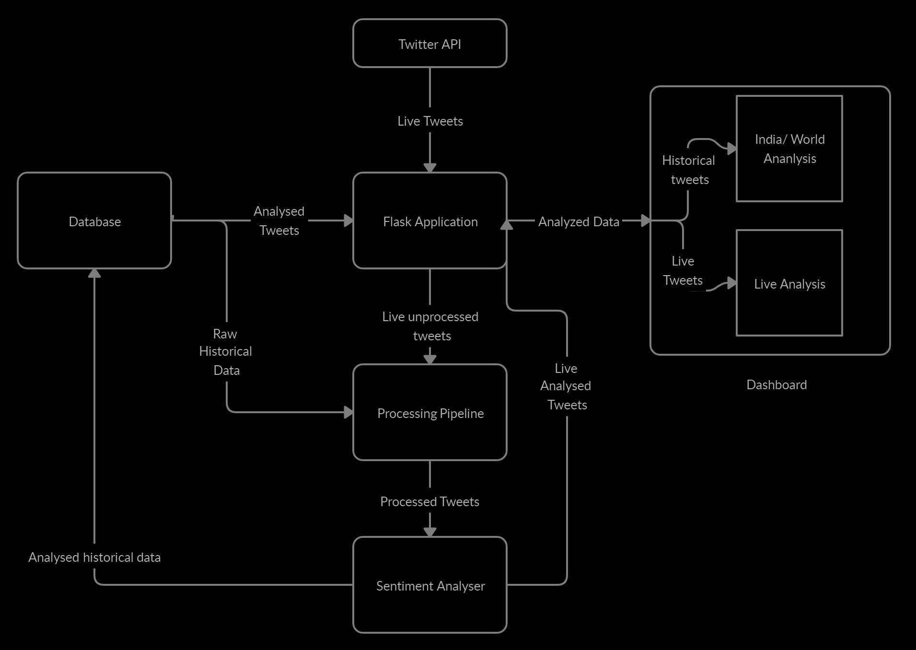

Slide 5







Python
Flask
NLTK
Technology Stack
HTML, CSS and JavaScript
jQuery
Jvector maps
Charts.js

Slide 6
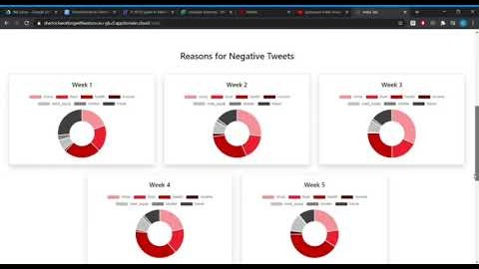

Slide 7
Future scope:
Analyze other languages
Increase size of dataset
Refine the filtering rules

Slide 8
Contributions:
Kartik
Python Scripts
Front End
Kevin
Python Scripts
Front End
Anamika
Flask Application
Designing
Designing
Designing

Slide 9
The End
https://sherlockworkingwithwatson.eu-gb.cf.appdomain.cloud/

