Slide 1
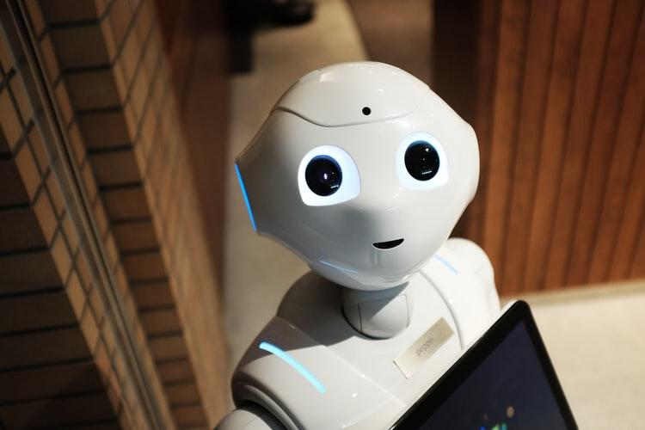
AI Recruiter
IBM HACK 2020
Group Members :-
Devdarshan Mishra
Rupesh Krishna Jha
Prabhat Kumar
Team : CodeFathers

Slide 2
General Description
52% of talent acquisition leaders say that the most difficult part of their job is to shortlist the right candidate and 3% of candidates never hear back from a company after one touchpoint.
On the flip side, it’s a challenge for employers to communicate well with all their candidates.
For high volume recruiting, this would require communicating with thousands of candidates, in addition to a recruiter’s normal screening functions and other duties.
Artificial Intelligence enabled software bots can definitely provide a solution for this problem.

Slide 3
Uniqueness
Our proposed solution aims to make the recruitment process smooth and hassle free both for the candidate and the employer.
All that the candidate needs to do is upload his resume on our platform.
We shall be using 3 AI models for the recruitment process.
1st :- To parse the resume of the candidate.
2nd:- To automatically filter out his areas of interest, grant points to the candidates based on their achievements and experiences and shortlist them based on some filtering criteria.
The shortlisted candidates will receive an automated mail with a link to an AI based interview.
3rd:- An AI based chatbot to conduct interviews(either viva or a timed written quiz) of candidates based on their field of interest and grant them scores on the basis of their performance

Slide 4
Businesss
On the upside, innovation in HR and recruitment is still booming and more and more new AI-driven solutions for various problems are emerging.
Finding talent starts with sourcing potential candidates and building a pipeline. But even if you know where to find those potential candidates (job boards, social media, etc.), this can be quite a challenging – and time-consuming – task.
In today’s Job market , Company struggle to find the top talent because the lack of resource. So Ai Recruiter application will help to find best candidate.

Slide 5
Technology Stack
Front-end:
React.js
Redux
HTML/CSS
Back-end:
Node.js
Express.js
MongoDB
Python(ML and DL Libraries)
IBM Cloud For Deployment

Slide 6
How AI will change the recruiter’s role?
The ability to use augmented AI to automate repetitive, administrative tasks will be extremely valuable. There are 3 main ways this technology will change the role of the recruiter:
Recruiters will be able to conduct proactive strategic hiring rather than spend most of their time with reactive backfilling.
Recruiters will have more time to spend with candidates in-person to build relationships and help determine culture fit.
Recruiters will able to close the loop with hiring managers as AI allows them to use data to show recruiting KPIs including quality of hire.

