Slide 1
PREDICTING THE ENERGY OUTPUT OF WIND TURBINE BASED ON WEATHER CONDITION
BY TEAM NAND
G.ARVINDH
S.SRI HARI

Slide 2
PROBLEM STATEMENT
Wind energy plays an increasing role in the supply of energy world-wide. The energy output of a wind farm is highly dependent on the wind conditions present at its site. If the output can be predicted more accurately, energy suppliers can coordinate the collaborative production of different energy sources more efficiently to avoid costly overproduction.

Slide 3
PROPOSED SOLUTION
As we have a considerable amount of data, we have used polynomial linear regression machine learning model to predict the output power and energy generated by the wind turbines, which is dependent on the wind speed.
We have developed the machine learning model in Python using Pycharm IDE.
We have also created a UI using Flask and Python.
Created a pickle file by importing the pickle library into the ML model code and then by running it.
Created a procfile.
Created a text file which consists of names and versions of all the libraries that we have used.
Created a html file for the web page.

Slide 4
Proposed solution
All of these files have been uploaded to the GItHub Repository.
We have connected the Heroku and GitHub to deploy the web application.
After the deployment in Heroku we would get a URL that can be used by anyone, to predict the energy output of wind turbine using our model.

Slide 5
Data analysis AND WORKING ON MODELS
After doing analysis on given data set from KAGGLE . We found out that wind direction has less that 1% effect in predicting output-power compared to wind speed.
After our research on wind speed and output power from wind-turbine , We concluded
Output power is directly proportional to cube of wind speed.
So, we used polynomial linear regression model to predict out put power from wind speed.
But ,after at a certain wind speed , output power decreases and below 3 for wind speed we are getting negative power.
So , we used if loop to get output power

Slide 6
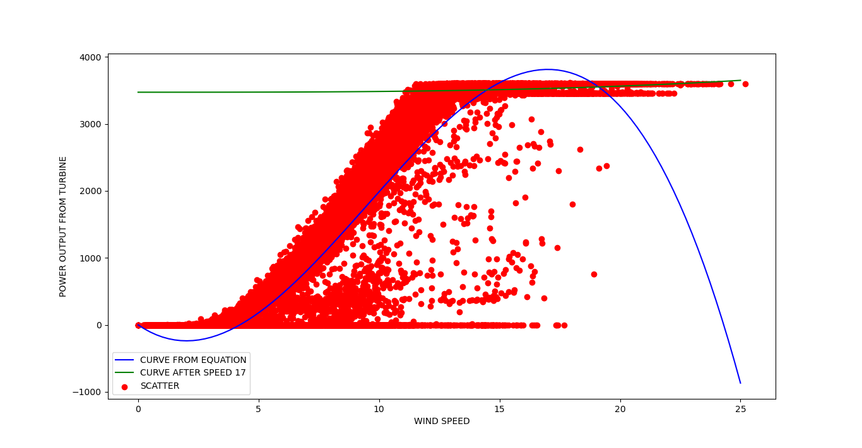

Slide 7
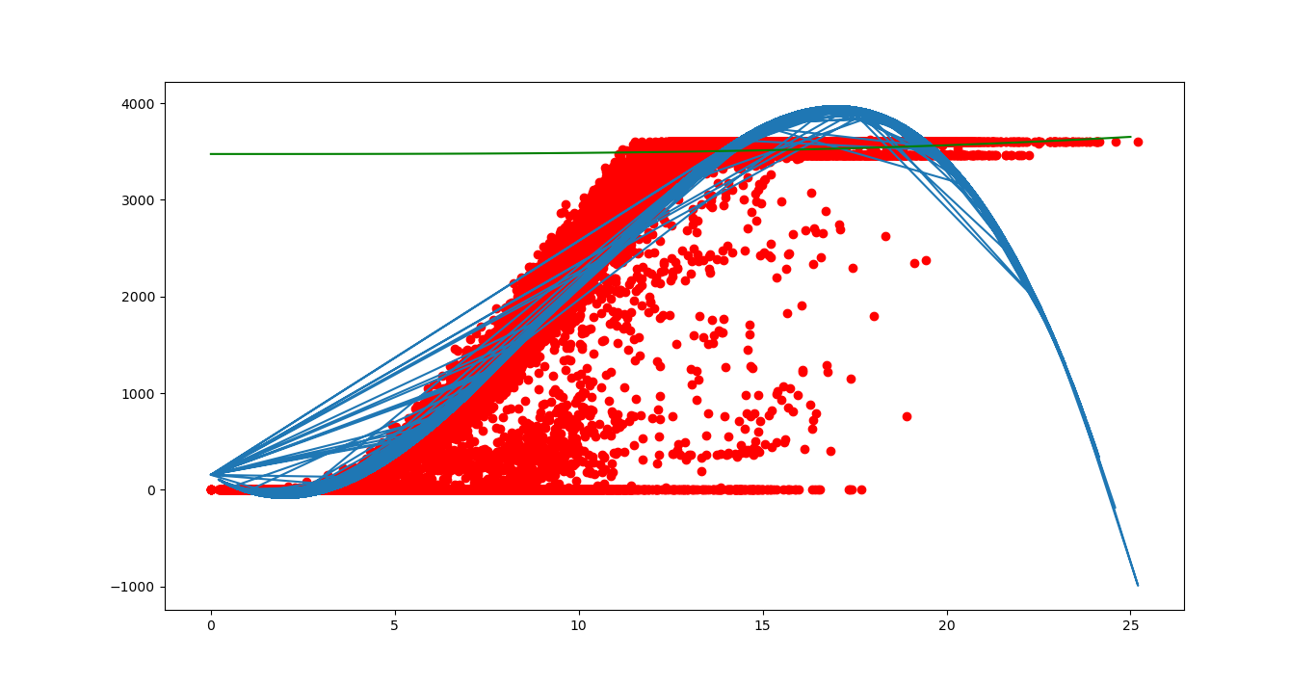

Slide 8
We used three speeds at intervals of 10 minutes to predict acceleration/deceleration
We used above acceleration/deceleration to get wind speeds for 10 minutes of interval for next 2 hours and used these speeds to predict output power.
Used these output powers to calculate energy .
(Using formulae : energy=power*(time intervals of 10 minutes)

Slide 9
FLOW CHARTS
MACHINE LEARNING MODELS.
1.MODEL TO PREDICT OUTPUT POWER.
2.MODEL To PREDICT ENERGY GENERATED FOR 2 HOURS.
USER INTERFACE

Slide 10
Wind-speeds
POLYNOMIAL LINEAR-
REGRESSION MODEL
(degree=3)
Output power
Input Wind speed(m/s)
TRAIN THE MODEL
Predicted Output power

Slide 11
Speed at t = 0
Speeds for next 2 hours for intervals of 10 minutes
Speed at t = 10minutes
ACCELERATION/DECELERATION
Speed at t =
20minutes
MODEL TO PREDICT OUTPUT POWER
OUTPUT-POWERS
ENRGY (POWER*TIME INTERVALS)

Slide 12
USE MODEL TO PREDICT ENERGY
PREDICTING ENERGY
THIS IS DONE ON CLOUD
USER
APP UI
PREDICTING OUTPUT POWER
USE MODEL TO PREDICT OUTPUT POER

Slide 13
result
A web application with simple and clear UI that can be used by anyone from anywhere in the world, given the URL has been created that takes the data to be processed as inputs and outputs the prediction after being processed by the previously trained machine learning model. (https://nandwindprediction.herokuapp.com)
This is the link to code on git-hub of our main code
https://github.com/SmartPracticeschool/SBSPS-Challenge-3409-Predicting-the-energy-output-of-wind-turbine-based-on-weather-condition/blob/master/ENERGY-POWER-PREDICTION.ipynb

Slide 14
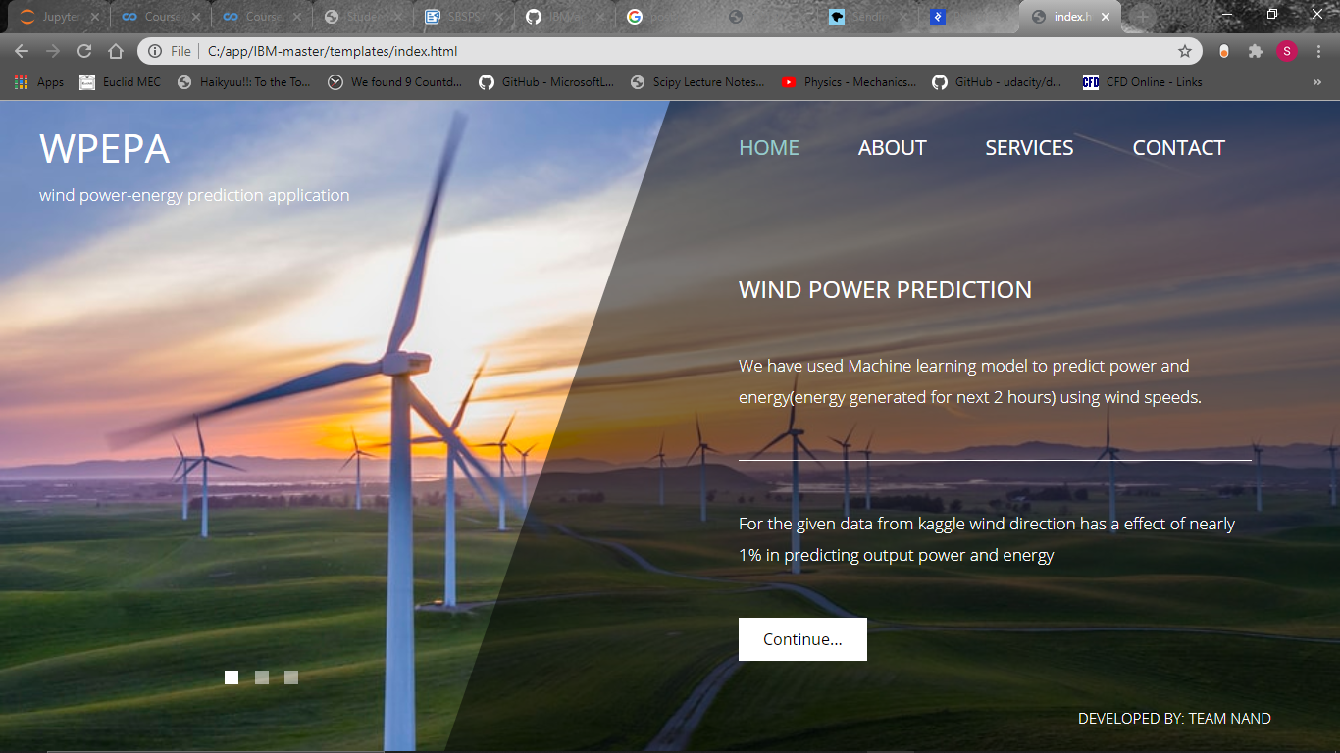

Slide 15


Slide 16
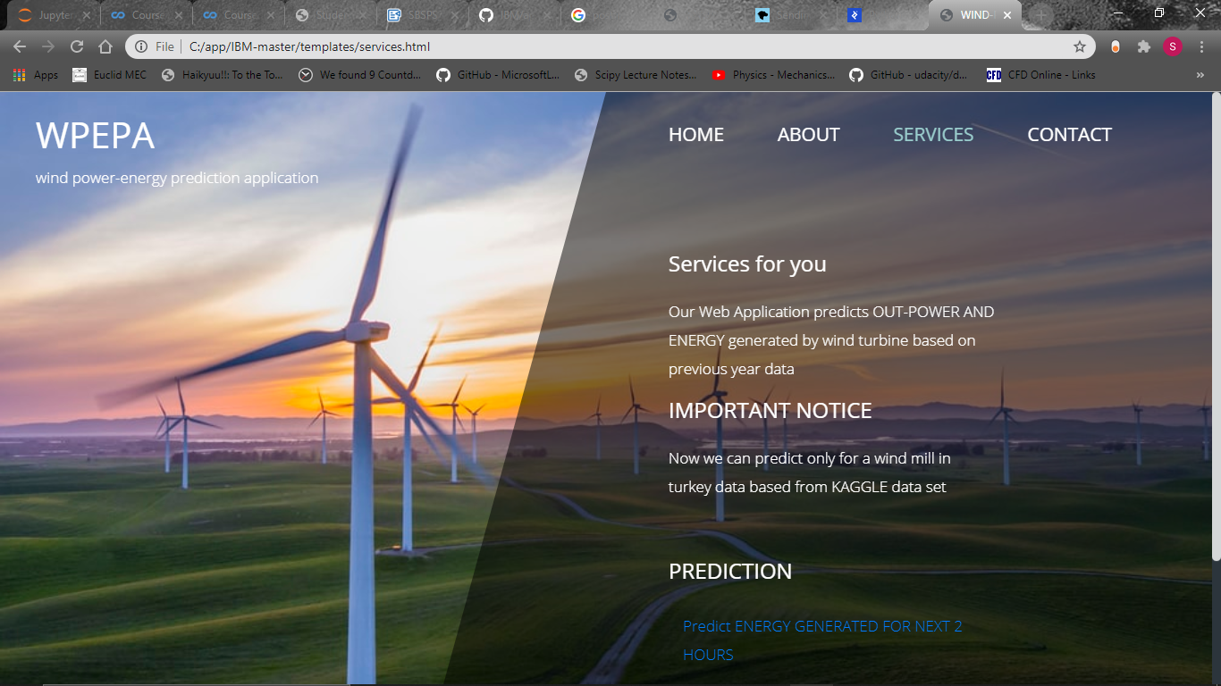

Slide 17
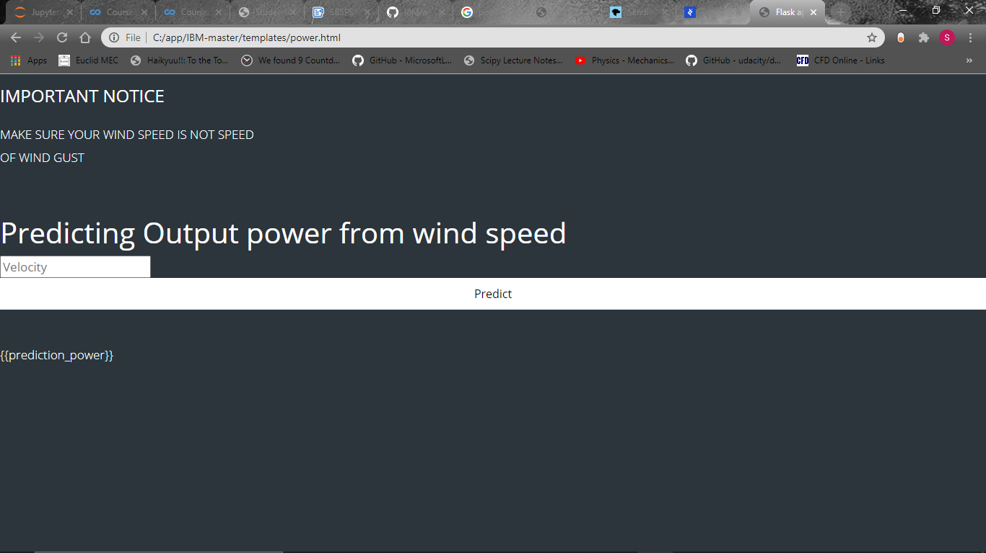

Slide 18
Applications
As we are all aware of the Global Warming, it's time we find the alternate methods to generate power from renewable energy resources like wind.
The wind energy industry has a lot of potential to develop, but the drawbacks that are setting it backwards is improper estimation of where the plants should be setup and even the unpredictive nature of the wind.
With proper amount of data that has been collected from some time it is possible to predict the unpredictable.
Our model can help you predict the estimated amount of energy that could be generated by the wind given the dataset with very high accuracy
Accuracy is everything when it comes to wind energy industry, this accuracy can attract the investors to setup power plants without any second thoughts.
As the only investment that we have to put into this industry is infrastructure and maintenance the cost of power would considerably less than others.
Thereby helping the people, as it is a renewable energy resources there are no green house gases released, thereby helping the world.

Slide 19
advantages and disadvantages
As all the resources that have been used in the development are open source, we don't have to pay anything.
Coming to the disadvantages if there is wind gust present the accuracy of the model decreases.
Some uncertainty in predicting wind speed .

Slide 20
CONCLUSION
This project gives you a basic idea on how to create a machine learning model and how to deploy it on the web using tferoku and Github services along with Flask.

Slide 21
BIBILOGRAPtfY
Names: S. SRI HARI College Name: Mahindra Ecole Centrale, Hyderabad,
Names: G. ARVIND College Name: Gitam Deemed To Be University, Vizag.
References:
Heroku.com Github.com
jupyterlabs
Flask Documentation: https://flask.palletsprojects.com/en/1.1.x/
Requirements Text: https://www.jetbrains.com/help/pycharm/managing-dependencies.html
Youtube videos: https://www.youtube.com/watch?v=mrExsjcvF4o&list=LLjRS2z7JlxfERxDBnWLCUA&index=3&t=0s
https://www.youtube.com/watch?v=p_tpQSY1aTs&list=LLjRS2-z7JlxfERxDBnWLCUA&index=2&t=0s

