Slide 1

Predicting the energy
output of wind turbine
based on weather condition
Made by – Data Pirates

Slide 2
Wind Energy
Wind energy plays an increasing role in the supply of
energy world-wide. The energy output of a wind farm is
highly dependent on the wind conditions present at its site.
If the output can be predicted more accurately, energy
suppliers can coordinate the collaborative production of
different energy sources more efficiently to avoid costly
overproduction.

Slide 3
Wind turbine power output is known to be a strong function of wind speed, but is also affected by turbulence and shear. In this work, new aerostructural simulations of a generic 1.5 MW turbine are used to rank atmospheric influences on power output. Most significant is the hub height wind speed, followed by hub height turbulence intensity and then wind speed shear across the rotor disk. These simulation data are used to train regression trees that predict the turbine response for any combination of wind speed, turbulence intensity, and wind shear that might be expected at a turbine site. The statistical predictive algorithms are not robust to changing environmental conditions and can be impractical for long term usage
EXISTING PROBLEM

Slide 4
PROPOSED SOLUTION
1. A Machine Learning based predictive model that uses wind speed,wind direction to predict the energy output of 1 hour to 72 hours.
2. We have used a multivariate SCADA (Supervisory control and data acquisition) dataset that have multiple observations taken in every 10 minutes for one year.
3. Since the energy generated from the windmills get wasted if not used at the moment and battery storage, pump storage hydro electricity, or compressed air storage are costly and have a finite capacity, the predictive model suggests better working schedules for the industries.

Slide 5

A wind turbine's blades sweep through a circular disk, known as the rotor disk .
The power output by a wind turbine is a function of the kinetic energy flux through the rotor disk and the efficiency with which that energy can be captured.
If the wind has an instantaneous speed u that is uniform throughout a rotor disk of diameter d, the power captured is:

Slide 6
However, real wind turbines do not achieve this theoretical limit. Their performance is a function of aerodynamics and the need to limit power capture once the rated generator power is reached, at 'rated' wind speed. The generator power, turbine diameter and blade shape are optimized based on site characteristics such as annual average wind speed and the wind speed distribution. Turbine manufacturers measure their turbine's 'power curve'—the relationship between power output and wind speed—at turbine test site

Slide 7

Steps for Wind Energy Prediction :
Data Collection
Data Preprocessing
Machine Learning Model
Making User Interface

Slide 8
TECHNICAL REQUIREMENTS
Libraries used – Pandas , Numpy , Scikit learn.
Tools used – IBM Watson Studio, Machine Learning , Auto AI, Node Red.
Platform Used - IBM Cloud Services

Slide 9
DATASET
source – KAGGLE
sample dataset
Date/Time | LV ActivePower (kW) | Wind Speed (m/s) | Theoretical_Power_Curve (KWh) | Wind Direction (Â°)
01 01 2018 00:00 | 380.0478 | 5.311336 | 416.3289 | 259.9949
01 01 2018 00:10 | 453.7692 | 5.672167 | 519.9175 | 268.6411
01 01 2018 00:20 | 306.3766 | 5.216037 | 390.9 | 272.5648
01 01 2018 00:30 | 419.6459 | 5.659674 | 516.1276 | 271.2581
01 01 2018 00:40 | 380.6507 | 5.577941 | 491.703 | 265.6743
01 01 2018 00:50 | 402.392 | 5.604052 | 499.4364 | 264.5786

Slide 10
User Interface
Tool used – NODE RED
Node-RED is a flow-based development tool for visual
programming developed originally by IBM for wiring together
hardware devices, APIs and online services as part of the
Internet of Things. Node-RED provides a web browser-based
flow editor, which can be used to create JavaScript functions.
“Form node”, “Function node”, “Http request node”, “Debug node”, “Text
node” were used in the node red flow for making the user interface.

Slide 11
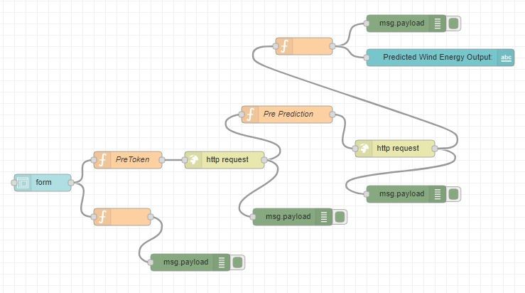
Node Red Flow

Slide 12
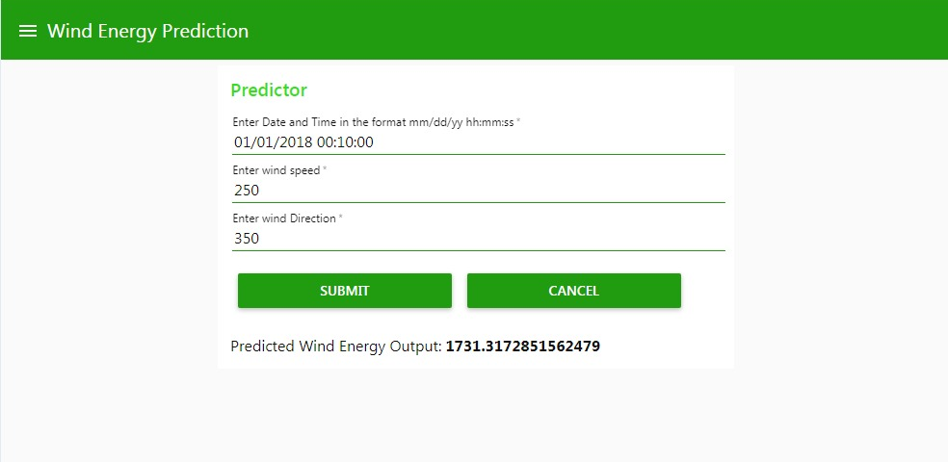
Output Screen

Slide 13
FUTURE SCOPE
We can maximize the production of WIND ENERGY which is
a renewable source of energy and achieve sustainable
energy resources much easily.
By observing and predicting the power we can set up
windmill farms on the location where there might be better
wind energy resources by studying the average wind speed
and direction of the wind.

Slide 14


