Slide 1
IBM HACK CHALLENGE
Made By : Aryan Bose
3rd Year B.Tech Electronics and Communication Engineering

Slide 2
Problem Statement
Optimized Warehouse Management of Perishable Goods for a Food Delivery Company
General Description
Freshness of products and timeliness of delivery are two critical factors which have impact on customer satisfaction in terminal delivery of perishable products.
Perishable products, such as fruits, dairy products , vegetables, and meat, have short delivery timespans. These products may start deteriorating from the moment they are produced and the freshness appears to be decreasing as transportation time elapses until spoilt.

Slide 3
Warehouse optimization
Warehouse optimization is a key to the efficient operation of warehouses of all sizes.
A disciplined process, warehouse optimization includes automation and a determination of how to save time, space, and resources while reducing errors and improving flexibility, communication, management, and customer satisfaction.
Other warehouse optimization considerations include warehouse flow, product placement, storage, and retrieval systems. Warehouse optimization is vital to lean warehouses and agile supply chains.
Following are examples of perishable goods
Frozen foods
Breads
Cakes or baked goods
Vaccines and medications
Floral arrangements
Dairy Products
Meat

Slide 4
Novelty / Uniqueness
Identification of products due for expiry date through the WMS software and use FIFO logic for inventory movement.
Similarly use the tags to identify procurement requirements and raise order for fulfilment of products which are consumed.
Use of AI controlled isothermal van that minimises the loss of temperature between the exterior and interior
Implementing zero wastage policy in terms of expiry , damage , shrinkage and process loss
Solar Panels across the roof of the warehouse which help in cost reduction by 25 to 30% annually (Green initiative)
Implementing vehicles with partly frozen and partly ambient temperatures to deliver both frozen and ambient goods
Inbound goods are brought in by the same delivery vehicle to reduce fuel usage (Reverse logistics)
Reusable plastic crates to be used for delivery
Incorporating STP(sewage treatment plant) to reuse water for flushing and gardening purpose thereby saving 5% power in terms of bore well water consumption (Green initiative)

Slide 5
Business / Social Impact
The deliveries must be fresh and on time as committed by the company , this will ensure customer satisfaction and delight
When customers are satisfied by the freshness of the product and the timely deliveries, it will result in positive word of mouth , and add value to the product brand
On the contrary , if the customer satisfaction is not met , there is a hit on the business and social aspect of the company
The warehouse must be in close proximity to the Local Distribution Centre which might be expensive
The refrigeration for the perishable goods will amount up to a greater electricity consumption

Slide 6
Technology Stack
Amidst this global pandemic situation , online FMCG (Fast-Moving Customer Goods) sales will exceed those from physical stores .
Hence there is a huge opportunity of an e-commerce method of supplying daily perishable goods .
Trust , Quality and speed of delivery will be a major factor
There are 4 important factors that affect the technology stack
WMS - Warehouse management system
TMS – Transportation management system
Mobile App for customer platform
Integration of WMS with mobile app for inventory efficiency

Slide 7
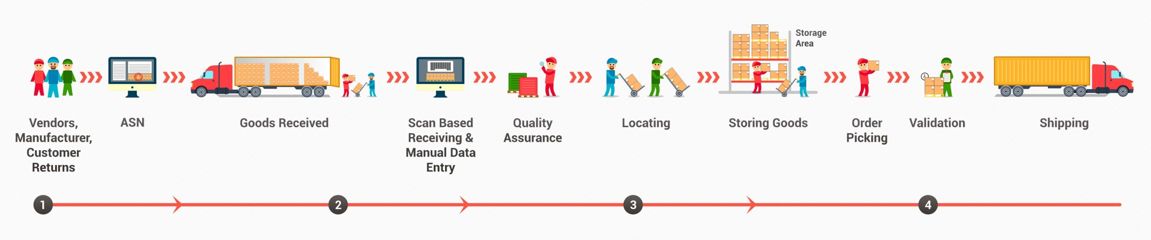
WMS - Warehouse management system
A warehouse management system (WMS) is a software application that helps control and manage the day-to-day operations in a warehouse
WMS software guides inventory receiving and put-away, optimizes picking and shipping of orders and advises on inventory replenishment.
Types of Warehouse Management Systems
Standalone System
ERP Modules
Cloud Based

Slide 8
TMS – Transportation management system
A transportation management system (TMS) is a logistics platform that uses technology to help businesses plan, execute, and optimize the physical movement of goods, both incoming and outgoing, and making sure the shipment is compliant, proper documentation is available. This kind of system is often part of a larger supply chain management (SCM) system
A TMS allows shippers to automate the processes they have in place and receive valuable insights to save time and reduce spend on future shipments.
Benefits of TMS
Technological capabilities
Simplify processes
Track freight
Business insights

Slide 9
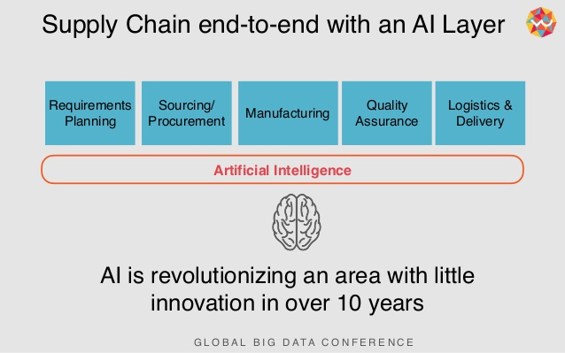
Artificial intelligence

Slide 10
Use of Artificial Intelligence
We can use 3D image scanners to scan each of the products and make a repository of the same, using AI we can then sort the goods at the sorting section to prepare a tag with classification attributes like product type , weight , manufacturing date , expiry date so as to classify and place in relevant storage section
The tags will enable segregation.
After sorting the goods are taken to the temperature controlled docks via a conveyer belt
Demand forecasting

Slide 11
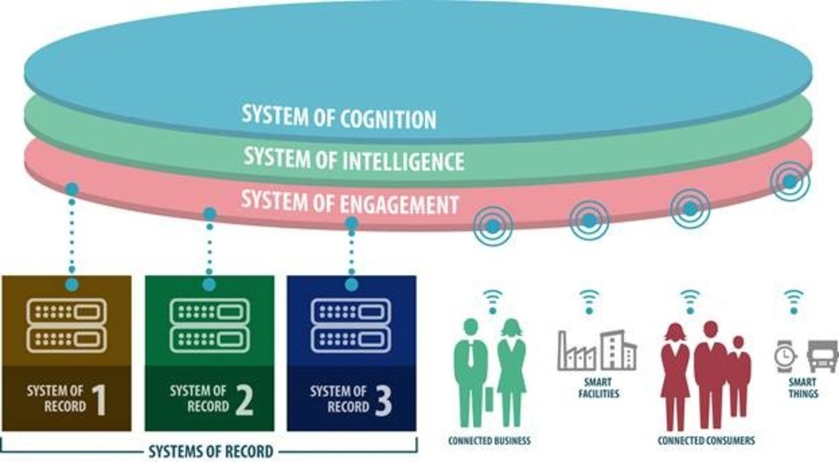
Use of Artificial Intelligence

Slide 12
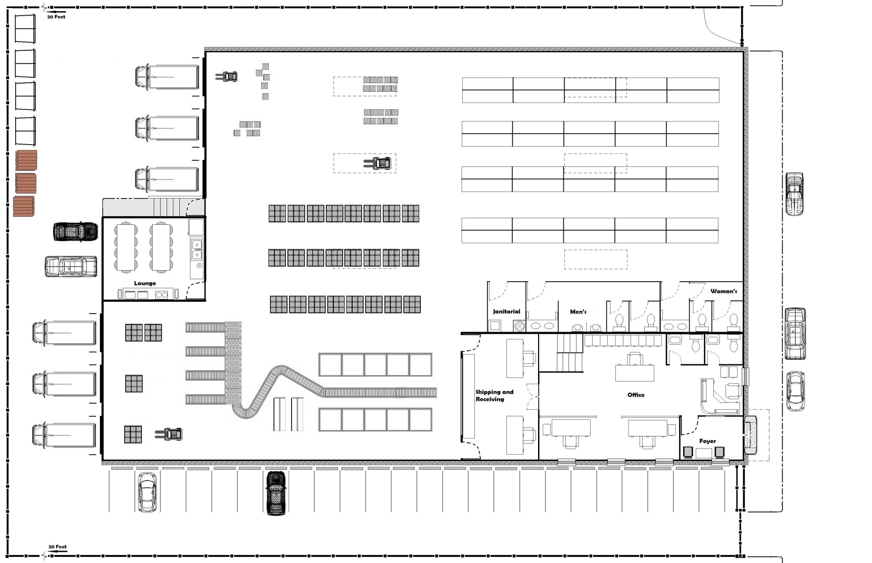
Scope of work
Infrastructure Setup
Temperature controlled compartments
Cleaning sorting and grading
Quality check / In scan / put away
Order processing / picking / packing / out scan / loading / dispatch
Process control / in bound and out bound transport management
Procurement / category management / inventory management
Admin / account / HR / Backend office

Slide 13
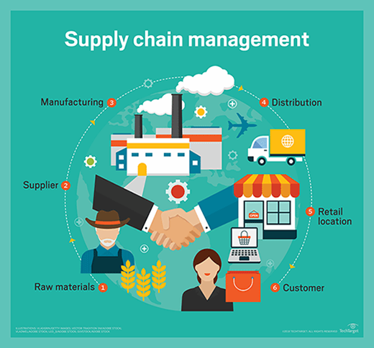
Supply chain cycle

